Slide 1
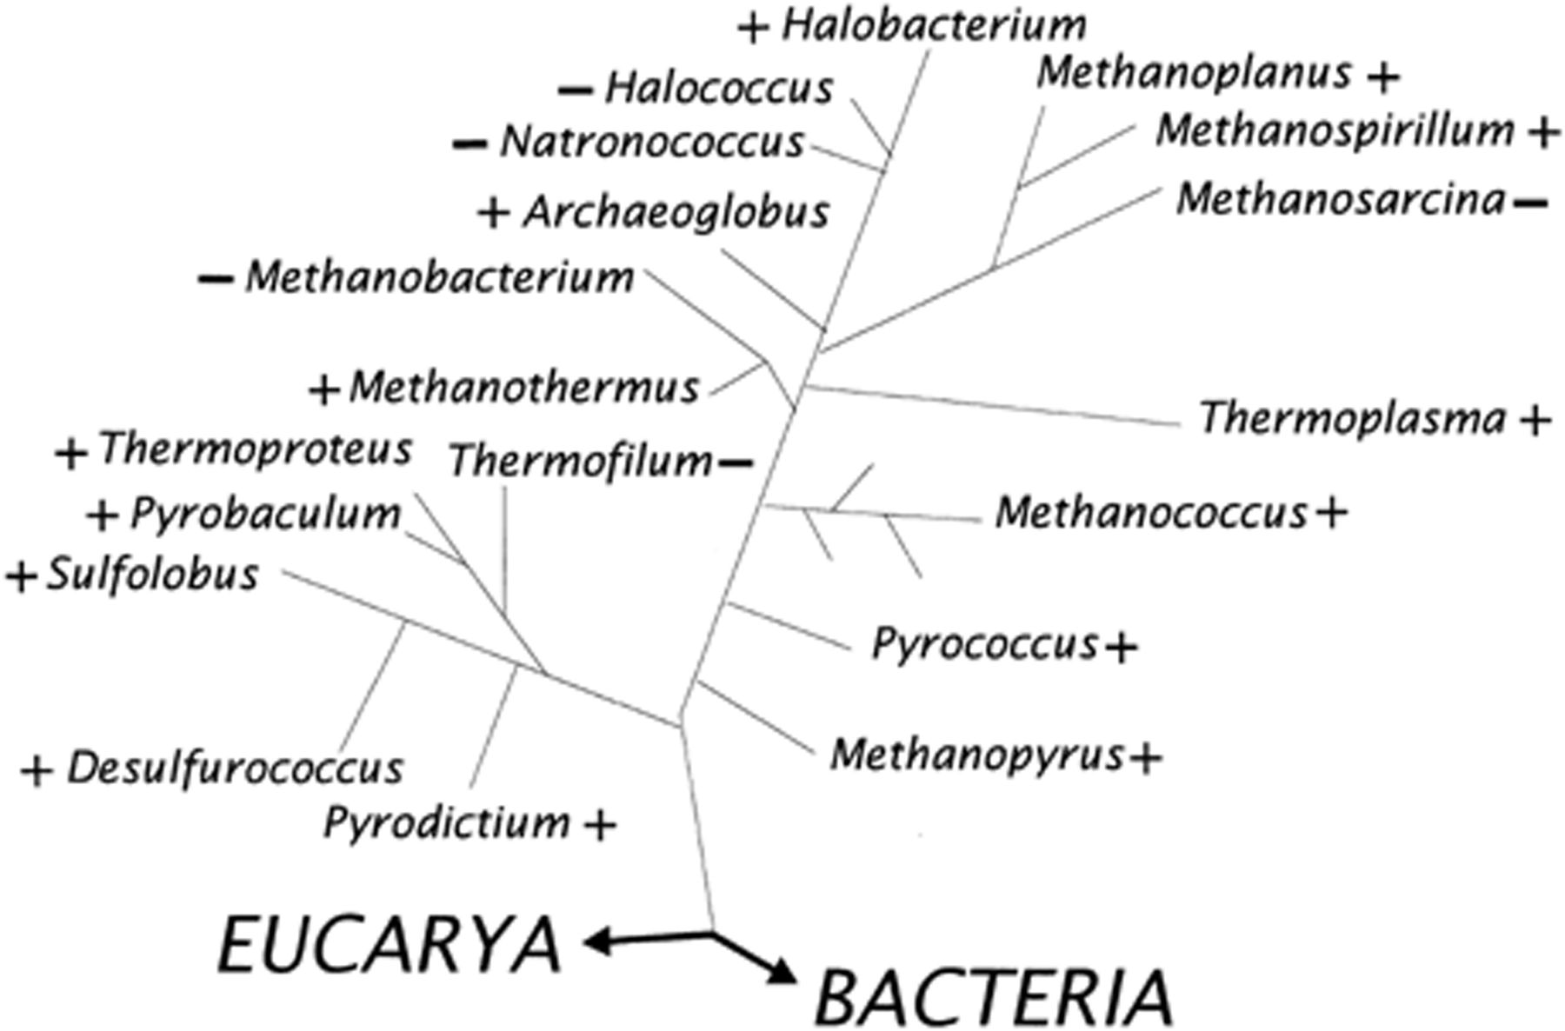
Figure 1 Distribution of flagellation throughout the Domain Archaea. +, at least some members of the genus are ...
Notes:
Figure 1 Distribution of flagellation throughout the Domain Archaea. +, at least some members of the genus are flagellated; −, no members of the genus are flagellated. Reprinted with updated material from [8].
Unless provided in the caption above, the following copyright applies to the content of this slide: © 2001 Federation of European Microbiological Societies.

Slide 2
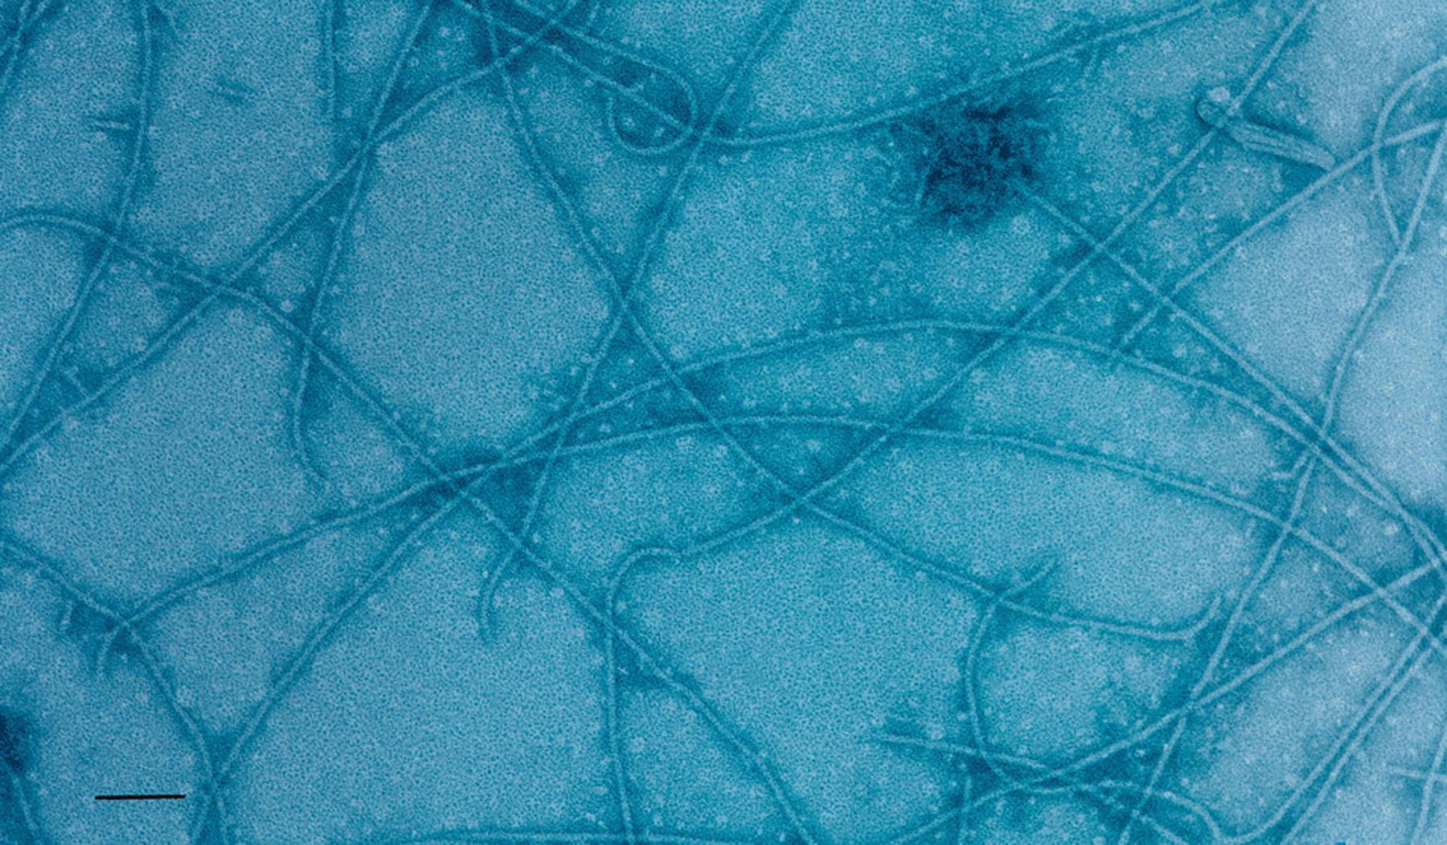
Figure 2 Negatively stained preparation of flagella from M. voltae showing hook regions. Samples were prepared by S.L. ...
Notes:
Figure 2 Negatively stained preparation of flagella from M. voltae showing hook regions. Samples were prepared by S.L. Bardy using the phase separation technique with Triton X-114 [14] and stained with 2% phosphotungstic acid by S.-I. Aizawa. Note the curved hook structure present at the ends of many flagellar filaments. Bar=100 nm.
Unless provided in the caption above, the following copyright applies to the content of this slide: © 2001 Federation of European Microbiological Societies.

Slide 3
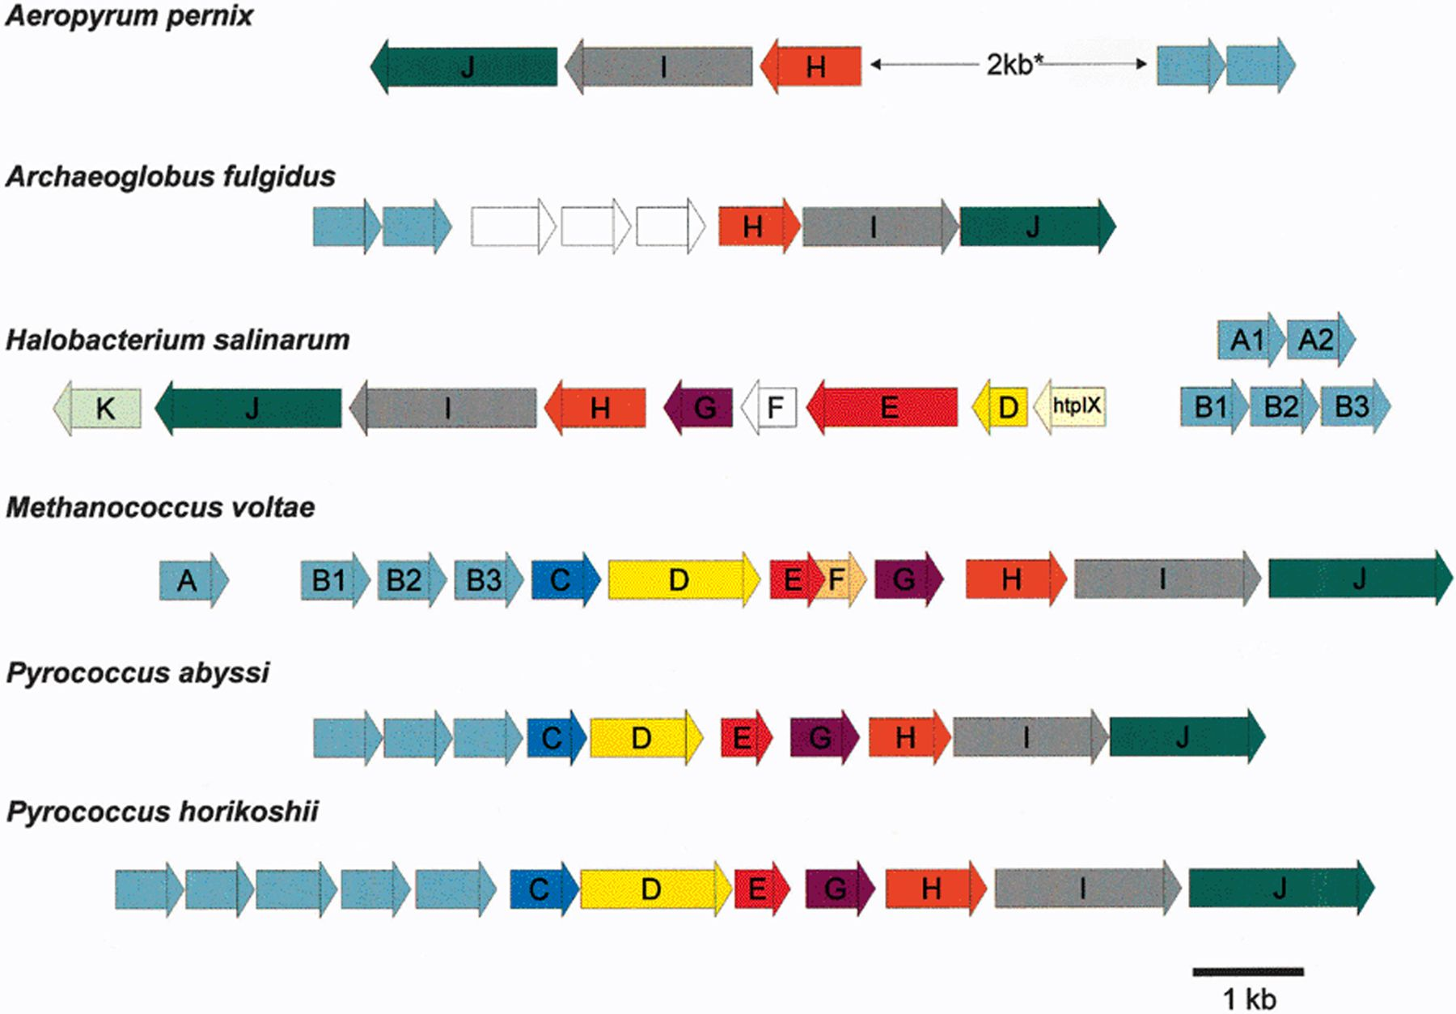
Figure 3 Flagella gene families of selected archaeal species. Similar colors indicate homologues shared among ...
Notes:
Figure 3 Flagella gene families of selected archaeal species. Similar colors indicate homologues shared among families. White unlabeled boxes are ORFs that have no sequence similarity to genes in universal databases. The genes are transcribed in the direction of the respective arrows. The 2-kb region separating the flagellin genes and the accessory genes in Aeropyrum pernix contains a number of overlapping ORFs that are not shown in this diagram. The flaF gene designated in H. salinarum is not a homologue of the flaF gene in M. voltae. The B flagellin genes of H. salinarum are adjacent to the accessory genes, whereas the A flagellins are located elsewhere on the chromosome.
Unless provided in the caption above, the following copyright applies to the content of this slide: © 2001 Federation of European Microbiological Societies.

Slide 4
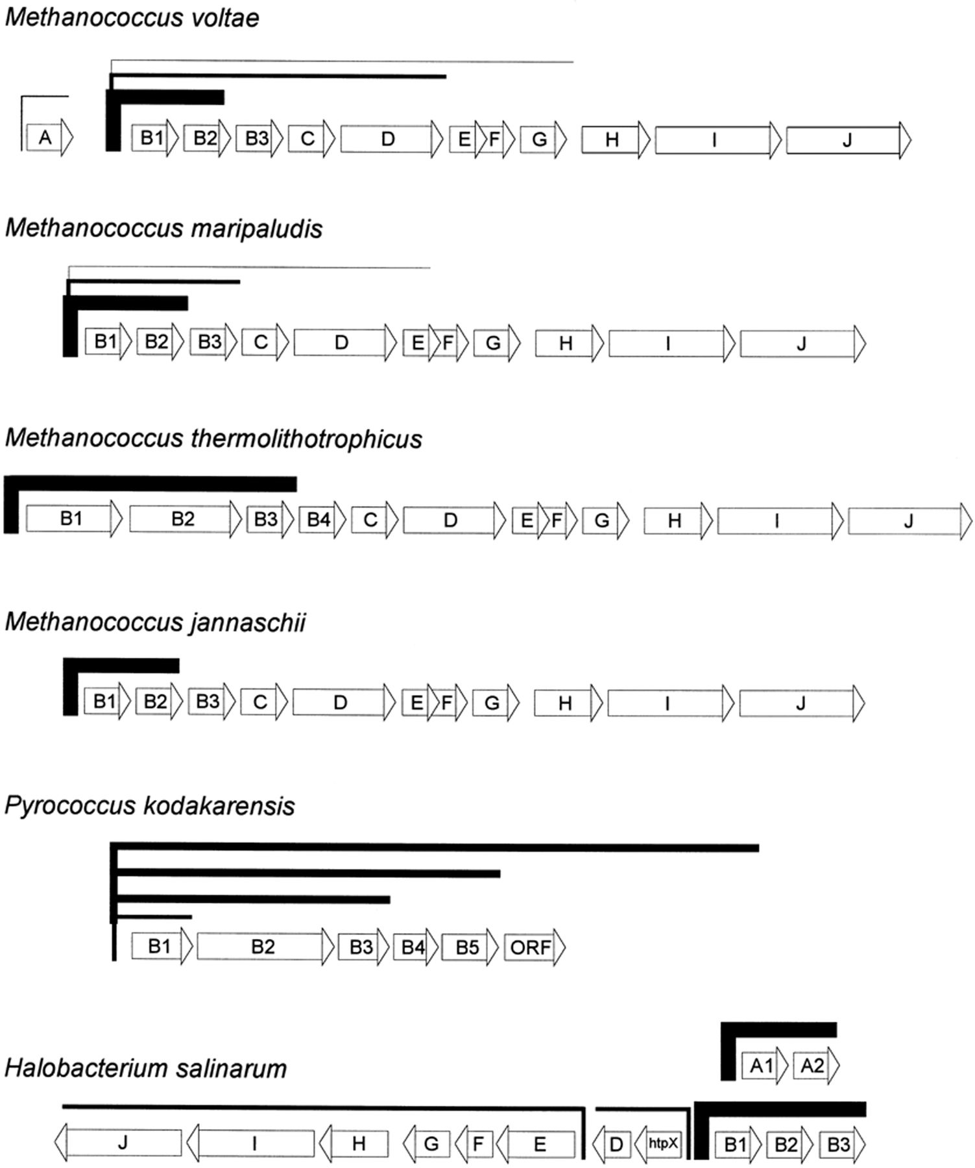
Figure 4 Schematic diagram summarizing data obtained from transcriptional studies of archaeal flagella gene families. ...
Notes:
Figure 4 Schematic diagram summarizing data obtained from transcriptional studies of archaeal flagella gene families. The genes are transcribed in the direction of the respective arrows. The thickness of bars above the genes is indicative of the relative abundance of the transcripts but is not meant to be quantitative. In the case of H. salinarum, the flagellin gene transcripts are likely more abundant than those for the accessory genes, however, transcriptional data for the flagellin genes and the accessory genes were obtained from two different studies, so the relative abundance of the transcripts is not known with certainty. See text for further details.
Unless provided in the caption above, the following copyright applies to the content of this slide: © 2001 Federation of European Microbiological Societies.

Slide 5
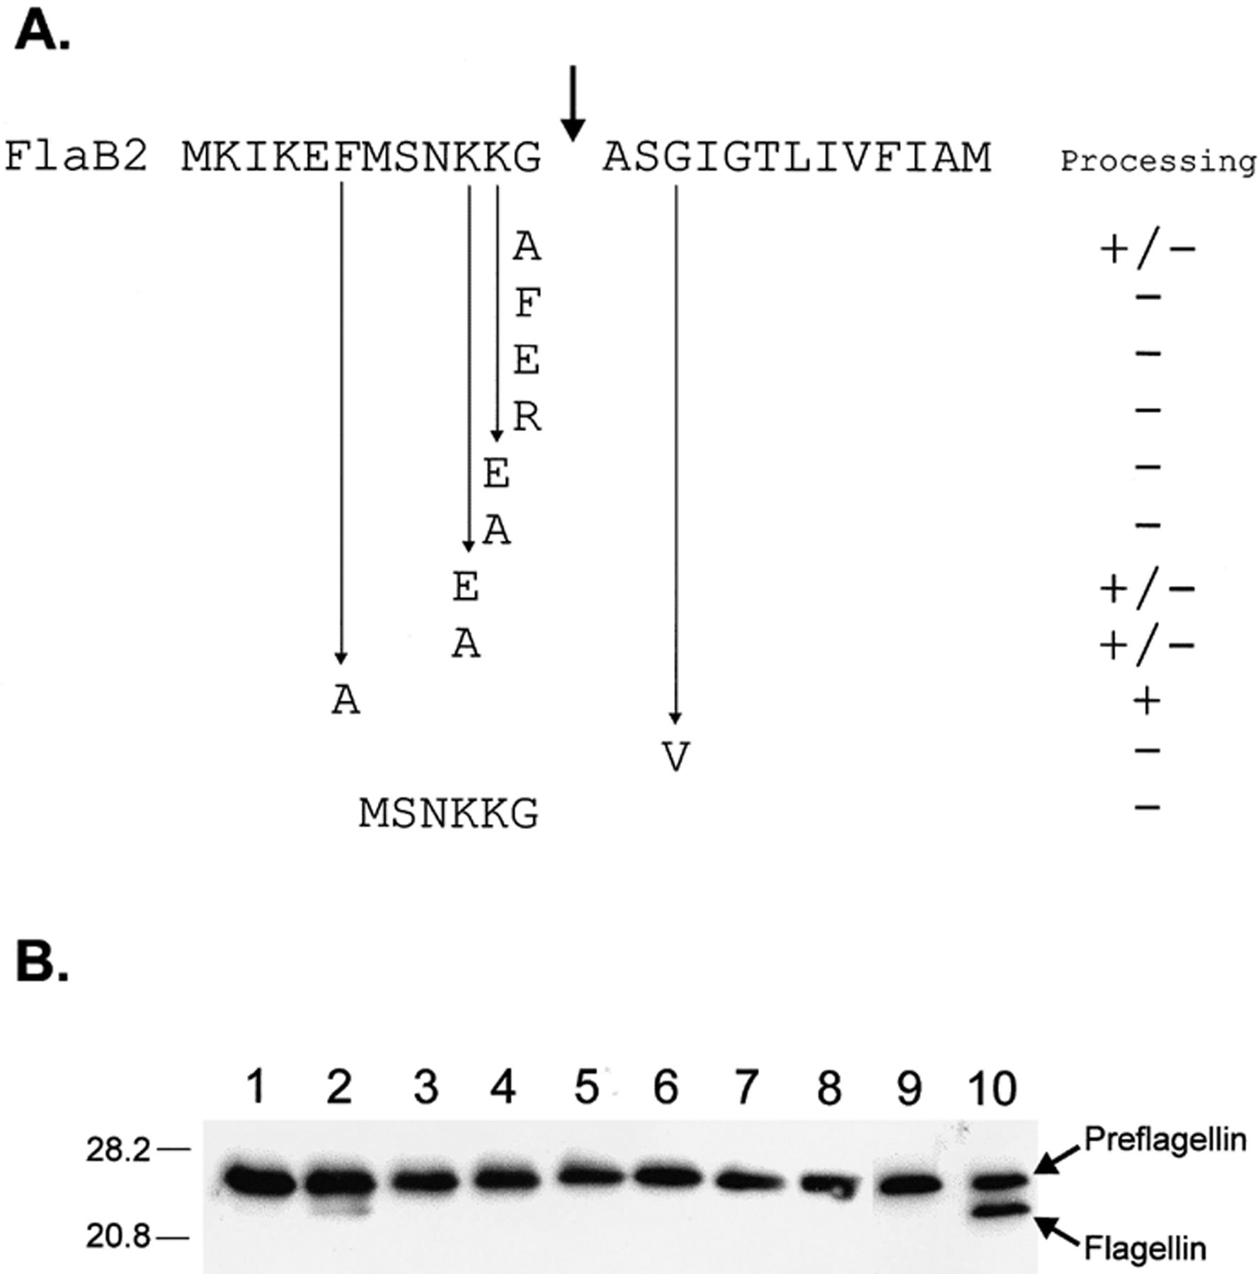
Figure 5 Posttranslational processing of wild-type and mutant M. voltae flagellin FlaB2 by a membrane-located ...
Notes:
Figure 5 Posttranslational processing of wild-type and mutant M. voltae flagellin FlaB2 by a membrane-located preflagellin peptidase. A: Schematic of mutant FlaB2 proteins with a single amino acid substitution or a deletion of amino acids. The wild-type sequence is shown at the top. B: Immunoblot of the cleavage reactions corresponding to the substitutions performed at the −1 position of FlaB2. After the peptidase assay was performed, processed flagellin was detected by immunoblotting. Time points correspond to 0 and 30 min after the addition of M. voltae membranes to start the reaction. Lane 1, −1 alanine 0 min; lane 2, −1 alanine 30 min; lane 3, −1 glutamic acid 0 min; lane 4, −1 glutamic acid 30 min; lane 5, −1 arginine 0 min; lane 6, −1 arginine 30 min; lane 7, −1 phenylalanine 0 min; lane 8, −1 phenylalanine 30 min; lane 9, −1 glycine (wild-type) 0 min; lane 10, −1 glycine 30 min. The arrow points to the cleavage product. Only partial processing was observed when alanine was substituted for glycine at position −1.
Unless provided in the caption above, the following copyright applies to the content of this slide: © 2001 Federation of European Microbiological Societies.

Slide 6
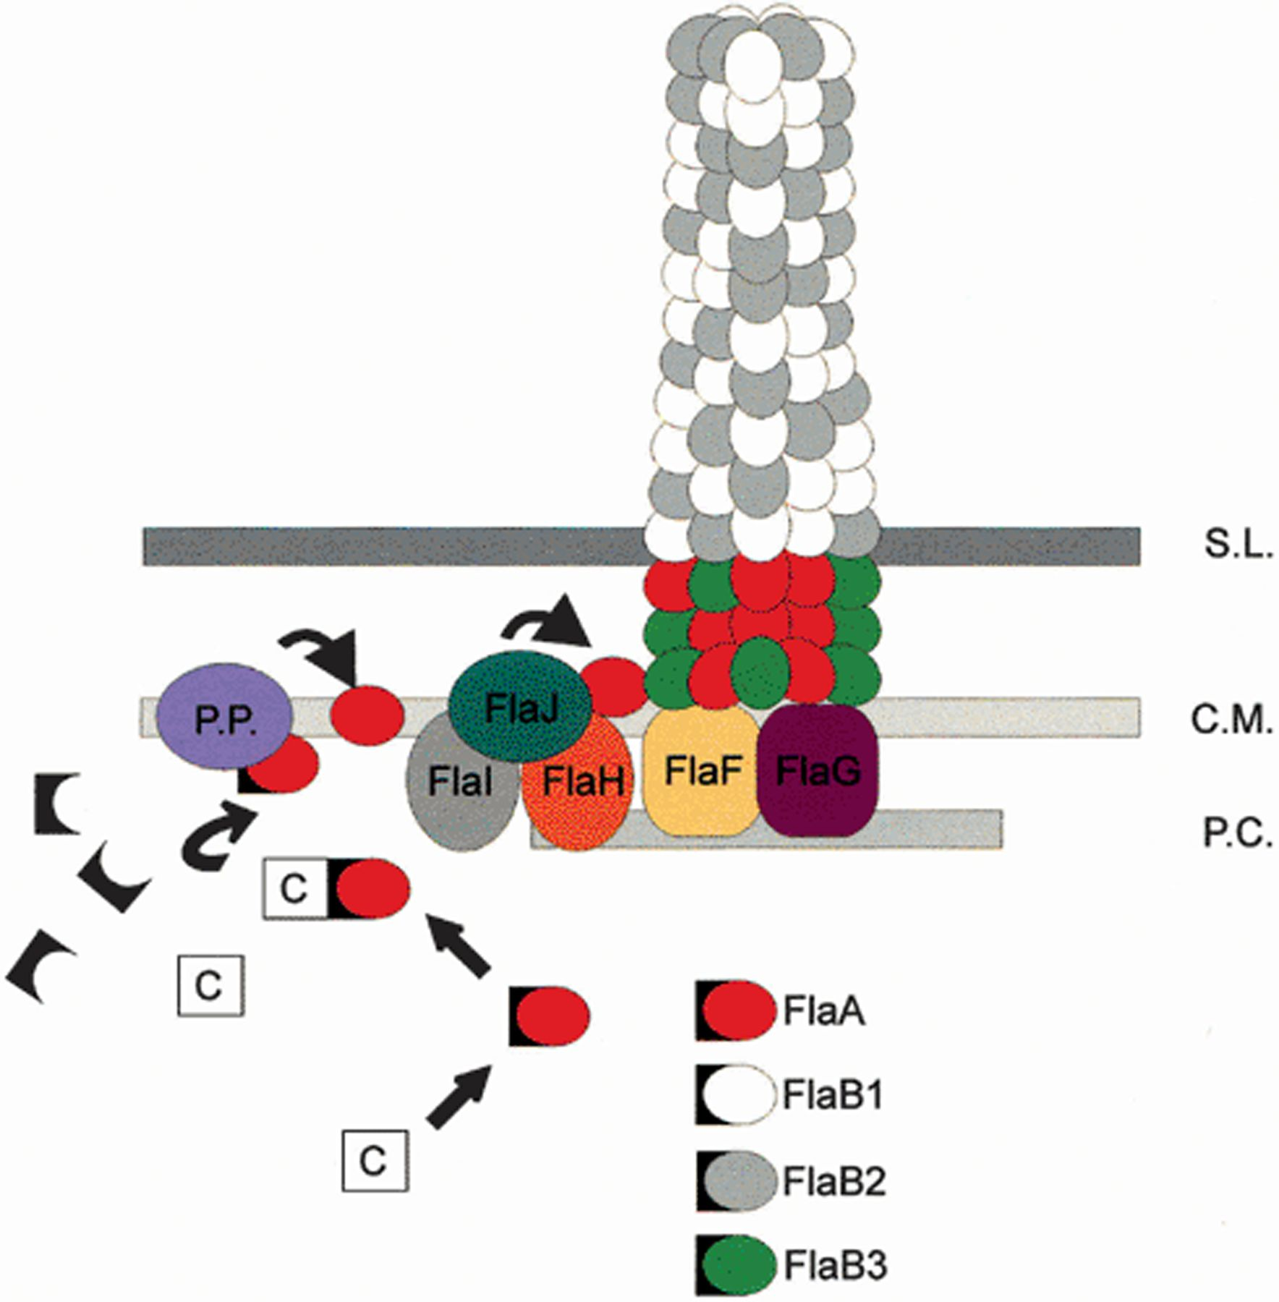
Figure 6 Speculative model for the structure and assembly of a M. voltae flagellum. Flagellin subunits are escorted to ...
Notes:
Figure 6 Speculative model for the structure and assembly of a M. voltae flagellum. Flagellin subunits are escorted to the cytoplasmic membrane by chaperones where they processed by the preflagellin peptidase and inserted at the base of the growing structure. S.L., S layer; C.M., cytoplasmic membrane; P.C., polar cap; P.P., preflagellin peptidase.
Unless provided in the caption above, the following copyright applies to the content of this slide: © 2001 Federation of European Microbiological Societies.

