Slide 1
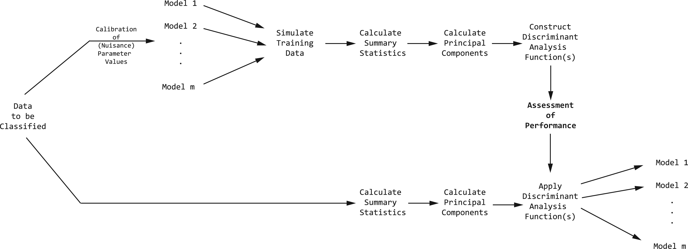
Figure 1. Flowchart showing general inference scheme. Training data are simulated under each of the candidate models ...
Notes:
Figure 1. Flowchart showing general inference scheme. Training data are simulated under each of the candidate models (with process parameter values that are not of interest calibrated using the data to be classified), summary statistics are calculated on the training data, principal components are calculated on the summary statistics, and the principal components are then used to construct a discriminant analysis function. Principal components are calculated on same summary statistics of the data to be classified, and the discriminant analysis function is applied to obtain the posterior probabilities of each of the candidate models. See text for more detailed description.
Unless provided in the caption above, the following copyright applies to the content of this slide: ©The Author(s) 2015. Published by Oxford University Press, on behalf of the Society of Systematic Biologists. All rights reserved. For Permissions, please email: journals.permissions@oup.com

Slide 2
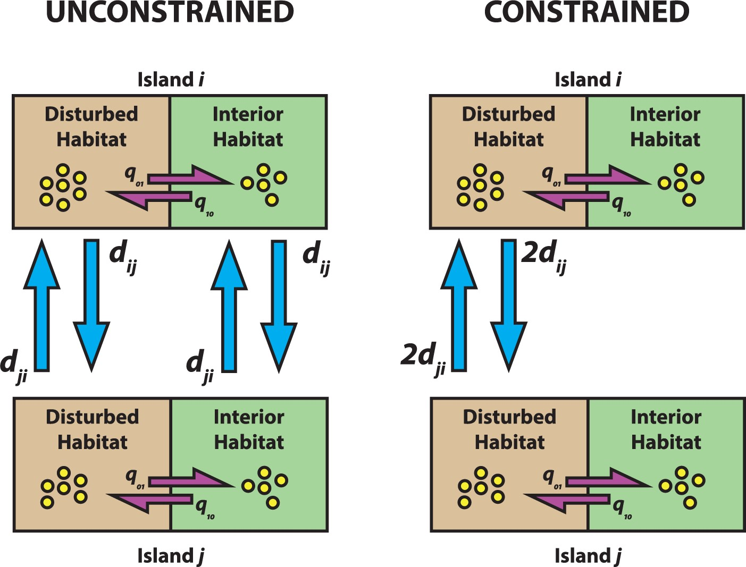
Figure 2. Schematic for study design to test if dispersal is constrained by habitat. In the unconstrained regime ...
Notes:
Figure 2. Schematic for study design to test if dispersal is constrained by habitat. In the unconstrained regime (left), lineages are free to disperse between islands regardless of their habitat trait. In the constrained regime (right), only lineages associated with the interior (undisturbed) habitat can disperse. Lineages evolve from the constrained habitat to the unconstrained under the same rate, q10=q01 . Dispersal rates in the constrained regime are weighted twice the dispersal rates in the interior regime to ensure that, on the average, the total flux between the constrained and unconstrained regimes are equal. This two-island system can be increased to an arbitrary number of islands.
Unless provided in the caption above, the following copyright applies to the content of this slide: ©The Author(s) 2015. Published by Oxford University Press, on behalf of the Society of Systematic Biologists. All rights reserved. For Permissions, please email: journals.permissions@oup.com

Slide 3
Figure 3. Flowchart showing assessment and validation of the inference scheme. We simulated test data under known ...
Notes:
Figure 3. Flowchart showing assessment and validation of the inference scheme. We simulated test data under known regimes, and applied our inference procedure on them (see Fig. 1 ). See text for more detailed description.
Unless provided in the caption above, the following copyright applies to the content of this slide: ©The Author(s) 2015. Published by Oxford University Press, on behalf of the Society of Systematic Biologists. All rights reserved. For Permissions, please email: journals.permissions@oup.com

Slide 4
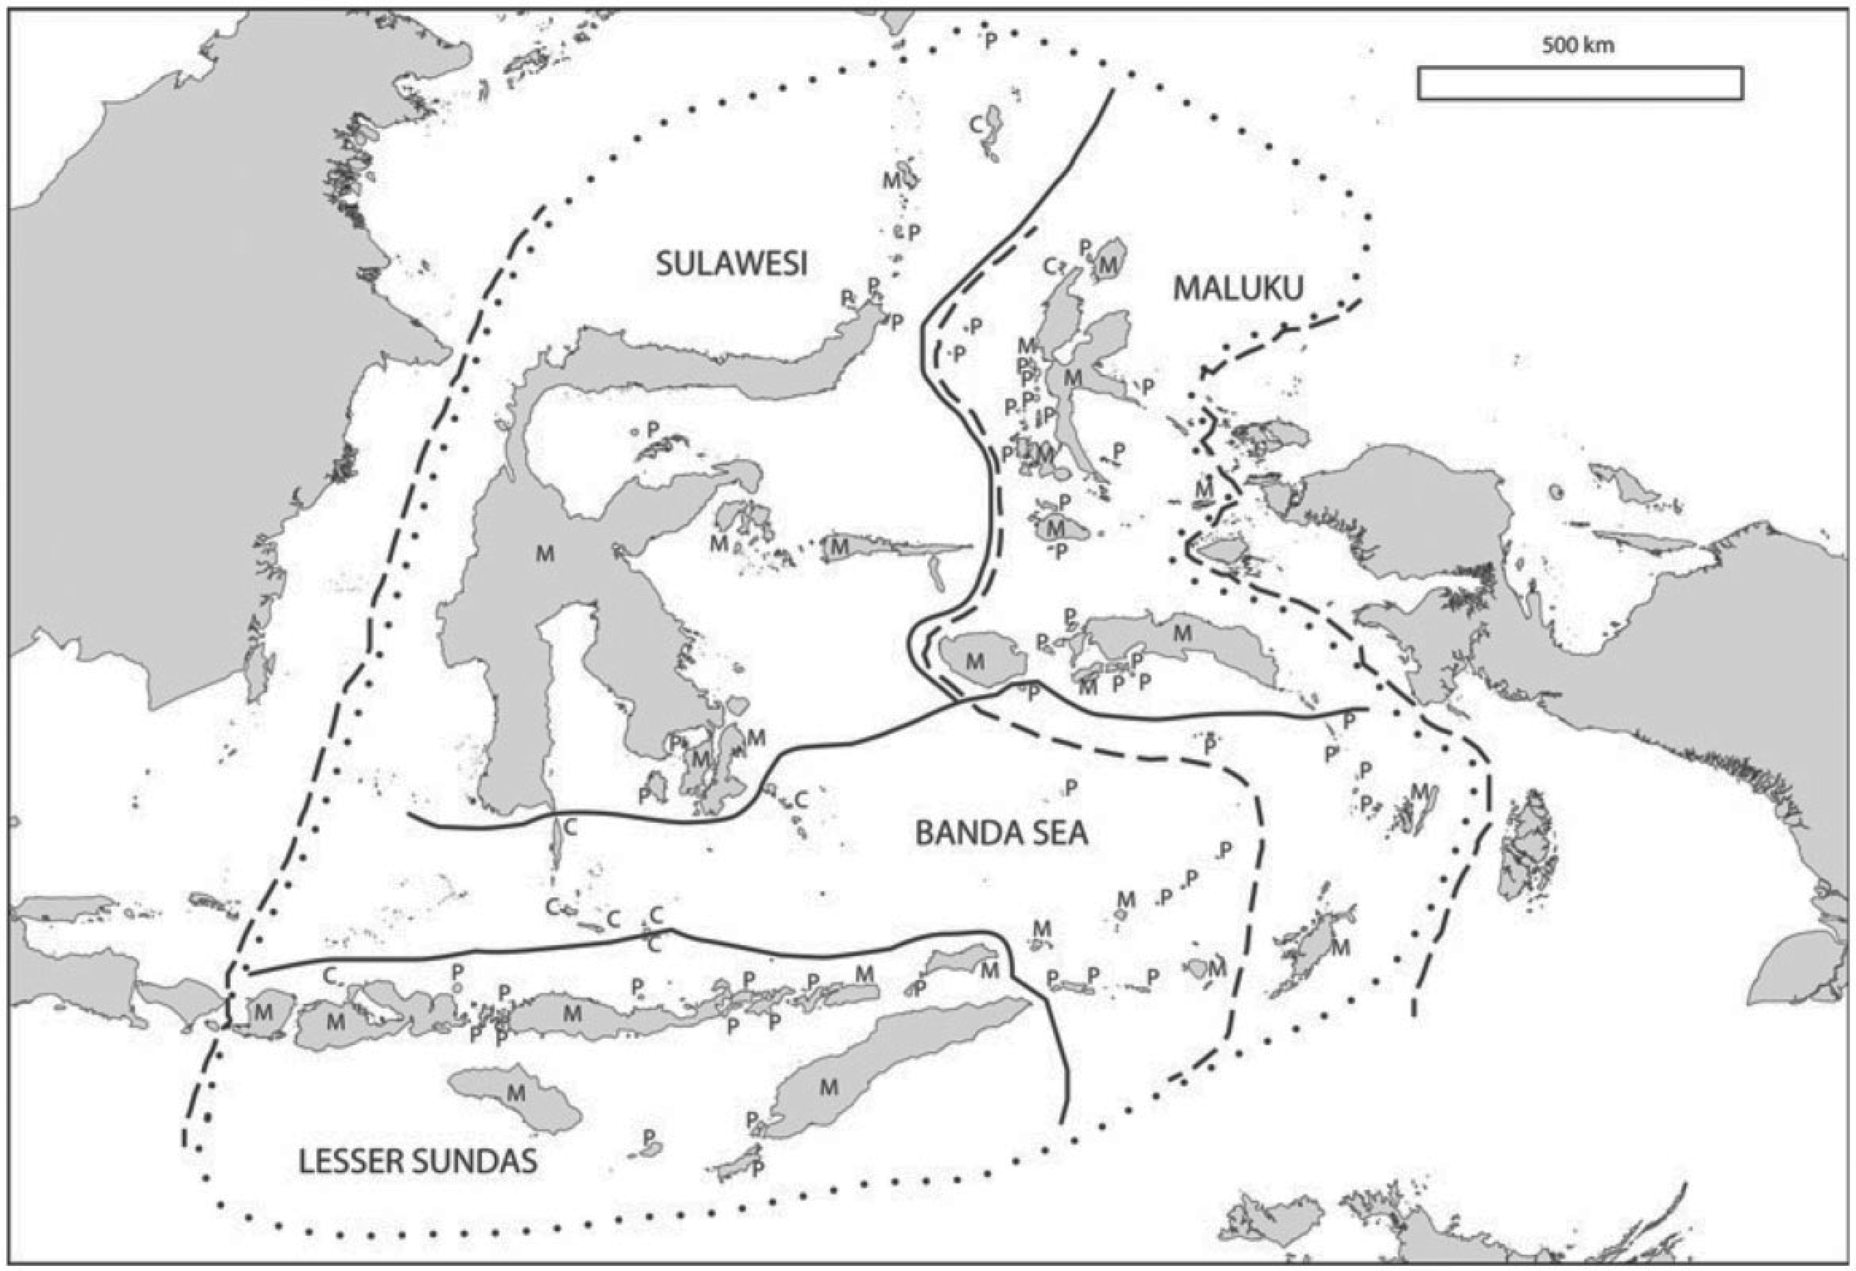
Figure 4. The biogeographical “modules” of Wallacea of Carstensen et al. (2012) , with module names in small caps. The ...
Notes:
Figure 4. The biogeographical “modules” of Wallacea of Carstensen et al. (2012) , with module names in small caps. The broken lines mark, from west Wallaces Line, Webers Line and Lydekkers Line. Figure from Carstensen et al. (2012) . See Carstensen et al. (2012) and Carstensen et al. (2013) for more details.
Unless provided in the caption above, the following copyright applies to the content of this slide: ©The Author(s) 2015. Published by Oxford University Press, on behalf of the Society of Systematic Biologists. All rights reserved. For Permissions, please email: journals.permissions@oup.com

Slide 5
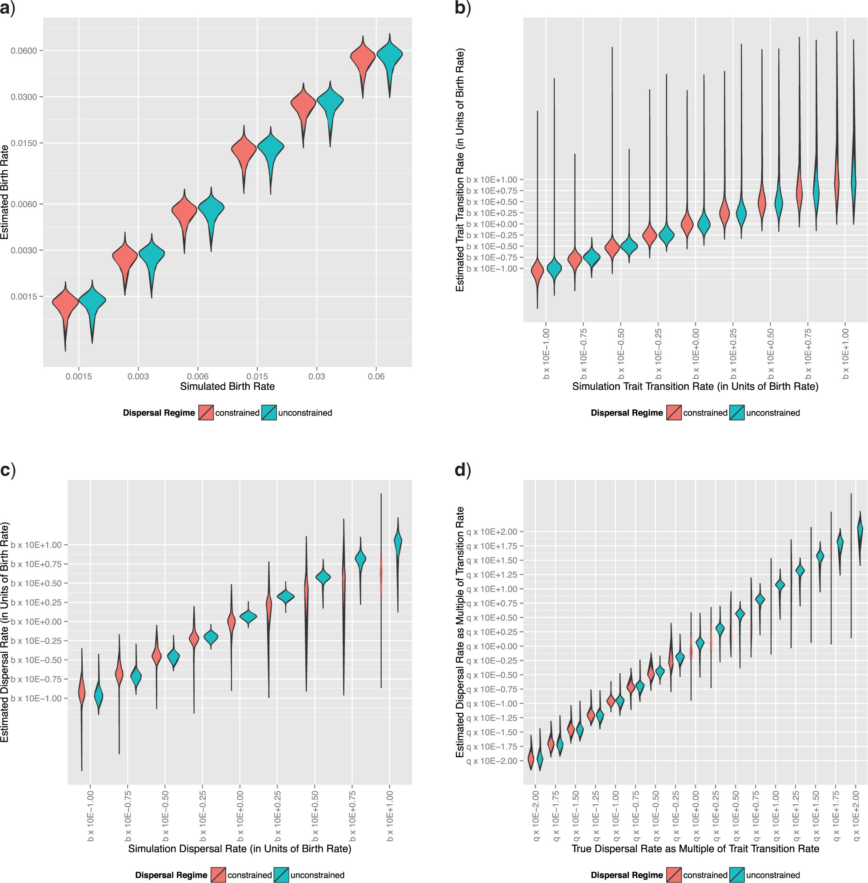
Figure 5. Maximum-likelihood estimates of various process parameter values compared with true (simulation) values to ...
Notes:
Figure 5. Maximum-likelihood estimates of various process parameter values compared with true (simulation) values to verify correct behavior of simulations, showing that the archipelago simulations are generating data as expected with respect to the a) diversification, b) trait evolution, c) dispersal parameters, and d) dispersal rate scaled by trait transition rate. The violin plots show the full distributions of the values, and the values for the trait evolution and dispersal rates are expressed in units of base 10 exponents of birth rate. In all cases, estimated parameter values generally track the simulation parameter values in both the “unconstrained” and “constrained” regimes. In the case of the “dispersal” parameter, however, the variance is greatly increased in the “constrained” regime, and this is related to variance in the trait transition rate, and thus stochasticity in the number of dispersing versus nondispersing lineages.
Unless provided in the caption above, the following copyright applies to the content of this slide: ©The Author(s) 2015. Published by Oxford University Press, on behalf of the Society of Systematic Biologists. All rights reserved. For Permissions, please email: journals.permissions@oup.com

Slide 6
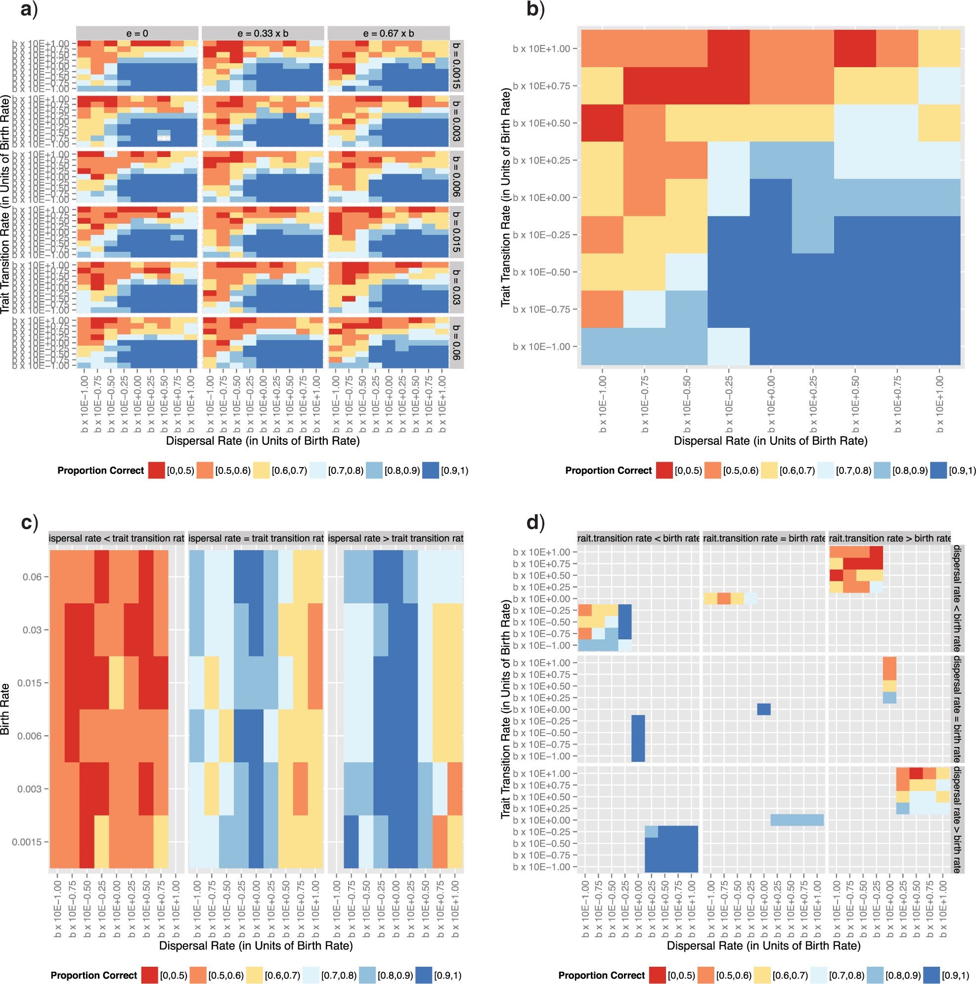
Figure 6. Performance of model choice by simulation-trained discriminant analysis function classification over ...
Notes:
Figure 6. Performance of model choice by simulation-trained discriminant analysis function classification over parameter space, as measured in proportion of correct classifications over 200 replicate analysis at each point in parameter space. Dispersal rates are on the x -axis and trait evolution transition rates are on the y -axis, expressed in units of birth rate (so that, e.g., a value of “ b×10E−1.00 ” indicates a rate one order of magnitude less than the birth rate). Plots are a) faceted to indicate different birth rates in rows and extirpation rates in columns, b) marginalized over birth rates and extirpation rates, c) partitioned into dispersal rates relative to trait transition rates, and d) partitioned into dispersal rates relative to trait transition relative to birth rates.
Unless provided in the caption above, the following copyright applies to the content of this slide: ©The Author(s) 2015. Published by Oxford University Press, on behalf of the Society of Systematic Biologists. All rights reserved. For Permissions, please email: journals.permissions@oup.com

Slide 7
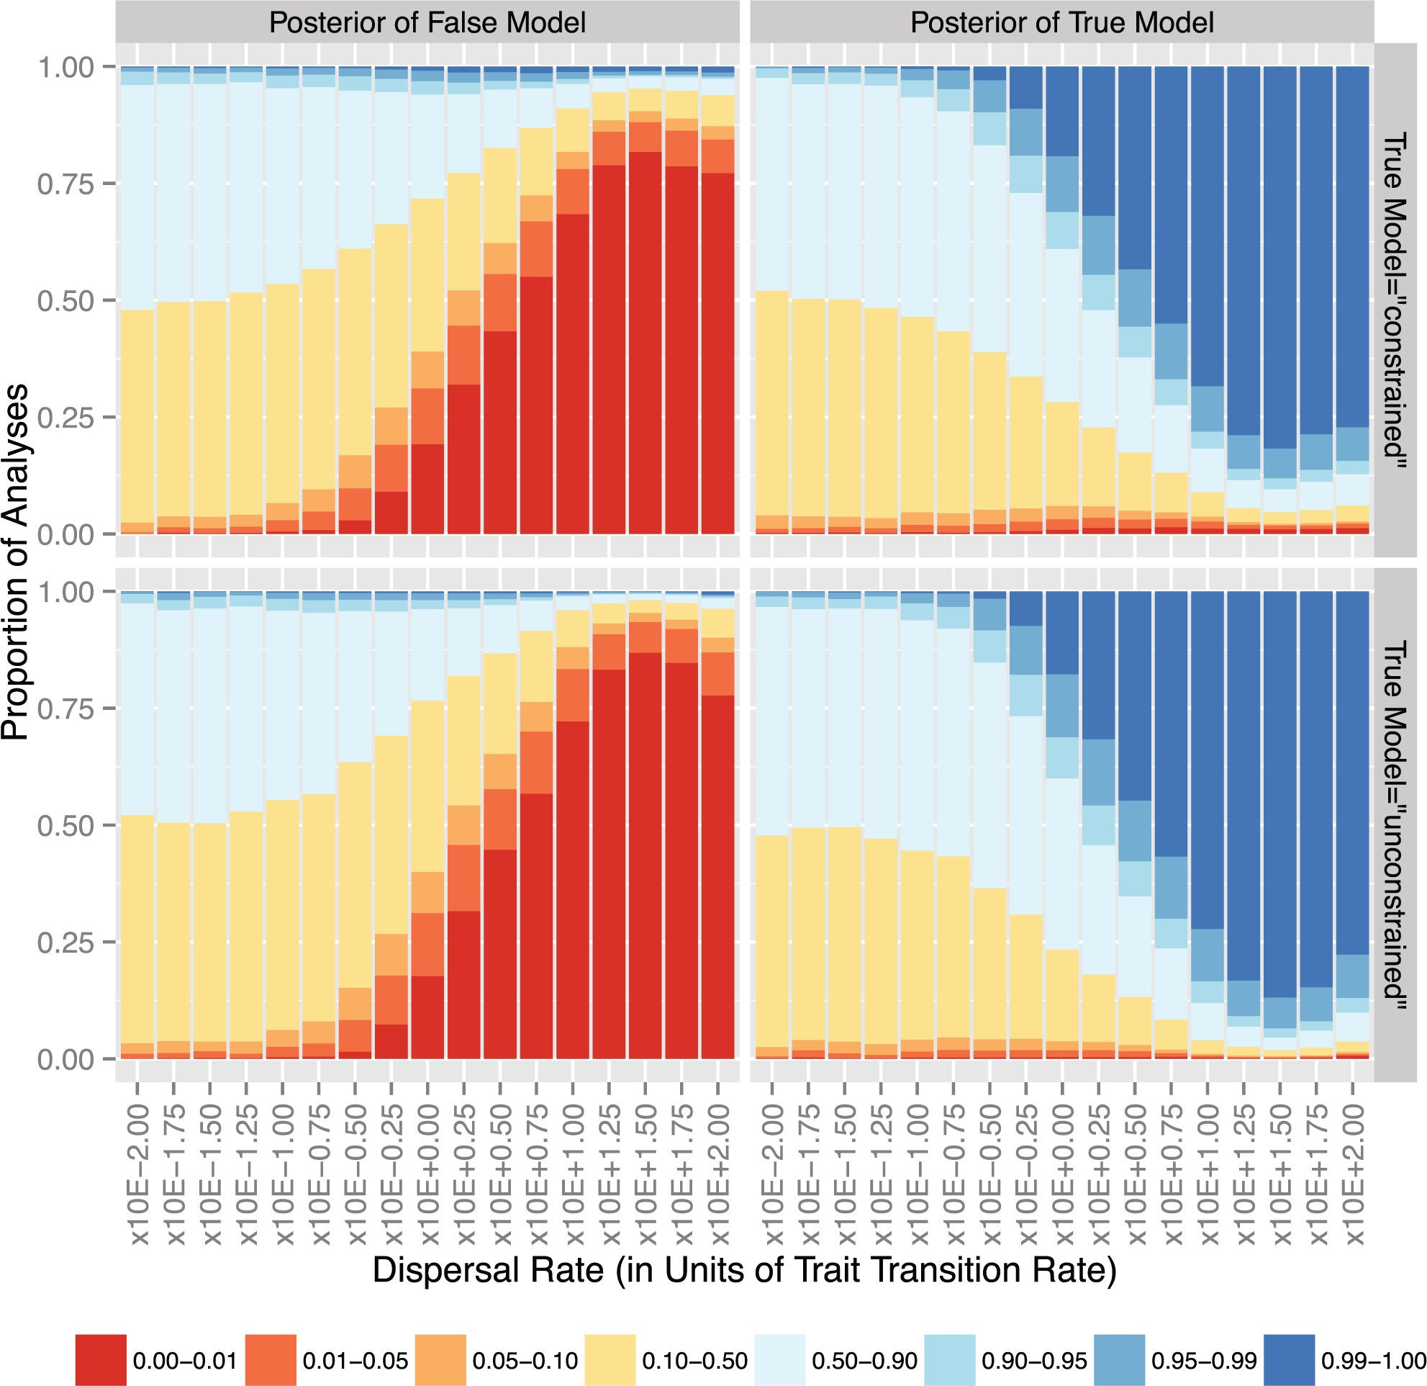
Figure 7. Performance over parameter space as measured by posterior probabilities given by the DAPC classification ...
Notes:
Figure 7. Performance over parameter space as measured by posterior probabilities given by the DAPC classification function of the true and false models. This figure collapses the entire parameter space into a single axis, expressing it as the dispersal rate in units of trait evolution transition rate on the x -axis, with each point marginalizing over the various birth- and extirpation-rates. Thus, for example, the value indicated by “ ×10E−1.00 ” encompasses all points in parameter space where the dispersal rate is 0.01 the value of the trait evolution transition rate, over all different birth rates and extirpation rate. The distribution of posterior probabilities across all analyses for a particular point in parameter space is shown on the y -axis, with the color indicating the value range of the posterior probability and the relative span of the color indicating the relative proportion of analyses resulting in that posterior probability. The left column shows the posterior probability of support for the false model, whereas the right column shows the posterior probability of support for the true model; the top row shows analyses where the true model was “constrained”, whereas the bottom row shows analyses where the true model was “unconstrained”. The cases where the true (generating) model corresponds to the “constrained” dispersal regime are shown in the first row, whereas the cases where the true model corresponds to the “unconstrained” dispersal regime are shown in the second row. The left column shows how support for the false model (i.e., the “unconstrained” dispersal regime if the true regime is “constrained”, and vice versa) varies over parameter space, whereas the right column shows the same for the true model. In each of the subplots, the x -axis shows dispersal rate in units of trait transition rate (so that, e.g., a value of “ ×10E−1.00 ” indicates a dispersal rate one order of magnitude less than the trait transition rate).
Unless provided in the caption above, the following copyright applies to the content of this slide: ©The Author(s) 2015. Published by Oxford University Press, on behalf of the Society of Systematic Biologists. All rights reserved. For Permissions, please email: journals.permissions@oup.com

Slide 8
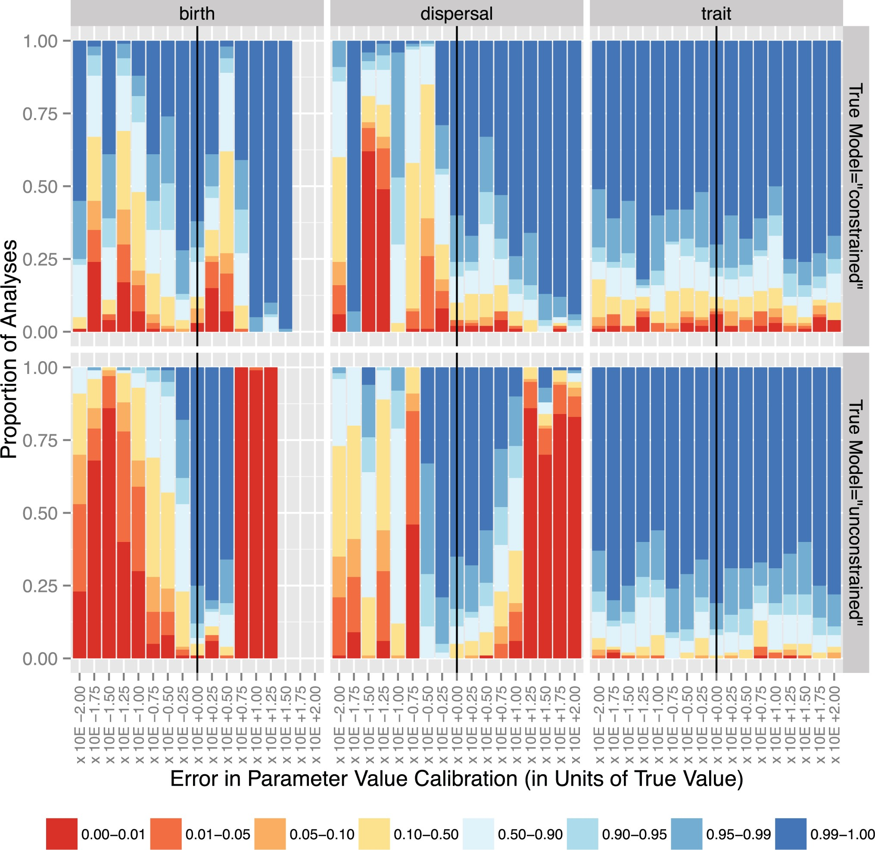
Figure 8. Changes in performance, as measured by posterior probability of support for the true model, as errors of ...
Notes:
Figure 8. Changes in performance, as measured by posterior probability of support for the true model, as errors of different magnitudes are introduced into the training data set calibration values for the birth (left), dispersal (center), and trait evolution transition (right) rates. The magnitude of the error is indicated on the x -axis, with “ b×10E+0.00 ” indicating no error (marked with the black vertical line). As in Figure 7 , above, the relative portion of the y -axis spanned by a sub-bar of a particular color indicates the proportion of the replicate analyses that yielded a posterior probability corresponding to that color.
Unless provided in the caption above, the following copyright applies to the content of this slide: ©The Author(s) 2015. Published by Oxford University Press, on behalf of the Society of Systematic Biologists. All rights reserved. For Permissions, please email: journals.permissions@oup.com

Slide 9
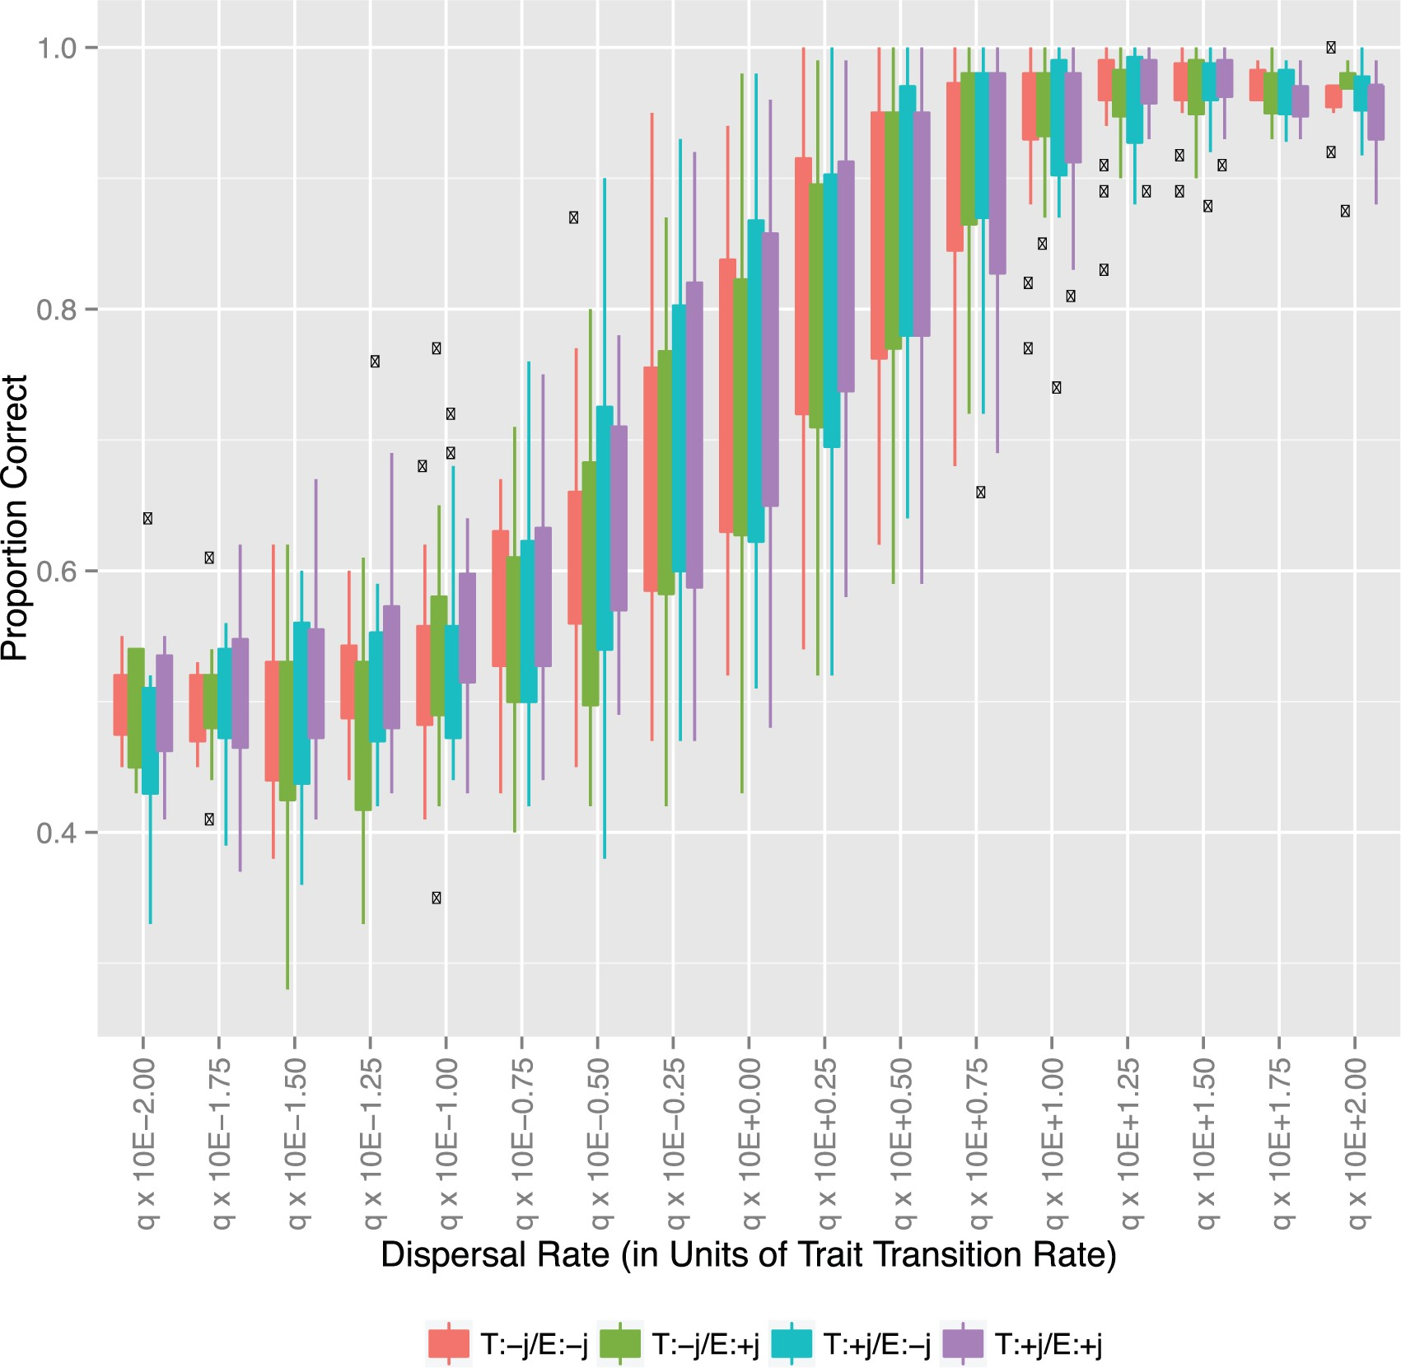
Figure 9. Performance over parameter space in different types of analytical regimes: with the true model including (“ ...
Notes:
Figure 9. Performance over parameter space in different types of analytical regimes: with the true model including (“ T:+j ”) or excluding (“ T:−j ”) jump dispersal, in combination with a corresponding estimation model including (“ E:+j ”) or excluding (“ E:−j ”) jump dispersal. The x -axis represents the parameter space collapsed onto a single dimension, and values correspond to the ratio of the dispersal rate to the transition rate. The y -axis represents the proportion of correctly classified test data sets, over 100 independent (true) test data sets generated over each combination of parameters. Outliers are indicated with dots instead of contributing to the box of the box plot.
Unless provided in the caption above, the following copyright applies to the content of this slide: ©The Author(s) 2015. Published by Oxford University Press, on behalf of the Society of Systematic Biologists. All rights reserved. For Permissions, please email: journals.permissions@oup.com

