Slide 1
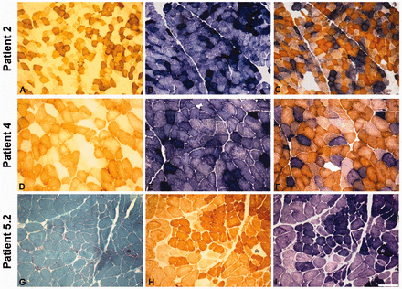
Figure 1 Histological and histochemical findings in muscle biopsies from Patients 2, 4 and 5.2. COX (A, D and H), SDH ...
Notes:
Figure 1 Histological and histochemical findings in muscle biopsies from Patients 2, 4 and 5.2. COX (A, D and H), SDH (B, E and I) and combined COX–SDH (C and F) histochemistry show severe and diffuse COX deficiency with evidence of mitochondrial proliferation in Patients 2 (A–C), 4 (D–F) and 5.2 (H and I). In Patient 5.2, Gomori thrichrome (G) histology and histochemistry (H and I) show one ragged-red fibre (asterisk) within an otherwise conserved muscle structure. Scale bar = 100 µm.
Unless provided in the caption above, the following copyright applies to the content of this slide: © The Author (2012). Published by Oxford University Press on behalf of the Guarantors of Brain. All rights reserved. For Permissions, please email: journals.permissions@oup.com

Slide 2
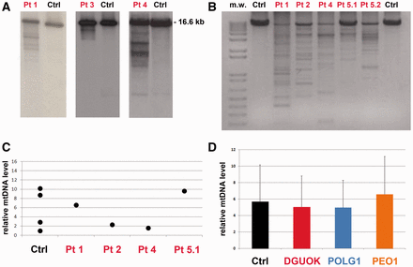
Figure 2 Molecular studies in skeletal muscle. (A) Southern blot analysis of muscle mitochondrial DNA from Patients 1, ...
Notes:
Figure 2 Molecular studies in skeletal muscle. (A) Southern blot analysis of muscle mitochondrial DNA from Patients 1, 3 and 4 (independent electrophoresis runs and blots are shown) demonstrates the presence of multiple bands. Next to each patient’s lane is a lane showing the Southern blot of mitochondrial DNA obtained from age-matched healthy controls, which displays only a single band corresponding to wild-type mitochondrial DNA. (B) Long-range PCR. This panel shows an agarose electrophoresis separation of the wild-type mitochondrial DNA long-range PCR amplified fragment of about 8520 bp. Variably abundant additional bands because of partially deleted mitochondrial DNA molecules from muscle are observed in all the probands but not in age-matched controls (Ctrl). (C) Mitochondrial DNA copy number is normal in muscle samples of our probands (Patients 1, 2, 4 and 5.1) as determined by quantitative real-time PCR and expressed as the ratio of the mitochondrial MT-CYB gene to the nuclear APP gene. Values are shown relative to age-matched control samples. (D) The mitochondrial DNA copy number was determined by quantitative real-time PCR in skeletal muscle samples of our probands (n = 4), age-matched control individuals (n = 4) and two groups of patients with autosomal dominant or recessive progressive external ophthalmoplegia and harbouring mutations in POLG1 (n = 4) or PEO1 (n = 4): no significant difference was observed. All determinations were performed in triplicate. Values, after normalization to a control sample, are presented as mean values of each group. Error bars indicate standard deviations.
Unless provided in the caption above, the following copyright applies to the content of this slide: © The Author (2012). Published by Oxford University Press on behalf of the Guarantors of Brain. All rights reserved. For Permissions, please email: journals.permissions@oup.com

Slide 3
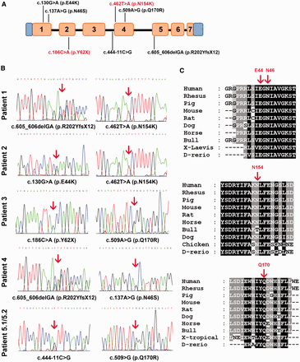
Figure 3 DGUOK gene analysis. (A) Scheme of DGUOK gene showing the localization of all identified mutations along its ...
Notes:
Figure 3 DGUOK gene analysis. (A) Scheme of DGUOK gene showing the localization of all identified mutations along its coding sequence. Exons are numbered. Novel mutations are highlighted in red. (B) Identification of DGUOK mutations in our patients; sequence analysis of DGUOK disclosed heterozygous compound mutations in all the probands as indicated by arrows above the electropherograms. (C) Alignments of nine vertebrate amino acid sequences of DGUOK demonstrating that the residues predicted to be mutated in our probands (indicated by red arrows) are evolutionarily conserved across species.
Unless provided in the caption above, the following copyright applies to the content of this slide: © The Author (2012). Published by Oxford University Press on behalf of the Guarantors of Brain. All rights reserved. For Permissions, please email: journals.permissions@oup.com

Slide 4
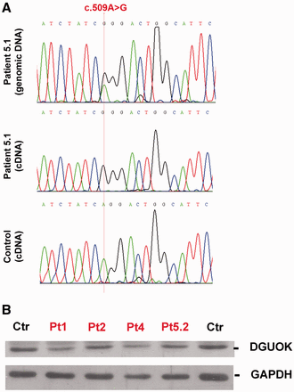
Figure 4 Transcript and protein analysis. (A) Transcript analysis in Patient 5.1 sequence of c.509A>G position located ...
Notes:
Figure 4 Transcript and protein analysis. (A) Transcript analysis in Patient 5.1 sequence of c.509A>G position located in exon 4 of DGUOK in genomic and complementary DNA prepared from muscle of Patient 5.1 and an unaffected control. Patient 5.1 was heterozygous for the c.509A>G variant at genomic level. Conversely, transcript analysis showed only the G allele, suggesting loss of the allele harbouring the c.444-11C>G mutation. Amplicons were prepared from first-strand complementary DNA using PCR primers designed on exon 3 and 6. (B) Analysis of DGUOK protein normalized to Glyceraldehyde 3-phosphate dehydrogenase (GAPDH) from muscle lysates of Patients 1, 2, 4, 5.2 and unaffected controls. Densitometric analysis showed that the normalized DGUOK staining in affected subjects was reduced by 20–45% compared with healthy controls.
Unless provided in the caption above, the following copyright applies to the content of this slide: © The Author (2012). Published by Oxford University Press on behalf of the Guarantors of Brain. All rights reserved. For Permissions, please email: journals.permissions@oup.com

