Slide 1
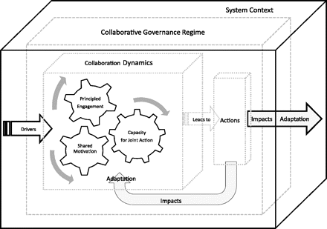
Figure 1 The Integrative Framework for Collaborative Governance
Notes:
Figure 1 The Integrative Framework for Collaborative Governance
Unless provided in the caption above, the following copyright applies to the content of this slide: © The Author 2011. Published by Oxford University Press on behalf of the Journal of Public Administration Research and Theory, Inc. All rights reserved. For permissions, please e-mail: journals.permissions@oup.com

