Slide 1
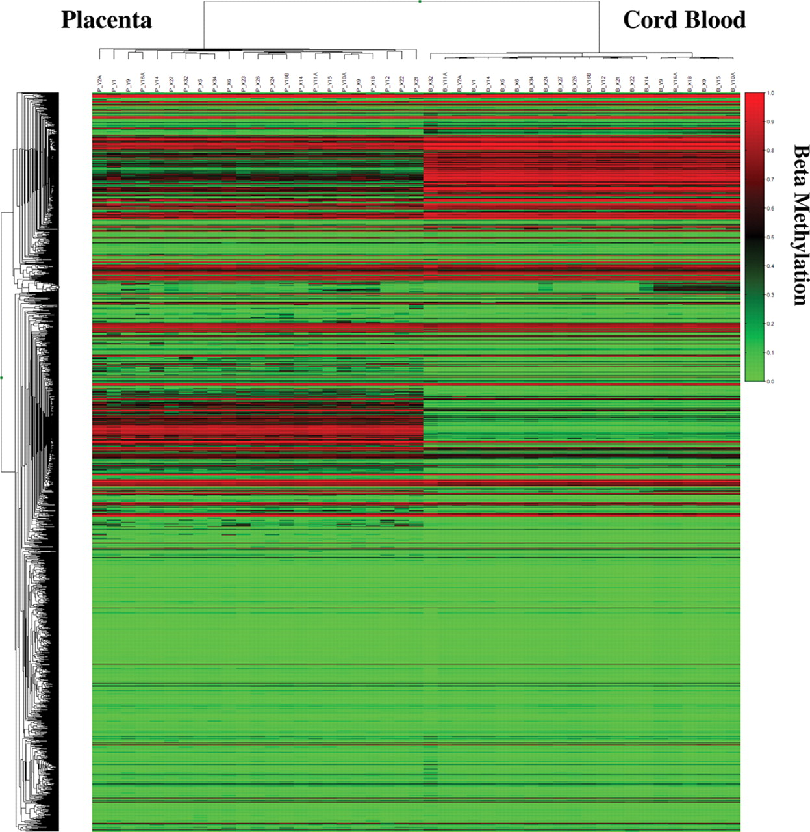
Figure 1. Hierarchical cluster analysis (heat map) of the methylation microarray data, based on all 1536 CpG loci, for ...
Notes:
Figure 1. Hierarchical cluster analysis (heat map) of the methylation microarray data, based on all 1536 CpG loci, for 10 in vitro and 13 in vivo controls (12 for blood). Each sample was assayed in duplicate. Each duplicate clustered together (data not shown) so the mean beta values were used in this figure for ease of representation. Red indicates complete methylation, green indicates absence of methylation and intermediate levels are indicated by intermediate shades. Note that all cord blood samples cluster separately from placental samples.
Unless provided in the caption above, the following copyright applies to the content of this slide: © The Author 2009. Published by Oxford University Press. All rights reserved. For Permissions, please email: journals.permissions@oxfordjournals.org

Slide 2
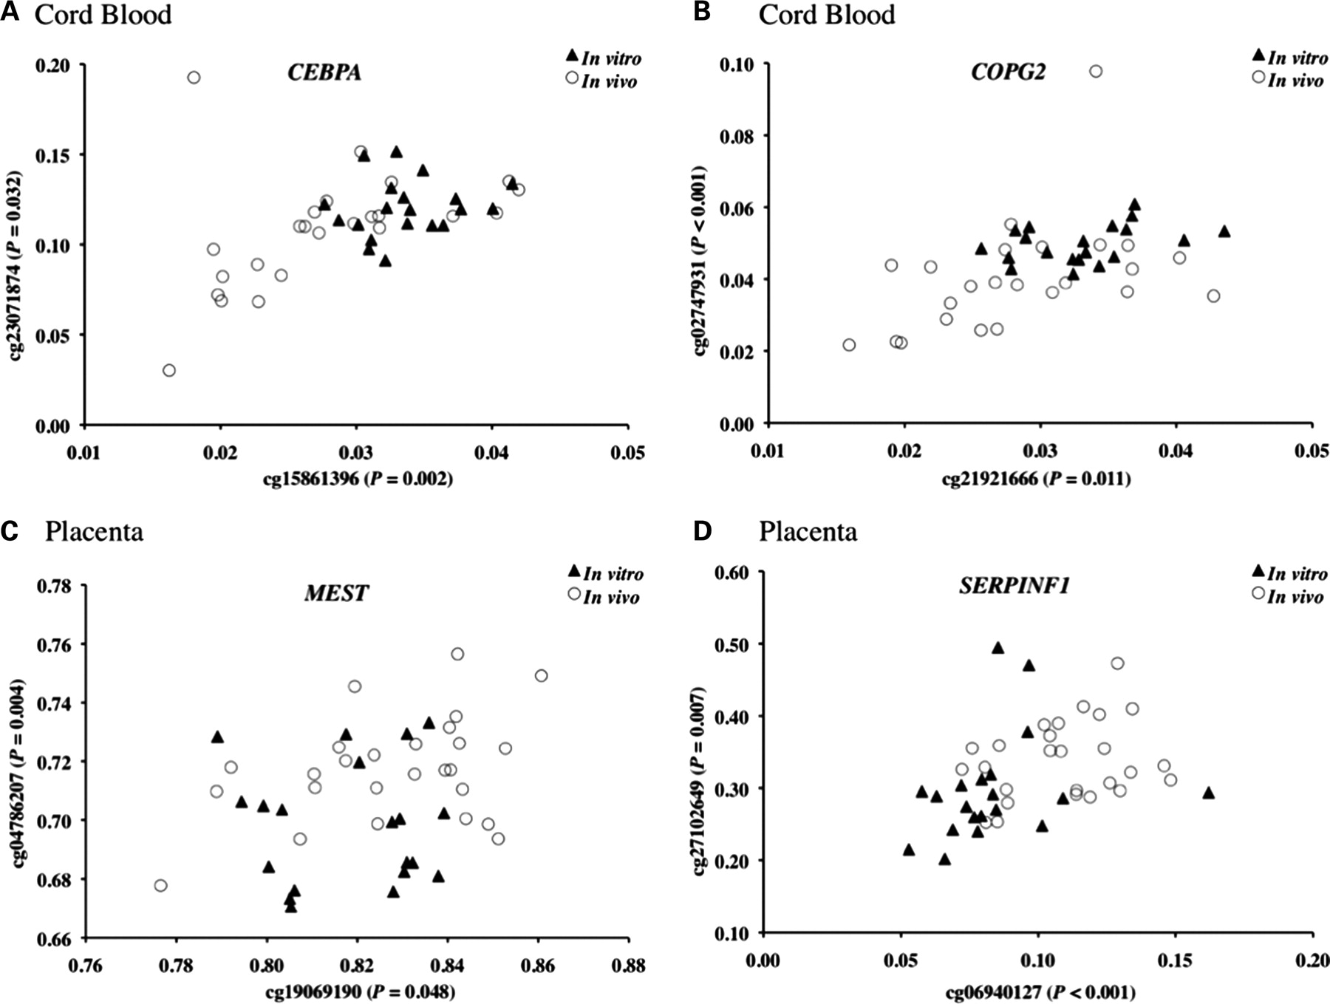
Figure 2. Beta values (fraction of CpG methylated at the indicated site) of CpG sites at which mean methylation ...
Notes:
Figure 2. Beta values (fraction of CpG methylated at the indicated site) of CpG sites at which mean methylation differences were different at two sites within the same gene (two-way ANOVA, P ≤ 0.08). (A) CEBPA in cord blood, (B) COPG2 in cord blood, (C) MEST in placenta and (D) SERPINF1 in placenta. The points represent data from 12 in vivo conceptions/24 beta values per CpG site versus 10 in vitro conceptions/20 beta values per CpG site. The in vitro individuals have slightly higher average methylation at the two CEBPA and COPG2 sites in cord blood and slightly lower average methylation at MEST and SERPINF1 CpG sites in placenta.
Unless provided in the caption above, the following copyright applies to the content of this slide: © The Author 2009. Published by Oxford University Press. All rights reserved. For Permissions, please email: journals.permissions@oxfordjournals.org

Slide 3
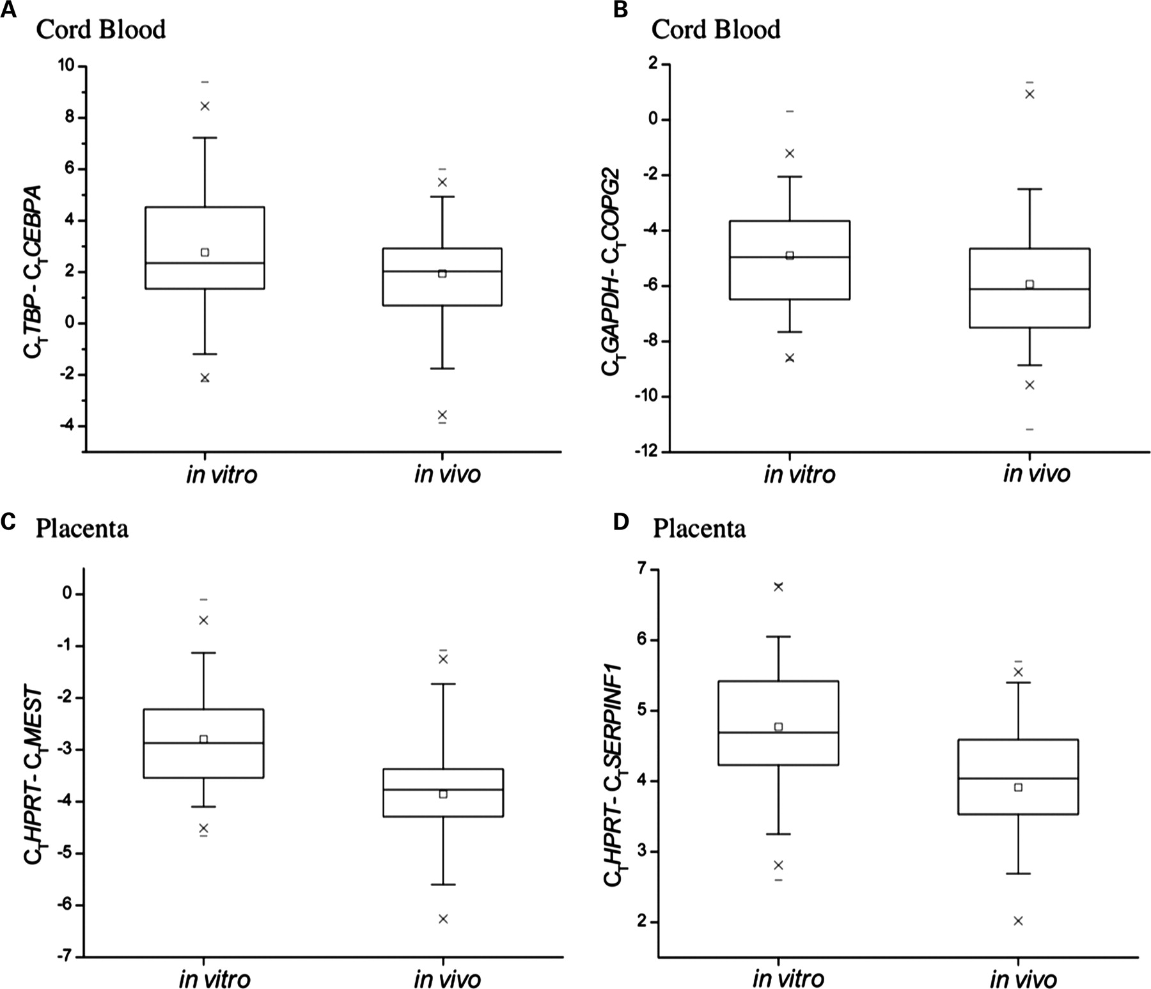
Figure 3. Boxplots with whiskers showing transcript levels for four genes in which mean transcript levels differ ...
Notes:
Figure 3. Boxplots with whiskers showing transcript levels for four genes in which mean transcript levels differ significantly (Student's t test, P ≤ 0.05) between in vitro and in vivo populations (A) CEBPA in cord blood, (B) COPG2 in cord blood, (C) MEST in placenta and (D) SERPINF1 in placenta. The plots represent data from 93, 85, 69 and 68 in vivo conceptions for CEBPA, COPG2, MEST and SERPINF1, respectively, versus 70, 73, 69 and 68 in vitro conceptions for CEBPA, COPG2, MEST and SERPINF1, respectively. Boxplot interpretation: the box contains the middle 50% of the data. The upper edge of the box indicates the 75th percentile of the data set, and the lower edge indicates the 25th percentile (the range of the middle two quartiles is known as the inter-quartile range). The mean (open square) is shown and the line in the box indicates the median value with the ends of the vertical lines or ‘whiskers’ indicating the 95th and 5th percentiles of the data set. The symbol (x) depicts the 99th and 1st percentiles of the data set, and (-) depicts the maximum data range.
Unless provided in the caption above, the following copyright applies to the content of this slide: © The Author 2009. Published by Oxford University Press. All rights reserved. For Permissions, please email: journals.permissions@oxfordjournals.org

