Slide 1
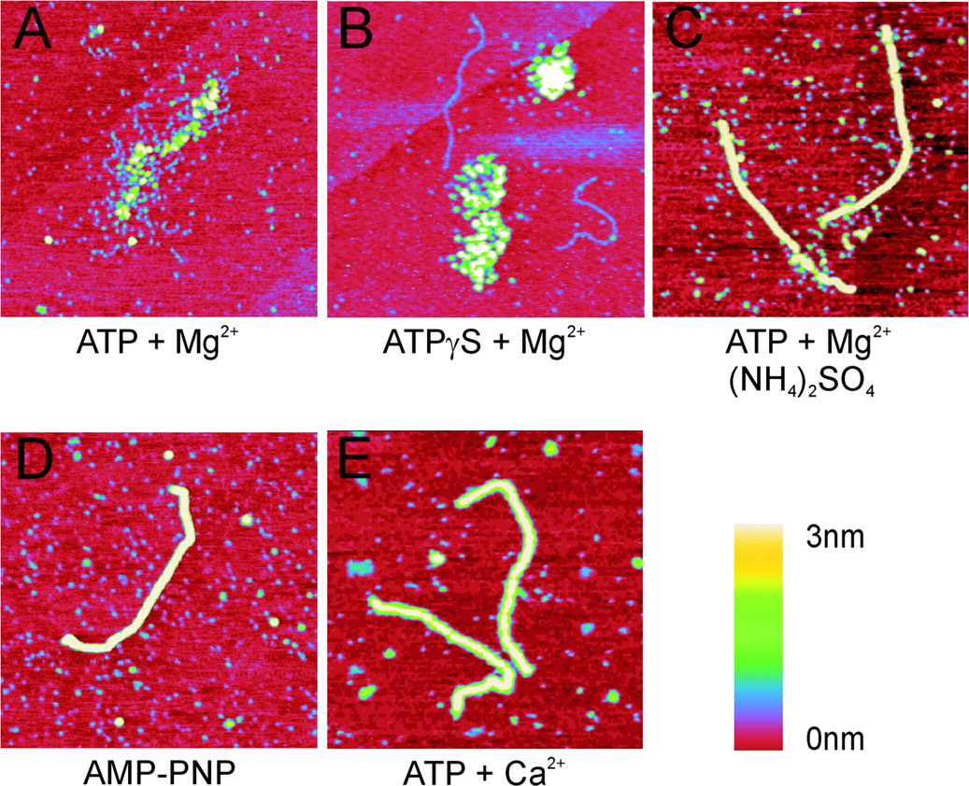
Figure 1 SFM images of filaments formed by human Rad51 on double-stranded DNA in the presence of various nucleotide ...
Notes:
Figure 1 SFM images of filaments formed by human Rad51 on double-stranded DNA in the presence of various nucleotide cofactors. (A and B) Examples of protein–DNA complexes described as irregular filaments formed on double-stranded DNA in the presence of ATP and MgCl2 (A) and ATPγS (B). (C–E) Examples of regular filaments formed on double-stranded DNA in conditions including ATP and MgCl2 treated with (NH4)2SO4 (C), AMP-PNP (D) and ATP and CaCl2 (E). All images are 1 × 1 μm and height is represented by color in the range of 0–3 nm, red to yellow as shown in the scale bar.
Unless provided in the caption above, the following copyright applies to the content of this slide: © The Author 2005. Published by Oxford University Press. All rights reserved The online version of this article has been published under an open access model. Users are entitled to use, reproduce, disseminate, or display the open access version of this article for non-commercial purposes provided that: the original authorship is properly and fully attributed; the Journal and Oxford University Press are attributed as the original place of publication with the correct citation details given; if an article is subsequently reproduced or disseminated not in its entirety but only in part or as a derivative work this must be clearly indicated. For commercial re-use, please contact journals.permissions@oupjournals.org

Slide 2
Figure 2 Distribution of filament and DNA lengths measured from SFM images. The length of DNA molecules or filaments ...
Notes:
Figure 2 Distribution of filament and DNA lengths measured from SFM images. The length of DNA molecules or filaments in the indicated conditions was measured and their distribution is plotted in histograms. (A) Bare DNA without any bound protein. (B) Filaments formed by Rad51 in the presence of ATP and MgCl2. (C) Filaments formed by Rad51 in the presence of ATP and MgCl2 and subsequently treated with (NH4)2SO4. (D) Filaments formed by Rad51 in the presence of AMP-PNP. (E) Filaments formed by Rad51 in the presence of ATP and CaCl2. The average measured length of the bare DNA fragment (blue line) and the length of this DNA fragment if it is extended 1.5 times in a filament (green line) are indicated in the histograms.
Unless provided in the caption above, the following copyright applies to the content of this slide: © The Author 2005. Published by Oxford University Press. All rights reserved The online version of this article has been published under an open access model. Users are entitled to use, reproduce, disseminate, or display the open access version of this article for non-commercial purposes provided that: the original authorship is properly and fully attributed; the Journal and Oxford University Press are attributed as the original place of publication with the correct citation details given; if an article is subsequently reproduced or disseminated not in its entirety but only in part or as a derivative work this must be clearly indicated. For commercial re-use, please contact journals.permissions@oupjournals.org

Slide 3
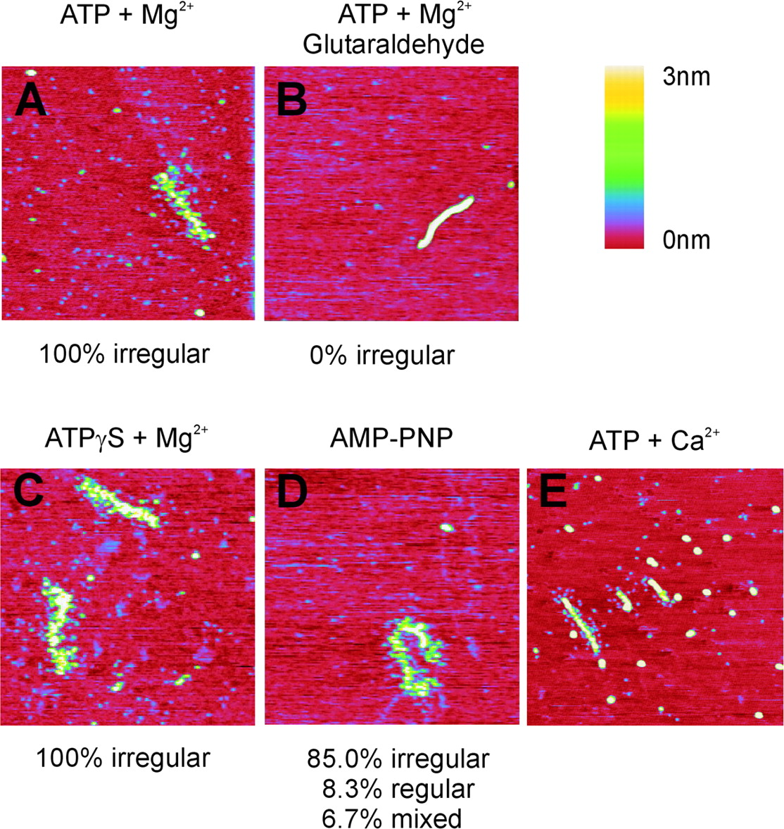
Figure 3 SFM images of filaments formed by human Rad51 on single-stranded DNA in the presence of various nucleotide ...
Notes:
Figure 3 SFM images of filaments formed by human Rad51 on single-stranded DNA in the presence of various nucleotide cofactors. Examples of protein–DNA complexes formed on single-stranded DNA in the presence of ATP and MgCl2 deposited directly (A) and after fixation with glutaraldehyde (B). Examples of filaments formed on single-stranded DNA in the presence of ATPγS (C), AMP-PNP (D), and ATP and CaCl2 (E). The percentage of filaments appearing irregular (such as in A and C) or regular is listed below the images. All images are 1 × 1 μm and height is represented by color in the range of 0–3 nm, red to yellow as shown in the scale bar.
Unless provided in the caption above, the following copyright applies to the content of this slide: © The Author 2005. Published by Oxford University Press. All rights reserved The online version of this article has been published under an open access model. Users are entitled to use, reproduce, disseminate, or display the open access version of this article for non-commercial purposes provided that: the original authorship is properly and fully attributed; the Journal and Oxford University Press are attributed as the original place of publication with the correct citation details given; if an article is subsequently reproduced or disseminated not in its entirety but only in part or as a derivative work this must be clearly indicated. For commercial re-use, please contact journals.permissions@oupjournals.org

Slide 4
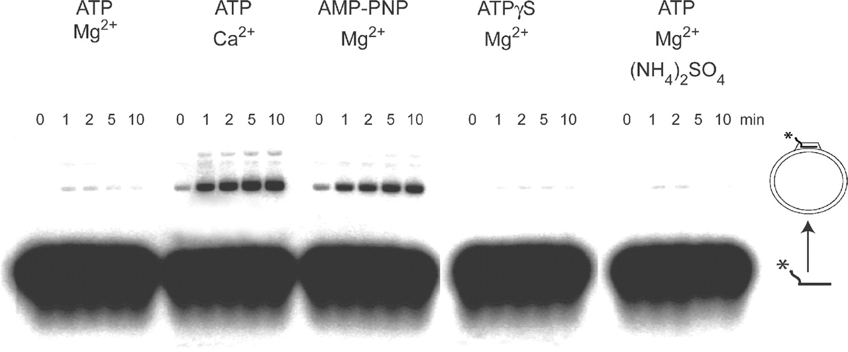
Figure 4 D-loop assay for recombination function. Human Rad51 was incubated with radiolabeled single-stranded ...
Notes:
Figure 4 D-loop assay for recombination function. Human Rad51 was incubated with radiolabeled single-stranded oligonucleotide, supercoiled plasmid and the indicated nucleotide cofactors. Oligonucleotide substrates and D-loop recombination products were separated on a gel and the appearance of the D-loop product was followed in time as indicated.
Unless provided in the caption above, the following copyright applies to the content of this slide: © The Author 2005. Published by Oxford University Press. All rights reserved The online version of this article has been published under an open access model. Users are entitled to use, reproduce, disseminate, or display the open access version of this article for non-commercial purposes provided that: the original authorship is properly and fully attributed; the Journal and Oxford University Press are attributed as the original place of publication with the correct citation details given; if an article is subsequently reproduced or disseminated not in its entirety but only in part or as a derivative work this must be clearly indicated. For commercial re-use, please contact journals.permissions@oupjournals.org

Slide 5
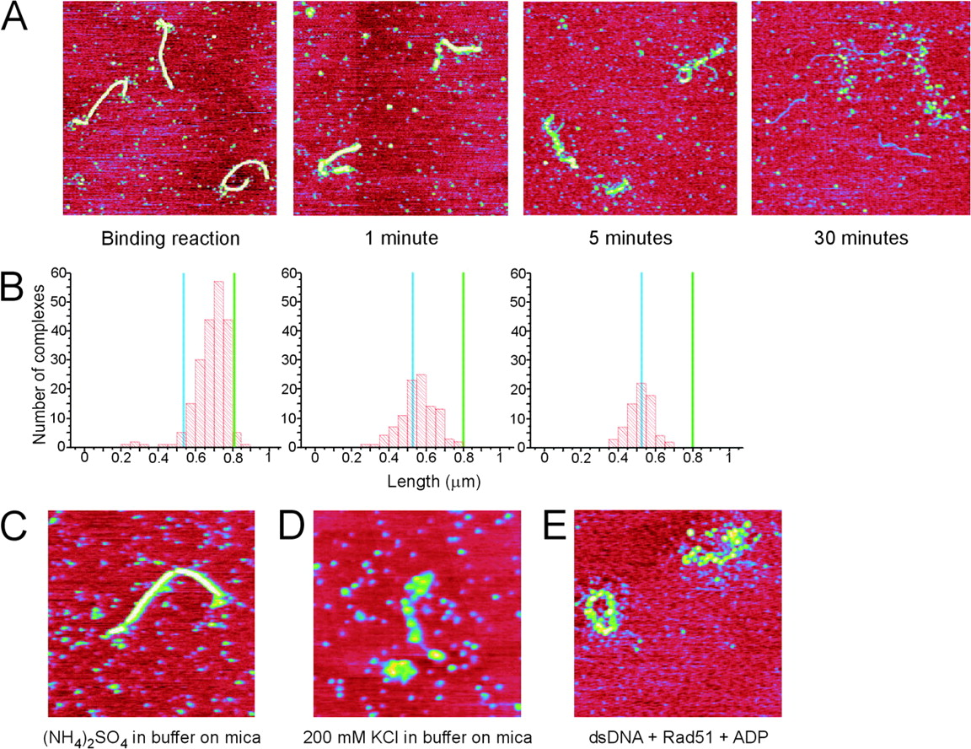
Figure 5 Disassembly of human Rad51 filaments formed on double-stranded DNA in the presence of ATP and ...
Notes:
Figure 5 Disassembly of human Rad51 filaments formed on double-stranded DNA in the presence of ATP and MgCl2 treated with (NH4)2SO4 before deposition onto mica for imaging. (A) SFM images of filaments from the binding reaction treated with (NH4)2SO4 and deposited (as in Figure 1C), and samples of the same reaction deposited onto mica and incubated on mica in buffer lacking (NH4)2SO4 for the indicated times (1, 5 and 30 min). (B) Quantification of filament disassembly on mica presented as histograms of filament lengths measured from the reactions shown in (A). The length of the bare DNA fragment (blue line) and the length of this DNA fragment if it is extended to 1.5 times its length in a filament (green line) are indicated in the histograms. (C–E) SFM images of control reactions showing the appearance of filaments formed as indicated: in the presence of ATP and MgCl2 and incubated on mica in buffer including (NH4)2SO4 (C), in the presence of ATP and MgCl2 incubated on mica in buffer including KCl (D), and filaments formed by Rad51 on double-stranded (ds) DNA in the presence of ADP and MgCl2 (E). Images are 1.5 × 1.5 μM in (A) and 1 × 1 μM in (C, D and E) and height is represented by color in the range of 0–3 nm, red to yellow.
Unless provided in the caption above, the following copyright applies to the content of this slide: © The Author 2005. Published by Oxford University Press. All rights reserved The online version of this article has been published under an open access model. Users are entitled to use, reproduce, disseminate, or display the open access version of this article for non-commercial purposes provided that: the original authorship is properly and fully attributed; the Journal and Oxford University Press are attributed as the original place of publication with the correct citation details given; if an article is subsequently reproduced or disseminated not in its entirety but only in part or as a derivative work this must be clearly indicated. For commercial re-use, please contact journals.permissions@oupjournals.org

Slide 6
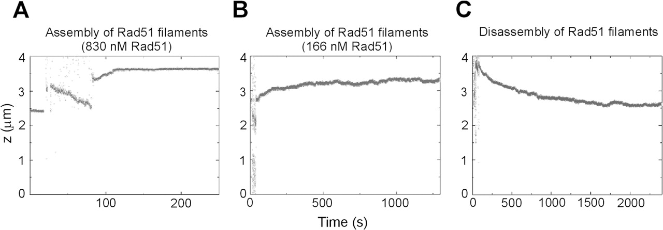
Figure 6 Assembly and disassembly of human Rad51 filaments on double-stranded DNA followed in real-time in a magnetic ...
Notes:
Figure 6 Assembly and disassembly of human Rad51 filaments on double-stranded DNA followed in real-time in a magnetic tweezers setup. (A) Time course of a fast filament assembly reaction with 830 nM Rad51. (B) Time course of a slow filament assembly reaction with 166 nM Rad51. (C) Time course of a Rad51 filament disassembly reaction upon removal of Rad51 and ATP from the flow cell. In all experiments, the DNA tether was held at a constant stretching force of 1.0 pN. Buffer exchange occured for the first 60–75 s.
Unless provided in the caption above, the following copyright applies to the content of this slide: © The Author 2005. Published by Oxford University Press. All rights reserved The online version of this article has been published under an open access model. Users are entitled to use, reproduce, disseminate, or display the open access version of this article for non-commercial purposes provided that: the original authorship is properly and fully attributed; the Journal and Oxford University Press are attributed as the original place of publication with the correct citation details given; if an article is subsequently reproduced or disseminated not in its entirety but only in part or as a derivative work this must be clearly indicated. For commercial re-use, please contact journals.permissions@oupjournals.org

