Slide 1
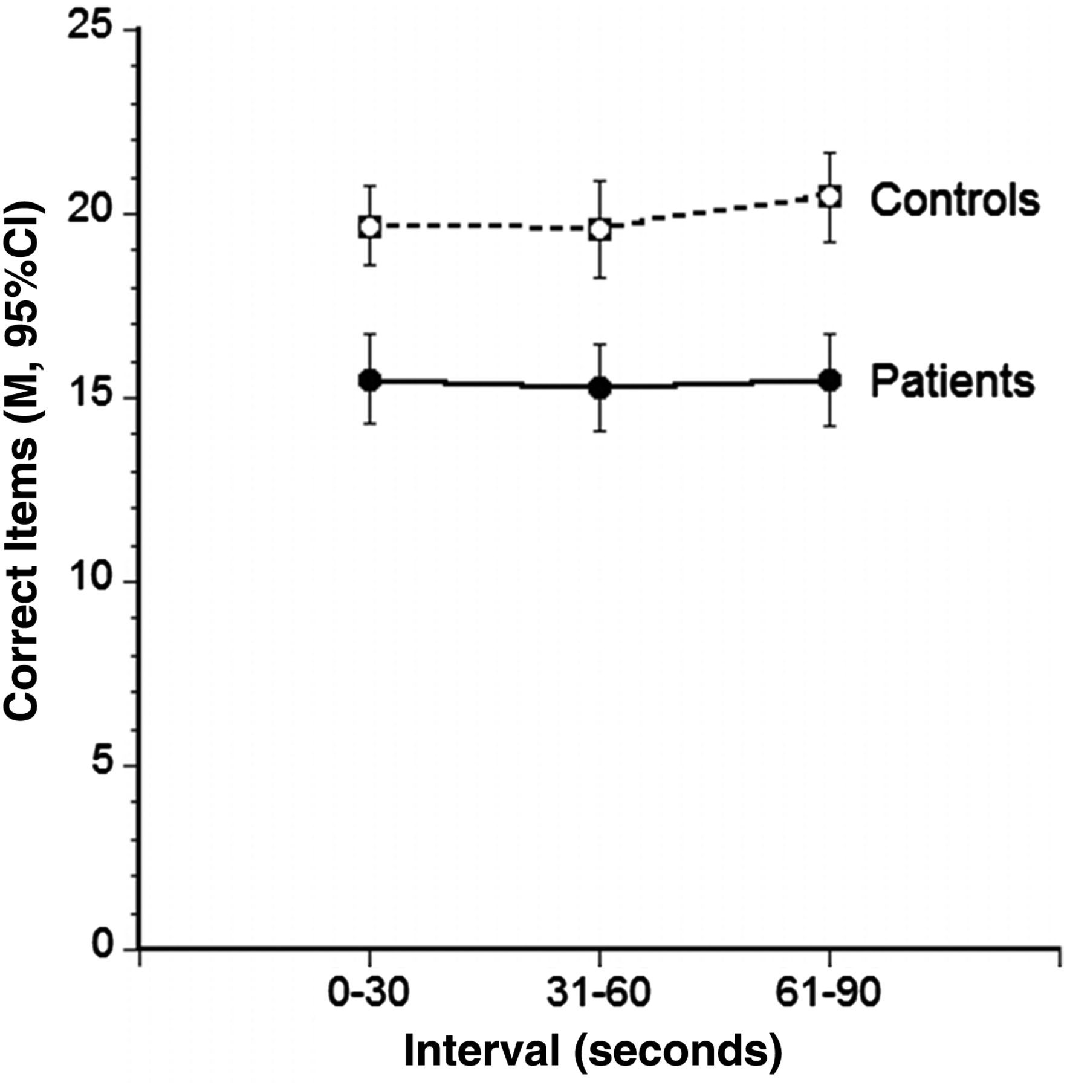
Fig. 1. Number of items completed by multiple sclerosis patients and healthy controls on three successive 30-s ...
Notes:
Fig. 1. Number of items completed by multiple sclerosis patients and healthy controls on three successive 30-s intervals of the computerized Symbol–Digit Modalities Test.
Unless provided in the caption above, the following copyright applies to the content of this slide: © The Author 2015. Published by Oxford University Press. All rights reserved. For permissions, please e-mail: journals.permissions@oup.com.

