Slide 1
Figure 1A. Northwestern Glacier 1909. Photograph by Ulysses Sherman Grant, 1909, by permission of the ...
Notes:
Figure 1A. Northwestern Glacier 1909. Photograph by Ulysses Sherman Grant, 1909, by permission of the National Snow and Ice Data Center/World Data Center for Glaciology, Boulder, CO. Figure 1B. Northwestern Glacier 2007. Photograph by Bruce F. Molnia, 2005, by permission of the National Snow and Ice Data Center/World Data Center for Glaciology, Boulder, CO. Comparative photographs of the Northwestern Glacier in Alaska, 1909 and 2005, demonstrate rapid changes in ice cover, and underscore the ways that climate scientists use history to document climate change.
Unless provided in the caption above, the following copyright applies to the content of this slide: © 2010 The Author. Published by Oxford University Press on behalf of the American Society for Environmental History and the Forest History Society. All rights reserved. For Permissions, please email: journals.permissions@oxfordjournals.org

Slide 2
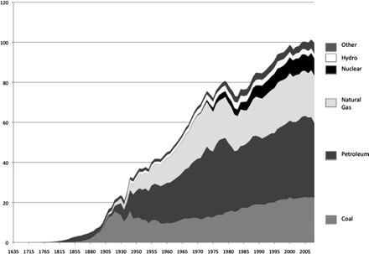
Figure 2. U.S. Energy Consumption by Source, 1635-2008 (quadrillion btu).¹⁴
Notes:
Figure 2. U.S. Energy Consumption by Source, 1635-2008 (quadrillion btu).14 The history of energy consumption in the United States shows how new fuels typically add to an expanding energy supply, rather than displace other fuels. The historical pattern of adding to the fuel supply underscores the challenge of cutting back on carbon dioxide emission-levels by increasing alternative energy production.
Unless provided in the caption above, the following copyright applies to the content of this slide: © 2010 The Author. Published by Oxford University Press on behalf of the American Society for Environmental History and the Forest History Society. All rights reserved. For Permissions, please email: journals.permissions@oxfordjournals.org

Slide 3
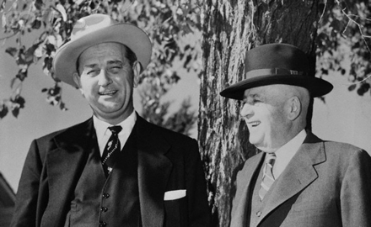
Figure 3. Powerful Allies.
Notes:
Figure 3. Powerful Allies. Senate Majority Leader Lyndon B. Johnson, left, and House-Speaker Elect Representative Sam Rayburn, pictured together in 1954, along with other powerful congressional allies helped protect the oil industry's financial interests with tax policies like the oil depletion allowance and intangible drilling expensing.
Unless provided in the caption above, the following copyright applies to the content of this slide: © 2010 The Author. Published by Oxford University Press on behalf of the American Society for Environmental History and the Forest History Society. All rights reserved. For Permissions, please email: journals.permissions@oxfordjournals.org

Slide 4
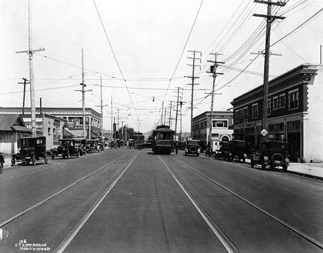
Figure 4. Streetcar on Santa Monica Blvd., Los Angeles, CA, 1922.
Notes:
Figure 4. Streetcar on Santa Monica Blvd., Los Angeles, CA, 1922. Streetcars and automobiles competed for primacy and political favor on the shared roadways.
Unless provided in the caption above, the following copyright applies to the content of this slide: © 2010 The Author. Published by Oxford University Press on behalf of the American Society for Environmental History and the Forest History Society. All rights reserved. For Permissions, please email: journals.permissions@oxfordjournals.org

