Slide 1
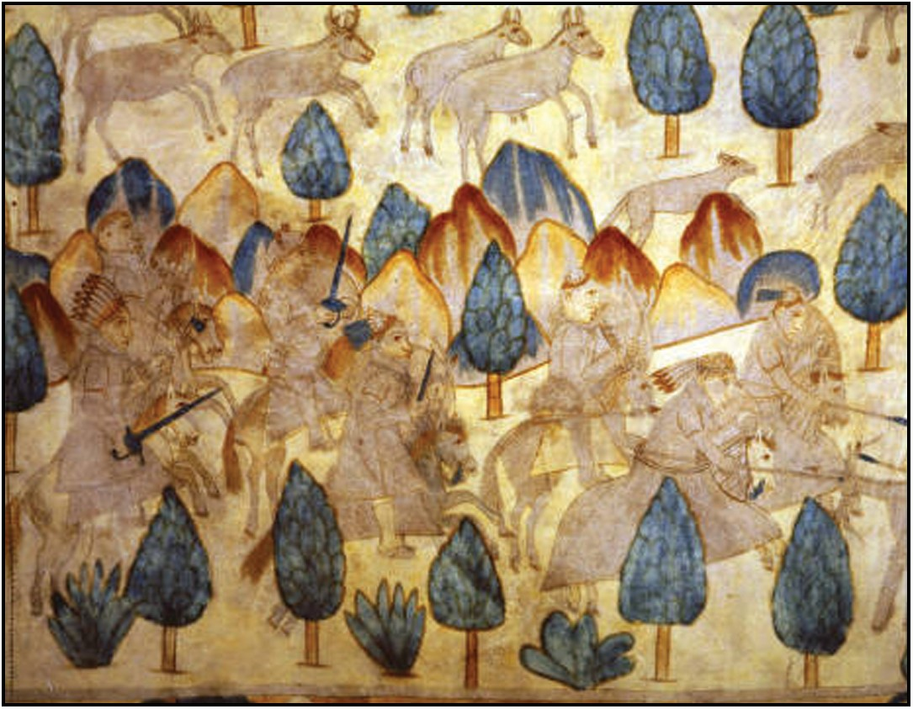
Figure 1. “Segesser I (center detail).” The violent spread of equestrianism is relayed in this dramatic hide-painting, ...
Notes:
Figure 1. “Segesser I (center detail).” The violent spread of equestrianism is relayed in this dramatic hide-painting, as Spanish metals, horses, and technologies reverberated across New Mexico's eighteenth-century hinterlands. Painted c. 1720–1729. Courtesy Palace of the Governors Photo Archives (NMHM/DCA), negative number 149799.
Unless provided in the caption above, the following copyright applies to the content of this slide: © The Author 2013. Published by Oxford University Press on behalf of the Organization of American Historians. All rights reserved. For permissions, please e-mail: journals.permissions@oup.com

Slide 2
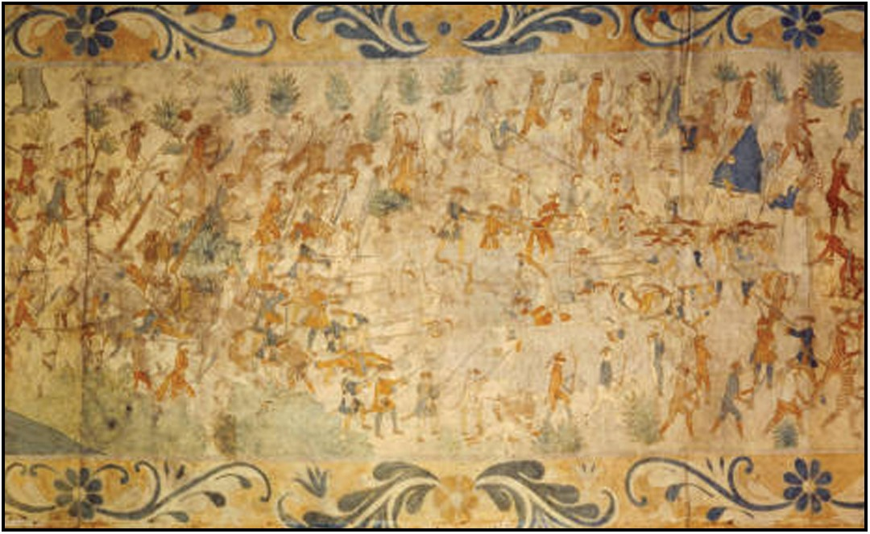
Figure 2. “Segesser II (center detail).” Larger and with more identifiable historical figures than Segesser I, Segesser ...
Notes:
Figure 2. “Segesser II (center detail).” Larger and with more identifiable historical figures than Segesser I, Segesser II shows the ambush of an expedition of Spaniards and Pueblo Indians, representing the ill-fated Villasur expedition of 1720. Courtesy Palace of the Governors Photo Archives (NMHM/DCA), negative number 184800.
Unless provided in the caption above, the following copyright applies to the content of this slide: © The Author 2013. Published by Oxford University Press on behalf of the Organization of American Historians. All rights reserved. For permissions, please e-mail: journals.permissions@oup.com

Slide 3
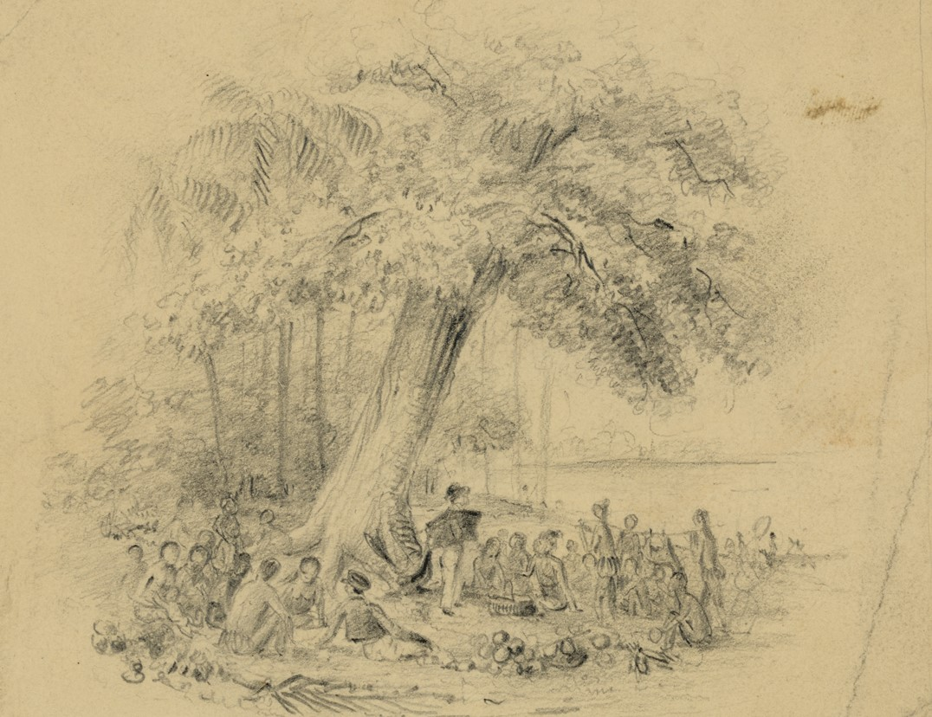
Figure 3. “Man lecturing native people under a tree.” Cultural exchanges occurred across the American landscape, ...
Notes:
Figure 3. “Man lecturing native people under a tree.” Cultural exchanges occurred across the American landscape, including outdoors. Courtesy Library of Congress.
Unless provided in the caption above, the following copyright applies to the content of this slide: © The Author 2013. Published by Oxford University Press on behalf of the Organization of American Historians. All rights reserved. For permissions, please e-mail: journals.permissions@oup.com

Slide 4
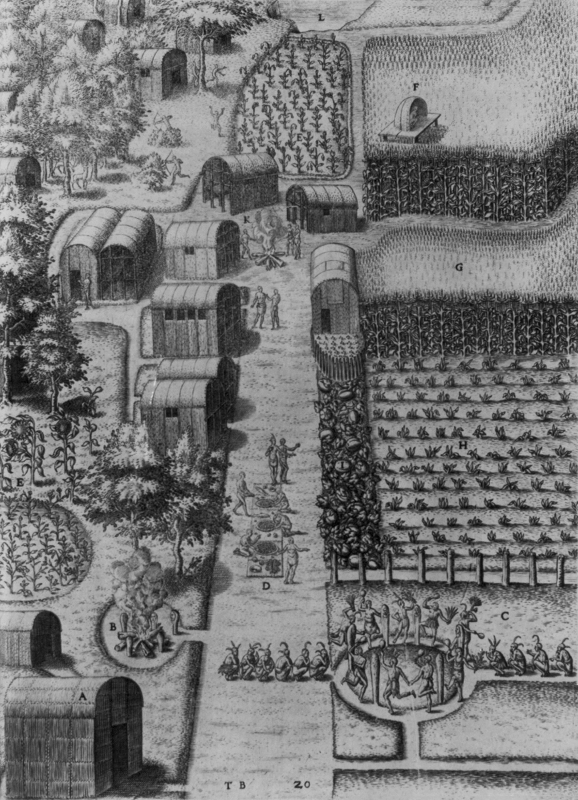
Figure 4. “Village of Secotan.” Engraved by Theodor de Bry (1528-1598) based upon a drawing by John White. It shows an ...
Notes:
Figure 4. “Village of Secotan.” Engraved by Theodor de Bry (1528-1598) based upon a drawing by John White. It shows an Algonquian village on the Pamlico River estuary showing Native structures, agriculture, and spiritual life in what is now North Carolina. Courtesy Library of Congress.
Unless provided in the caption above, the following copyright applies to the content of this slide: © The Author 2013. Published by Oxford University Press on behalf of the Organization of American Historians. All rights reserved. For permissions, please e-mail: journals.permissions@oup.com

Slide 5
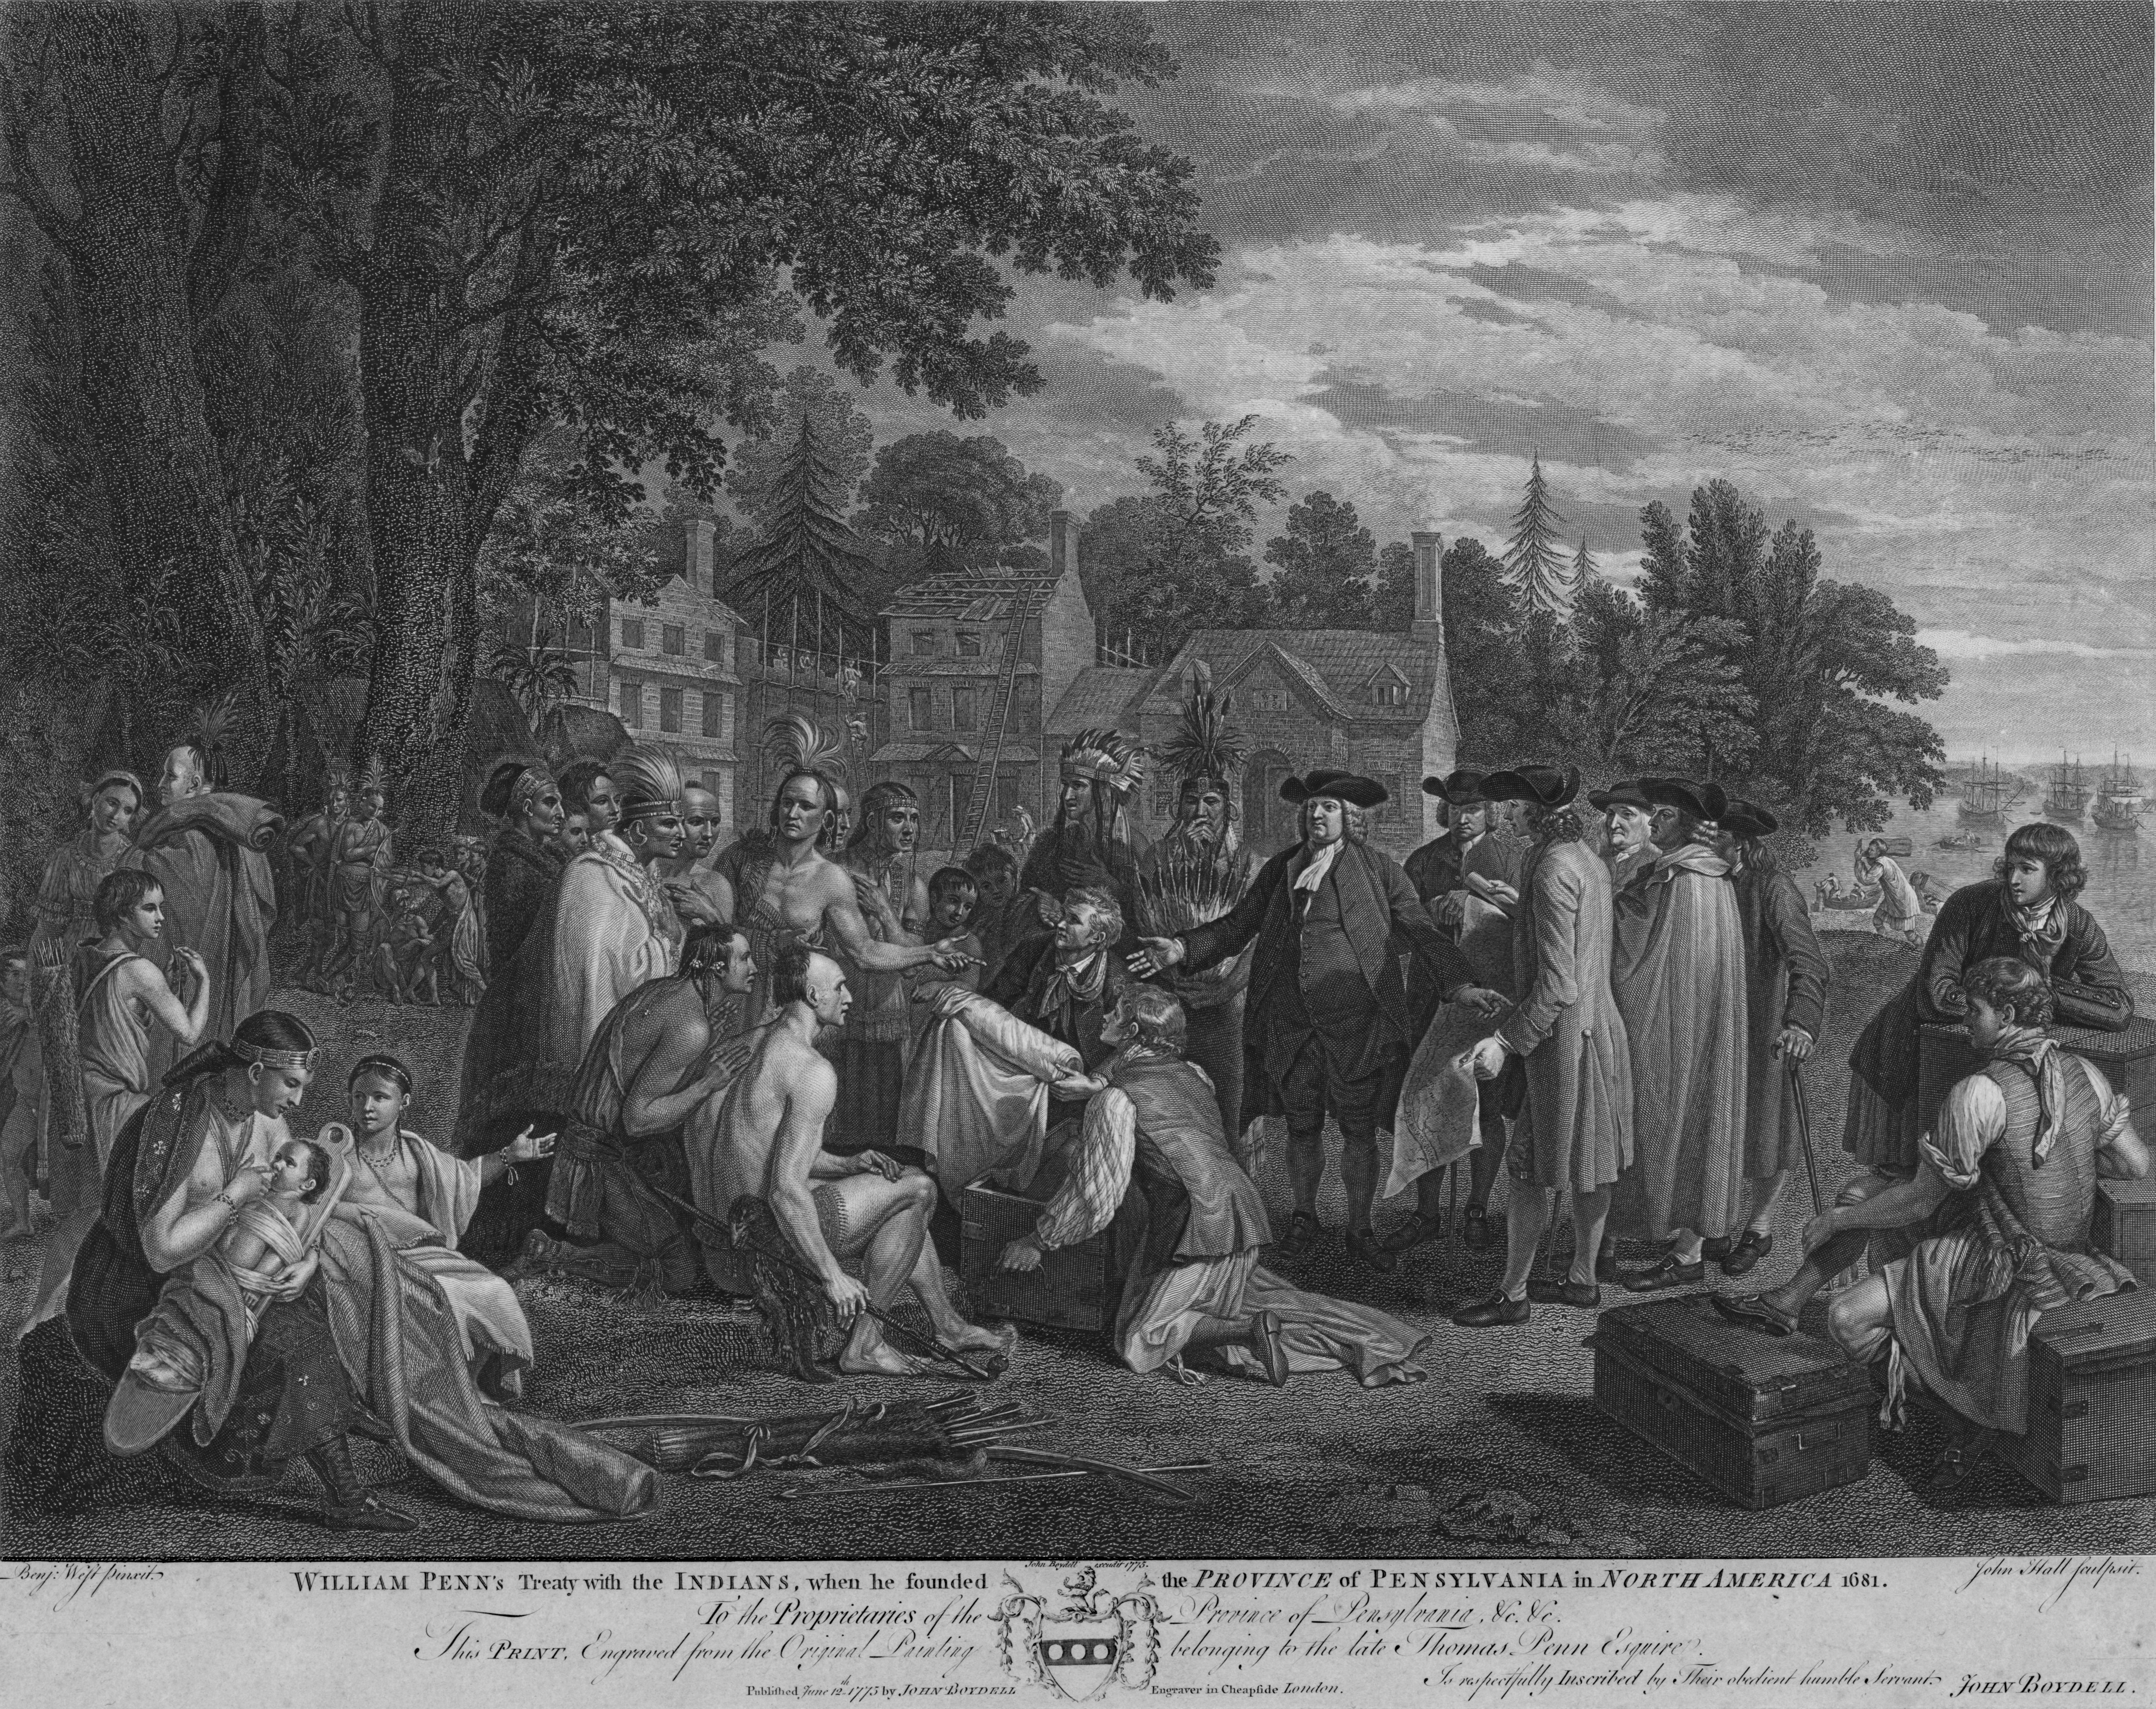
Figure 5. “William Penn's treaty with the Indians, when he founded the province of Pennsylvania in North America 1681.” ...
Notes:
Figure 5. “William Penn's treaty with the Indians, when he founded the province of Pennsylvania in North America 1681.” The text under the title of the print reads: “To the Proprietors of the Province of Pennsylvania. This Print, Engraved from the Original Painting belonging to the late Thomas Penn, Esquire. Is respectfully Inscribed by Their obedient humble servant. John Boydell.” It was published June 12, 1775 by John Boydell. Courtesy Library of Congress.
Unless provided in the caption above, the following copyright applies to the content of this slide: © The Author 2013. Published by Oxford University Press on behalf of the Organization of American Historians. All rights reserved. For permissions, please e-mail: journals.permissions@oup.com

