Slide 1
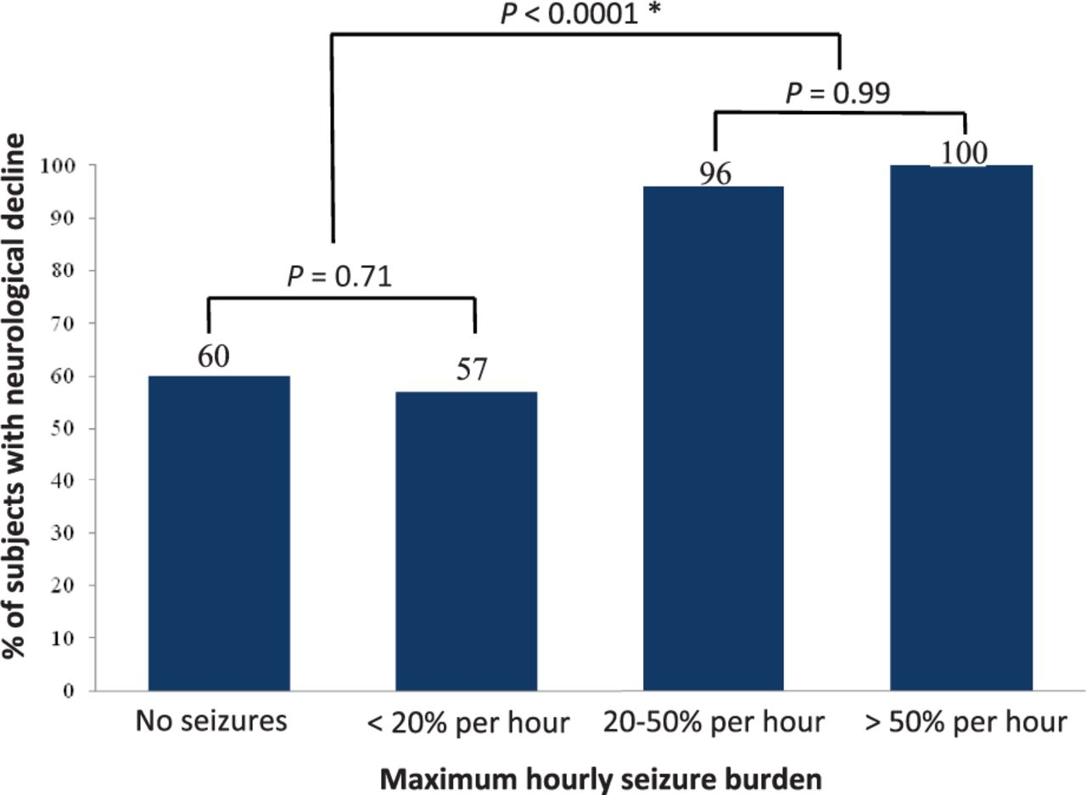
Figure 1 Maximum hourly seizure burden of 20% (12 min) is associated with neurological decline.Comparisons performed ...
Notes:
Figure 1 Maximum hourly seizure burden of 20% (12 min) is associated with neurological decline.Comparisons performed using Fisher’s exact test. The single subject with a seizure burden ≥20% per hour who did not experience neurological decline had a baseline PCPC score of 3. *Comparison of the ‘no seizures’ and ‘50% per hour’ groups combined.
Unless provided in the caption above, the following copyright applies to the content of this slide: © The Author (2014). Published by Oxford University Press on behalf of the Guarantors of Brain. All rights reserved. For Permissions, please email: journals.permissions@oup.com

Slide 2
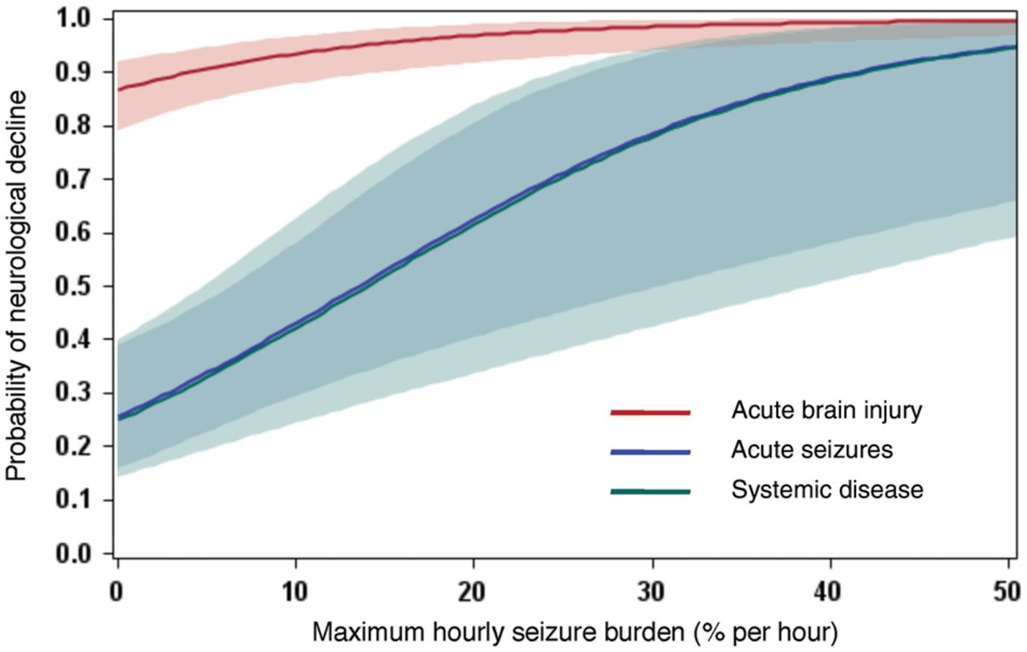
Figure 2 Probability of neurological decline rises with increasing seizure burden across all diagnostic categories. ...
Notes:
Figure 2 Probability of neurological decline rises with increasing seizure burden across all diagnostic categories. Prediction plot is based on the unadjusted multivariable model presented in Table 2, stratified by diagnostic category. The shaded areas represent the 95% confidence intervals.
Unless provided in the caption above, the following copyright applies to the content of this slide: © The Author (2014). Published by Oxford University Press on behalf of the Guarantors of Brain. All rights reserved. For Permissions, please email: journals.permissions@oup.com

Slide 3
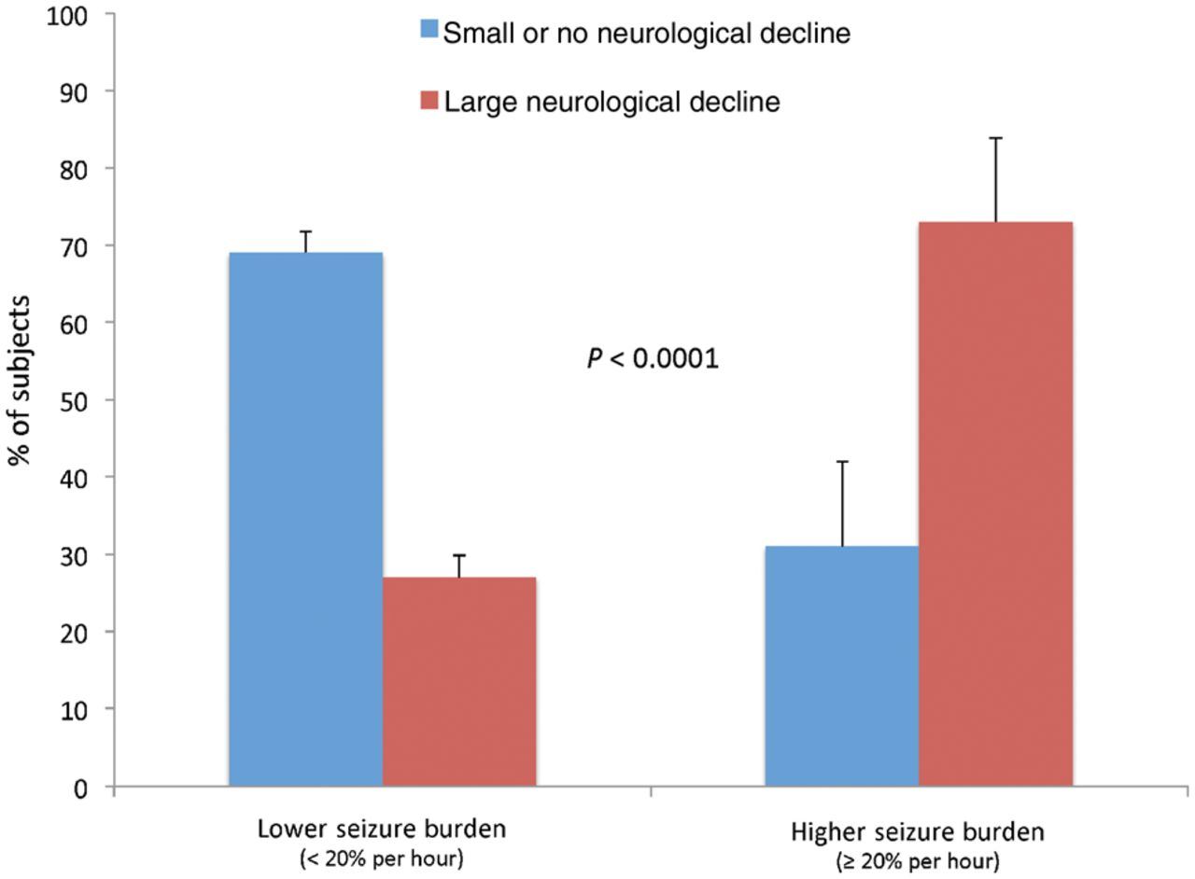
Figure 3 Higher seizure burden is associated with a greater magnitude of neurological decline. Small or no ...
Notes:
Figure 3 Higher seizure burden is associated with a greater magnitude of neurological decline. Small or no neurological decline is defined as ≤1 category increase in PCPC score; large neurological decline is defined as ≥2 category increase in PCPC score. Comparison performed using Fisher’s exact test.
Unless provided in the caption above, the following copyright applies to the content of this slide: © The Author (2014). Published by Oxford University Press on behalf of the Guarantors of Brain. All rights reserved. For Permissions, please email: journals.permissions@oup.com

Slide 4
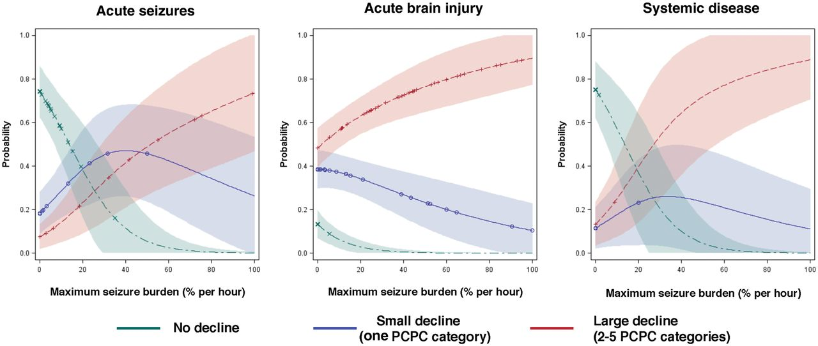
Figure 4 Magnitude of neurological decline rises with increasing seizure burden across all diagnostic categories. The ...
Notes:
Figure 4 Magnitude of neurological decline rises with increasing seizure burden across all diagnostic categories. The magnitude of neurological decline was categorized as no decline, small decline (a worsening by one PCPC category), and large decline (a worsening by two or more PCPC categories). Multinomial logistic regression with a generalized logit model was fitted and prediction plots were generated to illustrate the probability of neurological decline by seizure burden among the three primary diagnostic categories. The shaded areas represent the 95% confidence intervals. Across all diagnostic categories, as seizure burden increased, the probability of a large decline rose and the probability of no decline fell. The probability of a small decline peaked with moderate seizure burden (30–35% per hour), except among subjects with acute brain injury, where it declined monotonically.
Unless provided in the caption above, the following copyright applies to the content of this slide: © The Author (2014). Published by Oxford University Press on behalf of the Guarantors of Brain. All rights reserved. For Permissions, please email: journals.permissions@oup.com

