Slide 1
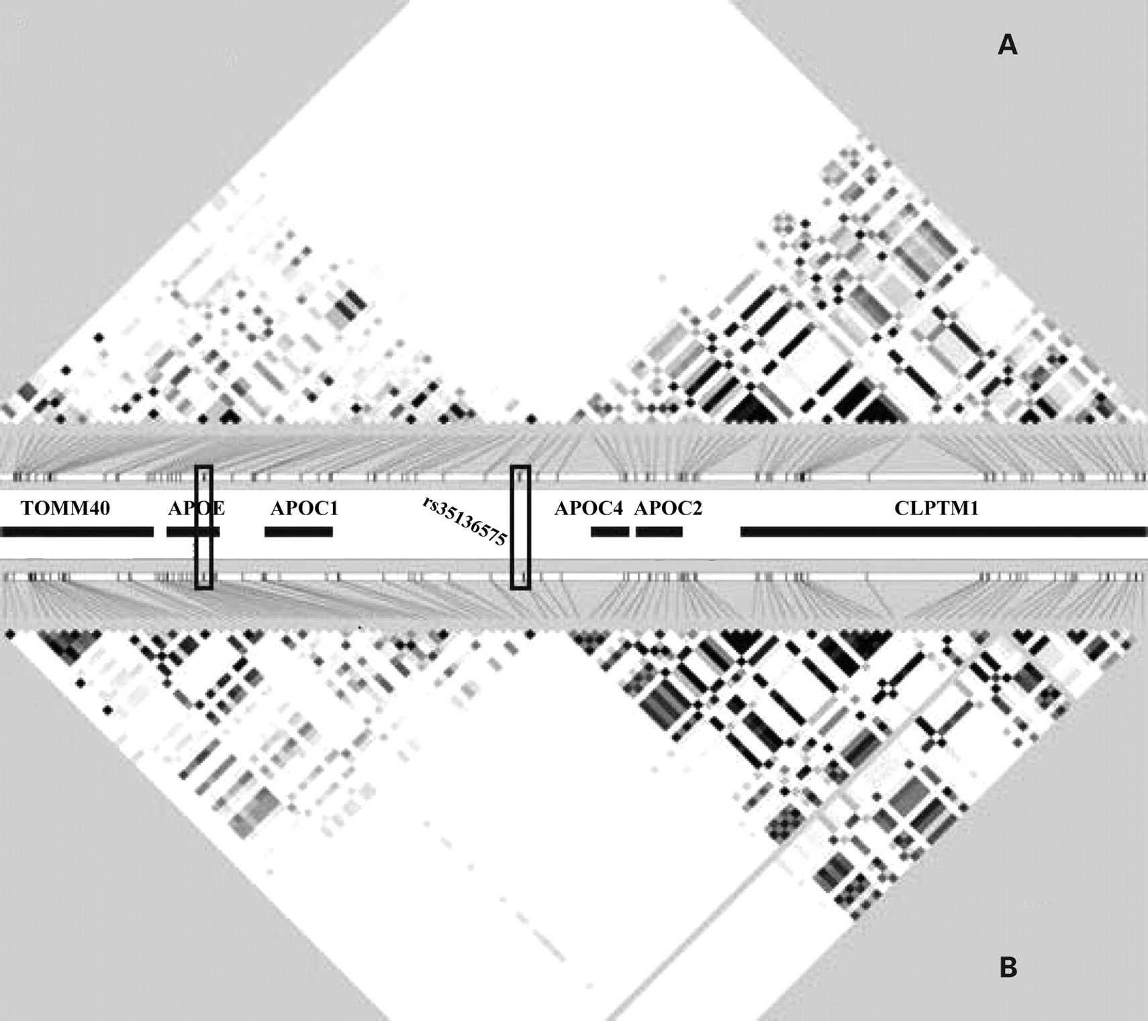
Figure 1. Pairwise linkage disequilibrium (LD) reported as r² for 115 SNPs on chromosome 19 in ( A ) ...
Notes:
Figure 1. Pairwise linkage disequilibrium (LD) reported as r2 for 115 SNPs on chromosome 19 in ( A ) African-Americans and ( B ) Caucasians of CARDIA. The colour gradient indicates relative level of LD from black = complete LD ( r2 = 1) to white = no LD ( r2 = 0). Black boxes indicate the locations of rs429358 and rs7412, in the APOE gene, and of rs35136575.
Unless provided in the caption above, the following copyright applies to the content of this slide: © The Author 2008. Published by Oxford University Press. All rights reserved. For Permissions, please email: journals.permissions@oxfordjournals.org

Slide 2
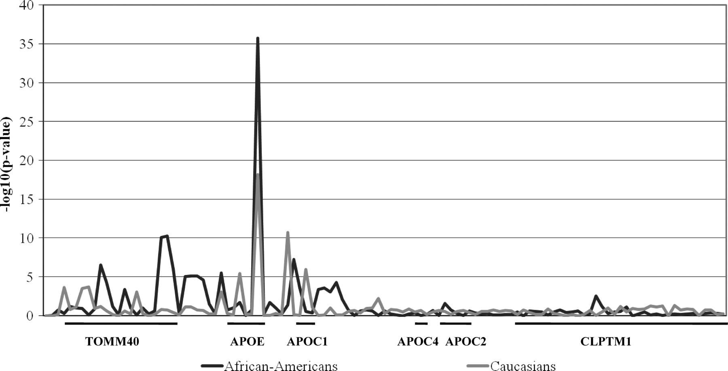
Figure 2. Results of the tests of association between plasma LDL-C level and 115 SNPs [reported as –log ₁₀ ...
Notes:
Figure 2. Results of the tests of association between plasma LDL-C level and 115 SNPs [reported as –log 10 (false discovery rate (FDR)-adjusted P -value)] in CARDIA African-Americans and Whites. A P -value = 0.05 corresponds to a –log 10 ( P -value) = 1.30. Consecutive SNPs within the genes of this region are noted below the X -axis.
Unless provided in the caption above, the following copyright applies to the content of this slide: © The Author 2008. Published by Oxford University Press. All rights reserved. For Permissions, please email: journals.permissions@oxfordjournals.org

Slide 3
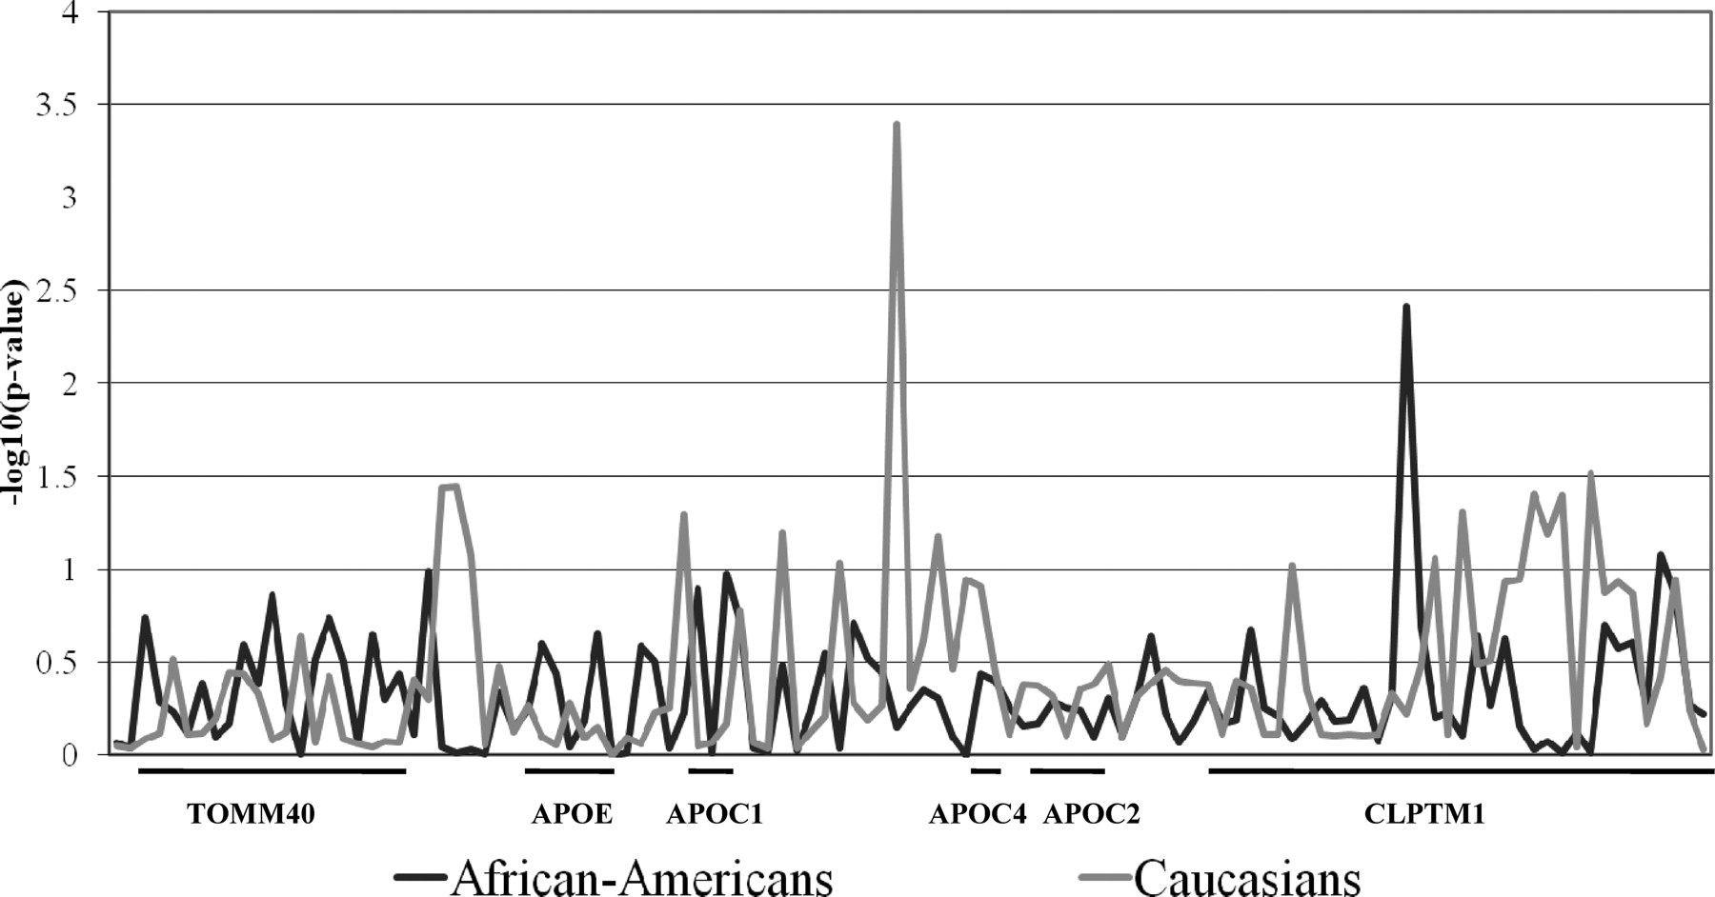
Figure 3. Results of the tests of association between plasma LDL-C level adjusted for APOE ε2/3/4 genotype and 115 ...
Notes:
Figure 3. Results of the tests of association between plasma LDL-C level adjusted for APOE ε2/3/4 genotype and 115 SNPs [reported as –log 10 (FDR-adjusted P -value] in CARDIA African-Americans and Whites. P = 0.05 corresponds to a –log 10 ( P -value) = 1.30. Consecutive SNPs within the genes of this region are noted below the X -axis.
Unless provided in the caption above, the following copyright applies to the content of this slide: © The Author 2008. Published by Oxford University Press. All rights reserved. For Permissions, please email: journals.permissions@oxfordjournals.org

Slide 4
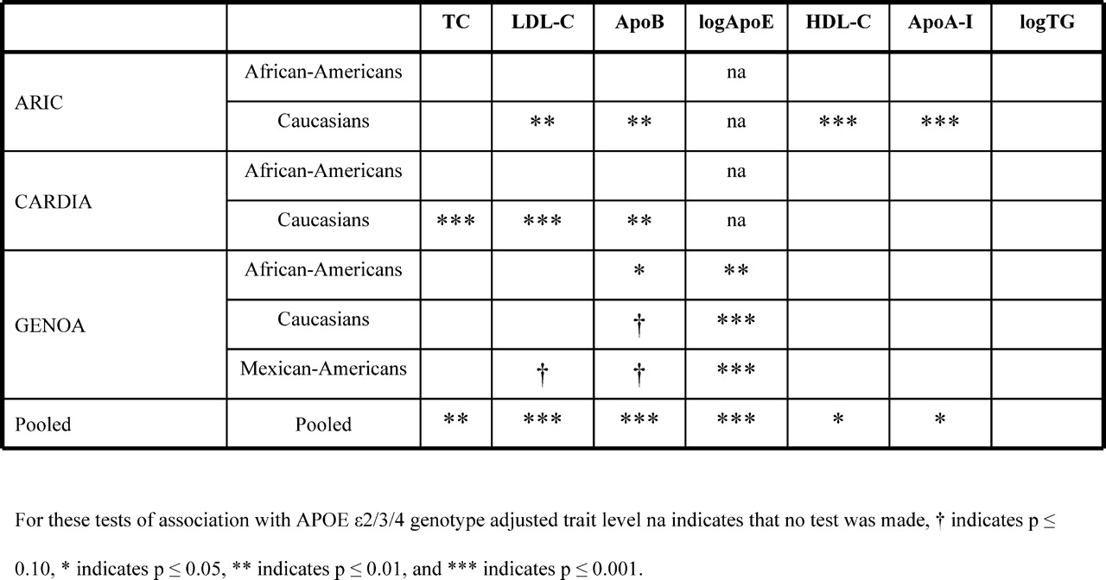
Figure 4. The strength of association between rs35136575 genotype and plasma levels of total cholesterol (TC), LDL ...
Notes:
Figure 4. The strength of association between rs35136575 genotype and plasma levels of total cholesterol (TC), LDL cholesterol (LDL-C), apolipoprotein (Apo) B, log-transformed ApoE, HDL cholesterol (HDL-C), ApoA-I and log-transformed triglycerides (TG) after linear adjustment for age, age 2 , age 3 , BMI, gender and APOE genotype.
Unless provided in the caption above, the following copyright applies to the content of this slide: © The Author 2008. Published by Oxford University Press. All rights reserved. For Permissions, please email: journals.permissions@oxfordjournals.org

