Slide 1
Fig. 1. Sparsity patterns in posterior probability matrices. Panels (a) and (b) illustrate the pairwise pairing ...
Notes:
Fig. 1. Sparsity patterns in posterior probability matrices. Panels (a) and (b) illustrate the pairwise pairing posterior probabilities for two different sequences (such as generated by a single-sequence probabilistic or partition function–based RNA folding program). Panel (c) shows the alignment match probabilities for these sequences (such as generated by a probabilistic HMM). In each panel, the darkness of each square represents the posterior confidence in the corresponding base pairing or alignment match. While the single sequence folder or the pairwise sequence aligner may not be able to identify the single correct folding or alignment, respectively, the set of likely candidate base pairings and matched positions, nonetheless, is extremely sparse.
Unless provided in the caption above, the following copyright applies to the content of this slide: © 2008 The Author(s)This is an Open Access article distributed under the terms of the Creative Commons Attribution Non-Commercial License (http://creativecommons.org/licenses/by-nc/2.0/uk/) which permits unrestricted non-commercial use, distribution, and reproduction in any medium, provided the original work is properly cited.

Slide 2
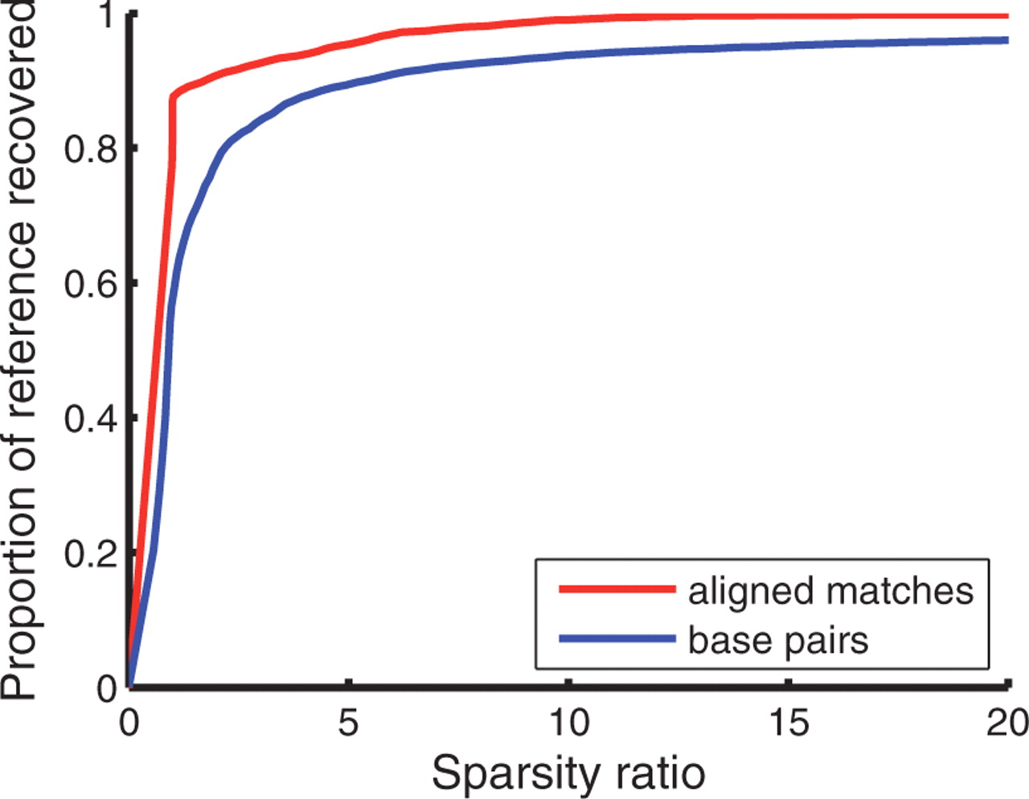
Fig. 2. Trade-off between sparsity factor and proportion of reference base-pairings or aligned matches covered when ...
Notes:
Fig. 2. Trade-off between sparsity factor and proportion of reference base-pairings or aligned matches covered when varying the cutoffs ɛpaired and ɛaligned. This graph was made using training set 𝒯3.
Unless provided in the caption above, the following copyright applies to the content of this slide: © 2008 The Author(s)This is an Open Access article distributed under the terms of the Creative Commons Attribution Non-Commercial License (http://creativecommons.org/licenses/by-nc/2.0/uk/) which permits unrestricted non-commercial use, distribution, and reproduction in any medium, provided the original work is properly cited.

