Slide 1
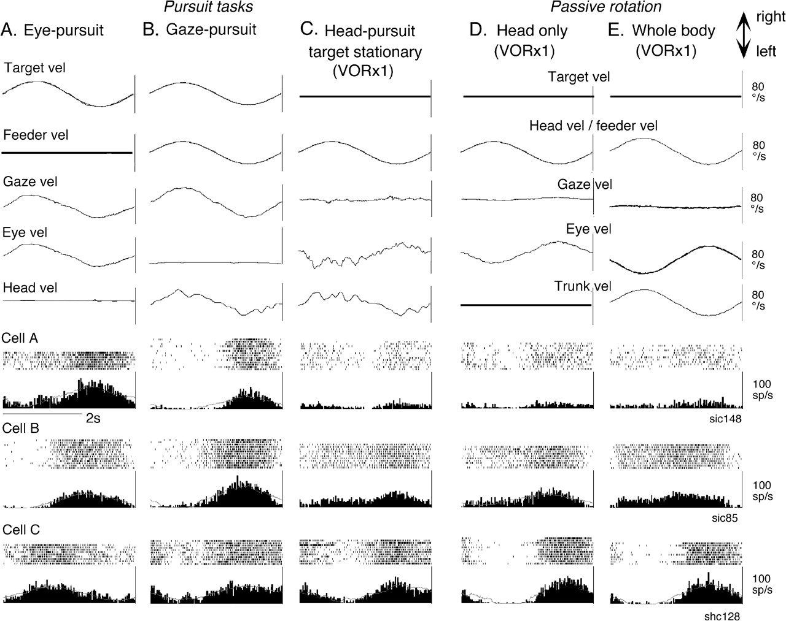
Figure 1. Representative discharge modulation of FEF pursuit neurons during different task conditions. Responses of 3 ...
Notes:
Figure 1. Representative discharge modulation of FEF pursuit neurons during different task conditions. Responses of 3 representative neurons (cells A–C) are shown during eye-pursuit (A), gaze-pursuit (B), head-pursuit (target stationary in space, C), passive head rotation on the stationary trunk (D) and passive whole-body rotation (E). In (D) and (E), a target was stationary in space. Five analog traces (top to bottom) in (A–C) are averaged traces for target-velocity (vel), feeder velocity, gaze-velocity, eye-velocity, and head-velocity. Analog traces in (D) and (E) are as indicated. Two traces for cell responses in (A–E) are raster and histograms of cell discharge.
Unless provided in the caption above, the following copyright applies to the content of this slide: © 2008 The AuthorsThis is an Open Access article distributed under the terms of the Creative Commons Attribution Non-Commercial License (http://creativecommons.org/licenses/by-nc/2.0/uk/) which permits unrestricted non-commercial use, distribution, and reproduction in any medium, provided the original work is properly cited.

Slide 2
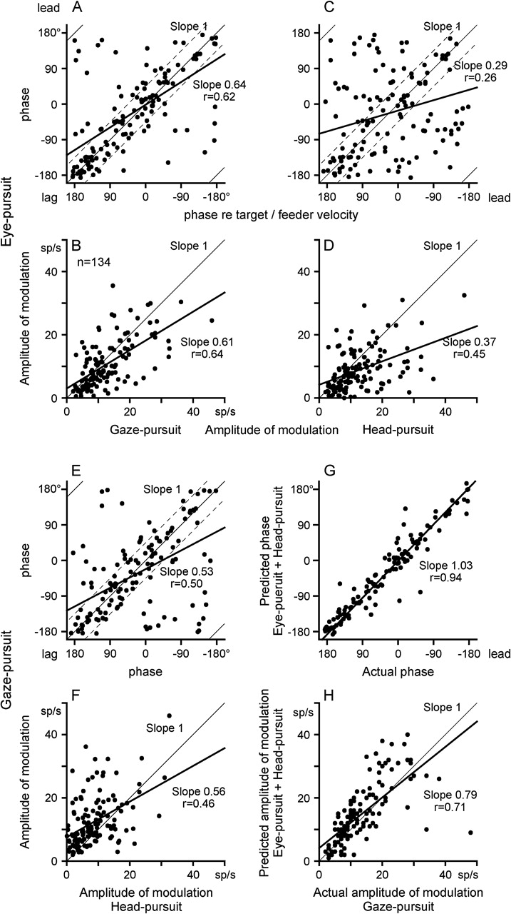
Figure 2. Comparison of discharge modulation during eye-pursuit, gaze-pursuit and head-pursuit. Response phase shifts ...
Notes:
Figure 2. Comparison of discharge modulation during eye-pursuit, gaze-pursuit and head-pursuit. Response phase shifts (relative to target/feeder velocity) and amplitude of modulation of FEF pursuit neuron discharge are plotted during eye-pursuit, gaze-pursuit and head-pursuit (target stationary in space). (A and B) Plot response phase and amplitude of modulation during eye-pursuit against those during gaze-pursuit with linear regressions (thick lines). (C and D) Plot response phase and amplitude of modulation during eye-pursuit against those during head-pursuit (target stationary in space) with linear regressions (thick lines). (E and F) Plot response phase and amplitude of modulation during gaze-pursuit against those during head-pursuit (target stationary in space) with linear regressions (thick lines). (G and H) Plot predicted phase and amplitude of modulation that were calculated by linear addition of modulation during eye-pursuit and head-pursuit against actual modulation during gaze-pursuit. Thin lines in (A–F) and (H) are slope one lines. In (A), (C), and (E), ±45° ranges are indicated by dashed lines. See text for further explanation.
Unless provided in the caption above, the following copyright applies to the content of this slide: © 2008 The AuthorsThis is an Open Access article distributed under the terms of the Creative Commons Attribution Non-Commercial License (http://creativecommons.org/licenses/by-nc/2.0/uk/) which permits unrestricted non-commercial use, distribution, and reproduction in any medium, provided the original work is properly cited.

Slide 3
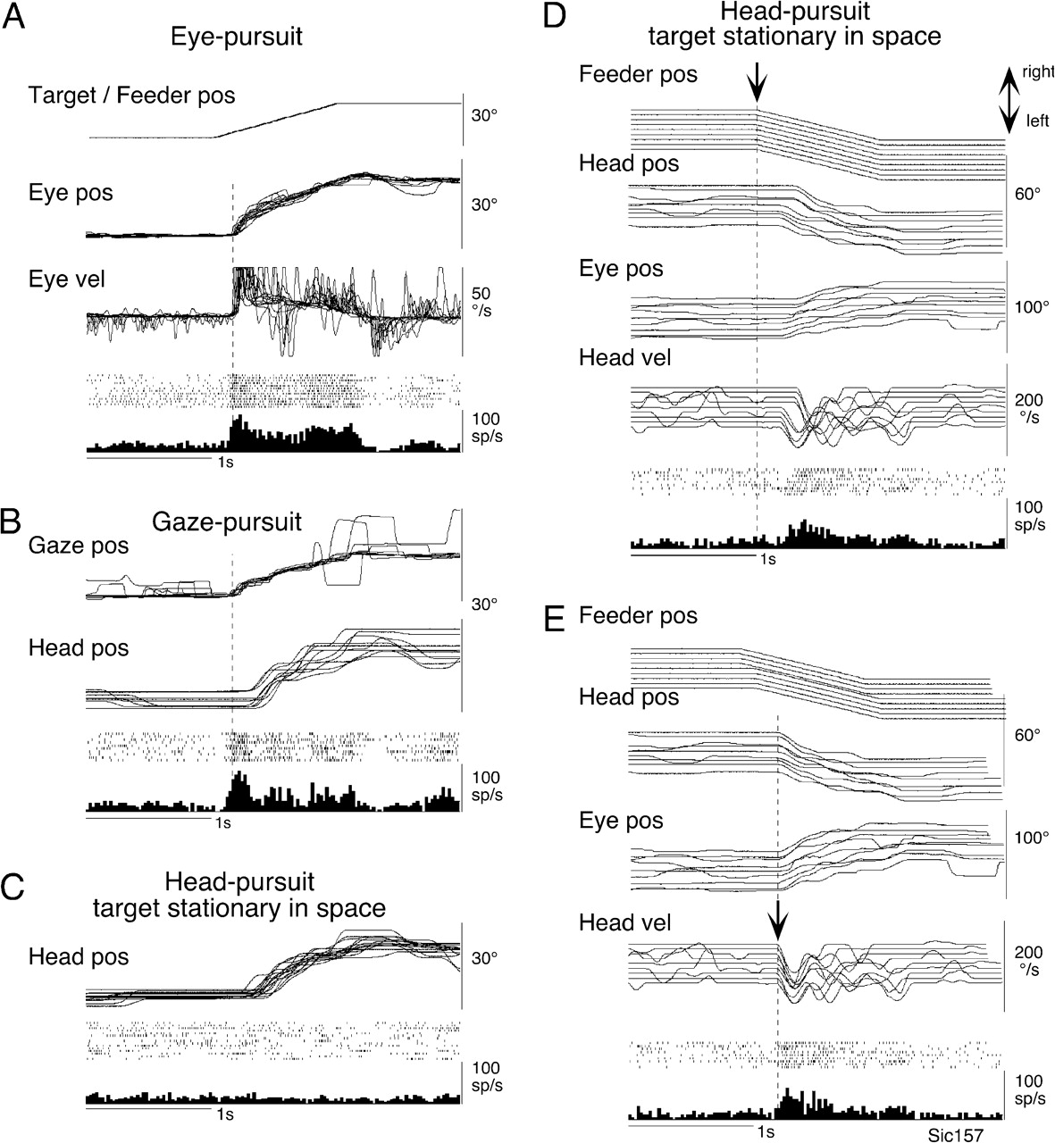
Figure 3. Head-pursuit–related modulation of a representative FEF pursuit neuron. (A–C) Discharge modulation aligned ...
Notes:
Figure 3. Head-pursuit–related modulation of a representative FEF pursuit neuron. (A–C) Discharge modulation aligned with the onset of rightward target and/or feeder motion during eye-pursuit, gaze-pursuit, and head-pursuit (target stationary in space), respectively. Analog traces were superimposed. Traces in (D) and (E) were aligned with the onset of leftward feeder motion (D, arrow) and with the onset of leftward head movements (E, arrow) during head-pursuit (target stationary in space). Pos and vel indicate position and velocity, respectively.
Unless provided in the caption above, the following copyright applies to the content of this slide: © 2008 The AuthorsThis is an Open Access article distributed under the terms of the Creative Commons Attribution Non-Commercial License (http://creativecommons.org/licenses/by-nc/2.0/uk/) which permits unrestricted non-commercial use, distribution, and reproduction in any medium, provided the original work is properly cited.

Slide 4
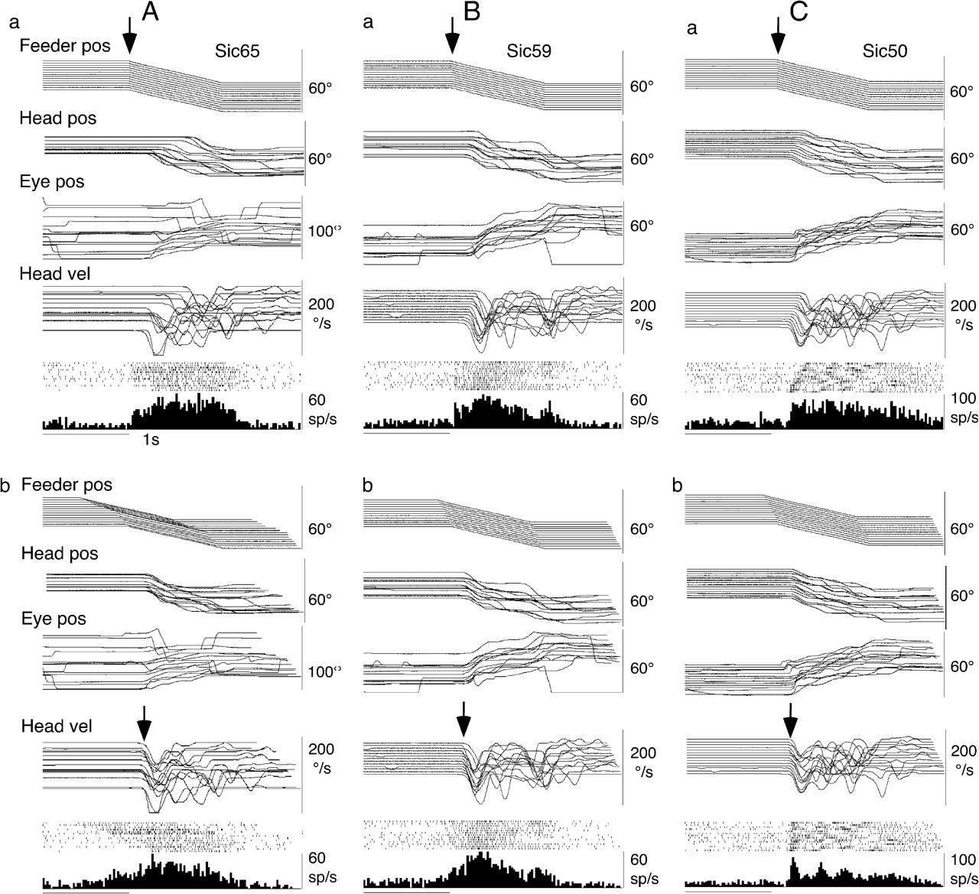
Figure 4. Head-pursuit–related discharge modulation of representative FEF pursuit neurons. (A–C) Three different ...
Notes:
Figure 4. Head-pursuit–related discharge modulation of representative FEF pursuit neurons. (A–C) Three different neurons during head-pursuit (target stationary in space). Traces were aligned with the onset of feeder motion (a, arrow) and the onset of head movements (b, arrow). Other conventions are as in Figure 3.
Unless provided in the caption above, the following copyright applies to the content of this slide: © 2008 The AuthorsThis is an Open Access article distributed under the terms of the Creative Commons Attribution Non-Commercial License (http://creativecommons.org/licenses/by-nc/2.0/uk/) which permits unrestricted non-commercial use, distribution, and reproduction in any medium, provided the original work is properly cited.

Slide 5
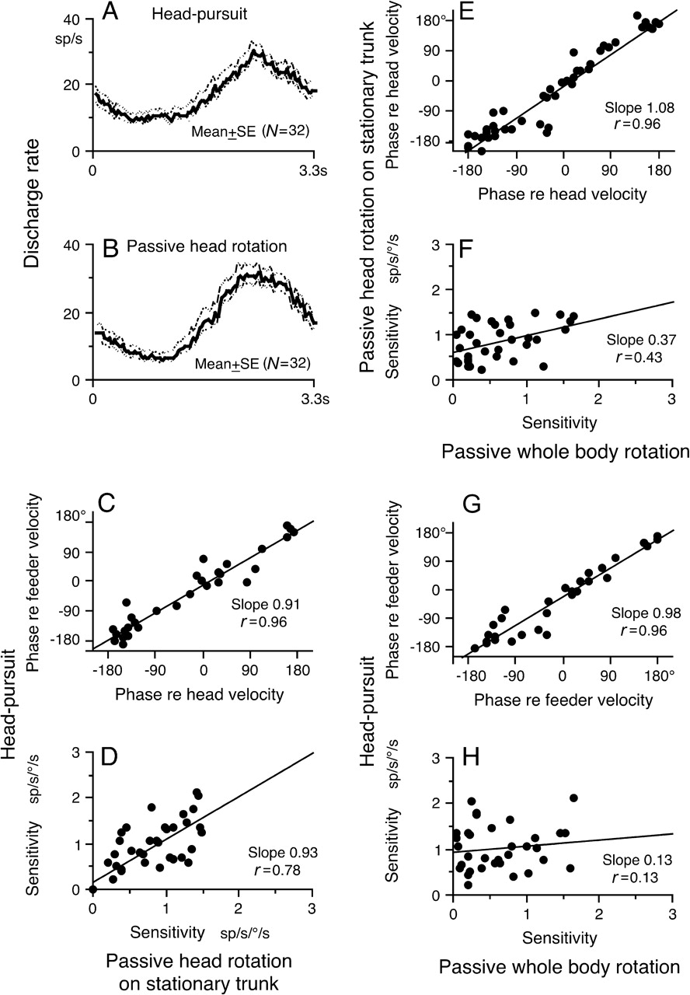
Figure 5. Correlation of discharge modulation during head-pursuit, passive head rotation on the stationary trunk and ...
Notes:
Figure 5. Correlation of discharge modulation during head-pursuit, passive head rotation on the stationary trunk and passive whole-body rotation. (A and B) Population response (mean ± SE) of 32 FEF pursuit neurons during head-pursuit (A) and passive head rotation on the stationary trunk (B). (C and D) Plot response phase shifts (relative to stimulus velocity) and sensitivity of FEF pursuit neurons during head-pursuit (target stationary in space) against those during passive head rotation on the stationary trunk with linear regressions. (E and F) Plot response phase shifts (relative to stimulus velocity) and sensitivity of FEF pursuit neurons during passive head rotation on the stationary trunk (target stationary in space) against those during passive whole-body rotation with linear regressions. (G and H) Plot response phase shifts (relative to stimulus velocity) and sensitivity of FEF pursuit neurons during head-pursuit (target stationary in space) against those during passive whole-body rotation with linear regressions. (D and H) Sensitivity during head-pursuit was corrected for lower head-velocity gains present while recording discharge of individual neurons. See text for further explanation.
Unless provided in the caption above, the following copyright applies to the content of this slide: © 2008 The AuthorsThis is an Open Access article distributed under the terms of the Creative Commons Attribution Non-Commercial License (http://creativecommons.org/licenses/by-nc/2.0/uk/) which permits unrestricted non-commercial use, distribution, and reproduction in any medium, provided the original work is properly cited.

Slide 6
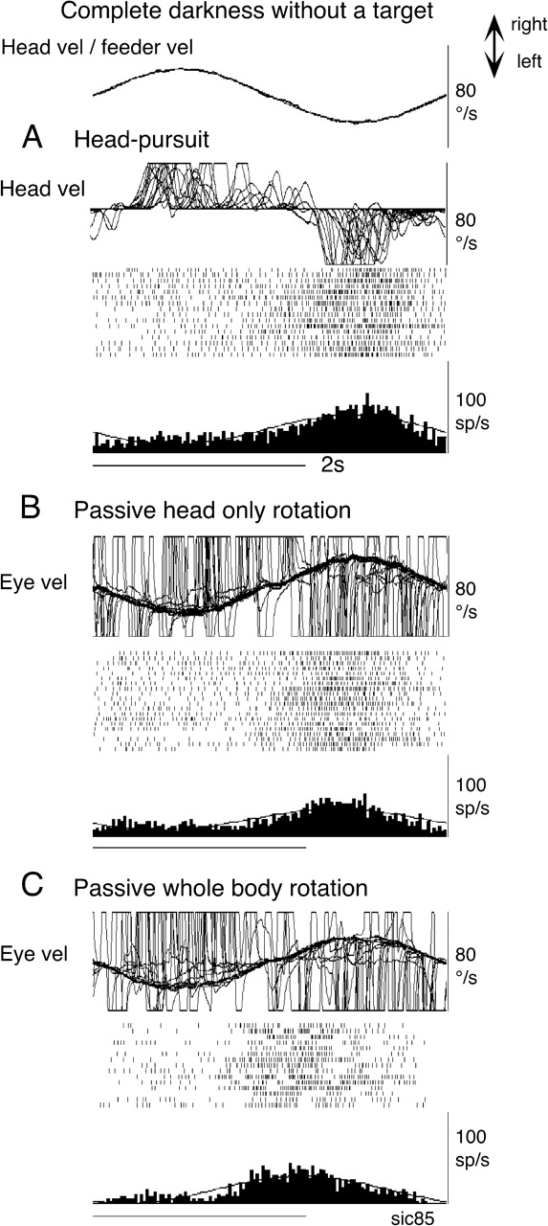
Figure 6. Discharge of a single neuron during head movement in complete darkness. This neuron is the same neuron shown ...
Notes:
Figure 6. Discharge of a single neuron during head movement in complete darkness. This neuron is the same neuron shown in Figure 1 (cell B). All traces were superimposed during head-pursuit (A), passive head-only rotation (B) and passive whole-body rotation (C) without a target stationary in space. Head-velocity (vel) and eye-velocity were clipped.
Unless provided in the caption above, the following copyright applies to the content of this slide: © 2008 The AuthorsThis is an Open Access article distributed under the terms of the Creative Commons Attribution Non-Commercial License (http://creativecommons.org/licenses/by-nc/2.0/uk/) which permits unrestricted non-commercial use, distribution, and reproduction in any medium, provided the original work is properly cited.

Slide 7
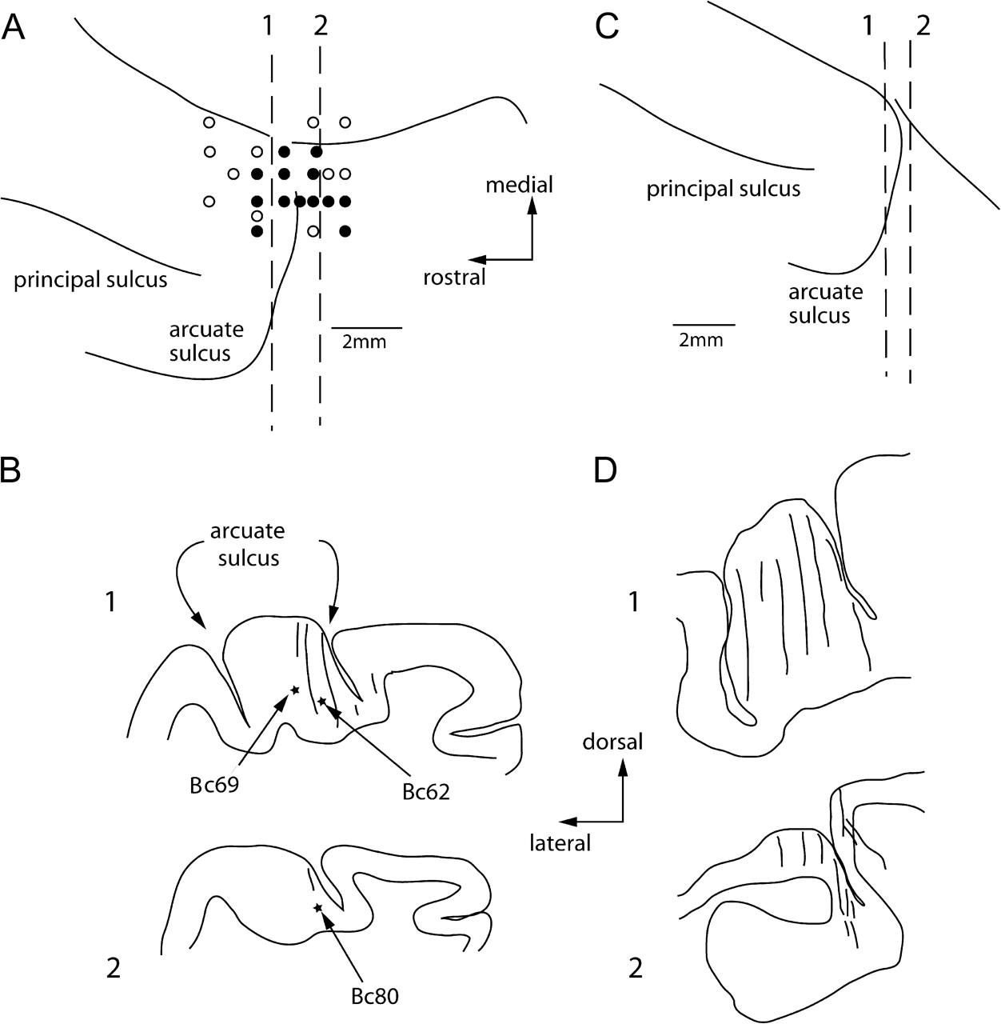
Figure 7. Recording locations. (A and C) Top views of the left frontal cortex of 2 monkeys. Filled circles and open ...
Notes:
Figure 7. Recording locations. (A and C) Top views of the left frontal cortex of 2 monkeys. Filled circles and open circles indicate locations of responsive neurons and unresponsive neurons during the pursuit tasks, respectively. (B and D) Transverse sections (1, 2) of representative recording tracks indicated in A (1, 2) and C (1, 2), respectively. Responding neurons were recorded mostly in the fundus of the arcuate sulcus in B1, D1, and D2. B2 is a section through the posterior bank. Two asterisks in A1 are locations of neurons that responded like those shown in Figure 1 (cells A and B). The asterisk in A2 is location of a neuron that exhibited modulation during gaze-pursuit and head-pursuit (target stationary in space) but not during eye-pursuit.
Unless provided in the caption above, the following copyright applies to the content of this slide: © 2008 The AuthorsThis is an Open Access article distributed under the terms of the Creative Commons Attribution Non-Commercial License (http://creativecommons.org/licenses/by-nc/2.0/uk/) which permits unrestricted non-commercial use, distribution, and reproduction in any medium, provided the original work is properly cited.

