Slide 1
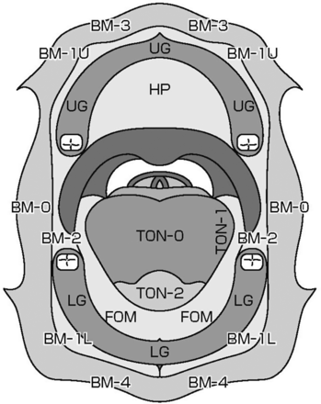
Figure. 1. Anatomical sites and subsites of the oral cavity.
Notes:
Figure. 1. Anatomical sites and subsites of the oral cavity.
Unless provided in the caption above, the following copyright applies to the content of this slide: © The Author 2012. Published by Oxford University Press. All rights reserved. For Permissions, please email: journals.permissions@oup.com

Slide 2
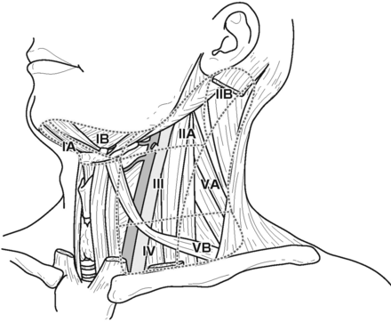
Figure. 2. Level classification of the cervical lymph nodes.
Notes:
Figure. 2. Level classification of the cervical lymph nodes.
Unless provided in the caption above, the following copyright applies to the content of this slide: © The Author 2012. Published by Oxford University Press. All rights reserved. For Permissions, please email: journals.permissions@oup.com

