Slide 1
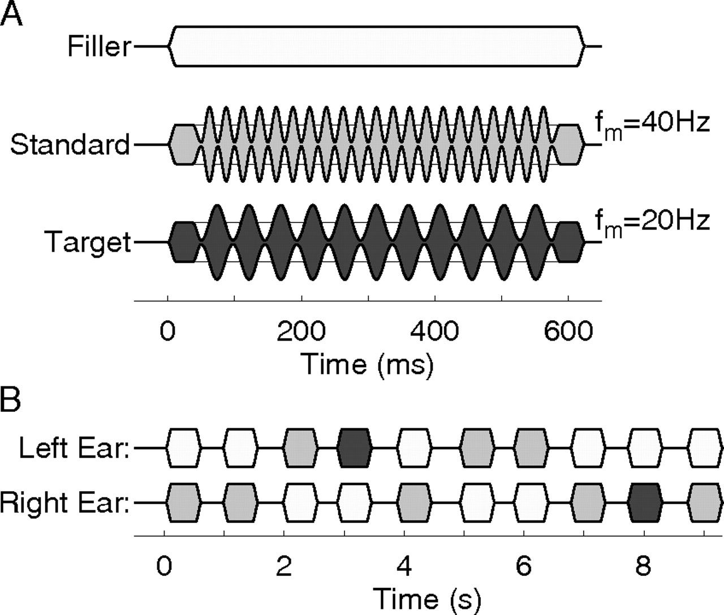
Figure 1. A) Auditory stimuli were AM tones with modulation frequency of 40 Hz (standard stimulus, middle gray shaded) ...
Notes:
Figure 1. A) Auditory stimuli were AM tones with modulation frequency of 40 Hz (standard stimulus, middle gray shaded) and 20 Hz (deviant, dark gray shaded), respectively, and pure tones of same duration of 600 ms (filler, light gray shaded). Note that the sound onset was identical for all stimuli, and the onset of AM was delayed by 40 ms. (B) Sequences of AM tones were presented in random order to the left or right ear. Pure tones were presented to the contralateral ear in order to minimize bottom-up attention switching between ears. Thus, continuous streams of sound appeared simultaneously in both ears. The carrier frequencies of the sounds were 400 and 700 Hz for one and the other ear, and the order was randomized between experimental blocks.
Unless provided in the caption above, the following copyright applies to the content of this slide: © The Author 2009. Published by Oxford University Press. All rights reserved. For permissions, please e-mail: journals.permissions@oxfordjournals.org

Slide 2
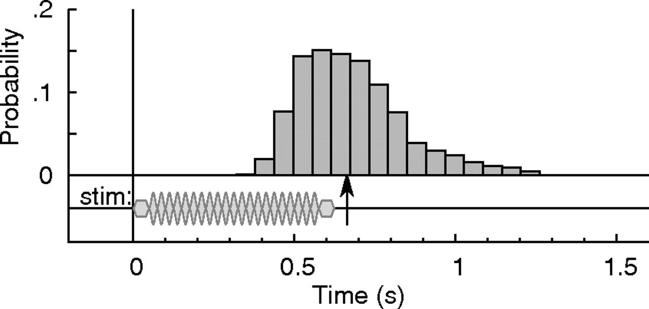
Figure 2. Histogram of reaction times with respect to the time course of the stimulus. The median reaction time was 663 ...
Notes:
Figure 2. Histogram of reaction times with respect to the time course of the stimulus. The median reaction time was 663 ms as indicated by the arrow.
Unless provided in the caption above, the following copyright applies to the content of this slide: © The Author 2009. Published by Oxford University Press. All rights reserved. For permissions, please e-mail: journals.permissions@oxfordjournals.org

Slide 3
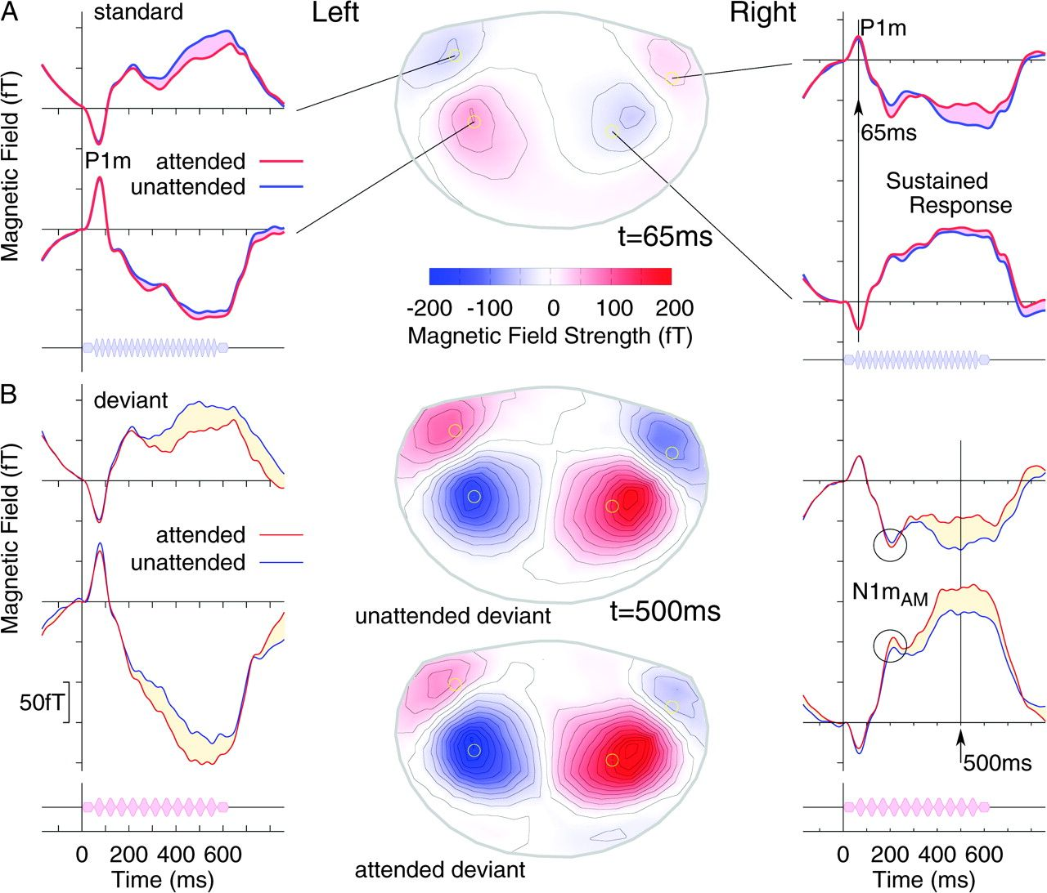
Figure 3. Grand-averaged AEFs. (A) Waveforms of responses to attended and unattended standard stimuli observed at MEG ...
Notes:
Figure 3. Grand-averaged AEFs. (A) Waveforms of responses to attended and unattended standard stimuli observed at MEG sensors close to the magnetic field maxima over the left and right temporal cortex and projection of the magnetic field map at the latency of the P1m peak (65 ms). The pink-shaded areas represent the effect of attention on the response waveforms to standard stimuli. The map of magnetic field distribution above the head is shown at 65-ms latency. The contour lines represent field changes of 25 fT. (B) Waveforms of responses to deviant stimuli at same MEG sensors and magnetic field maps at latency of maximal sustained response (500 ms). The beige-shaded area between waveforms indicates the effect of attention on the targets. The modulation of magnetic field strength by attention is expressed as increase above posterior and decrease above anterior areas. The waveforms of right-hemispheric responses show a peak of opposite polarity compared with P1m at latency around 200 ms. This peak most likely reflects the onset of AM in the stimulus and has been labeled N1mAM.
Unless provided in the caption above, the following copyright applies to the content of this slide: © The Author 2009. Published by Oxford University Press. All rights reserved. For permissions, please e-mail: journals.permissions@oxfordjournals.org

Slide 4
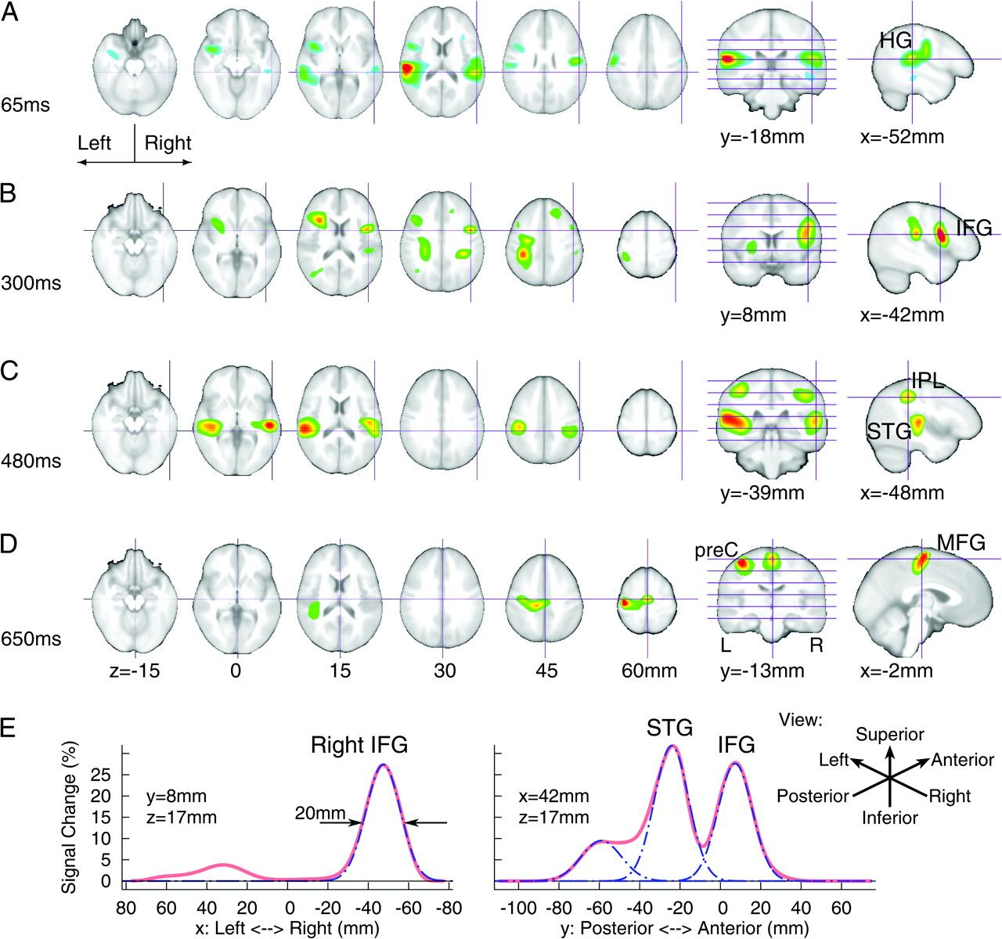
Figure 4. Overlay of maps of MEG source activity to a group-averaged MRI template. The threshold for the MEG maps was ...
Notes:
Figure 4. Overlay of maps of MEG source activity to a group-averaged MRI template. The threshold for the MEG maps was set to 70% of the peak value. The amount of activation over time is shown in Figure 5. (A) Amount of MEG source activity at the latency of the P1m response (65 ms) shows local maxima in bilateral HG, the location of primary auditory cortices. (B) Differences between MEG responses to attended and unattended standard stimuli shows local maxima in IFG at 300 ms and (C) at 400 ms posterior to HG in bilateral STG and IPL. (D) Differences in MEG responses to attended and unattended deviants in MFG, location of SMAs, and the precentral (preC) sulcus in the left hemisphere, contralateral to the right-hand button press at the median latency of the subject's response. (E) Profile of cortical source activity along the x-axis and y-axis for the right IFG source. The activity profiles have been approximated by Gaussian functions (blue dashed lines) of 12 mm standard deviation, equivalent to the width of 20 mm at half intensity. The Gaussian kernel approximated to the IFG activity does not contribute to the activity at the STG peak and vice versa, indicating good spatial separation of activities in IFG and STG.
Unless provided in the caption above, the following copyright applies to the content of this slide: © The Author 2009. Published by Oxford University Press. All rights reserved. For permissions, please e-mail: journals.permissions@oxfordjournals.org

Slide 5
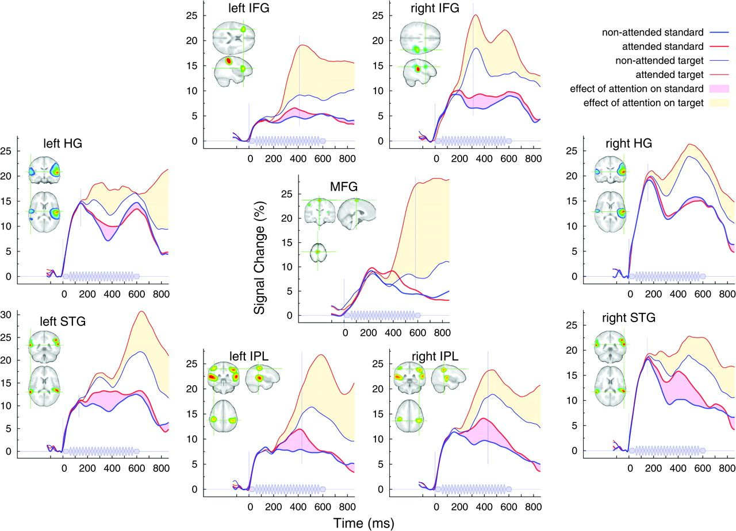
Figure 5. Waveforms of source activity at selected ROIs in response to standard and deviant stimuli under attention to ...
Notes:
Figure 5. Waveforms of source activity at selected ROIs in response to standard and deviant stimuli under attention to the stimulated ear or the contralateral side, respectively. The vertical axis represents the size of the event-related source activity in percentage of the standard deviation of the intrinsic brain activity at the location of interest. The colored areas between lines indicate the effect of attention on the standard and deviant responses. The first vertical line at time zero indicates the stimulus onset and the second vertical line the time point for the source activity maps overlaid on the MRI shown in the inserts. Common observation for all sources was that responses to both standard and deviant sounds increased under attention. Responses to deviant sounds were larger than those to standards, and this was even the case for unattended stimuli.
Unless provided in the caption above, the following copyright applies to the content of this slide: © The Author 2009. Published by Oxford University Press. All rights reserved. For permissions, please e-mail: journals.permissions@oxfordjournals.org

Slide 6
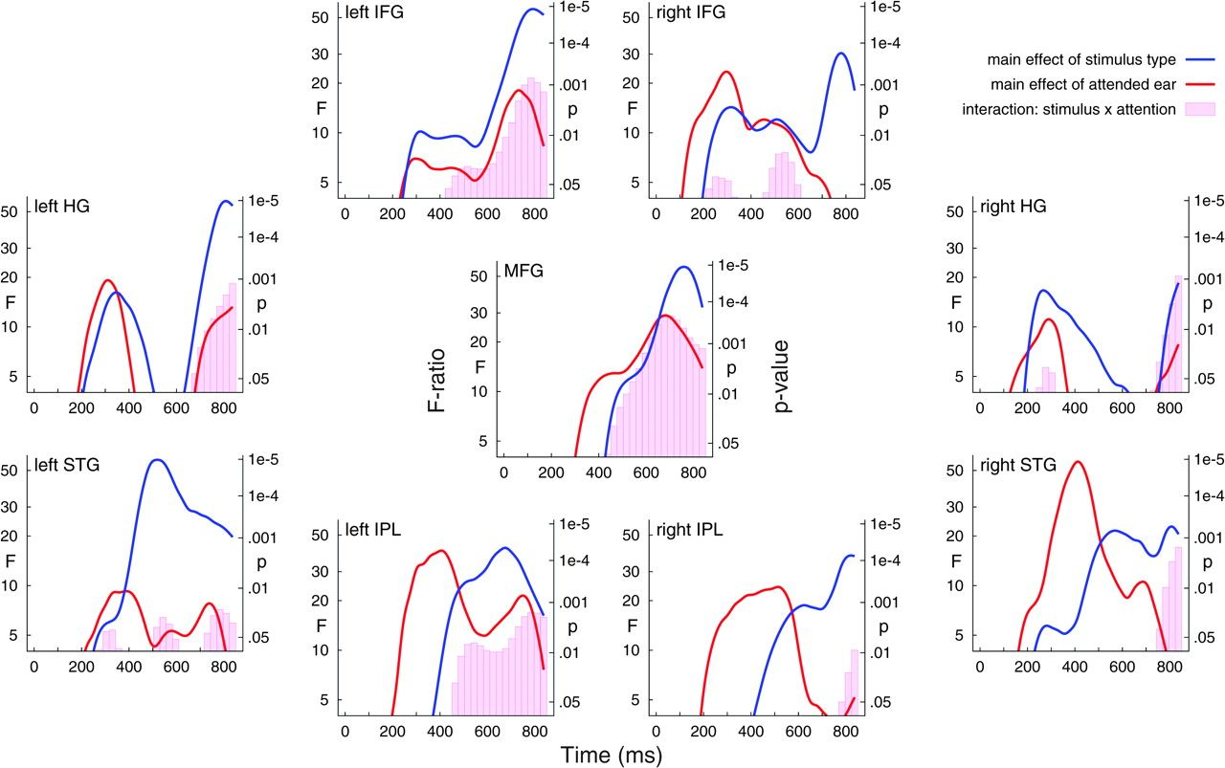
Figure 6. Time series of the main effects of attention, stimulus type, and the interaction between attention and ...
Notes:
Figure 6. Time series of the main effects of attention, stimulus type, and the interaction between attention and stimulus type as revealed by repeated measures ANOVA for the selected cortical sources.
Unless provided in the caption above, the following copyright applies to the content of this slide: © The Author 2009. Published by Oxford University Press. All rights reserved. For permissions, please e-mail: journals.permissions@oxfordjournals.org

Slide 7
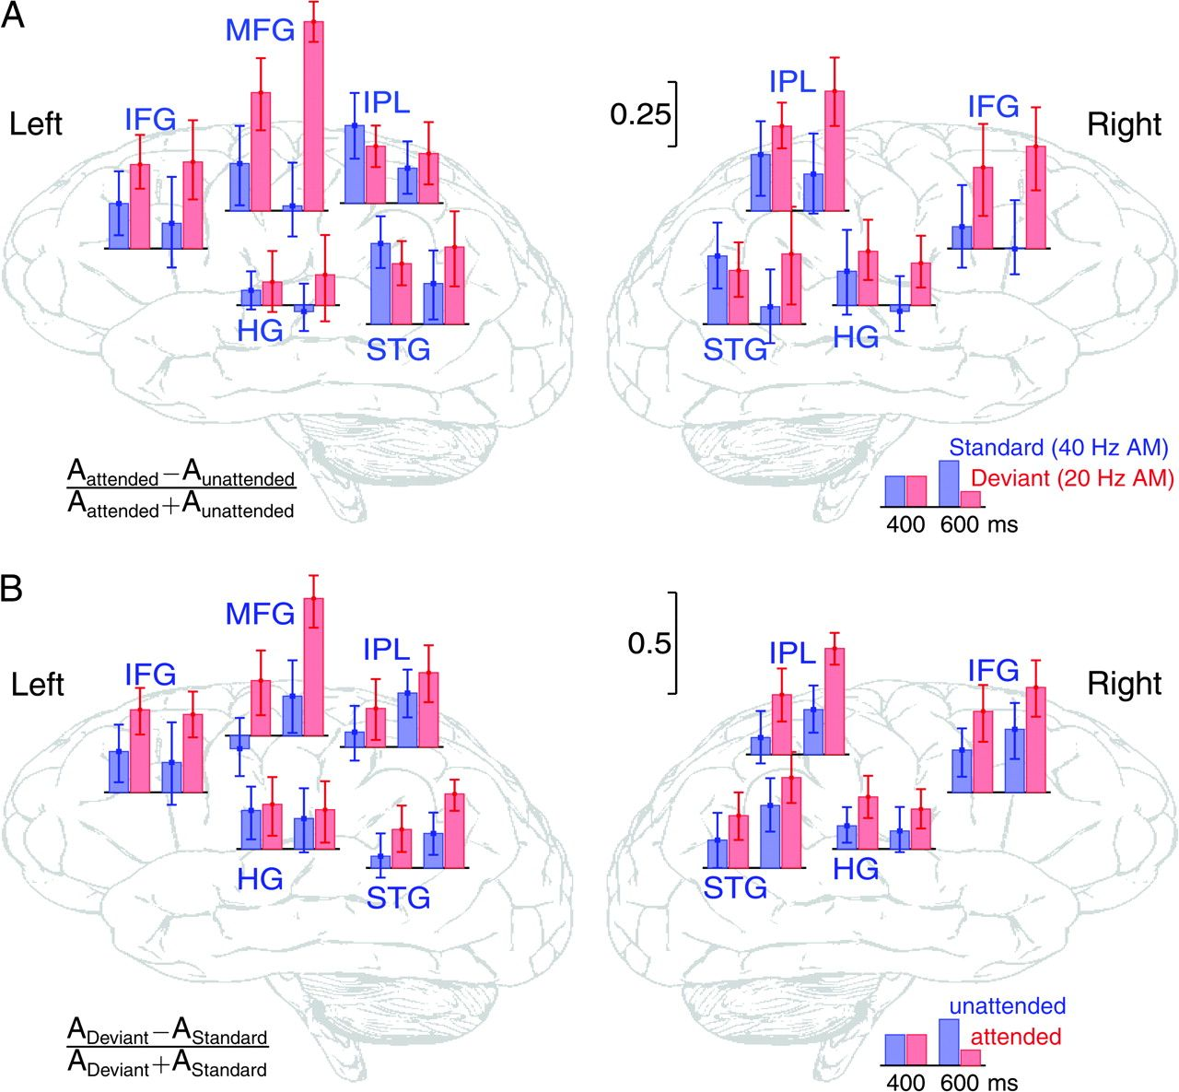
Figure 7. Summary of top-down and bottom-up attention effects on cortical source activity at 400- and 600-ms latency. ...
Notes:
Figure 7. Summary of top-down and bottom-up attention effects on cortical source activity at 400- and 600-ms latency. (A) The bar graphs indicate normalized measures of the effect of directed attention on the response observed with standard and deviant stimuli in specific cortical areas. The effect of attention increases over the 200-ms time interval for the deviants, whereas it decreases for the standards, indicating a process of stimulus selection in favor of the attended targets. (B) The bar graphs indicate normalized measures of the effect of the stimulus type under attended and unattended conditions. Deviant stimuli evoked in general larger responses, and this effect increased under attention in the time interval between 400 and 600 ms. However, responses to unattended deviants increased over the 200-ms interval also, indicating concomitant bottom-up effects. Error bars denote the 95% confidence limits for the effects of attention and stimulus type.
Unless provided in the caption above, the following copyright applies to the content of this slide: © The Author 2009. Published by Oxford University Press. All rights reserved. For permissions, please e-mail: journals.permissions@oxfordjournals.org

