Slide 1
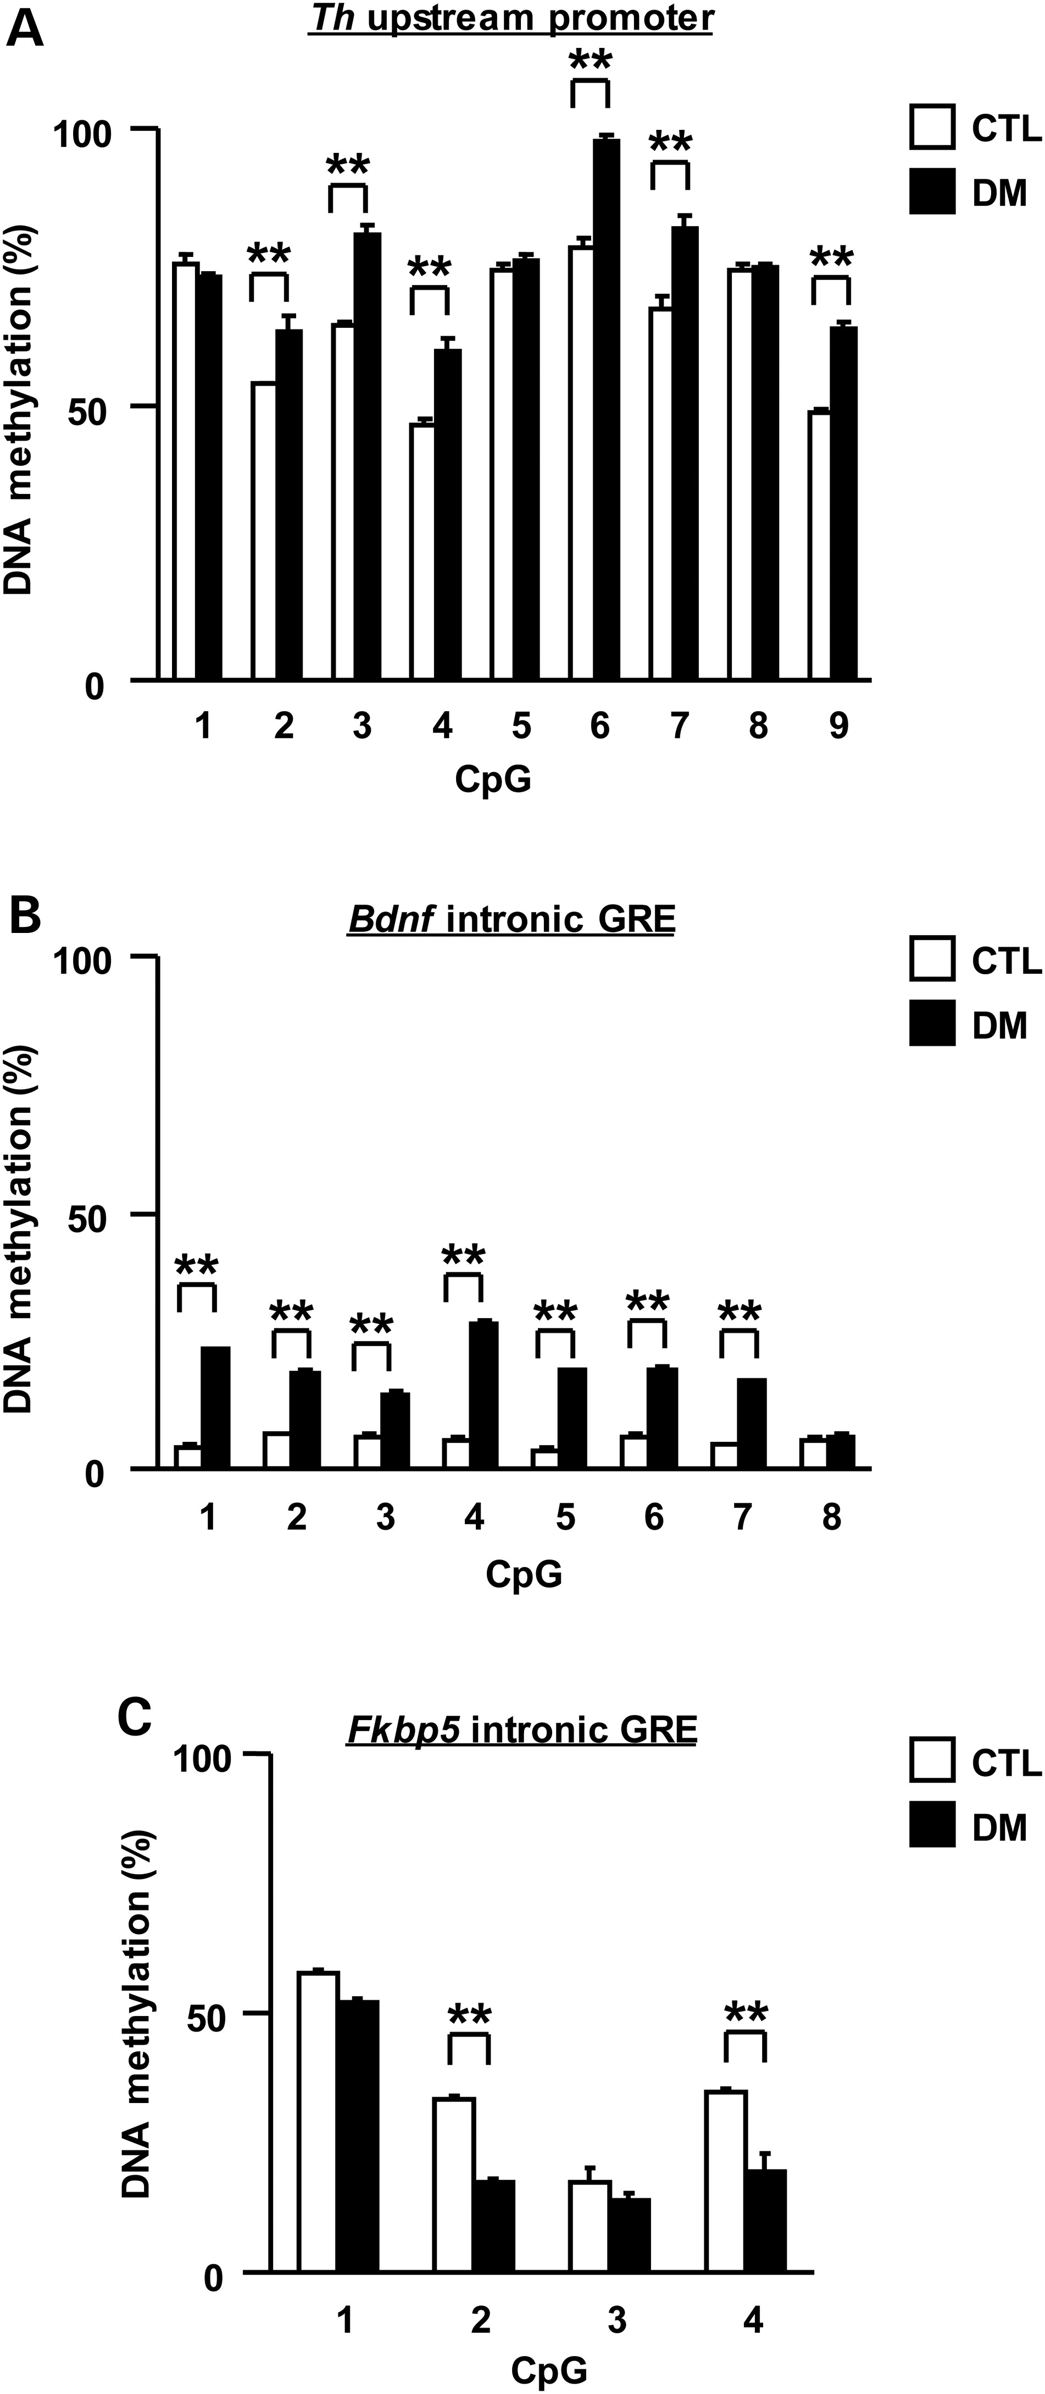
Figure 1. Influence of adolescent isolation on epigenetic modifications of the Th, Bdnf and Fkbp5 genes in VTA neurons ...
Notes:
Figure 1. Influence of adolescent isolation on epigenetic modifications of the Th, Bdnf and Fkbp5 genes in VTA neurons that project to the frontal cortex between CTL and DM. (A) DNA methylation in the promoter of Th. (B) DNA methylation in the intronic GRE of Bdnf. (C) DNA methylation in the intronic GRE of Fkbp5. CTL, wild-type mice without isolation. DM, DISC1 mutant exposed to 3-week isolation. N = 3. Each sample was pooled from five males. Values are means ± SEM. Statistical differences were detected using two-way ANOVA with repeated measures (group, F(1,4) = 52.34, P< 0.01 for A; F(1,4) = 444.3, P< 0.01 for B; F(1,4) = 53.24, P< 0.01 for C), followed by Bonferroni post hoc tests (**P< 0.01).
Unless provided in the caption above, the following copyright applies to the content of this slide: © The Author 2016. Published by Oxford University Press. All rights reserved. For Permissions, please email: journals.permissions@oup.com

Slide 2
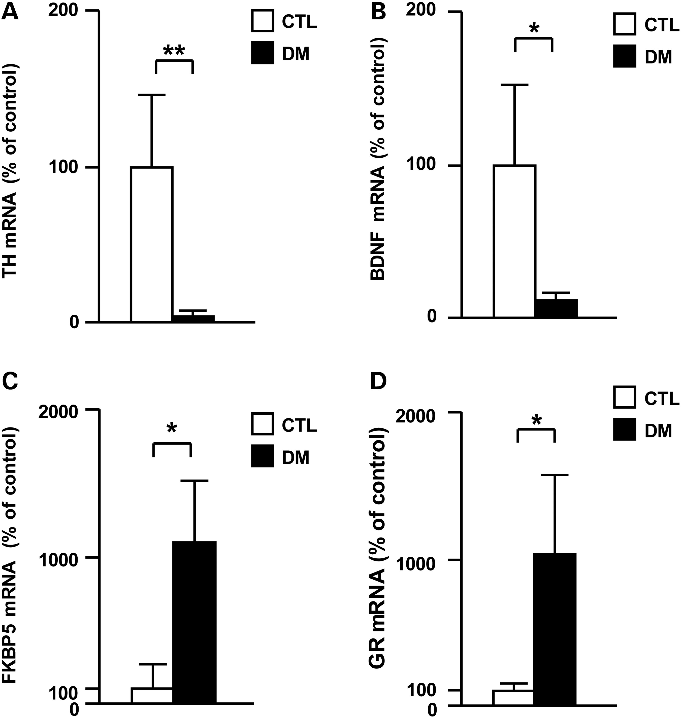
Figure 2. Influence of adolescent isolation on mRNA expression of Th, Bdnf, Fkbp5 and GR genes in VTA neurons that ...
Notes:
Figure 2. Influence of adolescent isolation on mRNA expression of Th, Bdnf, Fkbp5 and GR genes in VTA neurons that project to the frontal cortex between CTL and DM. (A) Expression levels of Th mRNA. (B) Expression levels of Bdnf mRNA. (C) Expression levels of Fkbp5 mRNA. (D) Expression levels of Gr mRNA. Expression levels of β-Actin were used as an internal control. N = 4–8. Each sample was pooled from five males. Values are means ± SEM. Statistical differences between two groups were analyzed with the t-test (**P< 0.01 and *P< 0.05).
Unless provided in the caption above, the following copyright applies to the content of this slide: © The Author 2016. Published by Oxford University Press. All rights reserved. For Permissions, please email: journals.permissions@oup.com

Slide 3
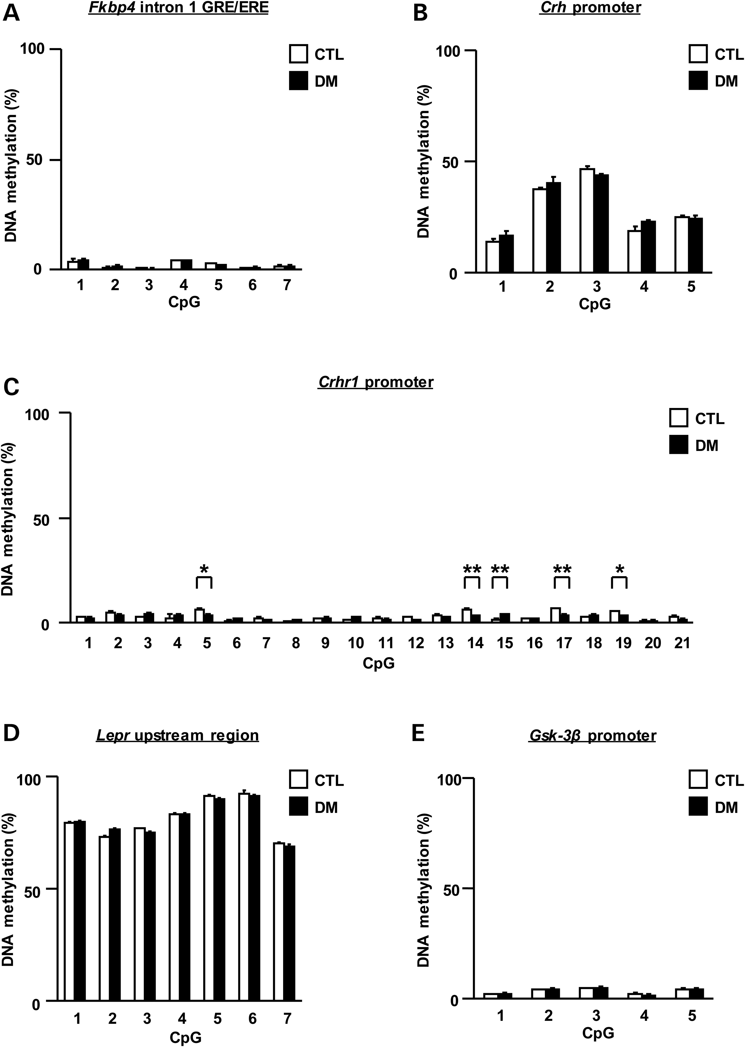
Figure 3. No influence of adolescent isolation on genes involved in the HPA-axis and other signaling pathways in VTA ...
Notes:
Figure 3. No influence of adolescent isolation on genes involved in the HPA-axis and other signaling pathways in VTA neurons that project to the frontal cortex between CTL and DM. (A) DNA methylation in the intronic GRE/ERE of Fkbp4. (B) DNA methylation in the promoter of Crh. (C) DNA methylation in the promoter of Crhr1. (D) DNA methylation in the upstream region of Lepr. (E) DNA methylation in the promoter of Gsk3β. N = 3. Each sample was pooled from five males. Values are means ± SEM. No statistical differences were detected using two-way ANOVA with repeated measures (group, F(1,4) = 0.04, P = 0.86 for A; F(1,4) = 1.21, P = 0.33 for B; F(1,4) = 44.73, P < 0.01 for C; F(1,4) = 0.69, P = 0.45 for D; F(1,4) = 0.00, P = 0.96 for E).
Unless provided in the caption above, the following copyright applies to the content of this slide: © The Author 2016. Published by Oxford University Press. All rights reserved. For Permissions, please email: journals.permissions@oup.com

Slide 4
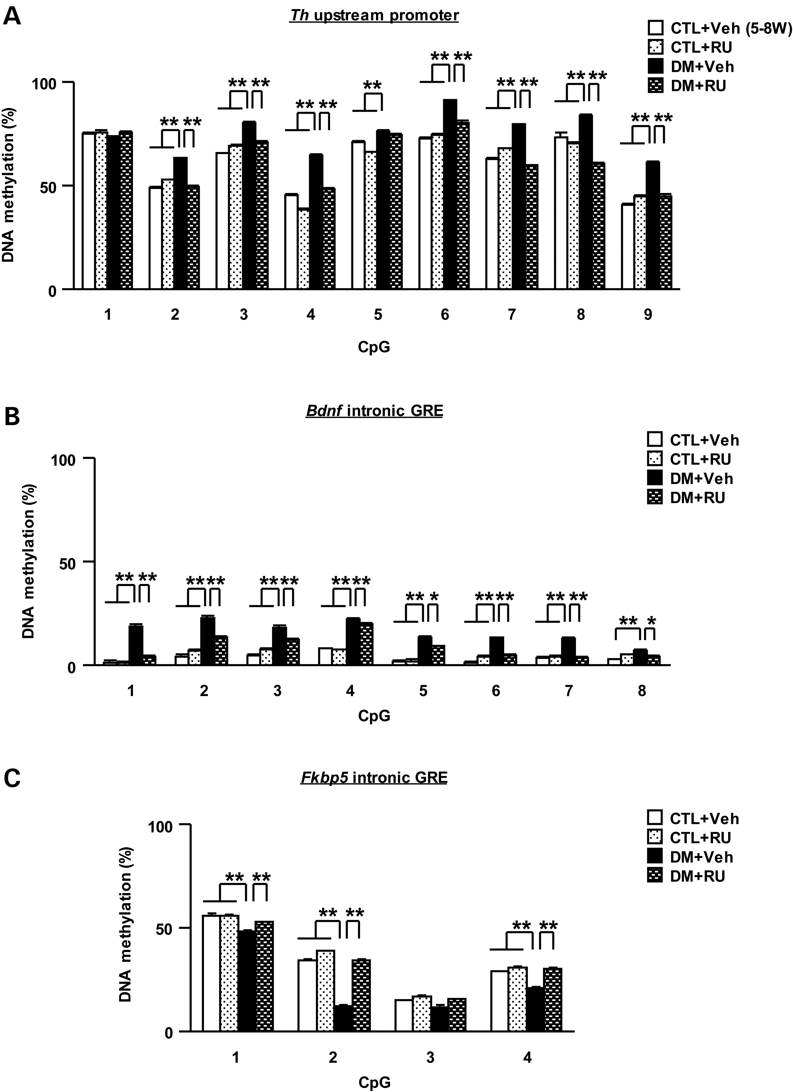
Figure 4. Influence of glucocorticoids from 5 to 8 weeks of age on epigenetic modifications of the Th, Bdnf and Fkbp5 ...
Notes:
Figure 4. Influence of glucocorticoids from 5 to 8 weeks of age on epigenetic modifications of the Th, Bdnf and Fkbp5 genes in the DM. (A) Effects of RU486 on increased DNA methylation in the promoter of Th. (B) Effects of RU486 on increased DNA methylation in the intronic GRE of Bdnf. (C) Effects of RU486 on decreased DNA methylation in the intronic GRE of Fkbp5. N = 3. Each sample was pooled from five males. Values are means ± SEM. Statistical differences were detected using three-way ANOVA with repeated measures (group × drug, F(1,8) = 1798.03, P< 0.01 for A; F(1,8) = 730.52, P< 0.01 for B; F(1,8) = 149.29, P< 0.01 for C) and two-way ANOVA (group × drug, F(1,8) = 0.68, P = 0.43 for CpG1 in A; F(1,8) = 685.10, P< 0.01 for CpG2 in A; F(1,8) = 183.80, P < 0.01 for CpG3 in A; F(1,8) = 125.80, P< 0.01 for CpG4 in A; F(1,8) = 15.55, P< 0.01 for CpG5 in A; F(1,8) = 104.00, P< 0.01 for CpG6 in A; F(1,8) = 1307.00, P< 0.01 for CpG7 in A; F(1,8) = 75.72, P< 0.01 for CpG8 in A; F(1,8) = 154.60, P< 0.01 for CpG9 in A; F(1,8) = 89.96, P< 0.01 for CpG1 in B; F(1,8) = 54.55, P< 0.01 for CpG2 in B; F(1,8) = 43.26, P< 0.01 for CpG3 in B; F(1,8) = 5.73, P< 0.05 for CpG4 in B; F(1,8) = 7.60, P< 0.05 for CpG5 in B; F(1,8) = 89.89, P< 0.01 for CpG6 in B; F(1,8) = 85.22, P< 0.01 for CpG7 in B; F(1,8) = 21.23, P< 0.01 for CpG8 in B; F(1,8) = 12.30, P< 0.01 for CpG1 in C; F(1,8) = 306.60, P< 0.01 for CpG2 in C; F(1,8) = 2.77, P = 0.13 for CpG3 in C; F(1,8) = 44.16, P< 0.01 for CpG4 in C), followed by Bonferroni post hoc tests (**P< 0.01 and *P< 0.05).
Unless provided in the caption above, the following copyright applies to the content of this slide: © The Author 2016. Published by Oxford University Press. All rights reserved. For Permissions, please email: journals.permissions@oup.com

Slide 5
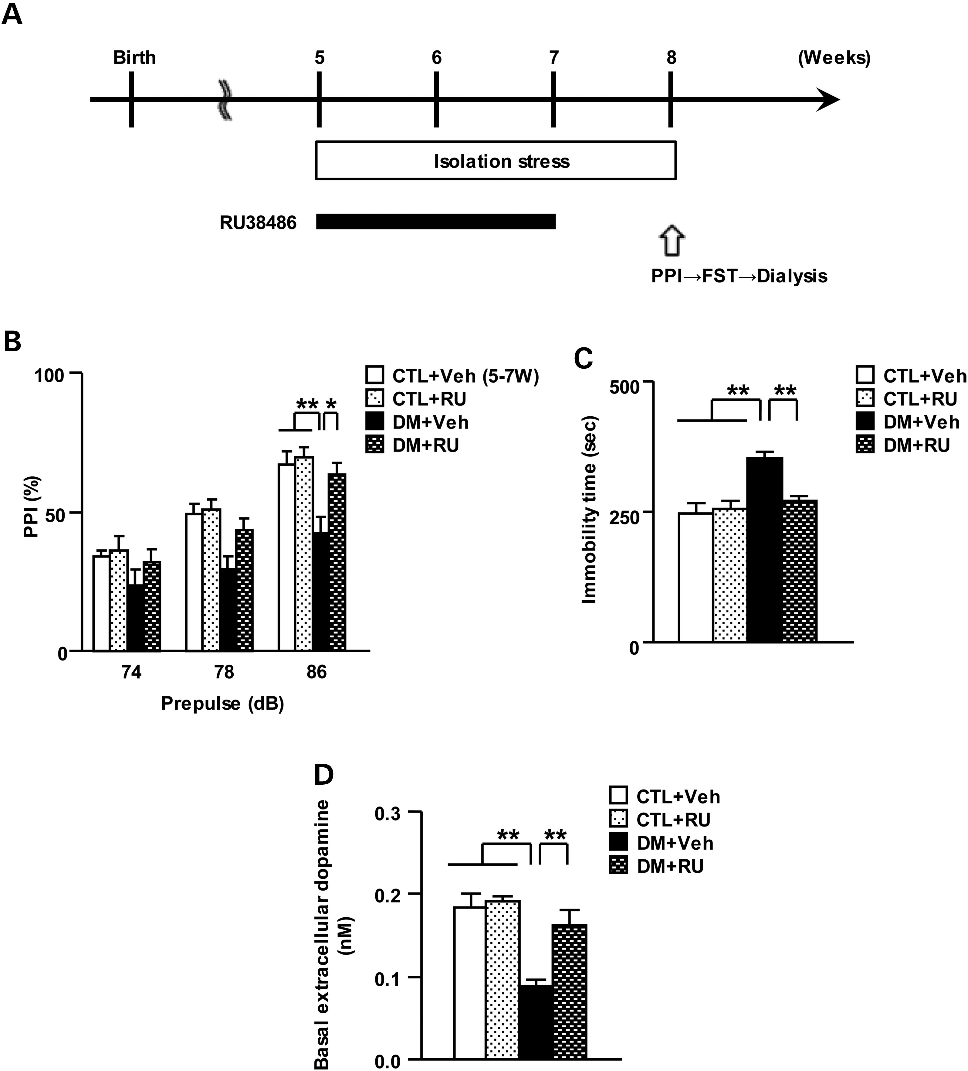
Figure 5. Influence of glucocorticoids from 5 to 7 weeks on behavioral and neurochemical abnormalities in the DM. (A) ...
Notes:
Figure 5. Influence of glucocorticoids from 5 to 7 weeks on behavioral and neurochemical abnormalities in the DM. (A) CTL and DM were treated with RU486 from 5 to 7 weeks of age. (B) Effects of RU486 on performance of prepulse inhibition. (C) Effects of RU486 on performance of the forced swim test. (D) Effects of RU486 on basal levels of extracellular dopamine in the frontal cortex. Veh, treated with vehicle; RU, treated with RU486. N = 11–13 for (B and C), N = 6 for (D). Values are means ± SEM. Statistical differences were determined using three-way ANOVA with repeated measures (group × drug, F(1,43) = 3.29, P= 0.08 for B), and two-way ANOVA (group × drug, F(1,43) = 0.42, P = 0.52 for prepulse 74 in B; F(1,43) = 2.19, P= 0.15 for prepulse 78 in B; F(1,43) = 4.08, P< 0.05 for prepulse 86 in B; F(1,43) = 8.37, P< 0.01 for C; F(1,20) = 5.88, P< 0.05 for D), followed by Bonferroni post hoc tests (**P< 0.01 and *P< 0.05).
Unless provided in the caption above, the following copyright applies to the content of this slide: © The Author 2016. Published by Oxford University Press. All rights reserved. For Permissions, please email: journals.permissions@oup.com

Slide 6
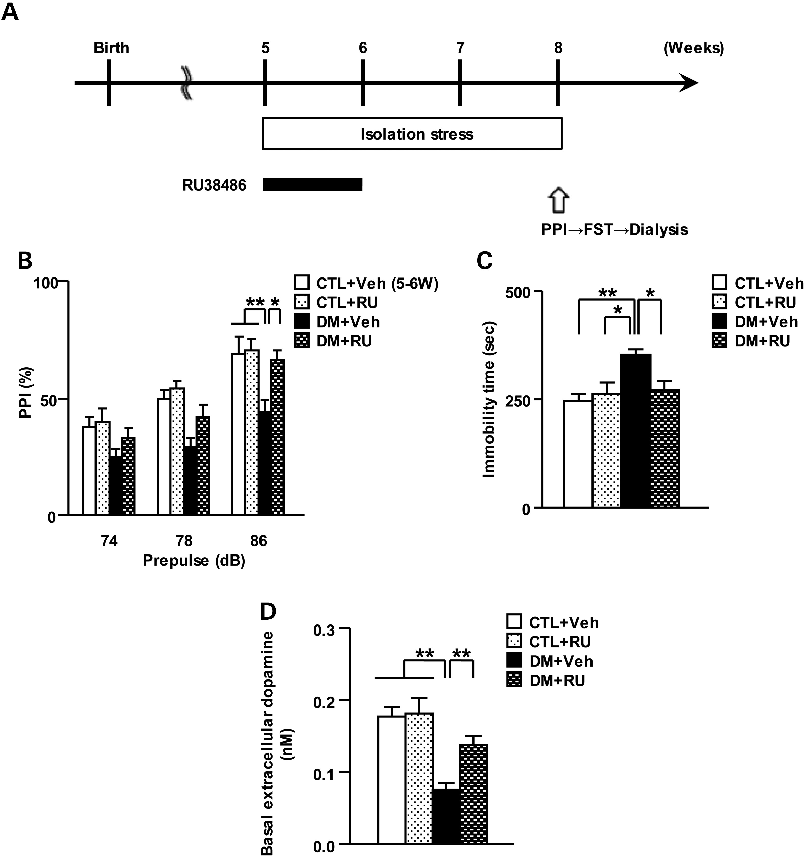
Figure 6. Influence of glucocorticoids from 5 to 6 weeks on behavioral and neurochemical abnormalities in the DM. (A) ...
Notes:
Figure 6. Influence of glucocorticoids from 5 to 6 weeks on behavioral and neurochemical abnormalities in the DM. (A) CTL and DM were treated with RU486 from 5 to 6 weeks of age. (B) Effects of RU486 on performance of prepulse inhibition. (C) Effects of RU486 on performance of the forced swim test. (D) Effects of RU486 on basal levels of extracellular dopamine in the frontal cortex. N = 11 for (B and C), N = 6–10 for (D). Values are means ± SEM. Statistical differences were determined using three-way ANOVA with repeated measures (group × drug, F(1,40) = 2.80, P= 0.10 for B), and two-way ANOVA (group × drug, F(1,40) = 0.48, P = 0.49 for prepulse 74 in B; F(1,40) = 0.91, P= 0.35 for prepulse 78 in B; F(1,40) = 4.25, P< 0.05 for prepulse 86 in B; F(1,40) = 6.70, P< 0.05 for C; F(1,24) = 6.14, P< 0.05 for D), followed by Bonferroni post hoc tests (**P< 0.01 and *P< 0.05).
Unless provided in the caption above, the following copyright applies to the content of this slide: © The Author 2016. Published by Oxford University Press. All rights reserved. For Permissions, please email: journals.permissions@oup.com

Slide 7
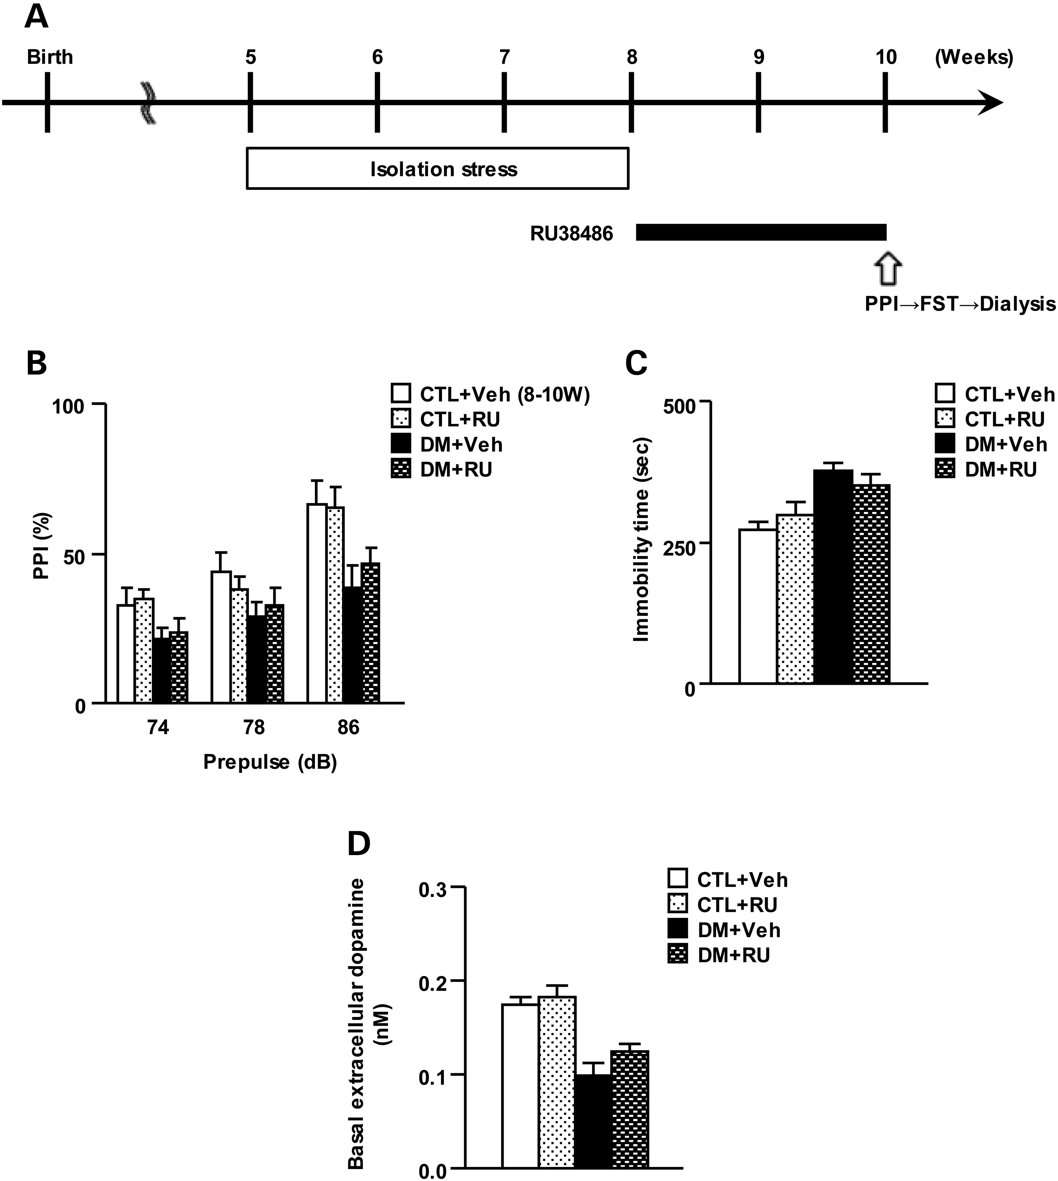
Figure 7. No influence of glucocorticoids from 8 to 10 weeks on behavioral and neurochemical abnormalities in the DM. ...
Notes:
Figure 7. No influence of glucocorticoids from 8 to 10 weeks on behavioral and neurochemical abnormalities in the DM. (A) CTL and DM were treated with RU486 from 8 to 10 weeks of age. (B) Effects of RU486 on performance of prepulse inhibition. (C) Effects of RU486 on performance of the forced swim test. (D) Effects of RU486 on basal levels of extracellular dopamine in the frontal cortex. N = 12–14 for (B and C), N = 6 for (D). Values are means ± SEM. Statistical differences were determined using three-way ANOVA with repeated measures (group × drug, F(1,48) = 0.56, P= 0.46 for B), and two-way ANOVA (group × drug, F(1,48) = 0.00, P = 0.99 for prepulse 74 in B; F(1,48) = 0.82, P= 0.37 for prepulse 78 in B; F(1,48) = 0.44, P= 0.51 for prepulse 86 in B; F(1,48) = 2.06, P= 0.16 for C; F(1,20) = 0.81, P= 0.38 for D).
Unless provided in the caption above, the following copyright applies to the content of this slide: © The Author 2016. Published by Oxford University Press. All rights reserved. For Permissions, please email: journals.permissions@oup.com

Slide 8
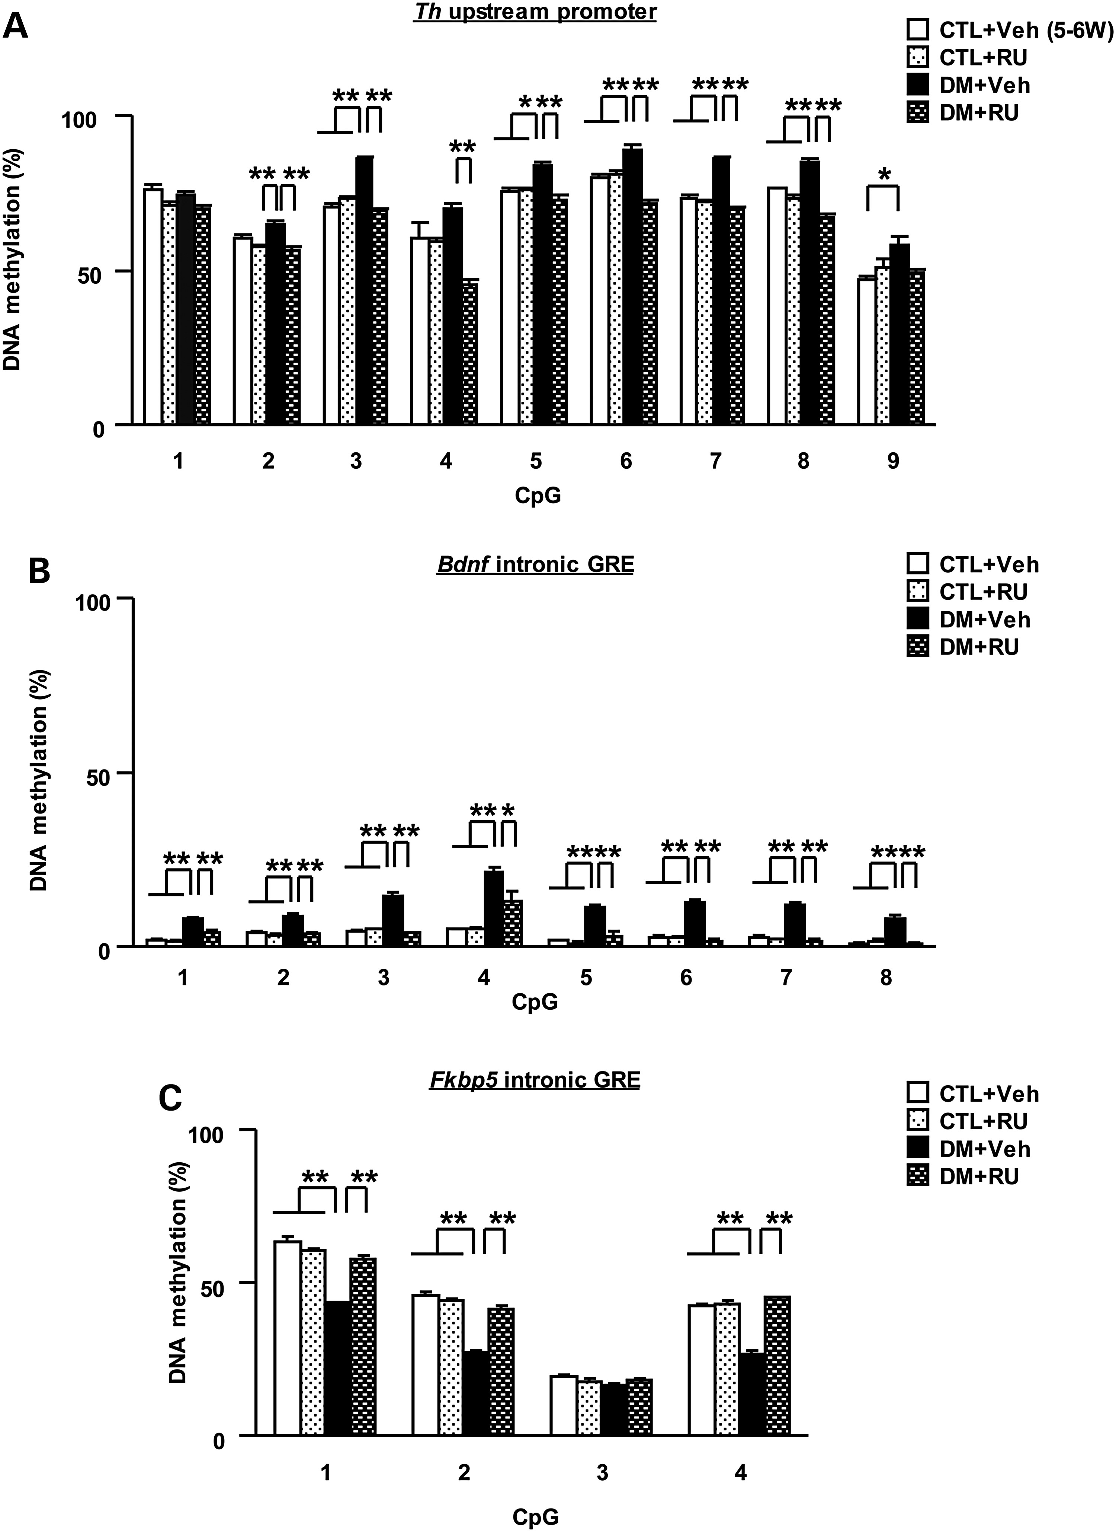
Figure 8. Influence of glucocorticoids from 5 to 6 weeks of age on epigenetic modifications of the Th, Bdnf and Fkbp5 ...
Notes:
Figure 8. Influence of glucocorticoids from 5 to 6 weeks of age on epigenetic modifications of the Th, Bdnf and Fkbp5 genes in the DM. (A) Effects of RU486 on increased DNA methylation in the promoter of Th. (B) Effects of RU486 on increased DNA methylation in the intronic GRE of Bdnf. (C) Effects of RU486 on decreased DNA methylation in the intronic GRE of Fkbp5. N = 3. Each sample was pooled from five males. Values are means ± SEM. Statistical differences were detected using three-way ANOVA with repeated measures (group × drug, F(1,8) = 358.35, P< 0.01 for A; F(1,8) = 106.99, P< 0.01 for B; F(1,8) = 374.77, P< 0.01 for C), and two-way ANOVA (group × drug, F(1,8) = 0.10, P = 0.76 for CpG1 in A; F(1,8) = 6.61, P< 0.05 for CpG2 in A; F(1,8) = 157.80, P< 0.01 for CpG3 in A; F(1,8) = 17.29, P< 0.01 for CpG4 in A; F(1,8) = 21.96, P< 0.01 for CpG5 in A; F(1,8) = 61.17, P< 0.01 for CpG6 in A; F(1,8) = 67.61, P< 0.01 for CpG7 in A; F(1,8) = 53.16, P< 0.01 for CpG8 in A; F(1,8) = 8.15, P< 0.05 for CpG9 in A; F(1,8) = 21.69, P< 0.01 for CpG1 in B; F(1,8) = 15.53, P< 0.01 for CpG2 in B; F(1,8) = 91.51, P< 0.01 for CpG3 in B; F(1,8) = 6.69, P< 0.05 for CpG4 in B; F(1,8) = 19.85, P< 0.01 for CpG5 in B; F(1,8) = 106.90, P< 0.01 for CpG6 in B; F(1,8) = 56.31, P< 0.01 for CpG7 in B; F(1,8) = 22.46, P< 0.01 for CpG8 in B; F(1,8) = 82.82, P< 0.01 for CpG1 in C; F(1,8) = 83.44, P< 0.01 for CpG2 in C; F(1,8) = 4.40, P = 0.07 for CpG3 in C; F(1,8) = 77.72, P< 0.01 for CpG4 in C), followed by Bonferroni post hoc tests (**P< 0.01 and *P< 0.05).
Unless provided in the caption above, the following copyright applies to the content of this slide: © The Author 2016. Published by Oxford University Press. All rights reserved. For Permissions, please email: journals.permissions@oup.com

