Slide 1
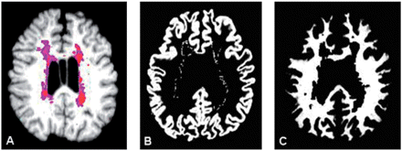
Fig. 1 MRI analysis. Brain T1-3D MRI in a representative patient (A) the whole parenchyma is shown with the total ...
Notes:
Fig. 1 MRI analysis. Brain T1-3D MRI in a representative patient (A) the whole parenchyma is shown with the total amount of lesions, classified in non-black hole (nBH; purple) and black hole (BH) portions (red). Gray matter (B) and normal appearing white matter (C) volumes are segmented from T1-FLAIR coregistered brain images to normalize all brain fractions in Talairach space, after lesion removal to minimize the possibility of misclassification artefacts. Slices B and C correspond to z-coordinate = 28.
Unless provided in the caption above, the following copyright applies to the content of this slide: © The Author (2008). Published by Oxford University Press on behalf of the Guarantors of Brain. All rights reserved. For Permissions, please email: journals.permissions@oxfordjournals.org

Slide 2
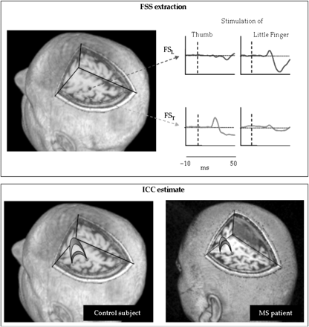
Fig. 2 FS_{T} and FS_{L} behaviour and ICC. In one representative subject top left, topographical ...
Notes:
Fig. 2 FST and FSL behaviour and ICC. In one representative subject top left, topographical representation on a 3D reconstructed brain volume of the extracted sources representing the thumb (FST) and the little finger (FSL) central primary representations projected on a suitable axial plane centrally located with respect to the two sources. Top right, dynamics of FST and FSL activities during contra-lateral thumb and little finger stimulation, shown after averaging the source signal timed on the stimulus onset (t = 0, vertical line) in the [−10, 50] ms time window. Bottom, the gamma band phase locking, i.e. the ICC index, of the right thumb (green) and little finger (light blue) representation. Note that in the multiple sclerosis patient, the finger-dependent functional specialization (thumb > little finger, Tecchio et al. 2007a) is lost.
Unless provided in the caption above, the following copyright applies to the content of this slide: © The Author (2008). Published by Oxford University Press on behalf of the Guarantors of Brain. All rights reserved. For Permissions, please email: journals.permissions@oxfordjournals.org

Slide 3
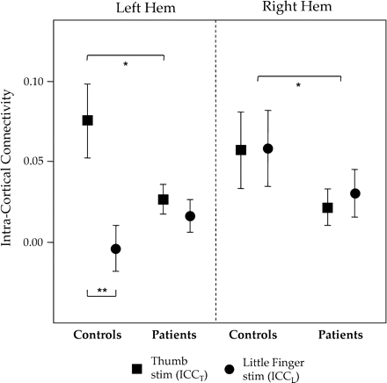
Fig. 3 ICC in healthy and multiple sclerosis patients. ICC in the two hemispheres and for the thumb ...
Notes:
Fig. 3 ICC in healthy and multiple sclerosis patients. ICC in the two hemispheres and for the thumb (ICCT) and little finger cortical representations (ICCL) in healthy subjects and multiple sclerosis patients. In the right hemisphere, both ICCT and ICCL were smaller in patients than in healthy subjects. In the left hemisphere, the ICC somatotopy (ICCT > ICCL) was lost in patients, and ICCT was smaller in multiple sclerosis patients than in controls.
Unless provided in the caption above, the following copyright applies to the content of this slide: © The Author (2008). Published by Oxford University Press on behalf of the Guarantors of Brain. All rights reserved. For Permissions, please email: journals.permissions@oxfordjournals.org

Slide 4
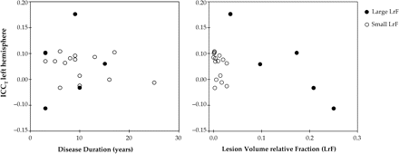
Fig. 4 ICC_{T} versus disease duration and lesion load. Scatter plot of left hemisphere ICC_{T} with ...
Notes:
Fig. 4 ICCT versus disease duration and lesion load. Scatter plot of left hemisphere ICCT with respect to the disease duration (left) and the lesion relative fraction (LrF, right). Two distinct subgroups are differentiated by smaller and larger TLVs.
Unless provided in the caption above, the following copyright applies to the content of this slide: © The Author (2008). Published by Oxford University Press on behalf of the Guarantors of Brain. All rights reserved. For Permissions, please email: journals.permissions@oxfordjournals.org

