Slide 1
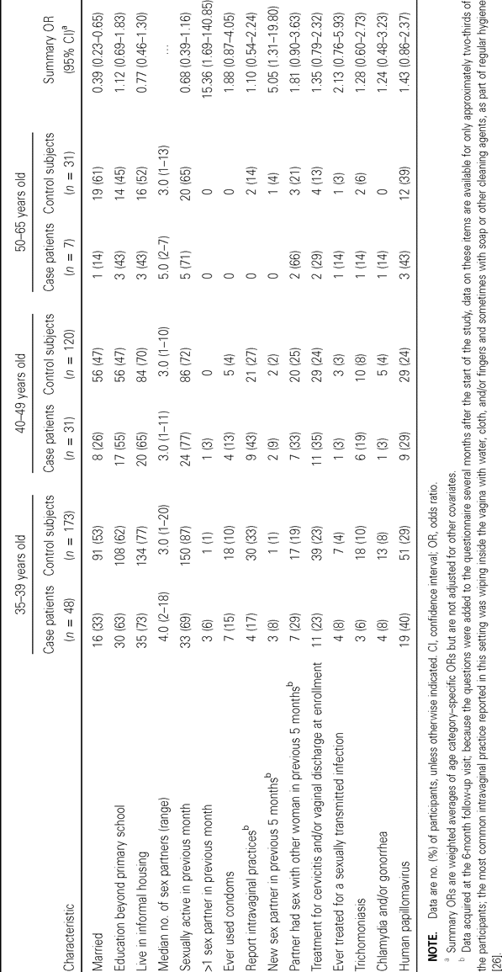
Table 1 Study characteristics of 86 case patients (HIV seroconverters) and 324 age-matched control subjects
Notes:
Table 1 Study characteristics of 86 case patients (HIV seroconverters) and 324 age-matched control subjects
Unless provided in the caption above, the following copyright applies to the content of this slide: © 2005 by the Infectious Diseases Society of America

Slide 2
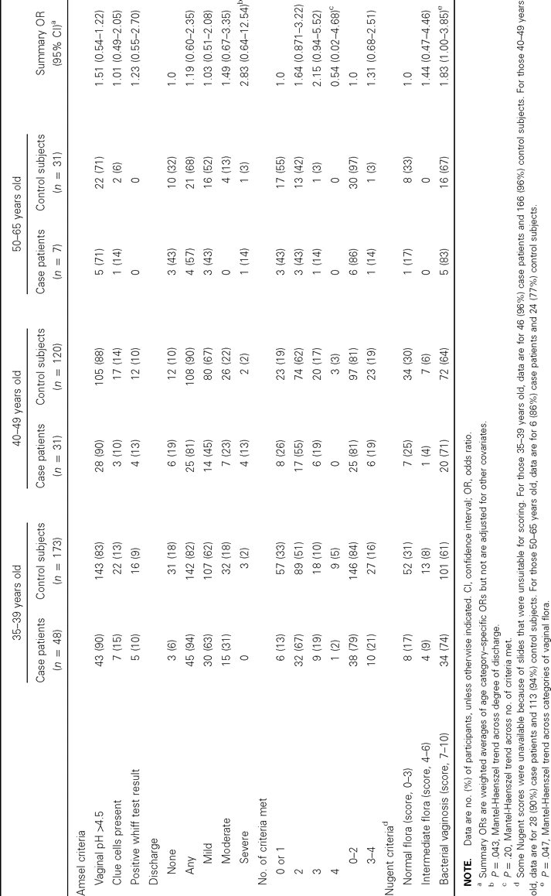
Table 2 Diagnosis of bacterial vaginosis by Amsel and Nugent criteria at enrollment in 86 case patients (HIV ...
Notes:
Table 2 Diagnosis of bacterial vaginosis by Amsel and Nugent criteria at enrollment in 86 case patients (HIV seroconverters) and 324 age-matched control subjects
Unless provided in the caption above, the following copyright applies to the content of this slide: © 2005 by the Infectious Diseases Society of America

Slide 3
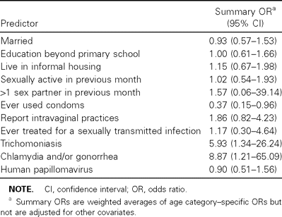
Table 3 Predictors of bacterial vaginosis diagnosed on the basis of a Nugent score of 7–10 in 324 control subjects
Notes:
Table 3 Predictors of bacterial vaginosis diagnosed on the basis of a Nugent score of 7–10 in 324 control subjects
Unless provided in the caption above, the following copyright applies to the content of this slide: © 2005 by the Infectious Diseases Society of America

Slide 4
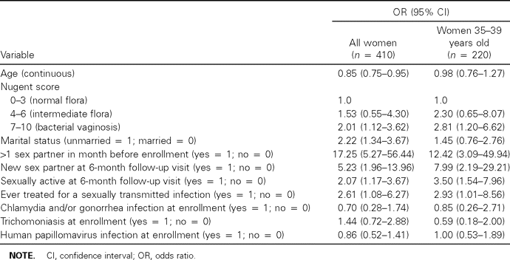
Table 4 Associations between HIV seroconversion and bacterial vaginosis (Nugent score, 7–10), adjusted for selected ...
Notes:
Table 4 Associations between HIV seroconversion and bacterial vaginosis (Nugent score, 7–10), adjusted for selected covariates, in the full cohort and restricted to women 35–39 years old
Unless provided in the caption above, the following copyright applies to the content of this slide: © 2005 by the Infectious Diseases Society of America

