Slide 1
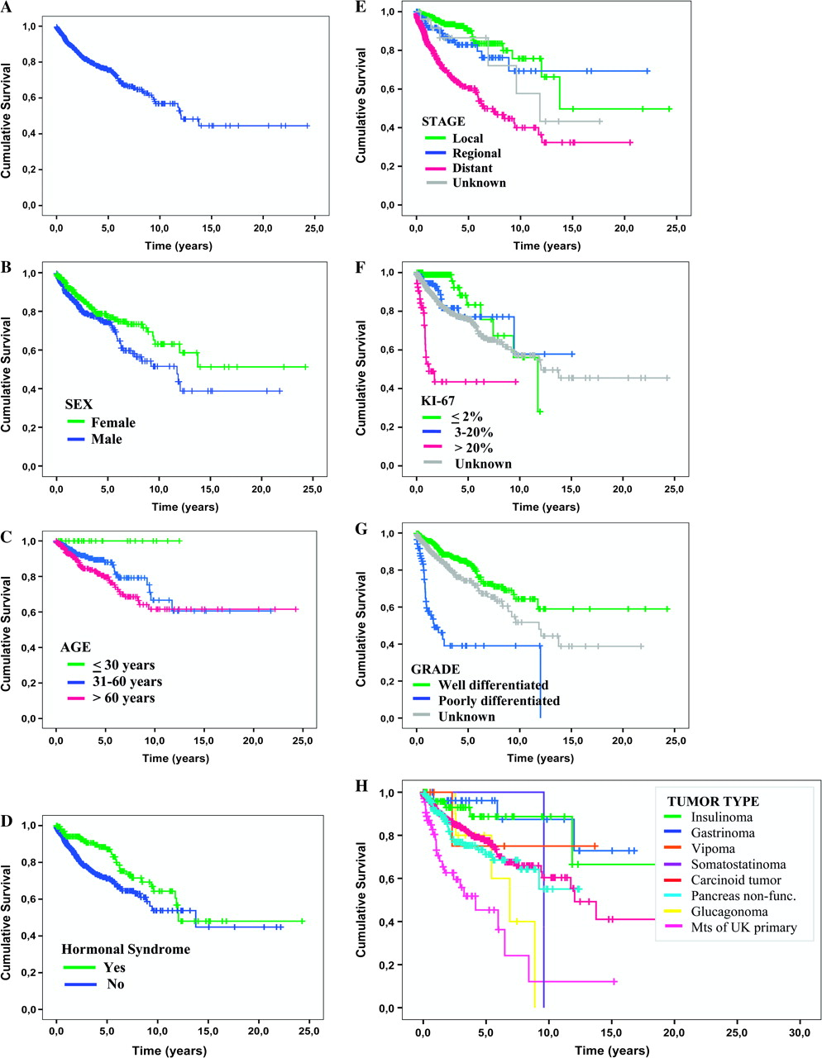
Figure 1. (A) Overall survival in all patients. (B) Overall survival by gender. (C) Overall survival by age. (D) ...
Notes:
Figure 1. (A) Overall survival in all patients. (B) Overall survival by gender. (C) Overall survival by age. (D) Overall survival by hormonal syndrome. (E) Overall survival by stage of disease. (F) Overall survival by Ki-67 index. (G) Overall survival by histological grade. (H) Overall survival by tumor type.
Unless provided in the caption above, the following copyright applies to the content of this slide: © The Author 2010. Published by Oxford University Press on behalf of the European Society for Medical Oncology. All rights reserved. For permissions, please email: journals.permissions@oxfordjournals.org

