Slide 1
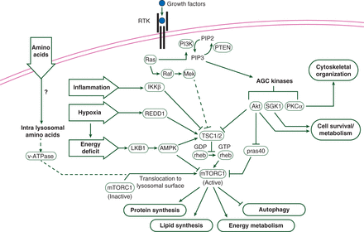
Figure 1. Connections of the mTOR signaling pathways to metabolic processes and cellular proliferation. The key ...
Notes:
Figure 1. Connections of the mTOR signaling pathways to metabolic processes and cellular proliferation. The key signaling nodes that regulate mTORC1 and mTORC2. Critical inputs regulating mTORC1 include growth factors, amino acids, stress, energy status, and oxygen. When active, mTORC1 promotes protein synthesis, lipogenesis, and energy metabolism, and inhibits autophagy and lysosome biogenesis. Alternatively, mTORC2 is activated by growth factors and regulates cell survival/metabolism, immune function, and angiogenesis. Adapted with permission from Laplante and Sabatini [13].
Unless provided in the caption above, the following copyright applies to the content of this slide: © The Author 2014. Published by Oxford University Press on behalf of the European Society for Medical Oncology. All rights reserved. For permissions, please email: journals.permissions@oup.com.

Slide 2
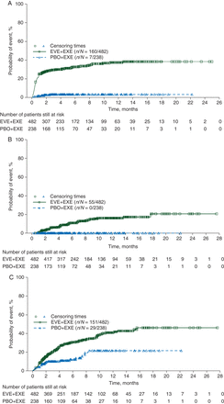
Figure 2. Cumulative incidence of grade ≥2 (A) stomatitis, (B) noninfectious pneumonitis, and (C) infections in ...
Notes:
Figure 2. Cumulative incidence of grade ≥2 (A) stomatitis, (B) noninfectious pneumonitis, and (C) infections in patients with advanced breast cancer (BOLERO-2). Infections included all infections and infestations. EVE, everolimus; EXE, exemestane; PBO, placebo. Parts (A) and (B) reprinted with permission from Rugo et al., OUP, on behalf of the European Society for Medical Oncology [16]. Part (C) reprinted with permission from Rugo et al. [26].
Unless provided in the caption above, the following copyright applies to the content of this slide: © The Author 2014. Published by Oxford University Press on behalf of the European Society for Medical Oncology. All rights reserved. For permissions, please email: journals.permissions@oup.com.

Slide 3
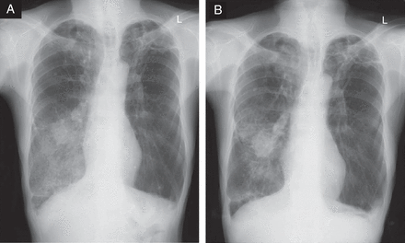
Figure 3. Radiographic scans of (A) pneumonitis and (B) improvement. This patient had metastatic renal cell carcinoma ...
Notes:
Figure 3. Radiographic scans of (A) pneumonitis and (B) improvement. This patient had metastatic renal cell carcinoma in the lower right lobe. After 8 weeks of everolimus treatment, the chest X-ray shows patch consolidation and ground glass opacity (A). Everolimus was discontinued; 2 weeks later, improvement was noted on the follow-up X-ray (B). Reprinted with permission from Lee et al. [33].
Unless provided in the caption above, the following copyright applies to the content of this slide: © The Author 2014. Published by Oxford University Press on behalf of the European Society for Medical Oncology. All rights reserved. For permissions, please email: journals.permissions@oup.com.

