Slide 1
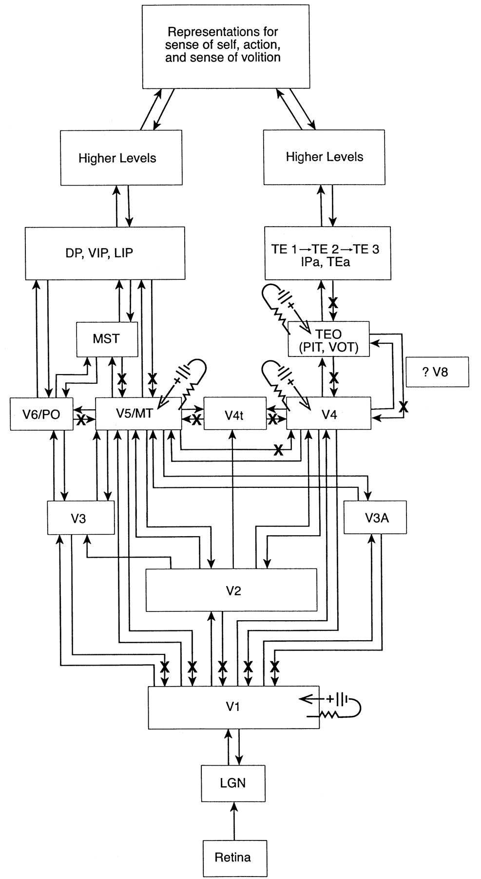
Figure 1. Schematic partial representation of afferent and recurrent projections between V1, V5 and V5 with ‘higher’ ...
Notes:
Figure 1. Schematic partial representation of afferent and recurrent projections between V1, V5 and V5 with ‘higher’ occipitoparietal (left side) and occipitotemporal (right side) cortical areas based upon those of Pandya and Yeterian (Pandya and Yeterian, 1985) and Felleman and Van Essen (Felleman and Van Essen, 1991). Upgoing arrows indicate feed forward projections and downgoing arrows indicate recurrent or feedback projections. Experimental interruptions in recurrent pathways to selective areas are indicated by crosses (X). LGN represents the lateral geniculate nucleus; MT, middle temporal cortex (V5); PO, parieto-occipital area (V6); MST, medial superior parietal area; TEO includes PIT, posterior inferotemporal area and possibly VOT; visual occipitotemporal area in other terminologies; DP, dorsal prelunate area; VIP, ventral intraparietal area; LIP, lateral intraparietal area; TE1, TE2, TE3 represent suggestive subdivisions of the inferotemporal cortex in the terminology of Pandya and Yeterian (Pandya and Yeterian, 1985), wherein IPa represents the intraparietal association area (within the temporal lobe) and TEa represents the association area of the inferotemporal region. Icons for microstimulation are indicated for particular cortical areas. Zeki (Zeki, 2003) doubts the existence of VP as a separate visual area. Hence, pending the outcome of this controversial issue, we have not included VP in the above scheme.
Unless provided in the caption above, the following copyright applies to the content of this slide: © Oxford University Press

Slide 2
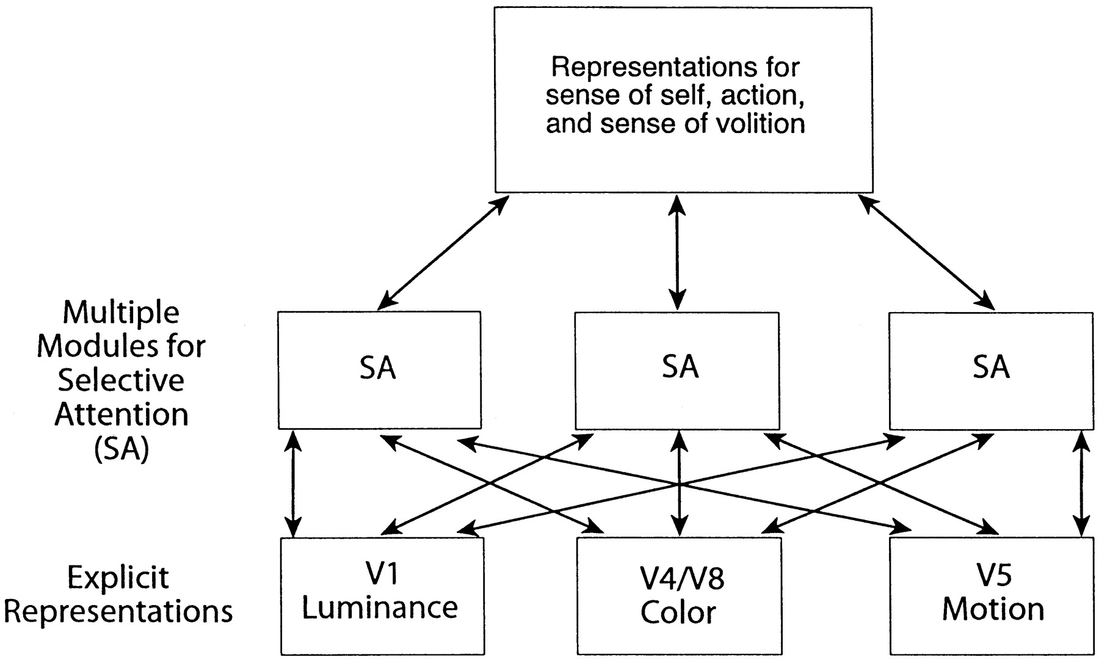
Figure 2. Schematic representation to show multiple sources of selective attention to earlier cortical representation ...
Notes:
Figure 2. Schematic representation to show multiple sources of selective attention to earlier cortical representation for luminance, color and motion. Hypothetical connections are indicated between sources of selective attention and neural representations for the sense of self, for action and for the sense of action.
Unless provided in the caption above, the following copyright applies to the content of this slide: © Oxford University Press

