Slide 1
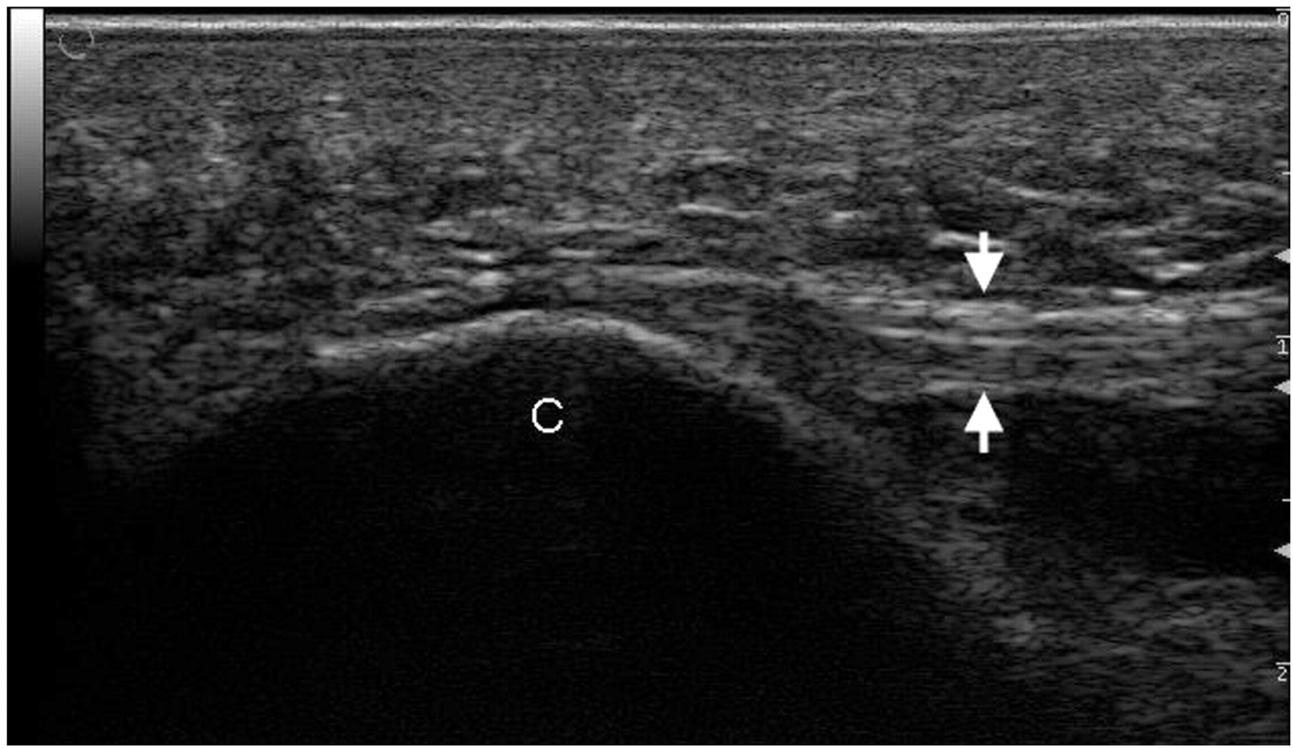
Fig. 1. Longitudinal dorsal scan of the heel showing plantar fascia and its insertion into the calcaneum. C, ...
Notes:
Fig. 1. Longitudinal dorsal scan of the heel showing plantar fascia and its insertion into the calcaneum. C, calcaneum; plantar fascia between two white arrows.
Unless provided in the caption above, the following copyright applies to the content of this slide: © The Author 2008. Published by Oxford University Press on behalf of the British Society for Rheumatology. All rights reserved. For Permissions, please email: journals.permissions@oxfordjournals.org

Slide 2
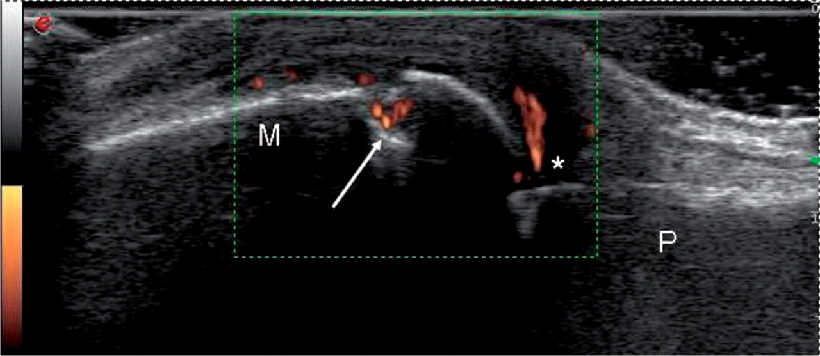
Fig. 2. Longitudinal dorsal scan of second MCP joint in a patient with RA showing a bone erosion and power Doppler ...
Notes:
Fig. 2. Longitudinal dorsal scan of second MCP joint in a patient with RA showing a bone erosion and power Doppler signal. M, metacarpal; P, proximal phalanx; asterisk, joint space; white arrow, bone erosion.
Unless provided in the caption above, the following copyright applies to the content of this slide: © The Author 2008. Published by Oxford University Press on behalf of the British Society for Rheumatology. All rights reserved. For Permissions, please email: journals.permissions@oxfordjournals.org

