Slide 1
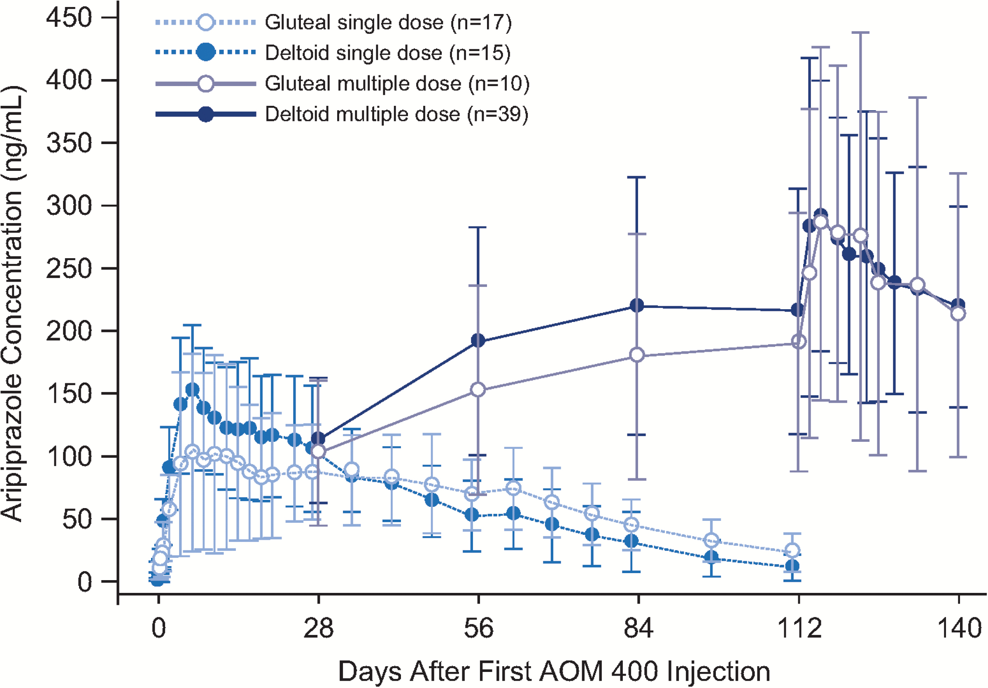
Figure 1. Mean (SD) aripiprazole concentration-time profiles after deltoid or gluteal injection of aripiprazole ...
Notes:
Figure 1. Mean (SD) aripiprazole concentration-time profiles after deltoid or gluteal injection of aripiprazole once-monthly 400 as single- or multiple-dose administrations. Because data are from multiple trials, only time points that were common in all trials are displayed. In multiple-dose studies (injections given every 28 d), samples at days 28, 56, 84, and 112 are predosing concentrations (trough levels), and more frequent sampling was done at steady state from days 112 to 140. Historical gluteal multiple-dose data are from an open-label, parallel-arm, multiple-dose, 24-week study (Mallikaarjun et al., 2013).
Unless provided in the caption above, the following copyright applies to the content of this slide: © The Author 2017. Published by Oxford University Press on behalf of CINP.This is an Open Access article distributed under the terms of the Creative Commons Attribution Non-Commercial License (http://creativecommons.org/licenses/by-nc/4.0/), which permits non-commercial re-use, distribution, and reproduction in any medium, provided the original work is properly cited. For commercial re-use, please contact journals.permissions@oup.com

Slide 2
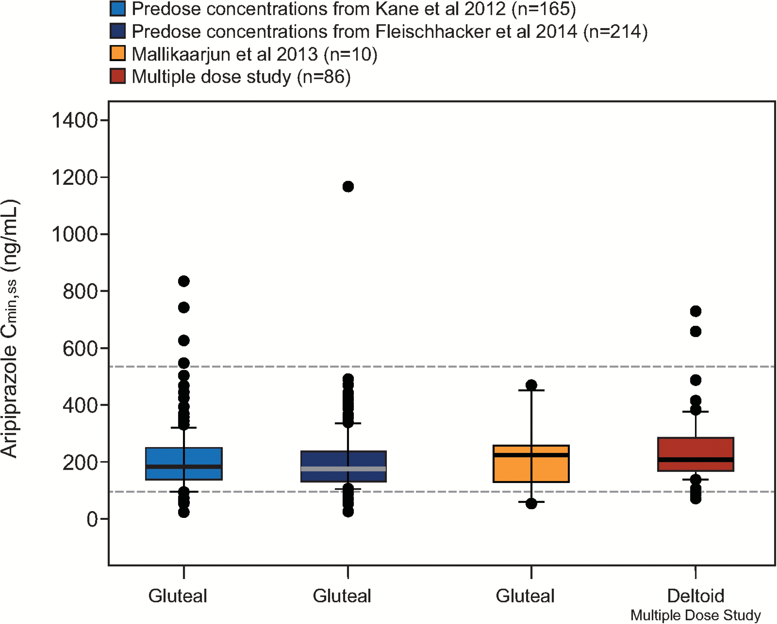
Figure 2. Aripiprazole C_{min,ss} after monthly injections of aripiprazole 400 mg at the deltoid site and ...
Notes:
Figure 2. Aripiprazole Cmin,ss after monthly injections of aripiprazole 400 mg at the deltoid site and comparison with historical data from the gluteal site. Steady-state concentration data for the deltoid site are from the multiple-dose study following the fifth injection, with gluteal/deltoid and deltoid/deltoid administration groups combined. Historical data are from patients with schizophrenia in a phase 3 randomized, placebo-controlled, 52-week study (Kane et al., 2012); a phase 3, randomized, active-controlled 38-week study (Fleischhacker et al., 2014); and a phase 1, open-label, parallel-arm, multiple-dose, 24-week study (Mallikaarjun et al., 2013). Boxes span the 25th and 75th percentiles with a thick horizontal bar at the median. Error bars denote the 10th and 90th percentiles. Dashed horizontal lines represent the therapeutic window (i.e., the median simulated Cmin,ss for oral aripiprazole 10 mg/d [94.0 ng/mL] and the 75th percentile of the simulated Cmax,ss for oral aripiprazole 30 mg/d [534 ng/mL]) based on population pharmacokinetic (PK) simulations of once-daily oral aripiprazole (Raoufinia et al., 2015). Points represent individual outliers below the 10th and above the 90th percentiles. Cmax,ss=maximum plasma concentration at steady state; Cmin,ss=minimum plasma concentration at steady state.
Unless provided in the caption above, the following copyright applies to the content of this slide: © The Author 2017. Published by Oxford University Press on behalf of CINP.This is an Open Access article distributed under the terms of the Creative Commons Attribution Non-Commercial License (http://creativecommons.org/licenses/by-nc/4.0/), which permits non-commercial re-use, distribution, and reproduction in any medium, provided the original work is properly cited. For commercial re-use, please contact journals.permissions@oup.com

