Slide 1
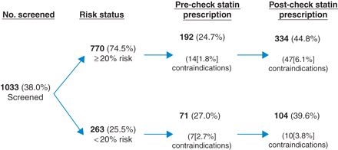
Fig. 1 Statin prescribing before and after the Health Checks.
Notes:
Fig. 1 Statin prescribing before and after the Health Checks.
Unless provided in the caption above, the following copyright applies to the content of this slide: © The Author 2011, Published by Oxford University Press on behalf of Faculty of Public Health. All rights reserved

