Slide 1
Fig. 1. Schematic representation of the normal cardiovascular circulation (Left) and Fontan circulation (Right). ...
Notes:
Fig. 1. Schematic representation of the normal cardiovascular circulation (Left) and Fontan circulation (Right). (Left) The pulmonary circulation (P) is connected in series with the systemic circulation (S). The right ventricle maintains a right atrial pressure lower than the left atrial pressure, and provides enough energy for the blood to pass through the pulmonary resistance. (Right) Fontan circuit: the systemic veins are connected to the pulmonary artery (PA), without a subpulmonary ventricle or systemic atrium. In the absence of a fenestration, there is no admixture of systemic and pulmonary venous blood, but the systemic venous pressures are markedly elevated. Ao, aorta; CV, caval veins; LA, left atrium; LV, left ventricle; PA, pulmonary artery; RV, right ventricle; V, single ventricle.
Unless provided in the caption above, the following copyright applies to the content of this slide: Published by European Association for Cardio-Thoracic Surgery. All rights reserved.

Slide 2
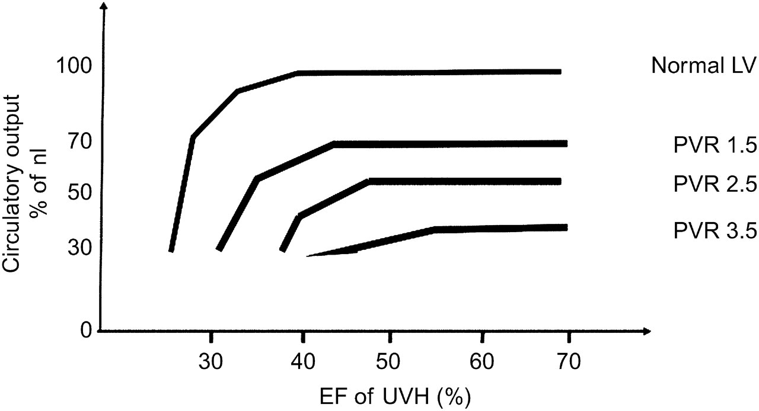
Fig. 2. Relationship of output at rest and ventricular function modulated by PVR. In a normal subject, cardiac output ...
Notes:
Fig. 2. Relationship of output at rest and ventricular function modulated by PVR. In a normal subject, cardiac output at rest is minimally influenced by ventricular function, except when severely depressed. In Fontan patients, minor changes of PVR result in marked changes of output; only when severely impaired, the ventricle will influence output. EF, ejection fraction; PVR, pulmonary vascular resistance; UVH, univentricular heart; LV, left ventricle.
Unless provided in the caption above, the following copyright applies to the content of this slide: Published by European Association for Cardio-Thoracic Surgery. All rights reserved.

Slide 3
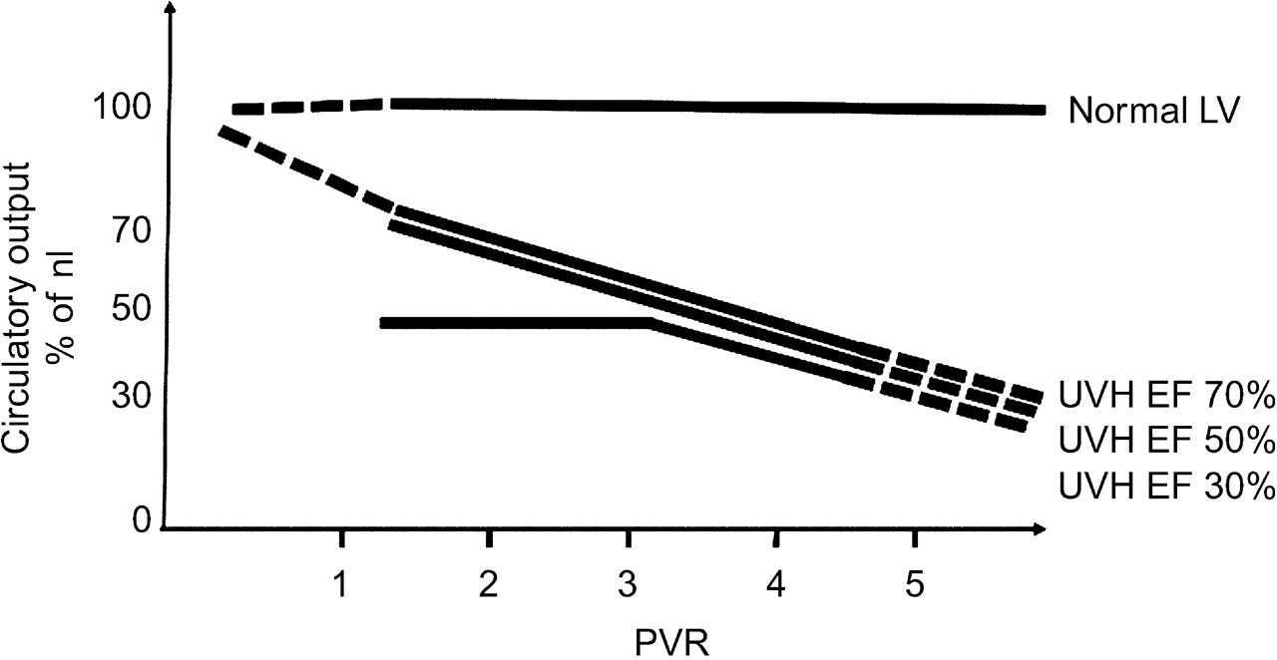
Fig. 3. Relationship of output at rest and pulmonary vascular resistance (PVR) modulated by ventricular function. In ...
Notes:
Fig. 3. Relationship of output at rest and pulmonary vascular resistance (PVR) modulated by ventricular function. In a normal subject (solid black line), cardiac output is not influenced by a mild increase of PVR up to 5 Woods Units. An increased PVR is invariably associated with decreased cardiac output at rest in all Fontan patients. If PVR is low, a good output is achieved in patients with normal or moderately depressed ventricular function; however, severely depressed ventricular function invariably results in low output. EF, ejection fraction; F, Fontan; UVH, univentricular heart; LV, left ventricle.
Unless provided in the caption above, the following copyright applies to the content of this slide: Published by European Association for Cardio-Thoracic Surgery. All rights reserved.

Slide 4
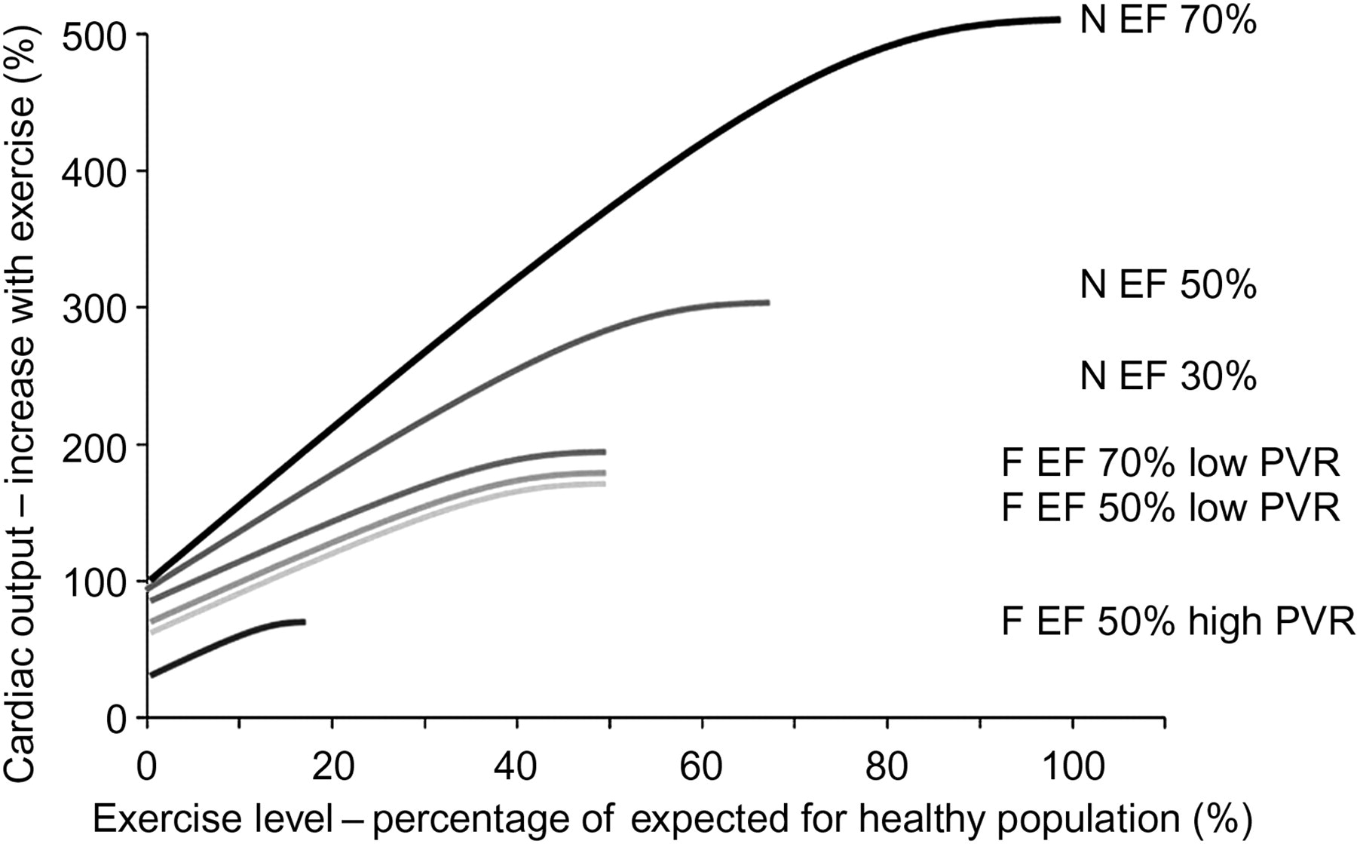
Fig. 4. Relationship of output during exercise, pulmonary vascular resistance (PVR) and ventricular function. A ...
Notes:
Fig. 4. Relationship of output during exercise, pulmonary vascular resistance (PVR) and ventricular function. A normal (N) subject with a biventricular circuit can increase his output by a factor of 5; if ventricular function is impaired, this will first result in decreased maximal output and subsequently in reduced output at low-level of exercise. In Fontan patients (F) output is more influenced by PVR than by ventricular function; all have significantly impaired exercise capacity. EF, ejection fraction.
Unless provided in the caption above, the following copyright applies to the content of this slide: Published by European Association for Cardio-Thoracic Surgery. All rights reserved.

Slide 5
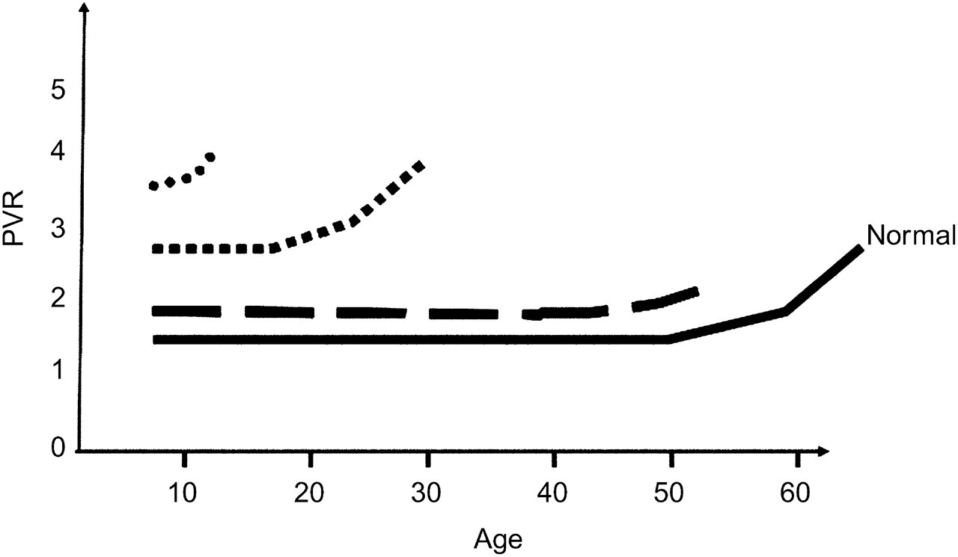
Fig. 5. Evolution of PVR with age. In normal subjects (solid black line), PVR remains low for many decades, and will ...
Notes:
Fig. 5. Evolution of PVR with age. In normal subjects (solid black line), PVR remains low for many decades, and will increase only at old age without significant cardiovascular limitation. In good Fontan patients with low PVR, resistance remains low for many decades, but is expected to increase at older age (semi solid line). In poor Fontan patients with increased PVR (dotted lines), PVR trends to increase faster with poor clinical outcome at resistances beyond 4 units. PVR, pulmonary vascular resistance.
Unless provided in the caption above, the following copyright applies to the content of this slide: Published by European Association for Cardio-Thoracic Surgery. All rights reserved.

