Slide 1
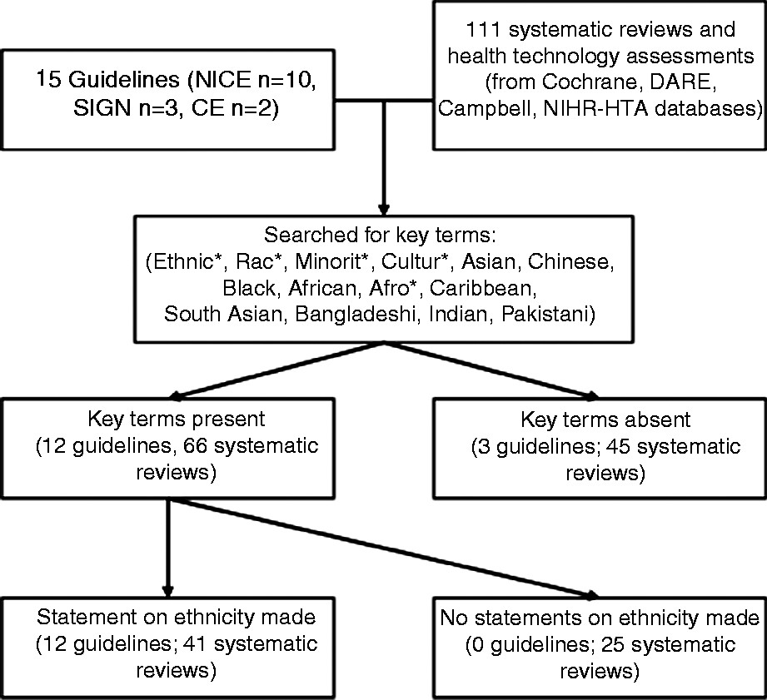
Figure 1 Identification of key terms and statements regarding ethnicity in UK guidelines and international systematic ...
Notes:
Figure 1 Identification of key terms and statements regarding ethnicity in UK guidelines and international systematic reviews
Unless provided in the caption above, the following copyright applies to the content of this slide: © Crown copyright 2013.

