Slide 1
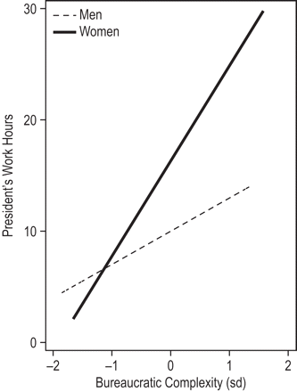
Figure 1. Presidents' Weekly Effort and the Bureaucratic Complexity * Gender Interaction
Notes:
Figure 1. Presidents' Weekly Effort and the Bureaucratic Complexity * Gender Interaction Notes: The difference in slopes is significant at the p &lt; .001 level and is conditioned on all items from Table 3 Model 4, including the structural features of the local chapter, individual attributes of the president and relevant controls.
Unless provided in the caption above, the following copyright applies to the content of this slide: © The Author 2011. Published by Oxford University Press on behalf of the University of North Carolina at Chapel Hill. All rights reserved. For permissions, please e-mail: journals.permissions@oup.com.

