Slide 1
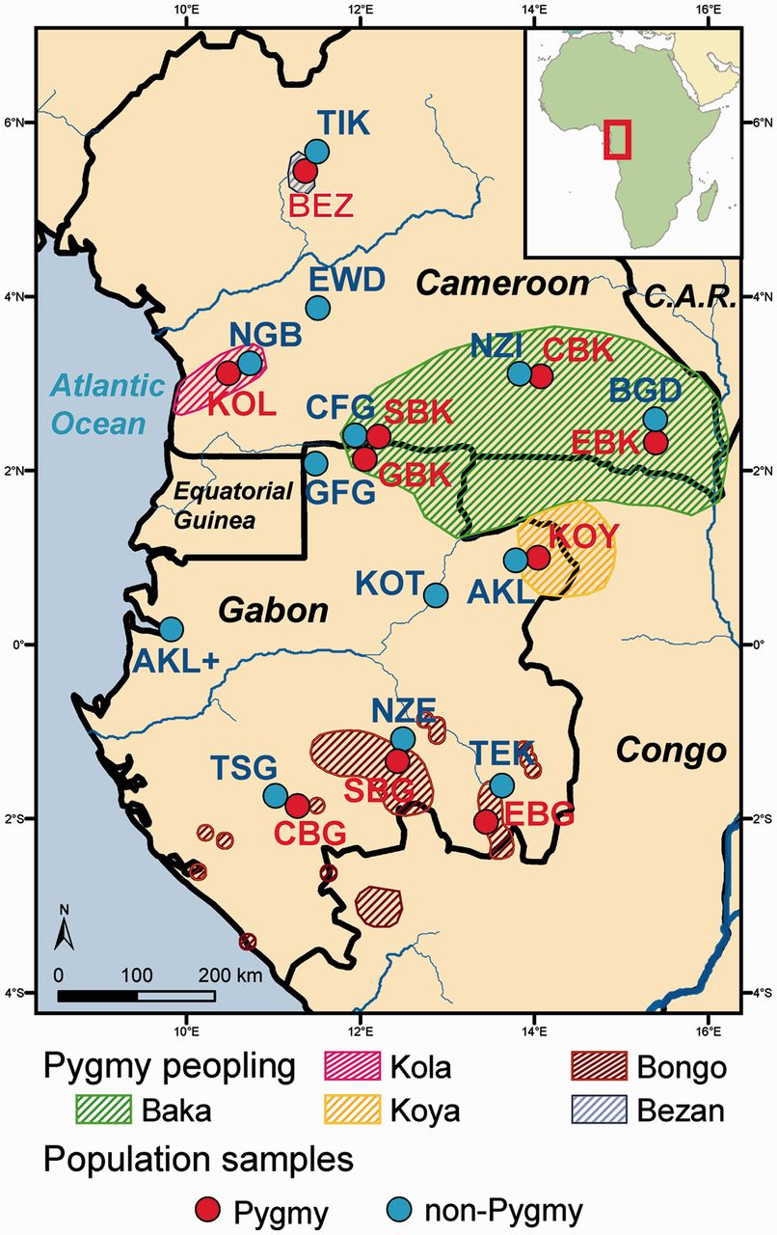
Fig. 1. Geographic location of population samples. Populations were categorized in Pygmy (in red) and non-Pygmy (in ...
Notes:
Fig. 1. Geographic location of population samples. Populations were categorized in Pygmy (in red) and non-Pygmy (in blue) based on numerous cultural criteria (see Materials and Methods). Pygmy areas of peopling were inferred based on our field work. See population codes in table 1.
Unless provided in the caption above, the following copyright applies to the content of this slide: © The Author 2013. Published by Oxford University Press on behalf of the Society for Molecular Biology and Evolution. All rights reserved. For permissions, please e-mail: journals.permissions@oup.com

Slide 2
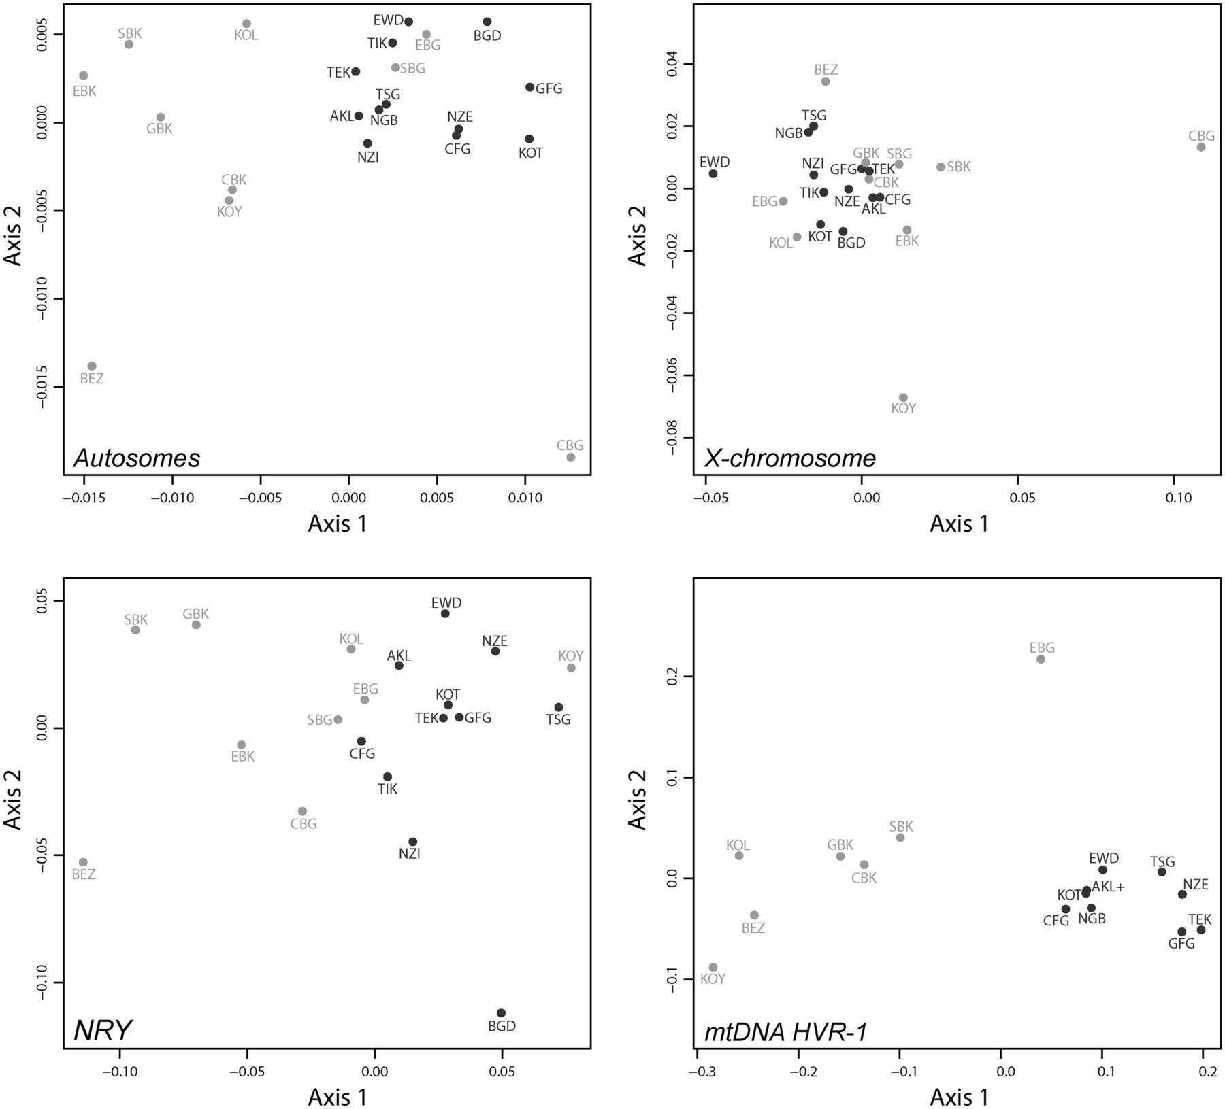
Fig. 2. Two-dimensional metric MDS based on population pairwise genetic distances. Pairwise genetic differentiation ...
Notes:
Fig. 2. Two-dimensional metric MDS based on population pairwise genetic distances. Pairwise genetic differentiation were estimated as FST (Weir and Cockerham 1984) and set to 0 when found not significant based on 10,000 permutation tests. Matrices of pairwise FST are then projected in a two-dimensional space using a metric MDS approach (Axis 1 = first principal coordinate, Axis 2 = second principal coordinate). Upper-left plot: pairwise FST for 28 autosomal microsatellites, Spearman’s ρ = 0.82 (see Materials and Methods). Upper-right plot: pairwise FST for eight X-chromosome microsatellites, Spearman’s ρ = 0.67. Lower-left plot: pairwise FST for six NRY microsatellites, Spearman’s ρ = 0.69. Lower-right plot: pairwise FST for mtDNA HVR-1 359 bp sequences, Spearman’s ρ = 0.98. Pygmy populations are indicated in light gray and non-Pygmy populations in dark gray. See population codes in table 1.
Unless provided in the caption above, the following copyright applies to the content of this slide: © The Author 2013. Published by Oxford University Press on behalf of the Society for Molecular Biology and Evolution. All rights reserved. For permissions, please e-mail: journals.permissions@oup.com

Slide 3
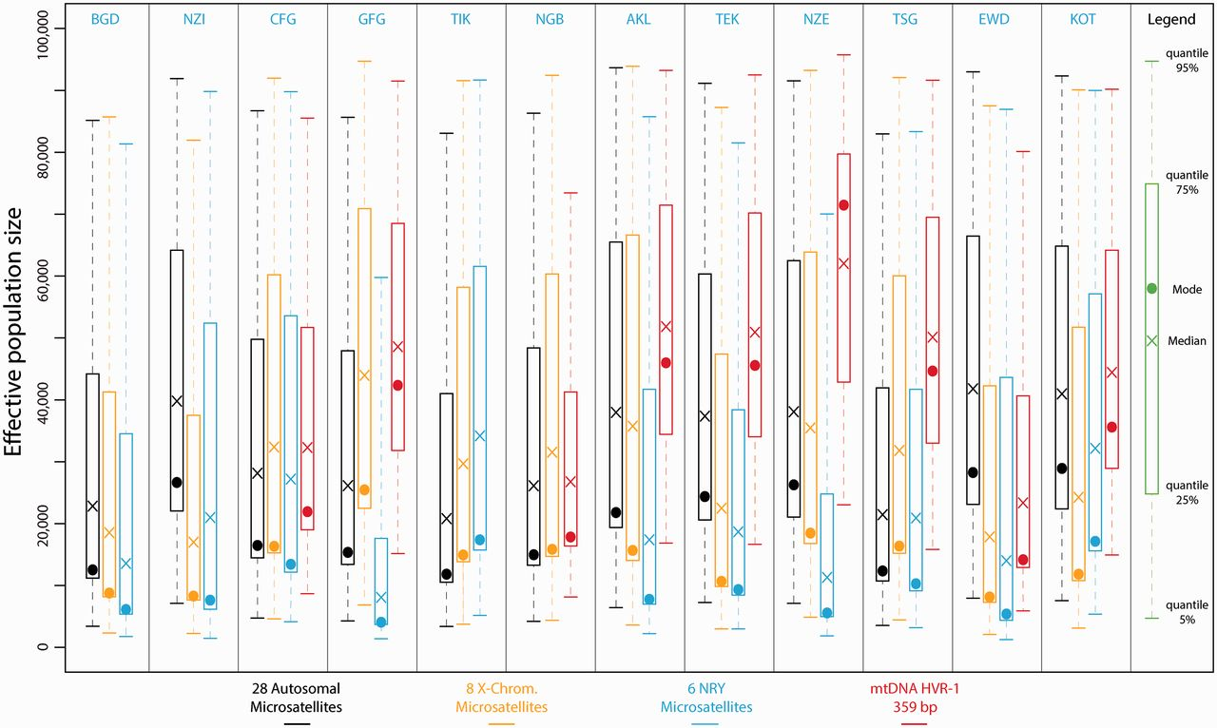
Fig. 3. Posterior distributions of non-Pygmy populations effective population sizes using ABC analyses. Posterior ...
Notes:
Fig. 3. Posterior distributions of non-Pygmy populations effective population sizes using ABC analyses. Posterior distributions were obtained considering scenarios with a single population and one potential change in effective population size, for each non-Pygmy population separately. For each one of the four chromosomal types, we simulated separately one million data sets and posterior distributions of the effective population sizes were estimated based on the 10,000 (1%) top simulations providing summary statistics closest to the observed data. Results in black correspond to the 28 autosomal microsatellites; in orange: eight X-chromosome microsatellites; in blue: six NRY microsatellites; and in red: mtDNA HVR-1 359 bp sequences. See Materials and Methods and supplementary materials, Supplementary Material online, for further description of the simulation and ABC analyses. See table 1 for population codes.
Unless provided in the caption above, the following copyright applies to the content of this slide: © The Author 2013. Published by Oxford University Press on behalf of the Society for Molecular Biology and Evolution. All rights reserved. For permissions, please e-mail: journals.permissions@oup.com

Slide 4
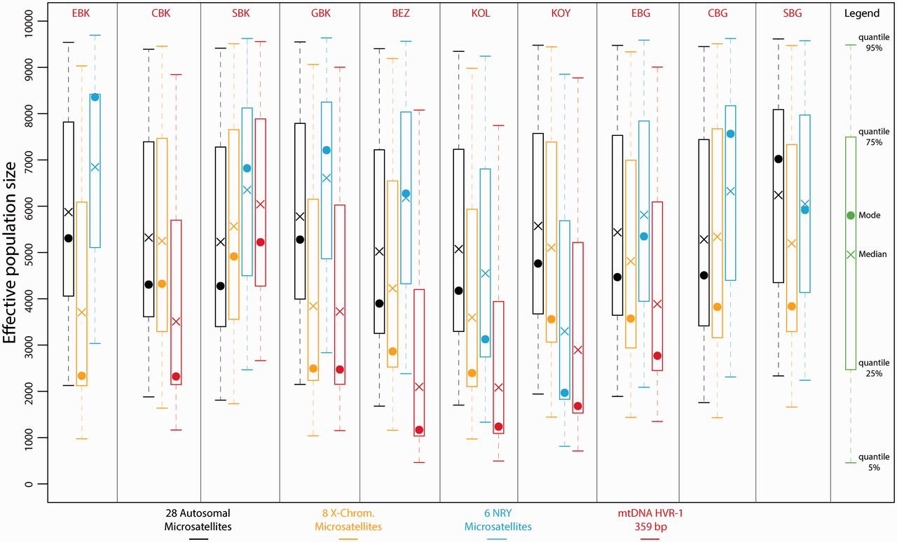
Fig. 4. Posterior distributions of Pygmy populations effective population sizes using ABC analyses. Posterior ...
Notes:
Fig. 4. Posterior distributions of Pygmy populations effective population sizes using ABC analyses. Posterior distributions were obtained considering scenarios with a single population and one potential change in effective population size, for each Pygmy population separately. For each one of the four chromosomal types, we simulated separately one million data sets and posterior distributions of the effective population size were estimated based on the 10,000 (1%) top simulations providing summary statistics closest to the observed data. Results in black correspond to the 28 autosomal microsatellites; in orange: eight X-chromosome microsatellites; in blue: six NRY microsatellites; and in red: mtDNA HVR-1 359 bp sequences. See Materials and Methods and supplementary materials, Supplementary Material online, for further description of the simulation and ABC analyses. See table 1 for population codes.
Unless provided in the caption above, the following copyright applies to the content of this slide: © The Author 2013. Published by Oxford University Press on behalf of the Society for Molecular Biology and Evolution. All rights reserved. For permissions, please e-mail: journals.permissions@oup.com

Slide 5
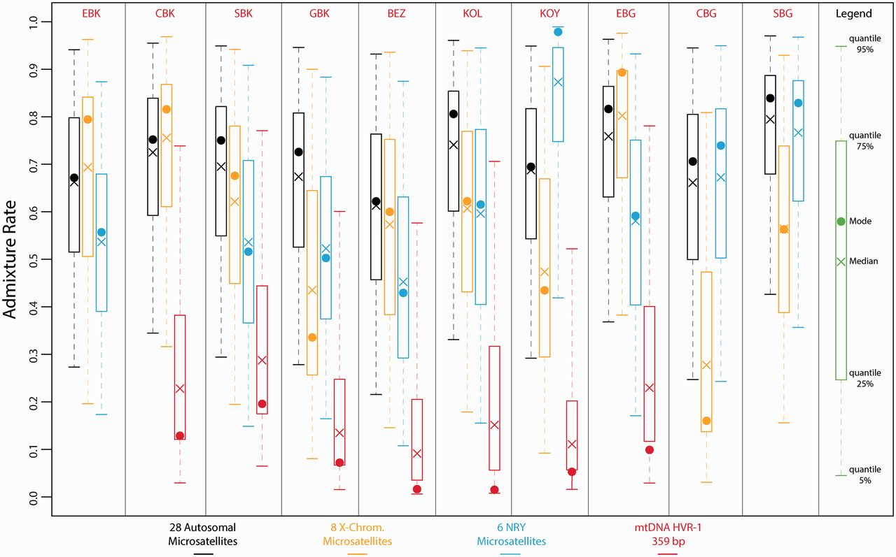
Fig. 5. Posterior distributions of the rate of genetic introgression from non-Pygmy populations into each Pygmy ...
Notes:
Fig. 5. Posterior distributions of the rate of genetic introgression from non-Pygmy populations into each Pygmy population using ABC analyses. Posterior distributions were obtained considering the three-population models described in supplementary figure S2, Supplementary Material online. For each one of the four chromosomal types, we simulated separately one million data sets for all the analyses involving a different pair of Pygmy populations (together with the corresponding non-Pygmy neighboring population see Materials and Methods and supplementary fig. S2, Supplementary Material online). For each Pygmy population and each chromosomal type separately, posterior distributions of the level of genetic introgression from the non-Pygmies were estimated based on the 10,000 (1%) top simulations providing summary statistics closest to the observed data. To obtain a single posterior distribution for a given Pygmy population and a given chromosomal type, we merged the corresponding posterior distributions obtained for the ABC analyses considering that particular Pygmy population (see Materials and Methods). The color code is the same as in figures 3 and 4. See table 1 for population codes.
Unless provided in the caption above, the following copyright applies to the content of this slide: © The Author 2013. Published by Oxford University Press on behalf of the Society for Molecular Biology and Evolution. All rights reserved. For permissions, please e-mail: journals.permissions@oup.com

Slide 6
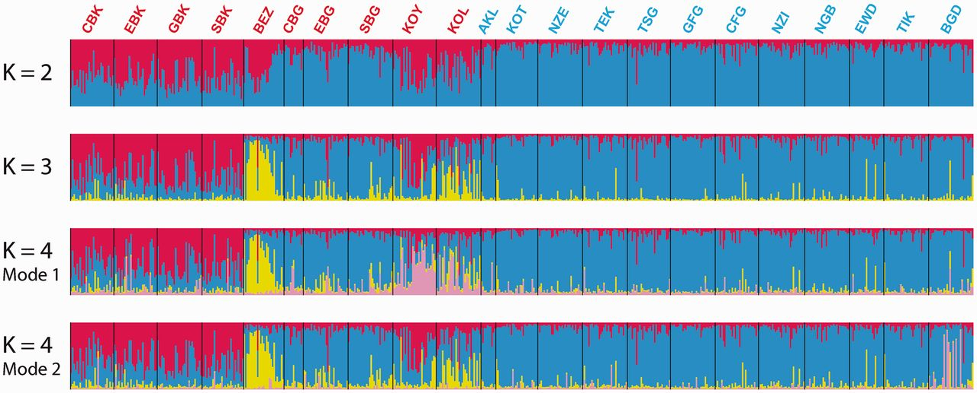
Fig. 6. Individual clustering of Central African Populations using autosomal and X-chromosome microsatellites. Each ...
Notes:
Fig. 6. Individual clustering of Central African Populations using autosomal and X-chromosome microsatellites. Each individual in the data set is represented by a single vertical line divided into K colors corresponding to the proportion of their genotype clustering in each one of the K pre-assumed clusters obtained with STRUCTURE v2.3 (Pritchard et al. 2000; Falush et al. 2003), using 28 autosomal and eight X-chromosome microsatellites. The number of pre-assumed clusters K is indicated on the left of each bar plot. See table 1 for population codes. Pygmy population codes are indicated in red and non-Pygmy in blue. At K = 2, all 40 runs (see Materials and Methods) provided results that belonged to the same mode [average ln(Probability of observing the data) = −63,164.2, SD = 13.0]. At K = 3, 21 runs out of the 40 belonged to the same mode (presented here) with a higher average likelihood [average ln(Probability of observing the data) = −63,250.0, SD = 231.7] than that of the 19 runs belonging to the second mode [average ln(Probability of observing the data) = −63,328.0, SD = 232.4]. This alternate mode was however highly uninformative (result not shown). At K = 4, we found two informative modes among the 40 runs: one comprising 15 runs out of the 40 [mode 1, average ln(Probability of observing the data) = −63,947.4, SD = 903.5]; one comprising five runs out of the 40 [mode 2, average ln(Probability of observing the data) = −63,795.5, SD = 1,078.8]. The last mode found at K = 4 comprised 20 runs out of 40 and was highly uninformative (result not shown). No further clear population-specific genetic structure was found at K = 5 and higher (result not shown) Results were plotted using DISTRUCT (Rosenberg 2004).
Unless provided in the caption above, the following copyright applies to the content of this slide: © The Author 2013. Published by Oxford University Press on behalf of the Society for Molecular Biology and Evolution. All rights reserved. For permissions, please e-mail: journals.permissions@oup.com

Slide 7
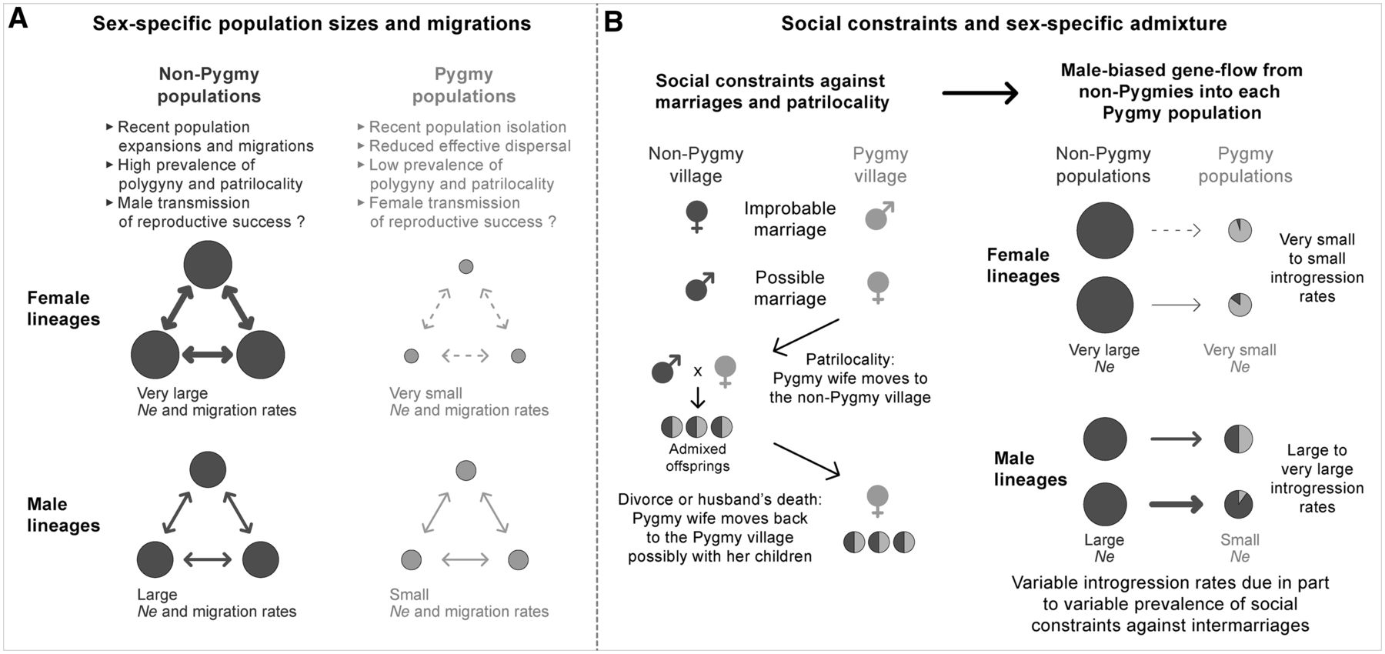
Fig. 7. Schematic representation of the influence of historical and sociocultural factors on the sex-specific ...
Notes:
Fig. 7. Schematic representation of the influence of historical and sociocultural factors on the sex-specific demography of Central African Pygmy and non-Pygmy populations inferred from genetic data. Non-Pygmy populations are represented in dark gray and Pygmy populations in light gray. Circle sizes are schematically proportional to effective population sizes (indicated by “Ne”). Arrow sizes represent schematically the intensity of migrations between populations in (A), and the intensity of genetic admixture in (B). ♀ represents women and ♂ represents men. (A) Sex-specific effective population sizes and migrations among non-Pygmy and Pygmy groups of populations, respectively. (B) How complex gender-related sociocultural behaviors regarding barriers against intermarriages and discriminations between Pygmies and non-Pygmies result in male-biased asymmetric gene flow from non-Pygmies in each Pygmy population in a context of patrilocality.
Unless provided in the caption above, the following copyright applies to the content of this slide: © The Author 2013. Published by Oxford University Press on behalf of the Society for Molecular Biology and Evolution. All rights reserved. For permissions, please e-mail: journals.permissions@oup.com

