Slide 1
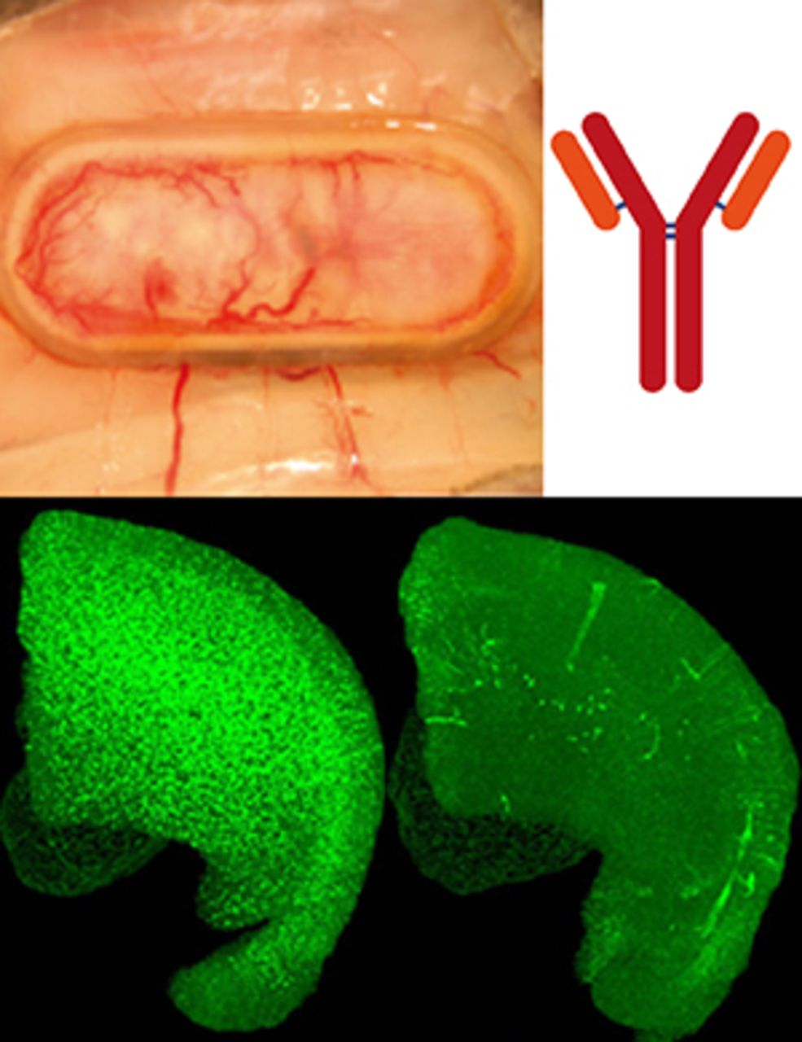
Passive immunization against toxic misfolded proteins could offer protection against neurodegenerative ...
Notes:
Passive immunization against toxic misfolded proteins could offer protection against neurodegenerative disease. Lathuilière et al . report the development of a retrievable device to encapsulate cells secreting recombinant anti-amyloid-β antibodies. When implanted in mouse models of Alzheimer’s disease, the system delivers antibodies to the brain and reduces amyloid and tau pathologies.
Unless provided in the caption above, the following copyright applies to the content of this slide: © The Author (2016). Published by Oxford University Press on behalf of the Guarantors of Brain. All rights reserved. For Permissions, please email: journals.permissions@oup.com

Slide 2
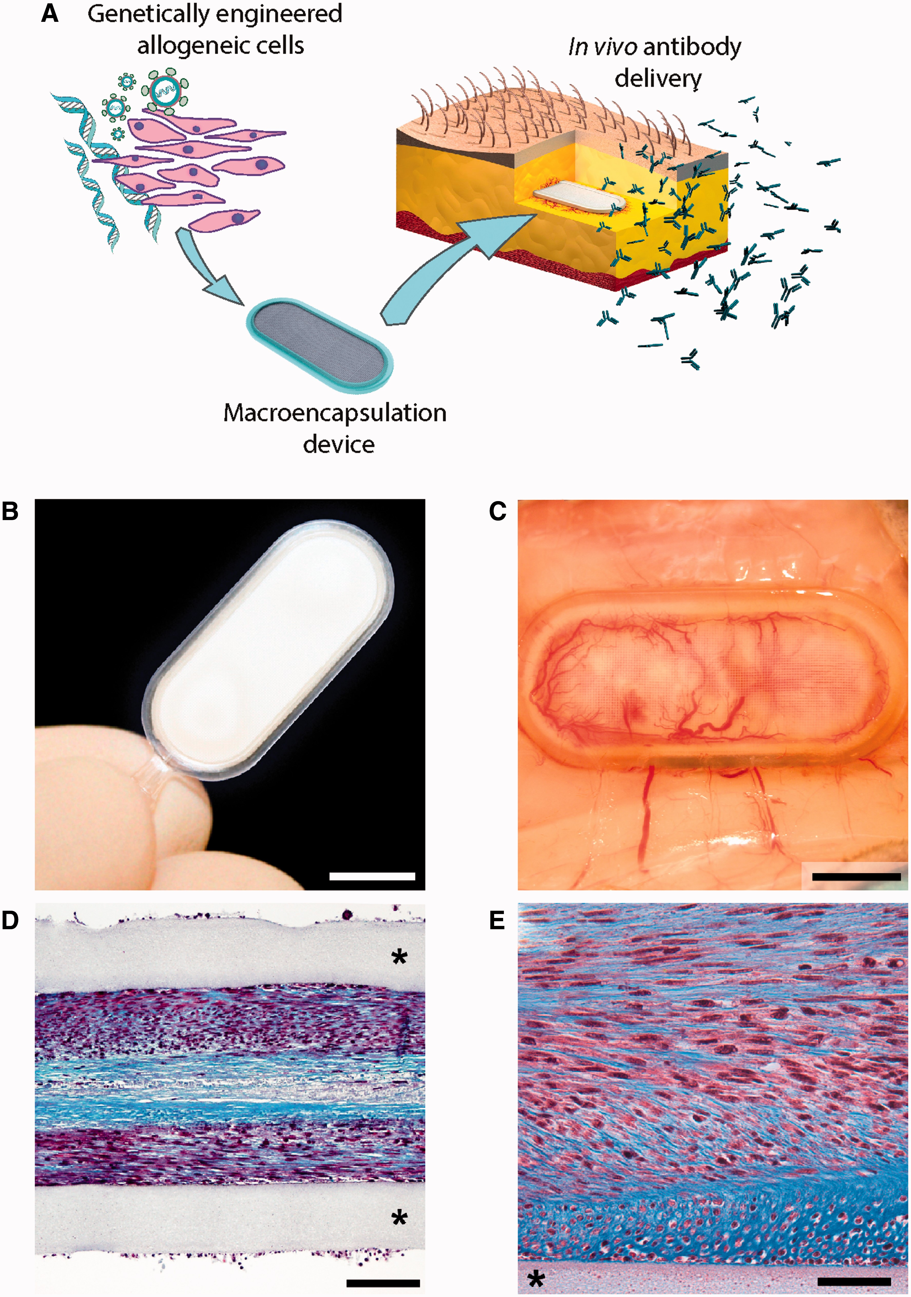
Figure 1 Cell encapsulation device for long-term subcutaneous therapeutic antibody delivery . ( A ) Schematic ...
Notes:
Figure 1 Cell encapsulation device for long-term subcutaneous therapeutic antibody delivery . ( A ) Schematic representation of ECT for passive immunization. Allogeneic cells are genetically engineered using lentiviral vectors to produce a therapeutic antibody. The modified cells are confined in a macroencapsulation ‘flat sheet’ device and implanted in the subcutaneous tissue for in vivo antibody secretion. ( B ) Macroscopic view of the encapsulation device, composed of a transparent frame supporting polymer permeable membranes and reinforced with an outer polyester mesh. ( C ) Dense neovascularization develops around a device containing antibody-secreting C2C12 myoblasts, 8 months after implantation in the mouse subcutaneous tissue. ( D and E ) Representative photomicrographs showing encapsulated antibody-secreting C2C12 myoblasts surviving at high density within the flat sheet device 39 weeks after implantation. ( E ) Higher magnification: note that the cells produce a collagen-rich matrix stained in blue with Masson’s trichrome protocol. Asterisk: polypropylene porous membrane. Scale bars = 750 µm ( B and C ), 100 µm ( D ), 50 µm ( E ).
Unless provided in the caption above, the following copyright applies to the content of this slide: © The Author (2016). Published by Oxford University Press on behalf of the Guarantors of Brain. All rights reserved. For Permissions, please email: journals.permissions@oup.com

Slide 3
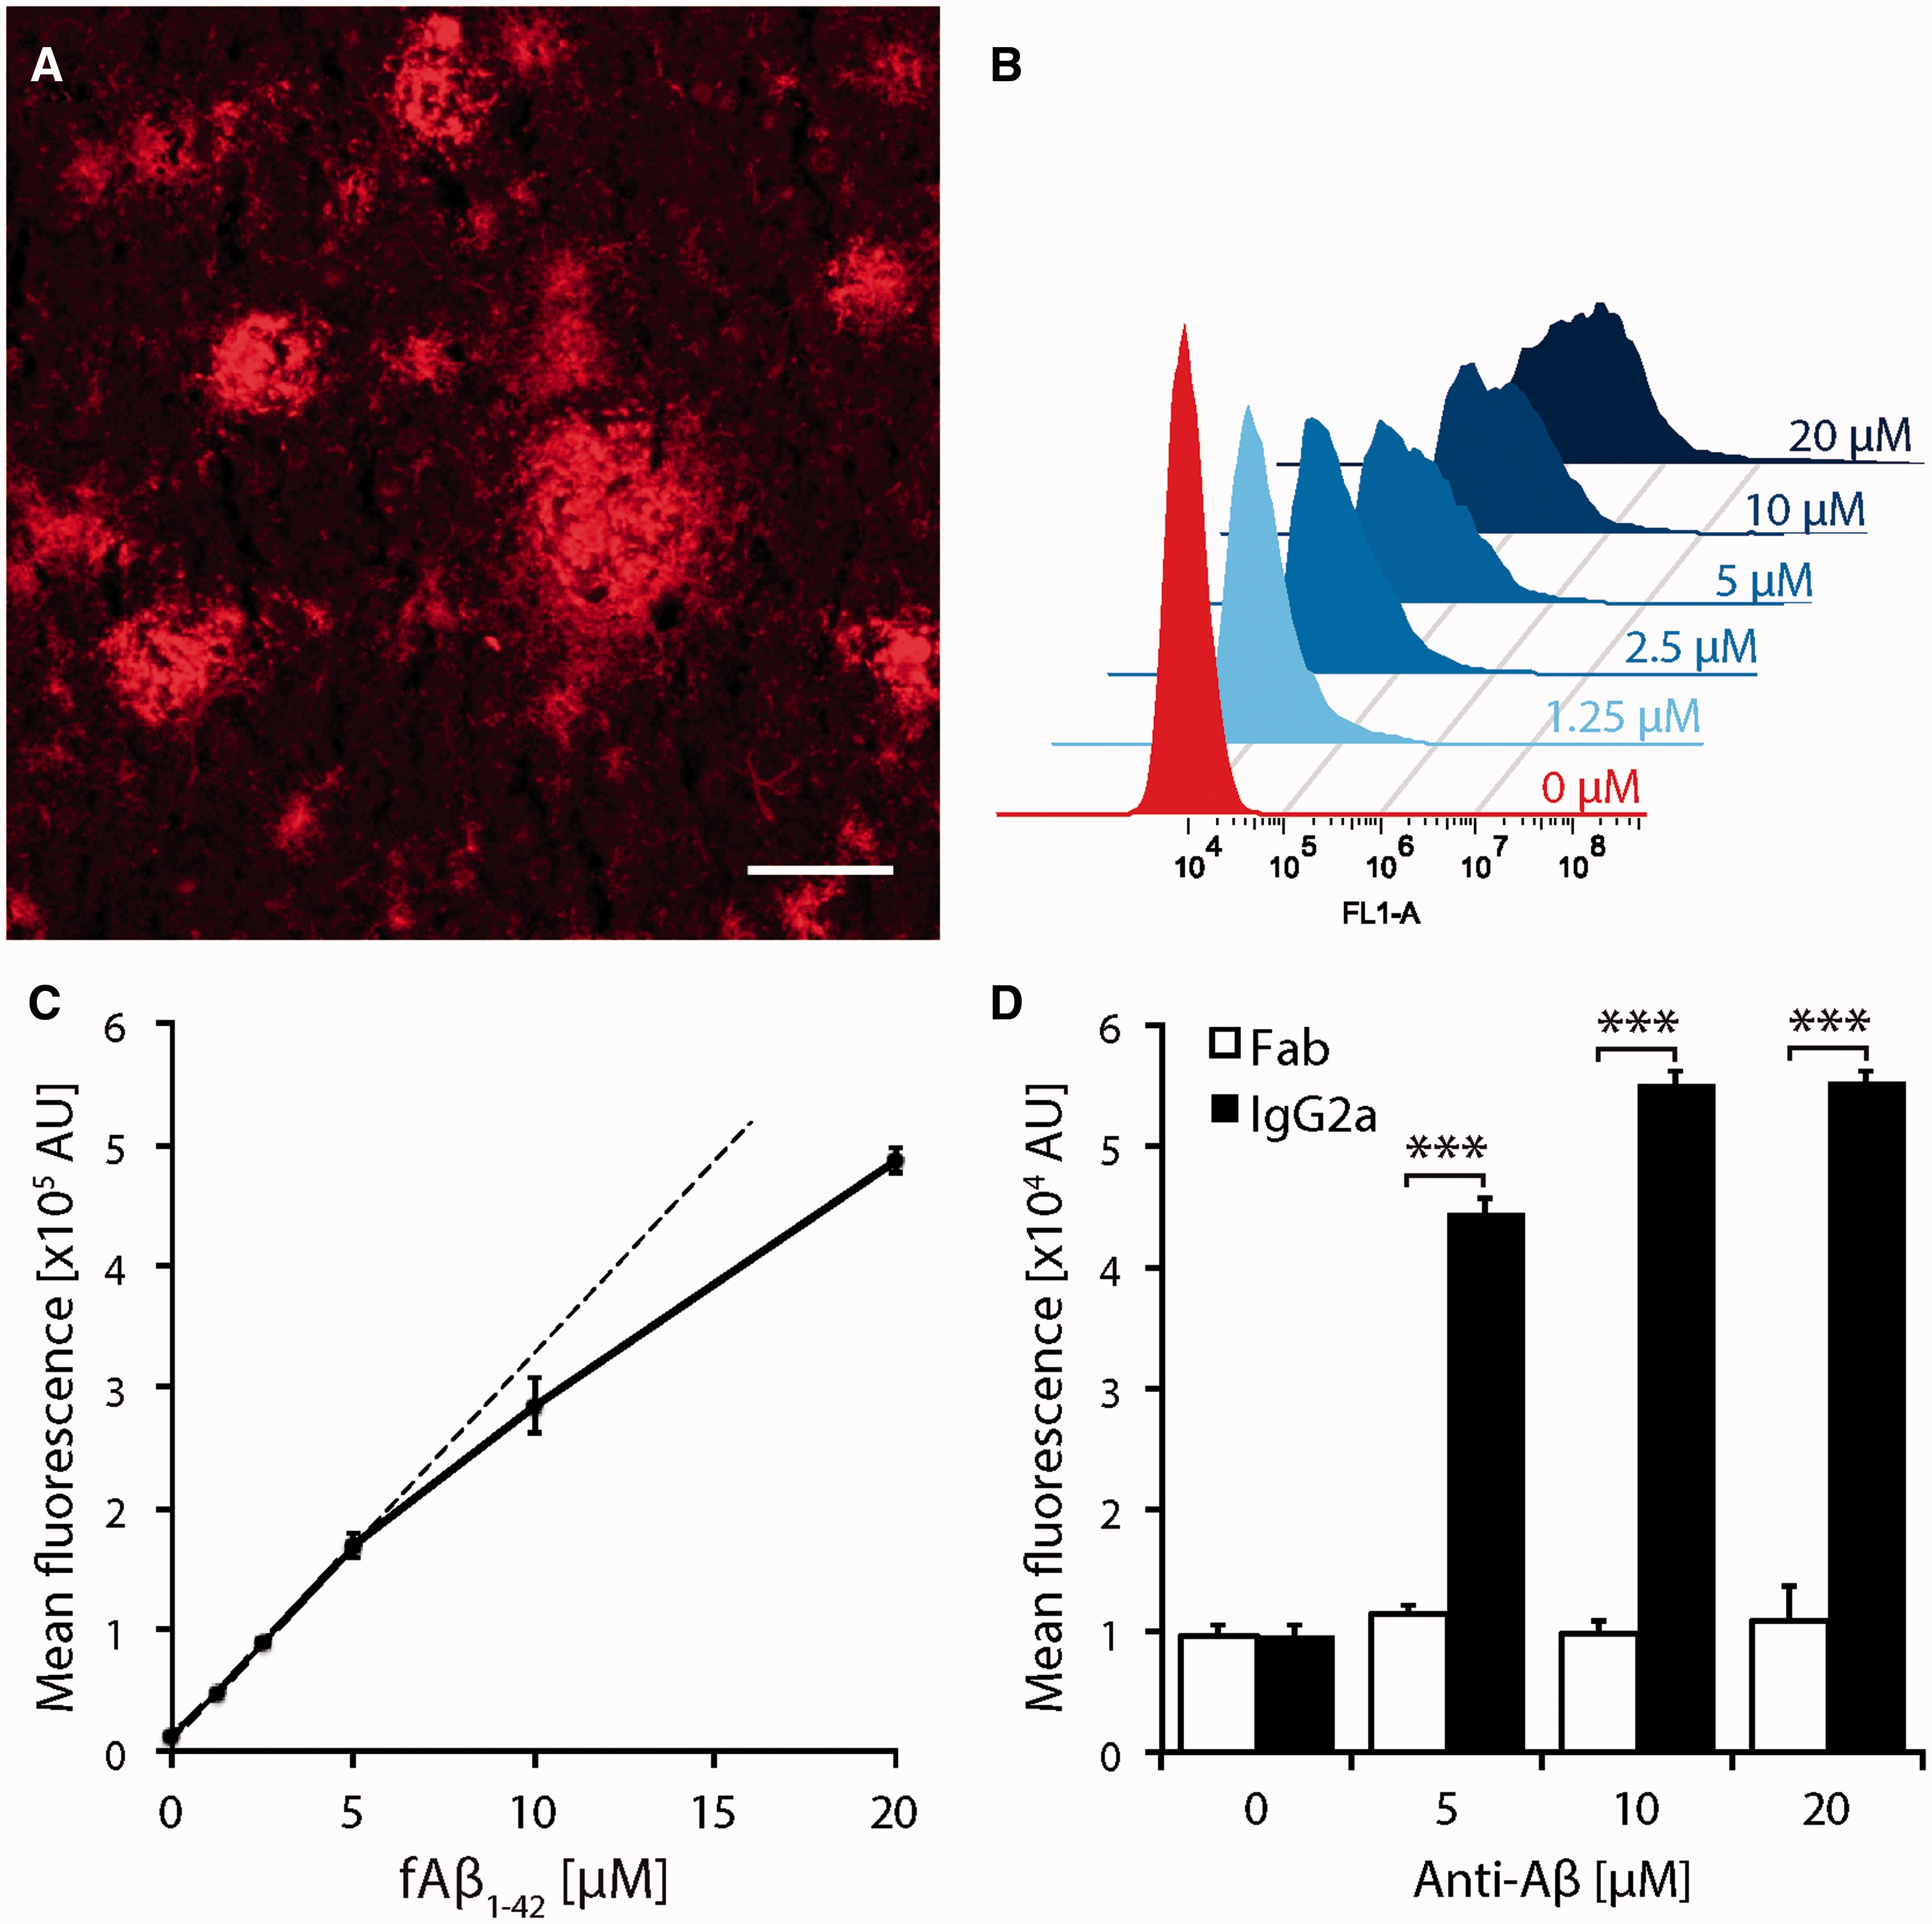
Figure 2 The plaque-specific anti-amyloid-β mAb-11 antibody enhances amyloid phagocytosis by microglial cells. ( A ) ...
Notes:
Figure 2 The plaque-specific anti-amyloid-β mAb-11 antibody enhances amyloid phagocytosis by microglial cells. ( A ) Brain section from a 16-month-old TauPS2APP mouse incubated with 1 μg/ml mAb-11 IgG2a antibody. Anti-mouse IgG staining reveals specific binding to diffuse amyloid deposits and the dense cores of amyloid plaques. Scale bar = 50 µm. ( B ) Flow cytometry analysis of C8-B4 microglial cells incubated with increasing concentrations of fluorescent fibrillar amyloid-β 42 (fAβ 42 ). Histograms of the fluorescence intensity demonstrate the dose-dependent internalization of fibrillar amyloid-β 42 . ( C ) The mean fluorescence intensity of C8-B4 microglial cells increases as a function of the fibrillar amyloid-β 42 concentration. Note the linear increase in fluorescence intensity with low fibrillar amyloid-β 42 concentrations (0–5 µM). Data are expressed as the mean ± SEM; n = 2 per condition. ( D ) Preincubation of fluorescent fibrillar amyloid-β 42 (1.5 µM) with mAb-11 IgG2a enhances internalization in C8-B4 microglial cells. No effect is observed when fibrillar amyloid-β 42 is pre-incubated with mAb-11 Fab fragments lacking the Fc region. Data are expressed as the mean + SEM; n = 2 per condition. Two-way ANOVA with Neuman-Keuls post hoc test: *** P < 0.001; group effect F (1,14) = 1998.7, P = 6.92 × 10 −11 .
Unless provided in the caption above, the following copyright applies to the content of this slide: © The Author (2016). Published by Oxford University Press on behalf of the Guarantors of Brain. All rights reserved. For Permissions, please email: journals.permissions@oup.com

Slide 4
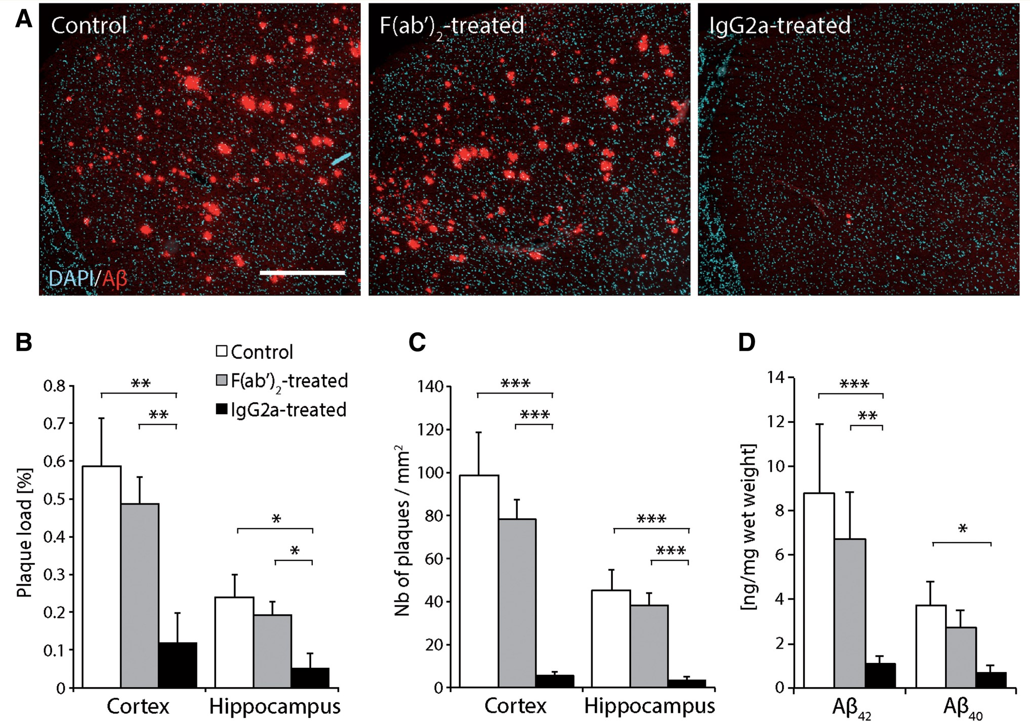
Figure 6 Preventive mAb-11 immunization using ECT delivery strongly reduces amyloid load in the brain of TauPS2APP ...
Notes:
Figure 6 Preventive mAb-11 immunization using ECT delivery strongly reduces amyloid load in the brain of TauPS2APP mice. ( A ) Amyloid burden revealed by anti-amyloid-β immunostaining (6E10) in the frontal cortices of 12-month-old TauPS2APP mice. Note the decreased amyloid pathology in the cortex of the TauPS2APP mouse continuously treated with mAb-11 IgG2a. ( B ) Plaque load, expressed as the percentage of the brain area occupied by amyloid-β-positive plaques, is significantly reduced in the cortex and hippocampus of mice treated with mAb-11 IgG2a. ( C ) The density of amyloid plaques is significantly decreased in these brain regions. ( D ) The amount of amyloid-β 42 and amyloid-β 40 is significantly decreased in the cortex of mice treated with mAb-11 IgG2a. Data are expressed as the mean ± SEM; Control group: n = 8, F(ab’) 2 - and IgG2a-treated groups: n = 10. One-way ANOVA with Newman-Keuls post hoc test: * P < 0.05, ** P < 0.01, *** P < 0.001. Scale bar = 500 µm ( A ).
Unless provided in the caption above, the following copyright applies to the content of this slide: © The Author (2016). Published by Oxford University Press on behalf of the Guarantors of Brain. All rights reserved. For Permissions, please email: journals.permissions@oup.com

Slide 5
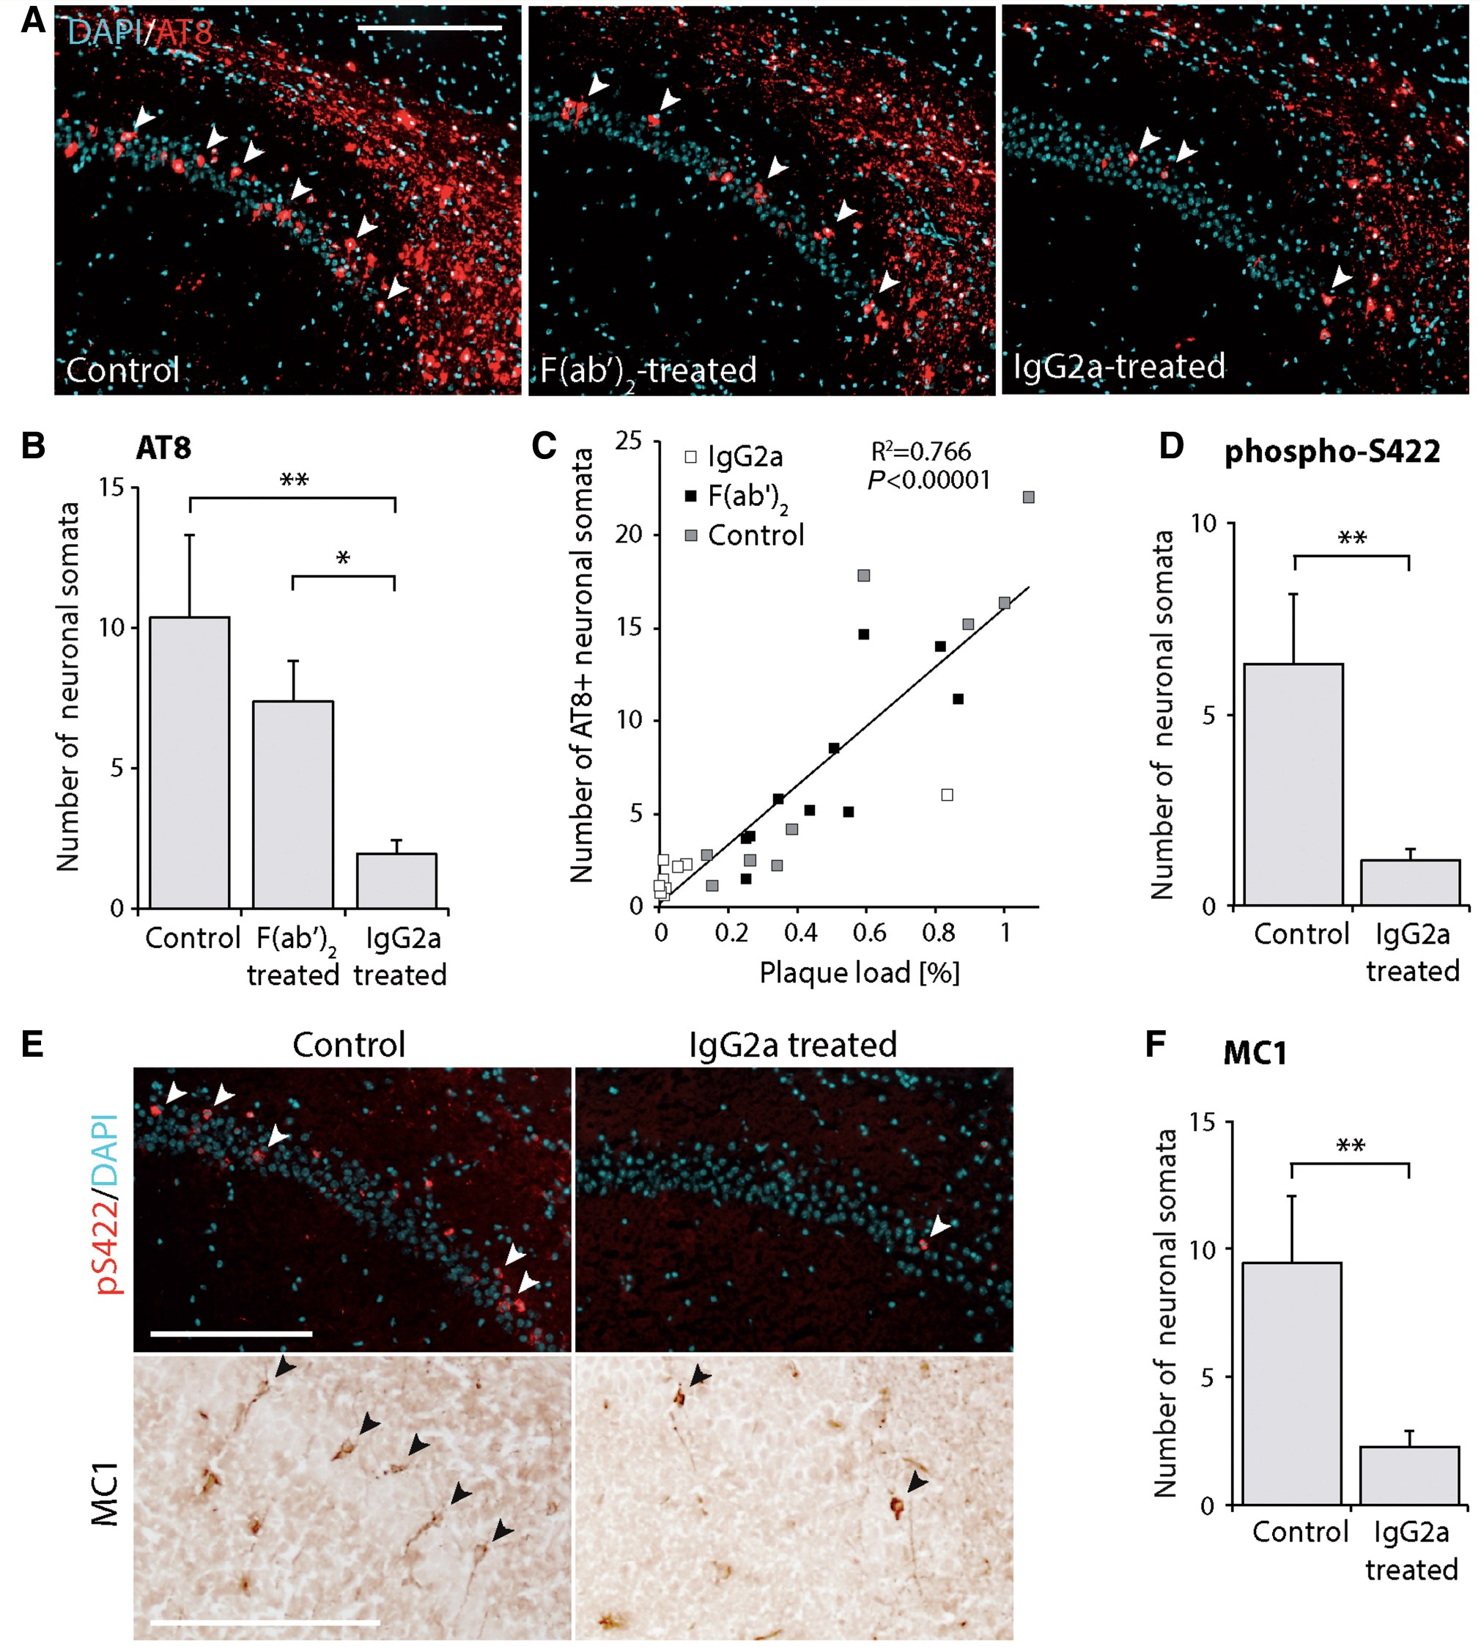
Figure 8 ECT delivery of mAb-11 IgG2a decreases tau pathology in the CA1 region of the hippocampus of TauPS2APP mice. ...
Notes:
Figure 8 ECT delivery of mAb-11 IgG2a decreases tau pathology in the CA1 region of the hippocampus of TauPS2APP mice. ( A ) Representative photomicrographs of the CA1 region of the hippocampus. Neurons are stained for tau phosphorylated at serine 202 and threonine 205 residues (AT8), and nuclei are stained with DAPI. AT8-positive neuronal somata in the pyramidal layer are indicated with arrowheads. ( B ) Quantification of the number of AT8-positive neurons in the CA1 pyramidal layer of the hippocampus. Note the significant reduction in mAb-11 IgG2a treated mice. ( C ) Correlation between amyloid-β burden and the number of AT8-positive neurons in the CA1 hippocampal region. Individual values from control, mAb-11 F(ab’) 2 -treated and IgG2a-treated mice are shown in the same graph for correlation. ( D ) Quantification of the number of neurons with somatodendritic localization of phospho-S422 tau in the CA1 pyramidal layer of the hippocampus. ( E ) Representative images of phospho-S422 tau and MC1 stainings in the hippocampal CA1 region. Arrowheads indicate neurons with somatodendritic staining. ( F ) Quantification of the number of MC1-positive neuronal somata in the CA1 pyramidal layer. Data are expressed as the mean ± SEM; Control group: n = 8, F(ab’) 2 - and IgG2a-treated groups: n = 10. One-way ANOVA with Newman-Keuls post hoc test ( B ) and two-tailed heteroscedastic t -tests ( D and F ): * P < 0.05, **P < 0.01. Correlation in ( C ) is analysed with the Pearson’s test. Scale bar = 200 µm ( A and E ).
Unless provided in the caption above, the following copyright applies to the content of this slide: © The Author (2016). Published by Oxford University Press on behalf of the Guarantors of Brain. All rights reserved. For Permissions, please email: journals.permissions@oup.com

Slide 6
Figure 3 Anti-amyloid-β antibodies delivered by ECT in the subcutaneous tissue bind to amyloid plaques in the brain of ...
Notes:
Figure 3 Anti-amyloid-β antibodies delivered by ECT in the subcutaneous tissue bind to amyloid plaques in the brain of 5XFAD mice. ( A ) Plasma levels of mAb-11 in 5XFAD mice implanted for 19 weeks with ECT devices containing mAb-11-secreting C2C12 myoblasts (clone 29, 29 pg mAb-11/cell/day). The bar graph shows the mAb-11 secretion rates of the ECT devices after explantation. Data are expressed as the mean ± SEM; n = 16. ( B ) Representative photomicrograph showing mAb-11 immunodecoration (green pseudocoloured IgG2a immunostaining) on amyloid-β plaques in the frontal cortex of a 27-week-old 5XFAD mouse exposed to 6432 µg/ml*day of antibody in the plasma. ( C ) High magnification confocal imaging of mAb-11 immunodecoration on amyloid-β plaques. Note that mAb-11 binds both fibrillar bundles (arrow) and plaques with a dense amyloid core (arrowhead). Scale bars = 100 µm ( B ), 10 µm ( C ).
Unless provided in the caption above, the following copyright applies to the content of this slide: © The Author (2016). Published by Oxford University Press on behalf of the Guarantors of Brain. All rights reserved. For Permissions, please email: journals.permissions@oup.com

Slide 7
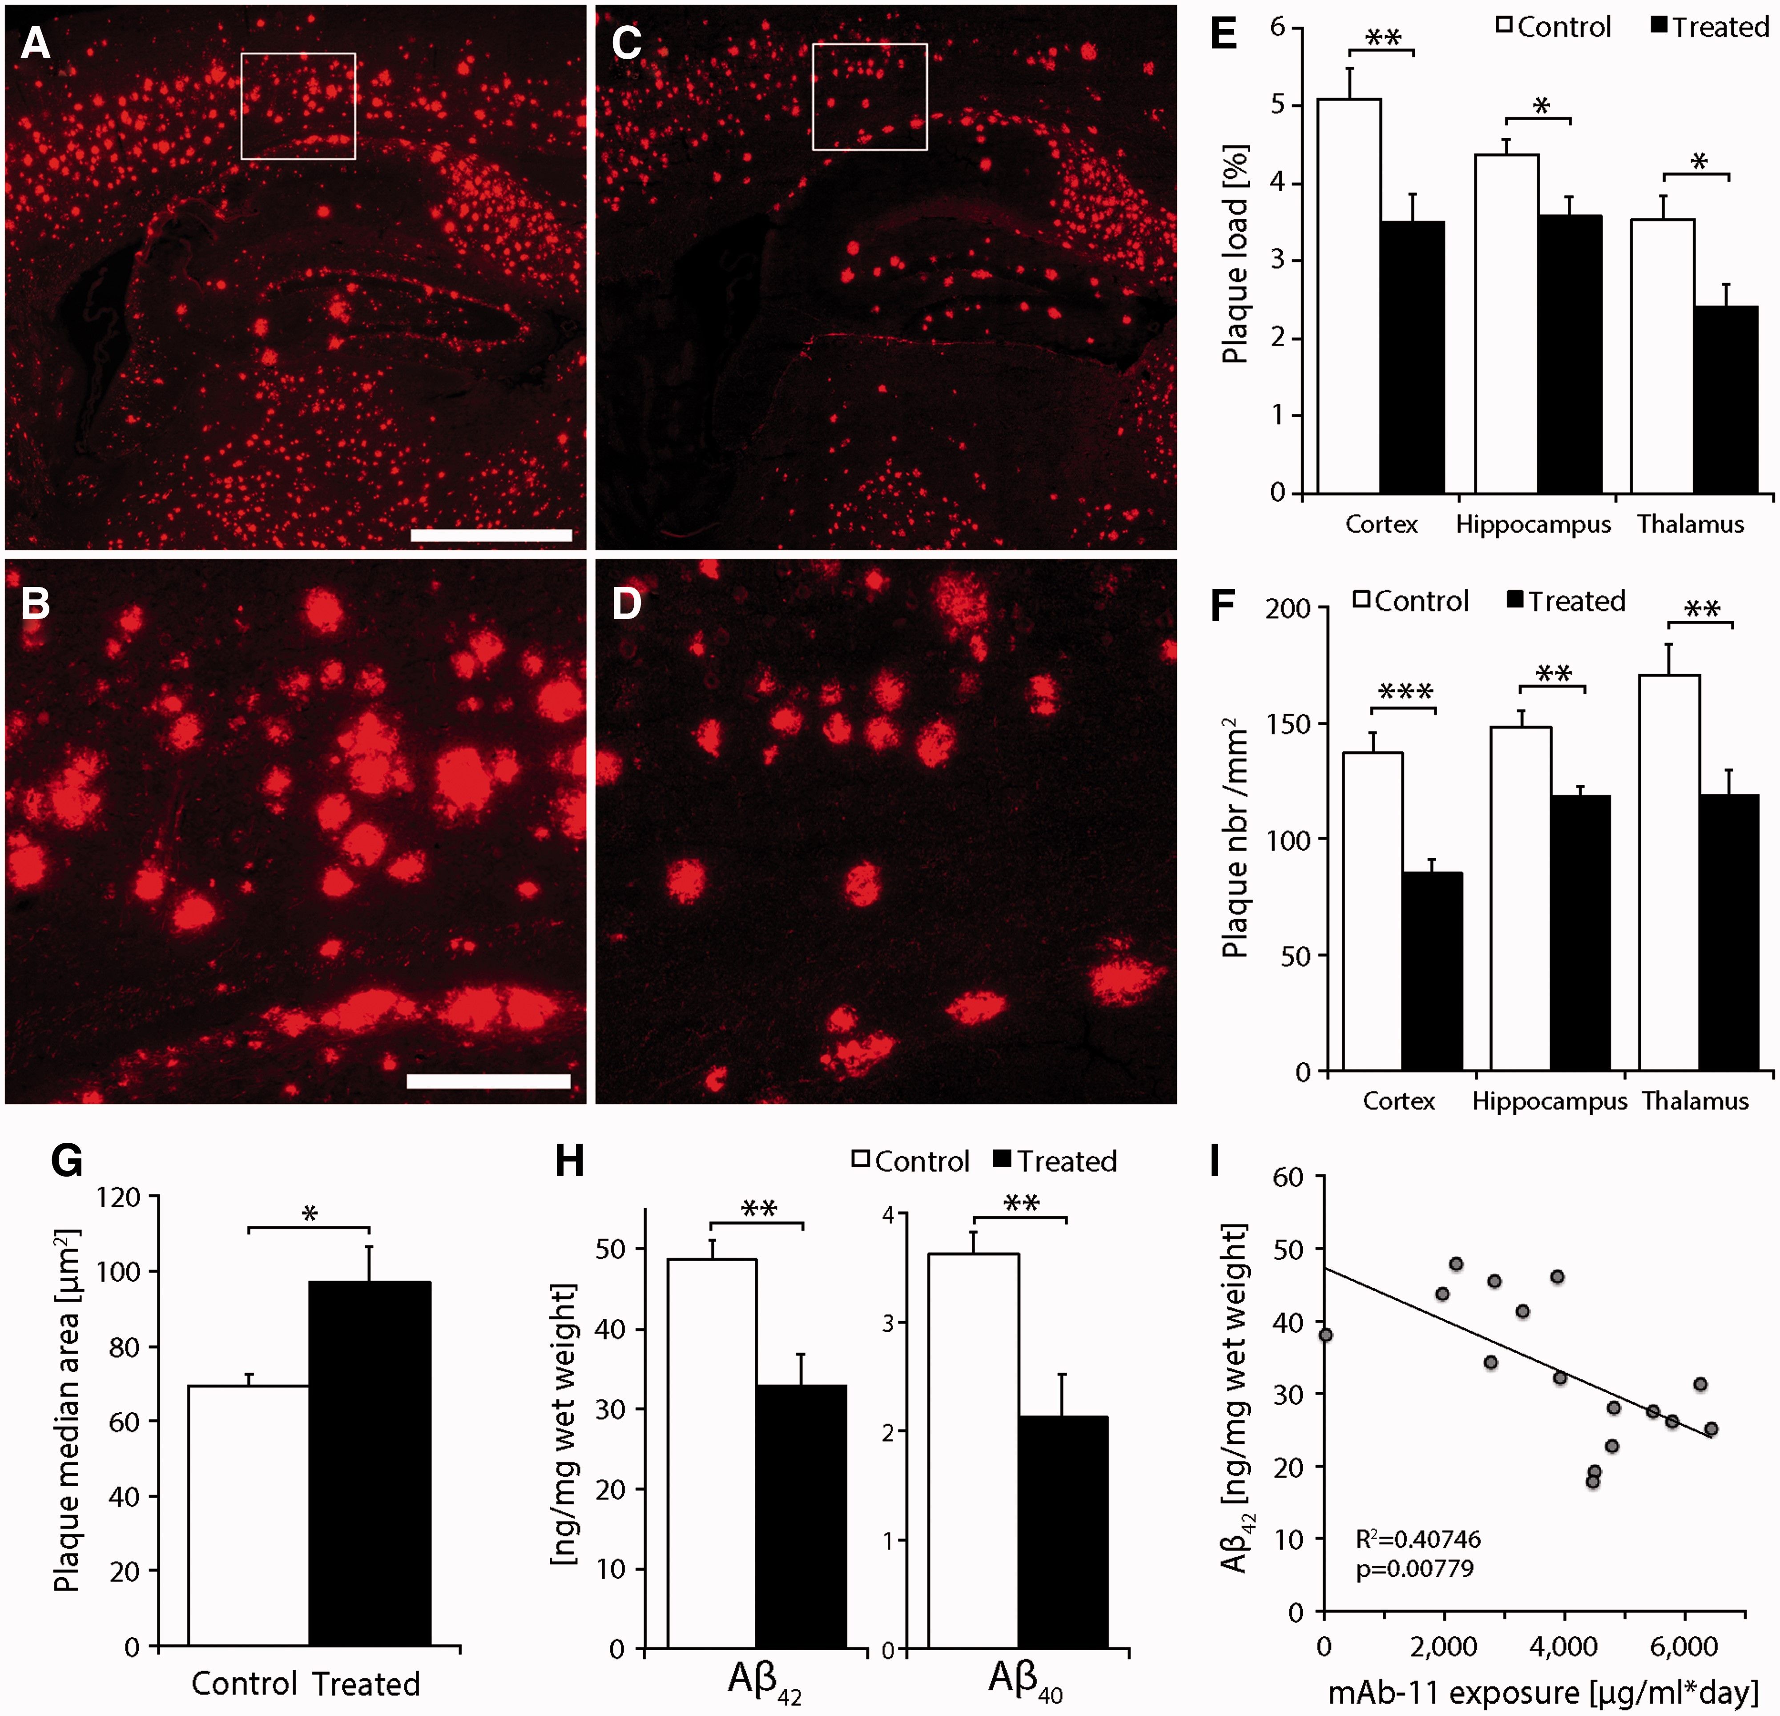
Figure 4 Continuous anti-amyloid-β antibody delivered by ECT reduces amyloid burden in 5XFAD mice. ( A – D ) ...
Notes:
Figure 4 Continuous anti-amyloid-β antibody delivered by ECT reduces amyloid burden in 5XFAD mice. ( A – D ) Representative photomicrographs of the amyloid pathology (6E10 immunofluorescence) in 5XFAD mice implanted for 19 weeks with control devices (containing GFP-expressing C2C12 myoblasts) ( A and B ) or with devices secreting mAb-11 ( C and D ). In these 5- to 6-month-old mice, the staining reveals a robust amyloid pathology that is reduced in the treated animals ( C and D ). ( B and D ) Higher magnifications of the regions outlined in ( A ) and ( C ), respectively. ( E ) The quantification of amyloid-β burden shows a significant reduction in the plaque load (percentage of the section surface occupied by plaques) in the cortex, hippocampus and thalamus of treated mice. ( F ) The density of amyloid plaques is significantly decreased in these brain regions. ( G ) The median amyloid plaque area is significantly larger in the treated animals. ( H ) The analysis of brain homogenates demonstrates a significant reduction in the amount of amyloid-β 42 and amyloid-β 40 peptides in mice implanted with mAb-11-releasing devices. ( I ) The level of amyloid-β 42 in cortex homogenates is significantly correlated with the total exposure to mAb-11 in the plasma of the treated animals. Data are expressed as the mean + SEM. n = 15 per group. Two-tailed heteroscedastic t -tests: * P < 0.05; **P < 0.01; ***P < 0.001. Correlation is analysed with the Pearson’s test. Scale bars = 1 mm ( A ), 200 µm ( C ).
Unless provided in the caption above, the following copyright applies to the content of this slide: © The Author (2016). Published by Oxford University Press on behalf of the Guarantors of Brain. All rights reserved. For Permissions, please email: journals.permissions@oup.com

Slide 8
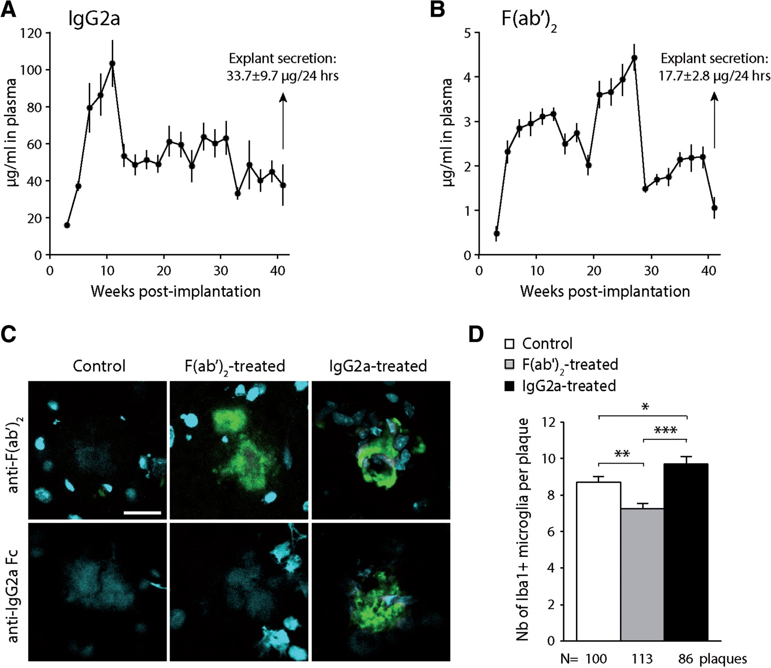
Figure 5 Preventive mAb-11 delivery using ECT affects the local recruitment of microglial cells in TauPS2APP mice. ( A ...
Notes:
Figure 5 Preventive mAb-11 delivery using ECT affects the local recruitment of microglial cells in TauPS2APP mice. ( A and B ) Plasma levels of mAb-11 in TauPS2APP mice implanted for 41 weeks with devices containing either IgG2a-secreting C2C12 myoblasts ( A ), or F(ab’) 2 fragment-secreting C2C12 myoblasts ( B ). The bar graph shows the mAb-11 secretion rate of the ECT devices after explantation. Data are expressed as the mean ± SEM; n = 10. ( C ) Representative photomicrographs showing mAb-11 immunodecoration (green pseudocoloured immunostaining) on amyloid-β plaques in the frontal cortex of a TauPS2APP mice implanted with either control, IgG2a-secreting or F(ab’) 2 -secreting devices. Note that the anti-IgG2a Fc antibody detects only the presence of the full IgG2a antibody, confirming staining specificity. Nuclei are stained with DAPI. ( D ) Quantification of Iba1-positive microglial cells present around amyloid plaques in each group of mice. Note the significant decrease in microglial cell density around plaques in F(ab’) 2 -treated TauPS2APP mice and the increase in IgG2a-treated mice. The number of plaques analysed in each group is indicated. Data are expressed as the mean ± SEM; F(ab’) 2 - and IgG2a-treated groups: n = 10. One-way ANOVA with Newman-Keuls post hoc test: * P < 0.05, **P < 0.01, ***P < 0.001. Scale bar = 20 µm.
Unless provided in the caption above, the following copyright applies to the content of this slide: © The Author (2016). Published by Oxford University Press on behalf of the Guarantors of Brain. All rights reserved. For Permissions, please email: journals.permissions@oup.com

Slide 9
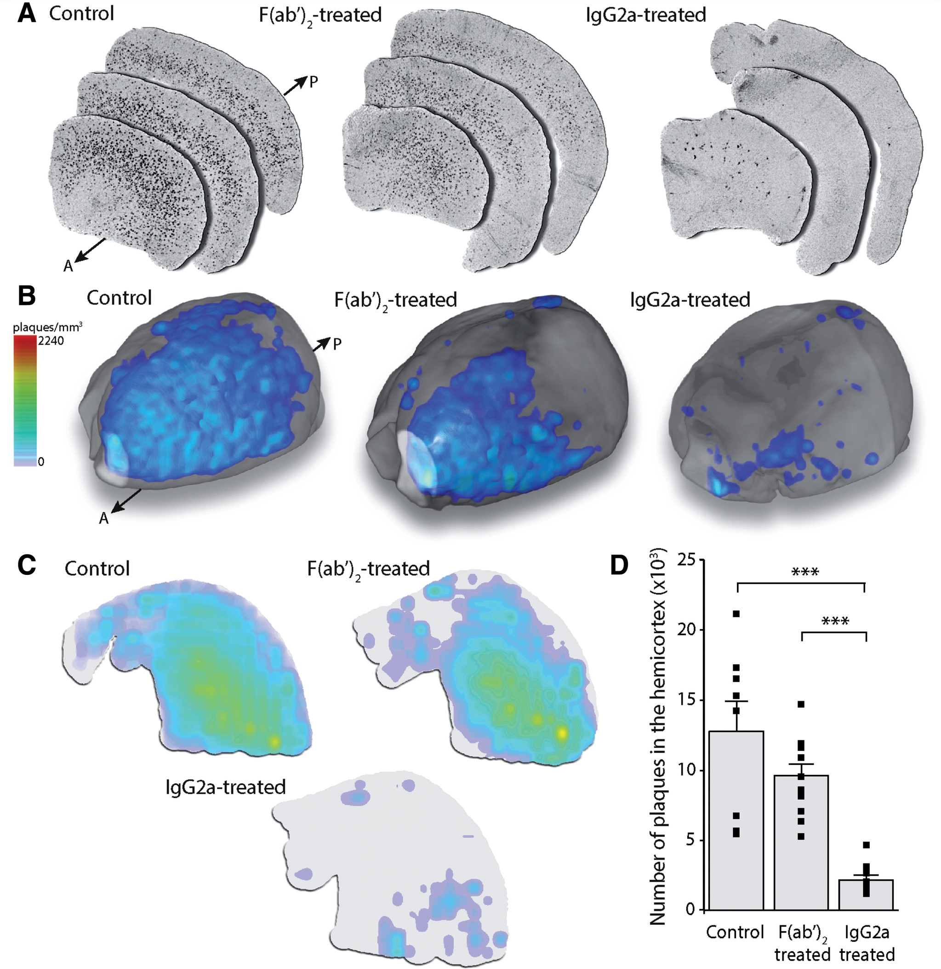
Figure 7 ECT delivery of mAb-11 IgG2a prevents amyloid plaque deposition throughout the entire cortex of TauPS2APP ...
Notes:
Figure 7 ECT delivery of mAb-11 IgG2a prevents amyloid plaque deposition throughout the entire cortex of TauPS2APP mice. ( A ) Phase-contrast tomographic microscopy of the whole hemicortex reveals hyperintense signals in 12-month-old TauPS2APP mice. The signals are shown on three cortex sections for three representative mice, one from each group, along the anterior (A)–posterior (P) axis. Note the reduction in hyperintense signals in the mAb-11 IgG2a-treated mice. ( B ) Representative hemicortex with superimposed colour-coded density of the hyperintense dots (plaques/mm 3 ). Note that IgG2a-treated mice have detectable plaques only in the most frontal part of the cortex. ( C ) Coronal maximum-intensity maps of the representative hemicortex. Note the overall reduction in plaque density in the IgG2a-treated mouse. ( D ) Quantification of the total number of plaques in the hemicortex of mice implanted either with control, mAb-11 F(ab’) 2 - and mAb-11 IgG2a-secreting ECT devices. Data are expressed as the mean ± SEM; Control group: n = 8, F(ab’) 2 -treated: n = 11, IgG2a-treated: n = 10. One-way ANOVA with Newman-Keuls post hoc test: ***P < 0.001.
Unless provided in the caption above, the following copyright applies to the content of this slide: © The Author (2016). Published by Oxford University Press on behalf of the Guarantors of Brain. All rights reserved. For Permissions, please email: journals.permissions@oup.com

