Slide 1
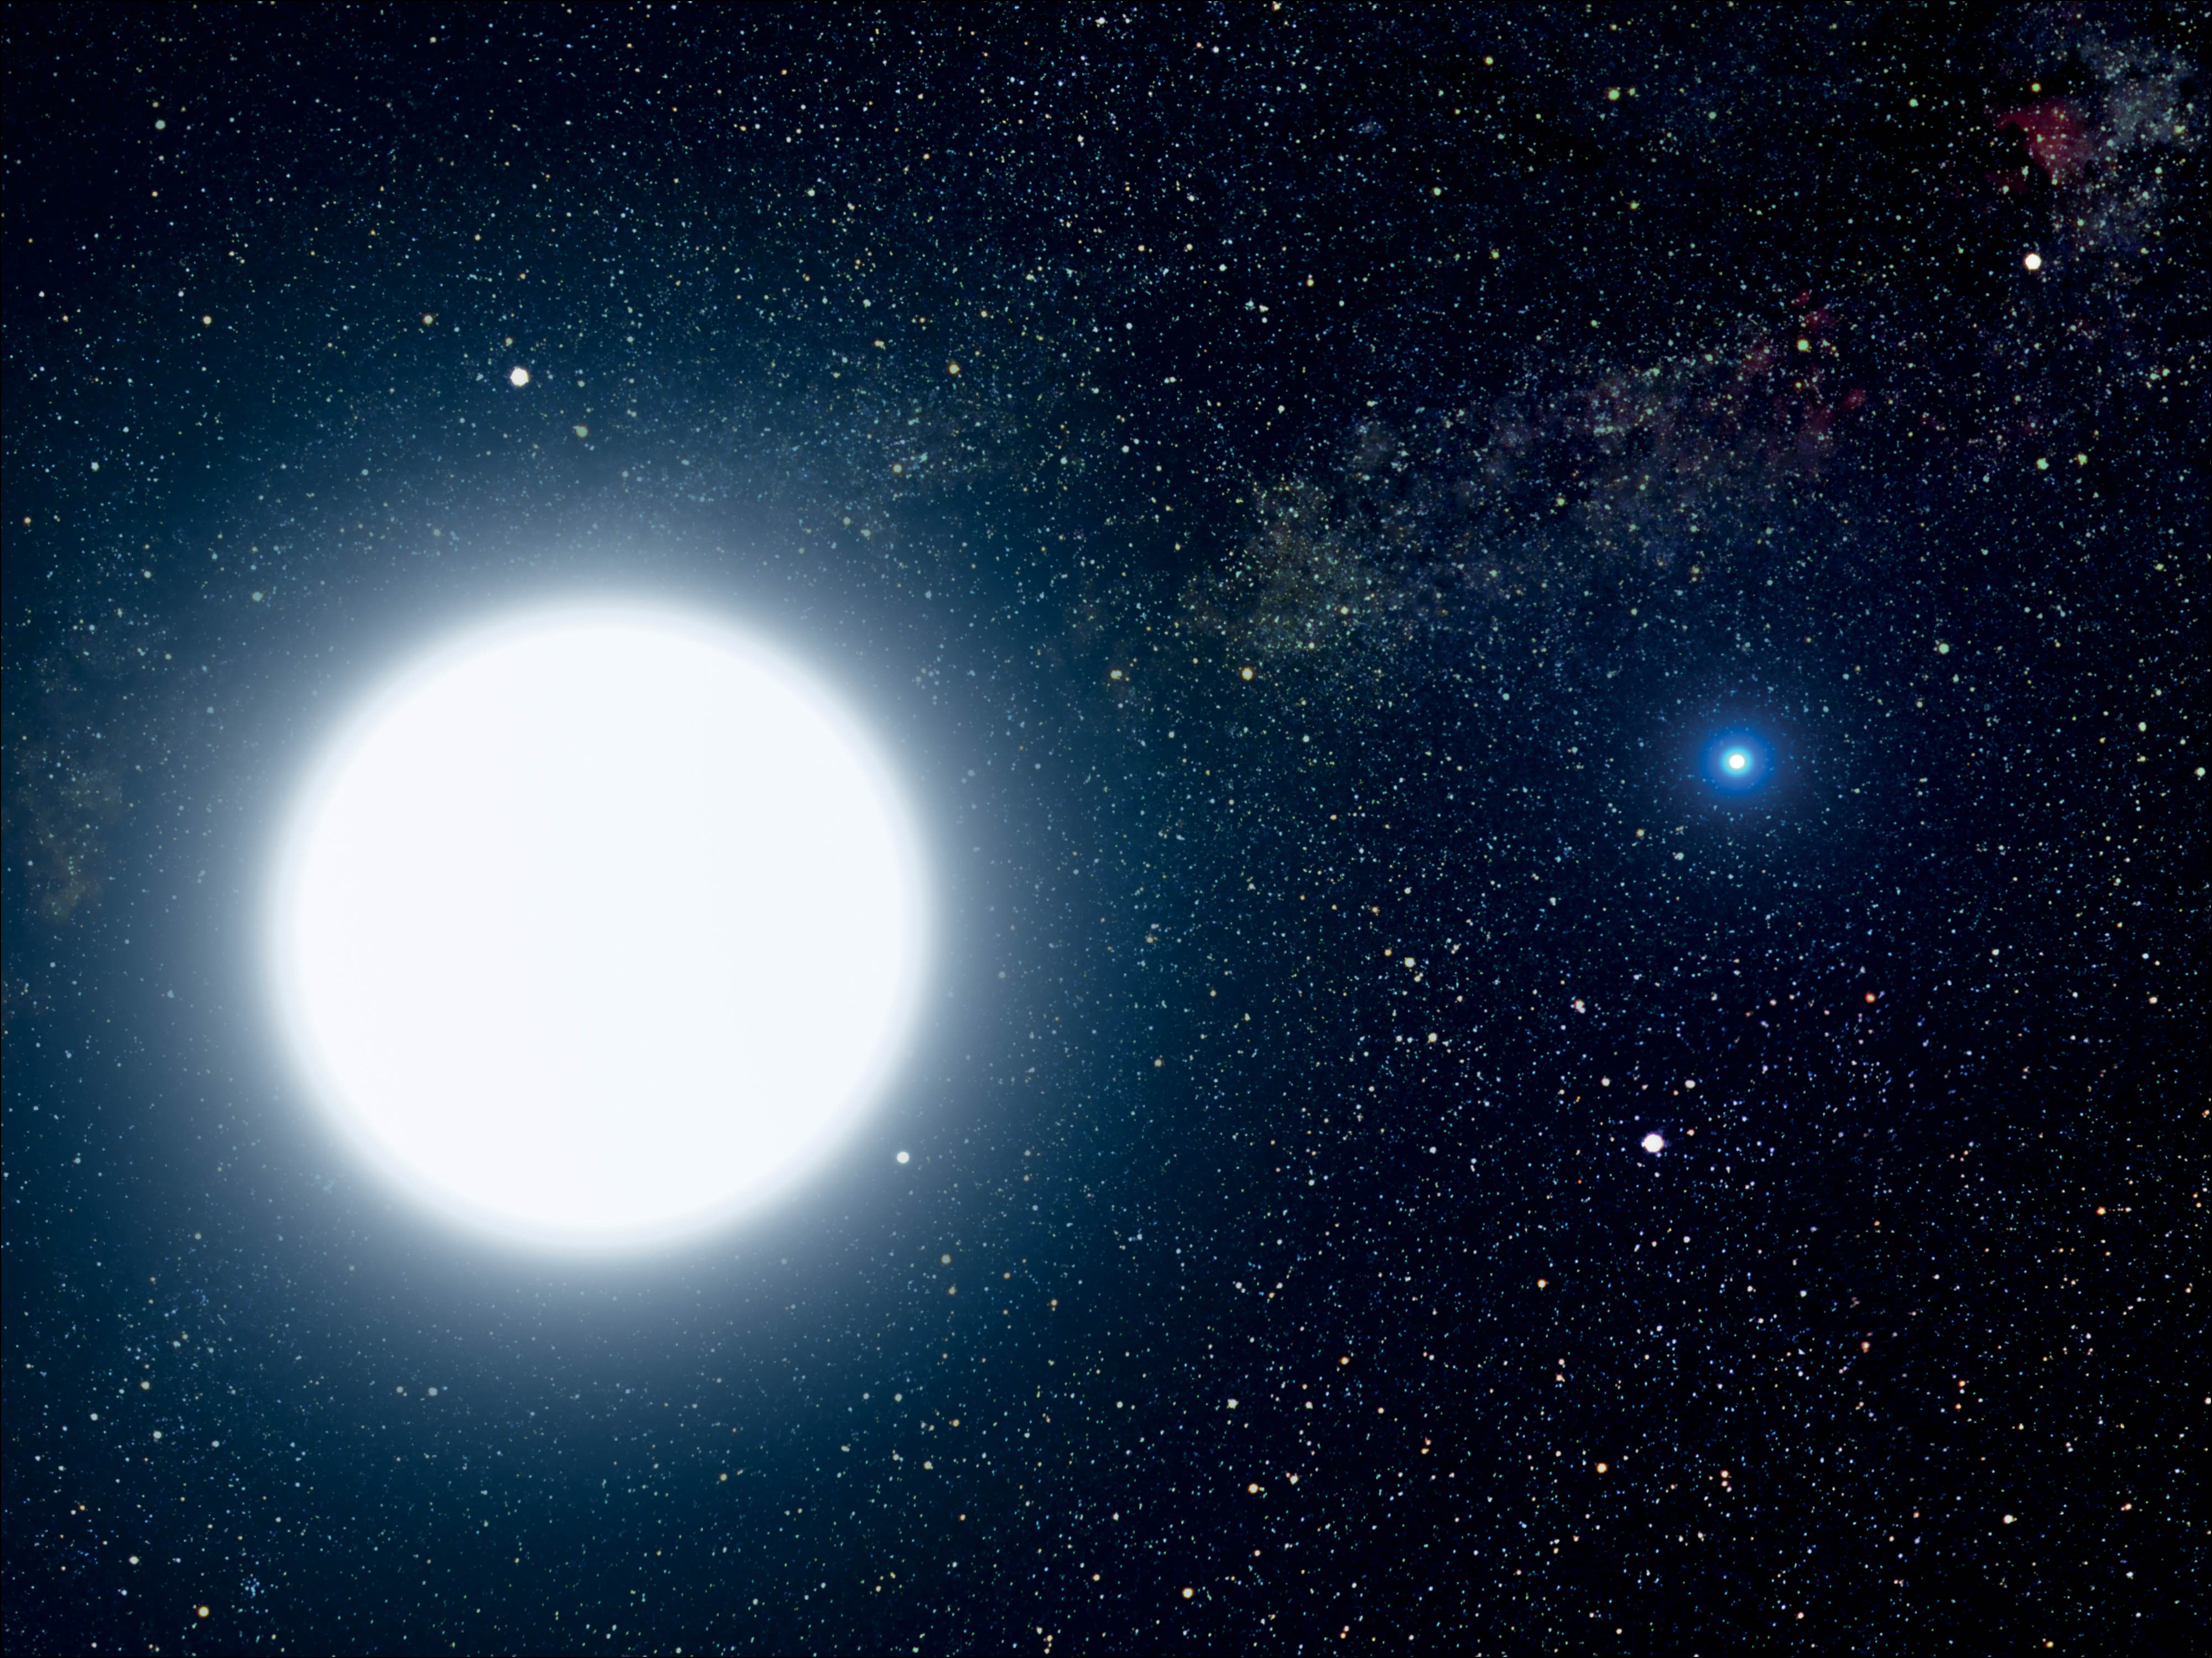
1 Artist's impression of the binary star system of Sirius A and the smaller white dwarf Sirius B. With a ...
Notes:
1 Artist's impression of the binary star system of Sirius A and the smaller white dwarf Sirius B. With a diameter of 7500 miles, Sirius B is slightly smaller than Earth. (NASA, ESA and G Bacon [STScI])
Unless provided in the caption above, the following copyright applies to the content of this slide: © 2016 Royal Astronomical Society

Slide 2
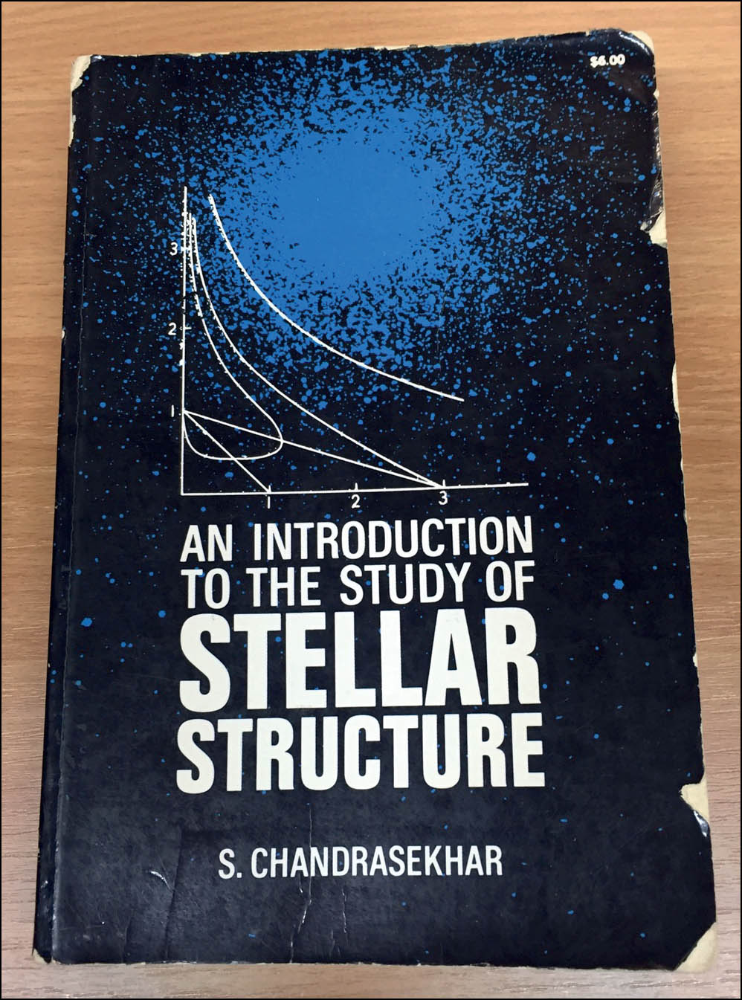
2 The author's own copy of Chandrasekhar's 1939 book, containing an influential explanation of white dwarfs.
Notes:
2 The author's own copy of Chandrasekhar's 1939 book, containing an influential explanation of white dwarfs.
Unless provided in the caption above, the following copyright applies to the content of this slide: © 2016 Royal Astronomical Society

Slide 3
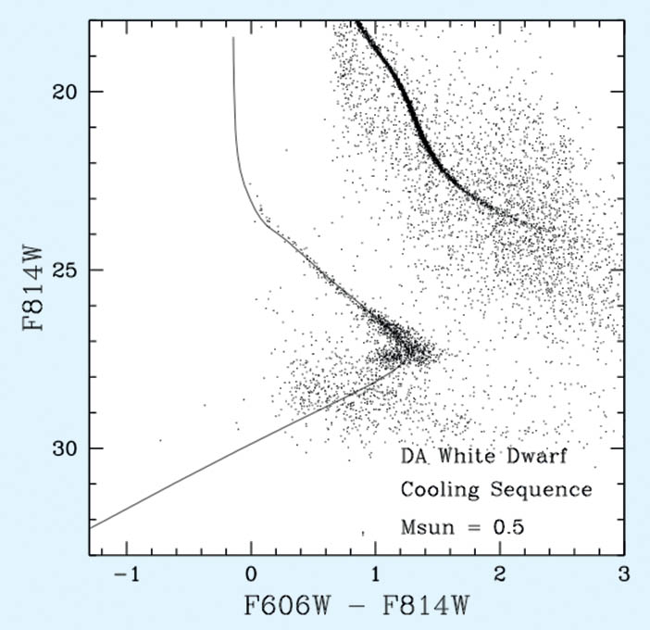
3 HR diagram showing white dwarf cooling sequence.
Notes:
3 HR diagram showing white dwarf cooling sequence.
Unless provided in the caption above, the following copyright applies to the content of this slide: © 2016 Royal Astronomical Society

Slide 4
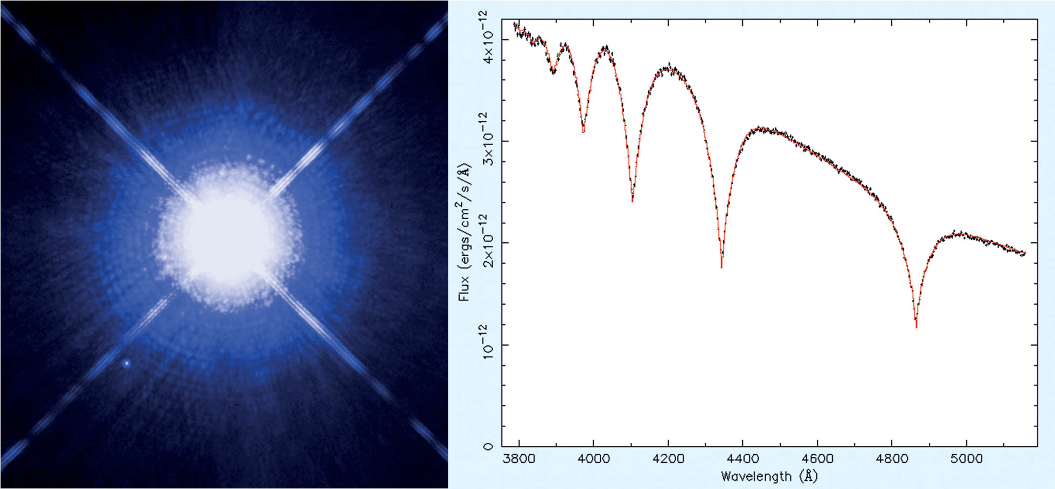
4 (Left) Sirius B clearly resolved in the HST image; note how close it lies to the diffraction spike from its ...
Notes:
4 (Left) Sirius B clearly resolved in the HST image; note how close it lies to the diffraction spike from its much brighter companion. (NASA, H E Bond and E Nelan [STSI]; M Barstow and M Burleigh [Univ. Leicester]; J B Holberg [Univ. Arizona]) (Right) Balmer line spectrum of Sirius B from the Balmer limit to H β, obtained from the STIS instrument on HST, using the G430L grating.
Unless provided in the caption above, the following copyright applies to the content of this slide: © 2016 Royal Astronomical Society

Slide 5
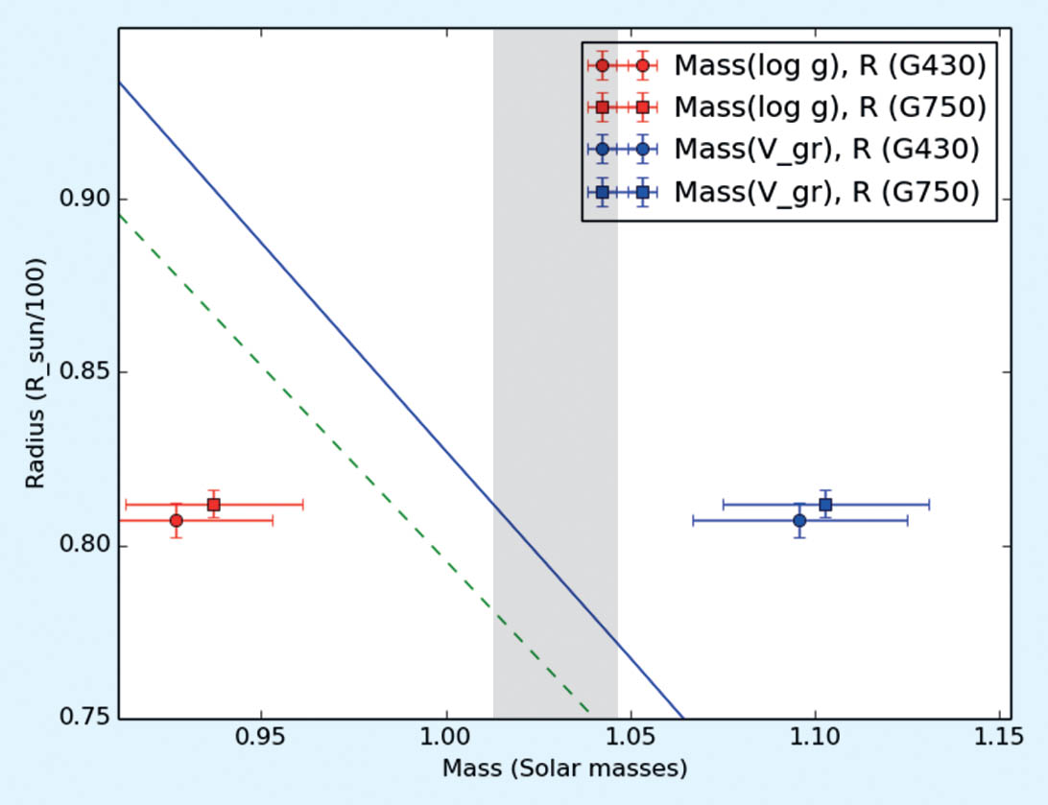
5 Red points show Sirius B masses derived from log g for the G430L and G750M spectra; blue points, masses ...
Notes:
5 Red points show Sirius B masses derived from log g for the G430L and G750M spectra; blue points, masses derived from the gravitational redshift. The blue line is the theoretical relation from Fontaine et al. (2001) for a CO core thick H layer; the green line for a thin H layer, both at 25 000 K. Shading shows the allowed range of the astrometric mass determination.
Unless provided in the caption above, the following copyright applies to the content of this slide: © 2016 Royal Astronomical Society

Slide 6
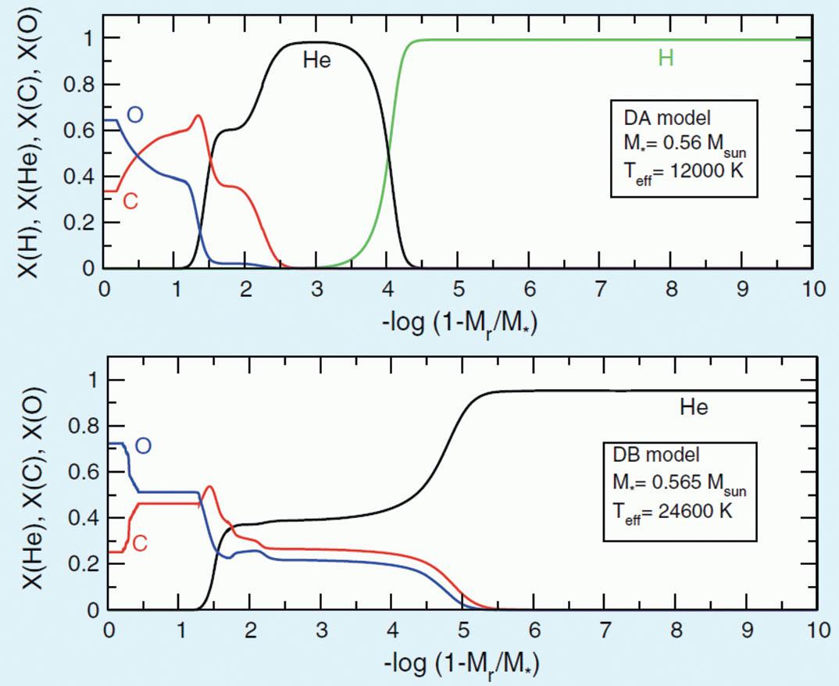
6 Profiles of white dwarf compositions from the surface down to the interior for both DA (top) and DB (bottom) ...
Notes:
6 Profiles of white dwarf compositions from the surface down to the interior for both DA (top) and DB (bottom) white dwarfs. Typically their cores are mixtures of carbon and oxygen, then all white dwarfs have a helium envelope. (Fig. 17 in Althaus et al. 2010)
Unless provided in the caption above, the following copyright applies to the content of this slide: © 2016 Royal Astronomical Society

Slide 7
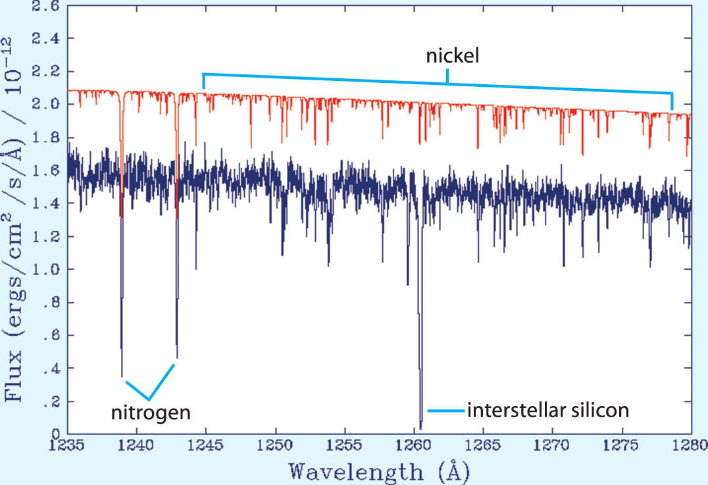
7 White dwarf spectrum (purple) and synthetic spectrum (red) demonstrating the typical composition of a white ...
Notes:
7 White dwarf spectrum (purple) and synthetic spectrum (red) demonstrating the typical composition of a white dwarf envelope. The synthetic spectrum is offset from the observation for clarity.
Unless provided in the caption above, the following copyright applies to the content of this slide: © 2016 Royal Astronomical Society

Slide 8
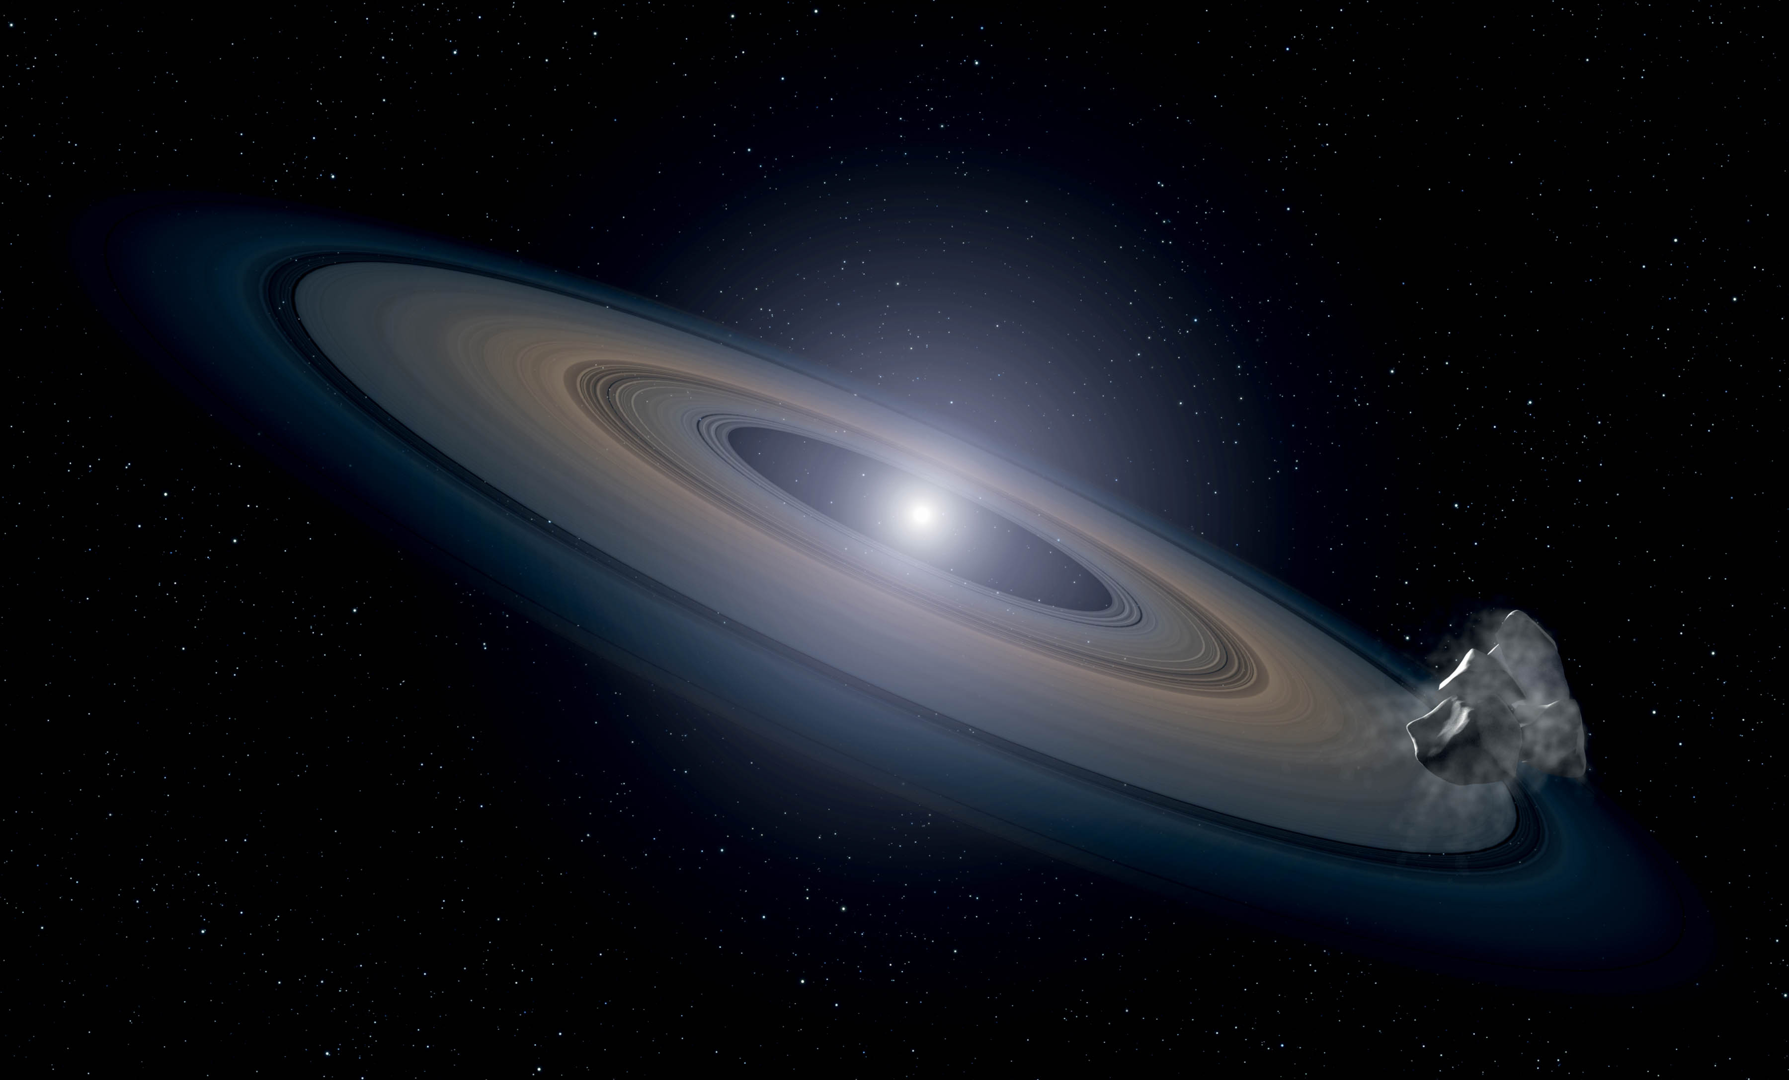
8 Artist's impression of a white dwarf accreting rocky debris left behind by the star's surviving planetary ...
Notes:
8 Artist's impression of a white dwarf accreting rocky debris left behind by the star's surviving planetary system. (NASA, ESA and G Bacon [STScI])
Unless provided in the caption above, the following copyright applies to the content of this slide: © 2016 Royal Astronomical Society

Slide 9
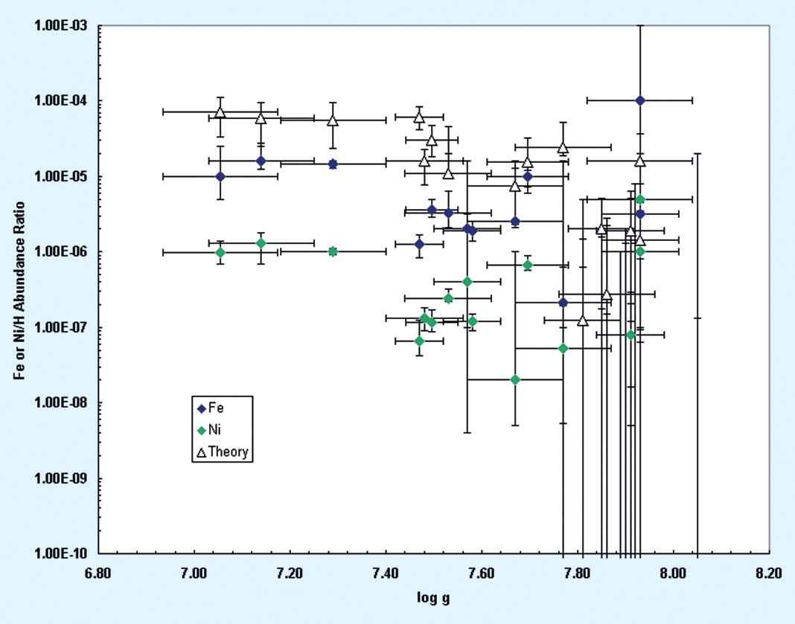
9 The measured abudances of nickel (green diamonds) and iron (blue). The unfilled triangles are the predictions ...
Notes:
9 The measured abudances of nickel (green diamonds) and iron (blue). The unfilled triangles are the predictions of radiation theory.
Unless provided in the caption above, the following copyright applies to the content of this slide: © 2016 Royal Astronomical Society

