Slide 1
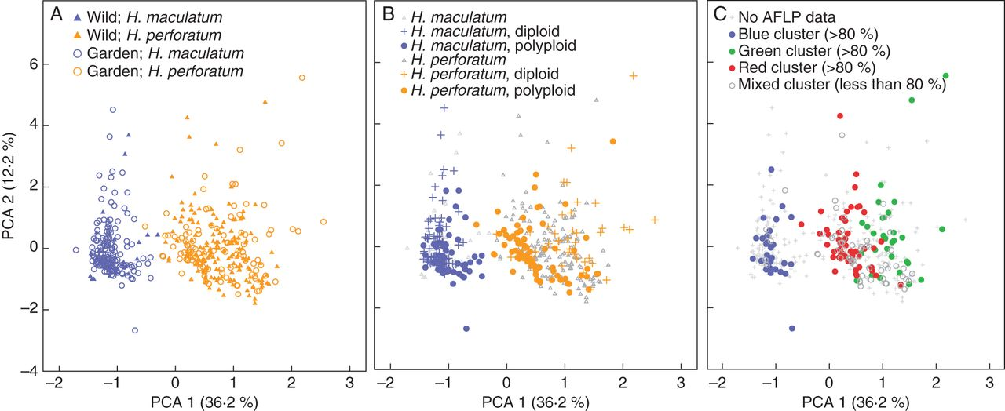
Fig. 1. Principal co-oordinate analysis (PCA) of the whole data set including 476 individuals (Supplementary Data ...
Notes:
Fig. 1. Principal co-oordinate analysis (PCA) of the whole data set including 476 individuals (Supplementary Data Table S3) and comparing H. maculatum with H. perforatum. (A) Phenotypic constancy of morphological characters: evaluation of discriminating power of morphological characters comparing morphology-based characters obtained from individuals directly collected in the wild with the respective material cultivated in a common garden experiment at Heidelberg Botanical Garden. (B) Combination of the morphological differentiation with ploidy. Unknown cytotypes are also indicated. (C) Combination of the morphological differentiation and affiliation with one out of the three genetic clusters as revealed by AFLP analysis. A colour signature (blue = H. maculatum; green/red = H. perforatum) follows the results as summarized in Supplementary Data Table S5. A colour is assigned only if the respective proportion of the genetic variation (blue, red or green) contributes >80 %. The remaining individuals scored for AFLPs but with no contribution of any genetic cluster >80 % are shown by open circles.
Unless provided in the caption above, the following copyright applies to the content of this slide: © The Author 2013. Published by Oxford University Press on behalf of the Annals of Botany Company. All rights reserved. For Permissions, please email: journals.permissions@oup.com

Slide 2
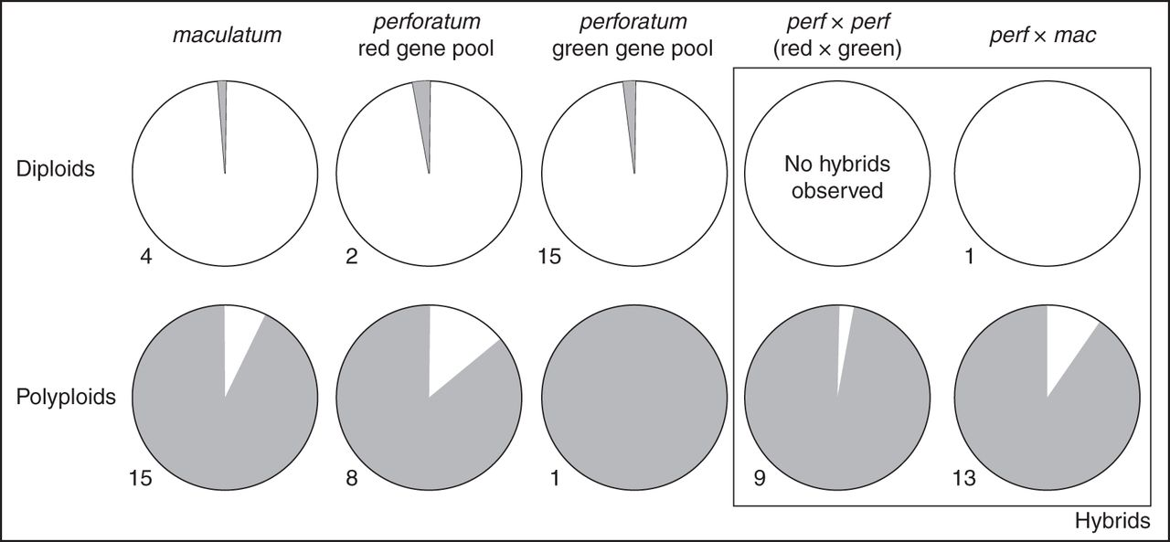
Fig. 5. The reproductive system of diploid and polyploid Hypericum perforatum, H. maculatum and hybrids. White, ...
Notes:
Fig. 5. The reproductive system of diploid and polyploid Hypericum perforatum, H. maculatum and hybrids. White, proportion of sexual reproduction; grey, proportion of any kind of asexual and apomictic seed production (see also Fig. 4). Diploids and polyploids are separated and further differentiated according to their genotypic designation (gene pool as indicated with AFLP and plastid DNA data, Figs 1 and 3; Supplementary Data Table S5). The numbers indicate the number of individuals investigated with seed screen analysis and providing endosperm:embryo DNA ratios.
Unless provided in the caption above, the following copyright applies to the content of this slide: © The Author 2013. Published by Oxford University Press on behalf of the Annals of Botany Company. All rights reserved. For Permissions, please email: journals.permissions@oup.com

Slide 3
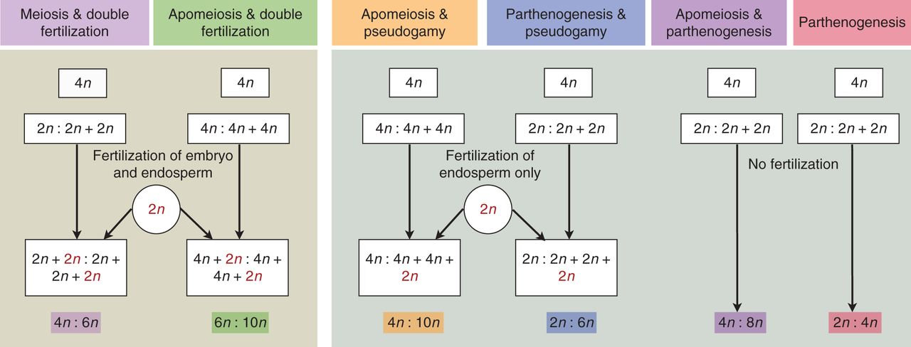
Fig. 4. Diagram summarizing the various modes of sexual and non-sexual reproduction in Hypericum maculatum and H. ...
Notes:
Fig. 4. Diagram summarizing the various modes of sexual and non-sexual reproduction in Hypericum maculatum and H. perforatum, and expected ratios in DNA content (embryo:endosperm) as measured here with FCSS (flow cytometric seed screen). The diagram uses a tetraploid (4n) mother plant as an example. The male gamete is indicated in red if contributing to endosperm fertilization and/or egg cell fertilization. The colour code corresponds to the categorization of our FCSS data summarized in Supplementary Data Table S6.
Unless provided in the caption above, the following copyright applies to the content of this slide: © The Author 2013. Published by Oxford University Press on behalf of the Annals of Botany Company. All rights reserved. For Permissions, please email: journals.permissions@oup.com

Slide 4
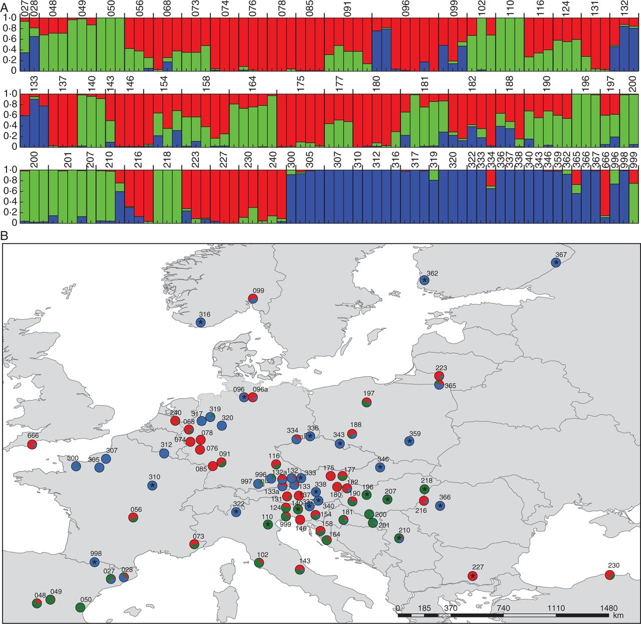
Fig. 3. (A) Structure analysis of the AFLP data of single individuals (optimal K = 3; n = 195). The population code ...
Notes:
Fig. 3. (A) Structure analysis of the AFLP data of single individuals (optimal K = 3; n = 195). The population code is given above the bars. The colour code corresponds to the plastid DNA data and distinguishes between Hypericum maculatum and two groups within H. perforatum (blue = H. maculatum; red and green = H. perforatum; Fig. 1). (B) Distribution map of populations. Pie charts combine the data from the individuals on the populational level. Asterisks (*) indicate diploid populations. Colour code follows (A) and Fig. 1 (blue = H. maculatum; red and green = H. perforatum). Additional populations analysed for morphometrics are shown in Supplementary Data Fig. S1.
Unless provided in the caption above, the following copyright applies to the content of this slide: © The Author 2013. Published by Oxford University Press on behalf of the Annals of Botany Company. All rights reserved. For Permissions, please email: journals.permissions@oup.com

Slide 5
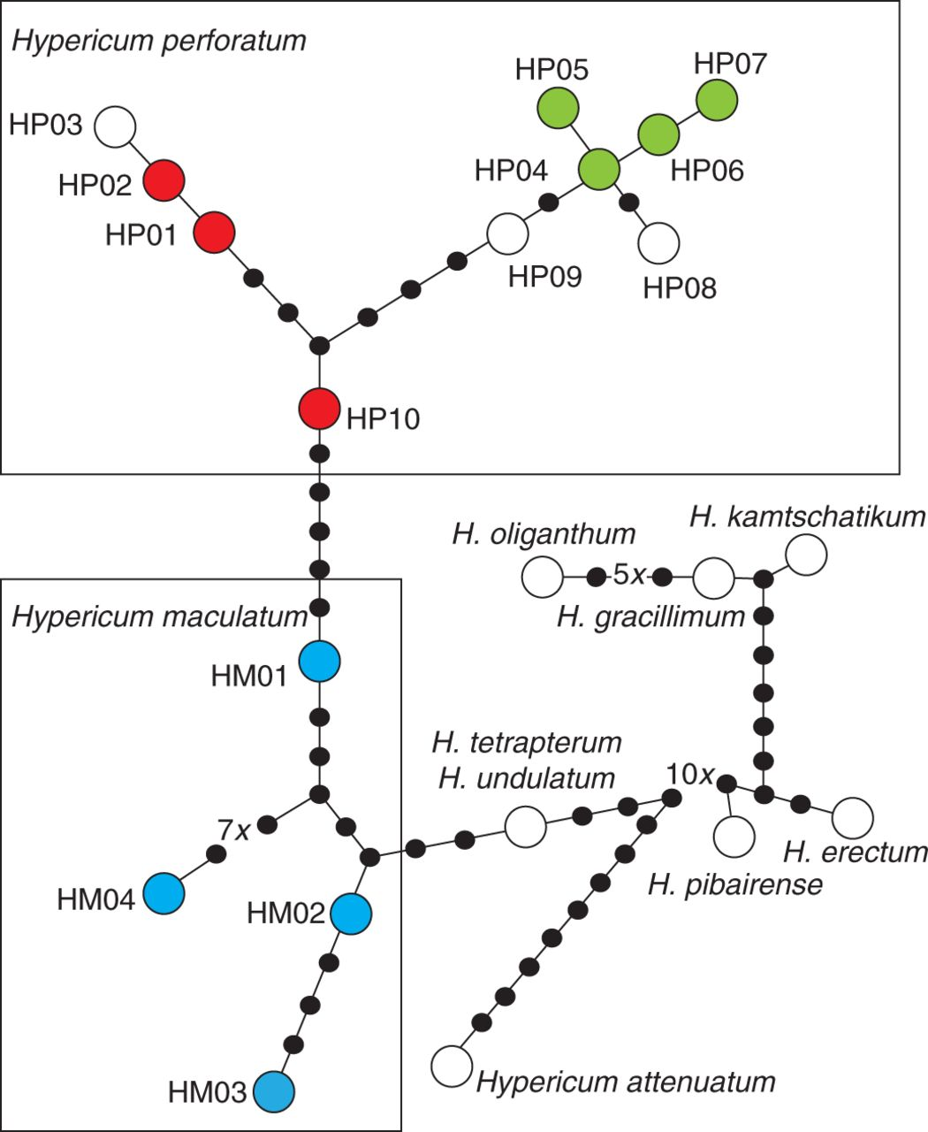
Fig. 2. Plastid DNA parsimony network of Hypericum perforatum and H. maculatum, and including various outgroup taxa. ...
Notes:
Fig. 2. Plastid DNA parsimony network of Hypericum perforatum and H. maculatum, and including various outgroup taxa. Hypericum tetrapterum and H. undulatum accessions shared an identical plastid DNA haplotype. The different colour codes correspond to those used for AFLP gene pool recognition (blue = H. maculatum; red and green = H. perforatum). Haplotype coding (HP01–HP10, HM01–HM04; and outgroup taxa) and respective sequence accession data are provided in Supplementary Data Table S4.
Unless provided in the caption above, the following copyright applies to the content of this slide: © The Author 2013. Published by Oxford University Press on behalf of the Annals of Botany Company. All rights reserved. For Permissions, please email: journals.permissions@oup.com

