Slide 1
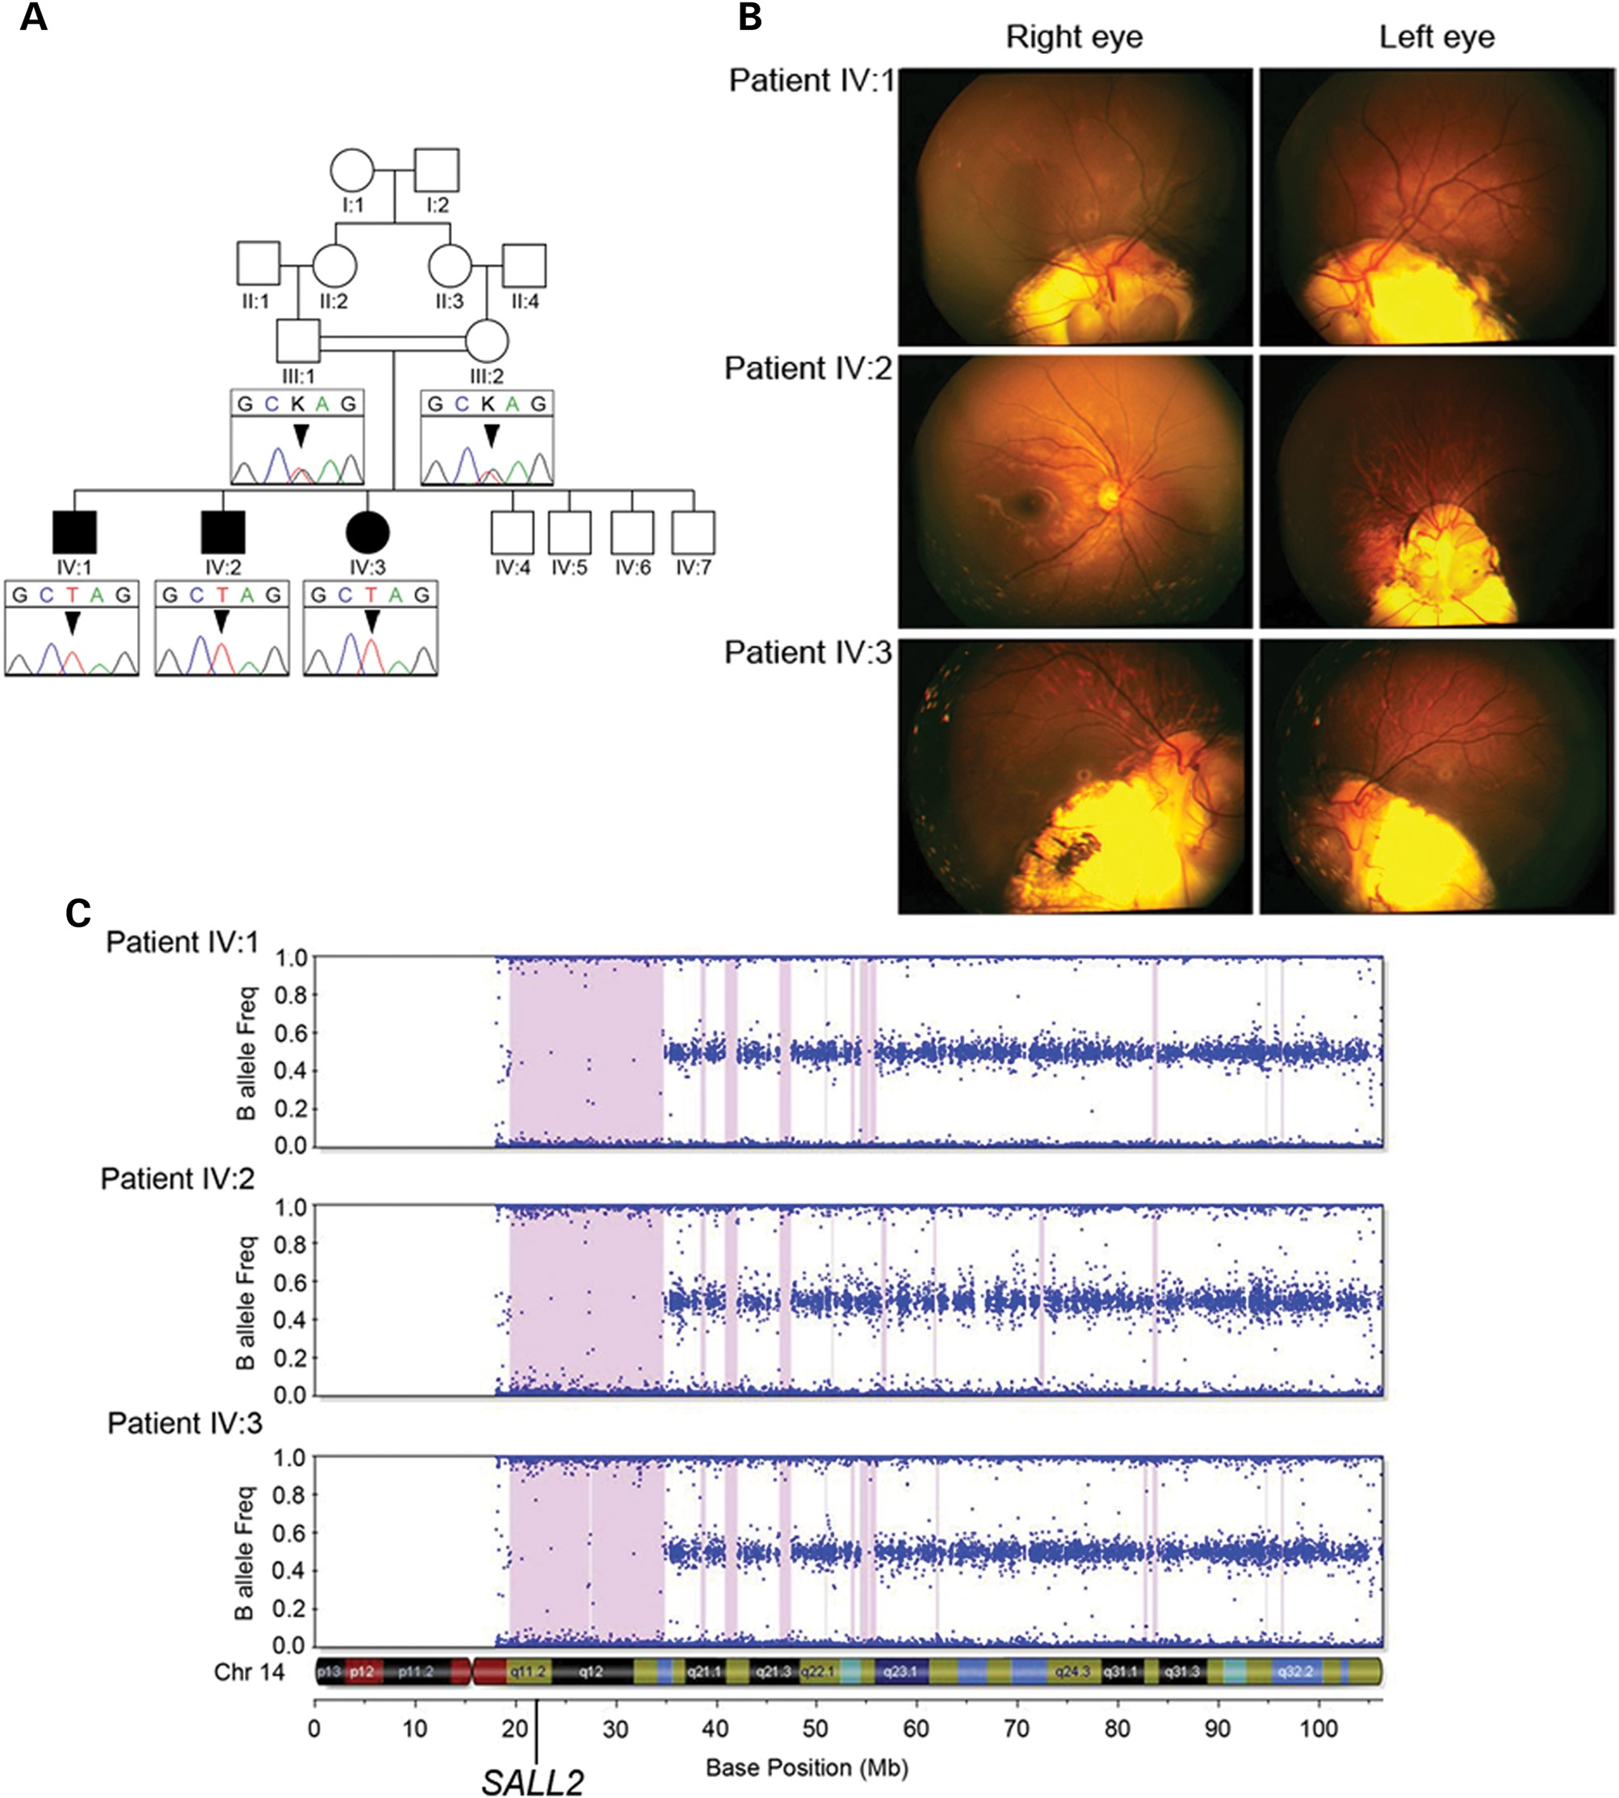
Figure 1. Pedigree structure, clinical images and homozygosity mapping. (A) Simplified pedigree of the family with ...
Notes:
Figure 1. Pedigree structure, clinical images and homozygosity mapping. (A) Simplified pedigree of the family with electropherograms of part of SALL2 exon 2 showing the c.85G>T mutation (arrowhead) homozygous in all three affected children and heterozygous in their parents. (B) Fundus photographs from all three affected children showing varying degrees of retinochoroidal coloboma affecting the optic disc in all cases except the right eye of patient IV:2 which has a normal appearance. (C) Homozygosity mapping output for each of the three affected siblings from Illumina Beadstudio v3.2 for chromosome 14 containing SALL2. Each dot represents an individual SNP marker on the array plotted as a function of the frequency of the minor (B) allele. Regions of extended homozygosity (>100 SNPs) are indicated by pink shading.
Unless provided in the caption above, the following copyright applies to the content of this slide: © The Author 2014. Published by Oxford University Press.This is an Open Access article distributed under the terms of the Creative Commons Attribution License (http://creativecommons.org/licenses/by/3.0/), which permits unrestricted reuse, distribution, and reproduction in any medium, provided the original work is properly cited.

Slide 2
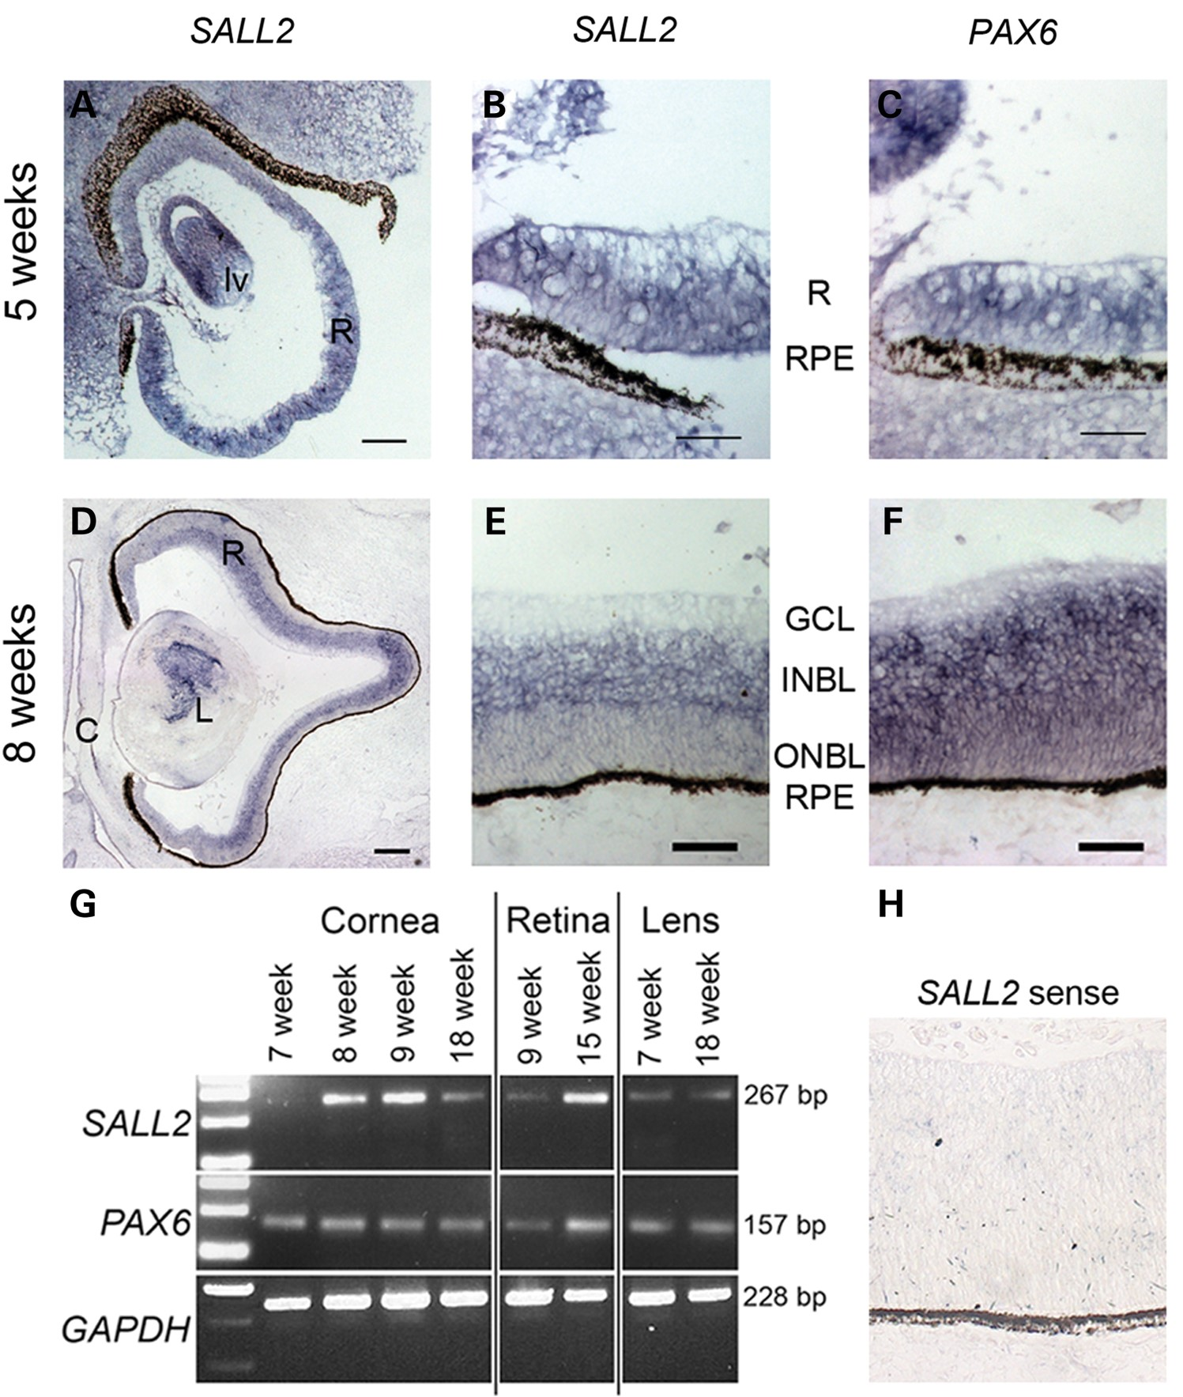
Figure 2. Expression analysis of SALL2 during human eye development. (A and B) RNA in situ hybridization on sagittal ...
Notes:
Figure 2. Expression analysis of SALL2 during human eye development. (A and B) RNA in situ hybridization on sagittal sections showing expression of SALL2 transcripts throughout the retina (R) and developing lens vesicle (lv) at 5 weeks of development in comparison to PAX6 expression (C). Expression of SALL2 is maintained at 8 weeks (D) but becomes restricted to the inner neuroblastic layer (INBL) as shown magnified in (E) as compared with PAX6 (F) which is expressed uniformly throughout the developing neural retina. (G) RT–PCR analysis using intron-flanking primers for SALL2 in total RNA extracted from microdissected cornea, retina and lens tissue from varying stages of development. PAX6 expression is shown for comparison and GAPDH was used as a positive control. (H) SALL2 sense probe shown as a control. GCL, ganglion cell layer;, INBL, inner neuroblastic layer; ONBL, outer neuroblastic layer; RPE, retinal pigmented epithelium. Scale bar represents 50 µm in (B, C, E, F and H), 100 µm in (A), 200 µm in (D).
Unless provided in the caption above, the following copyright applies to the content of this slide: © The Author 2014. Published by Oxford University Press.This is an Open Access article distributed under the terms of the Creative Commons Attribution License (http://creativecommons.org/licenses/by/3.0/), which permits unrestricted reuse, distribution, and reproduction in any medium, provided the original work is properly cited.

Slide 3
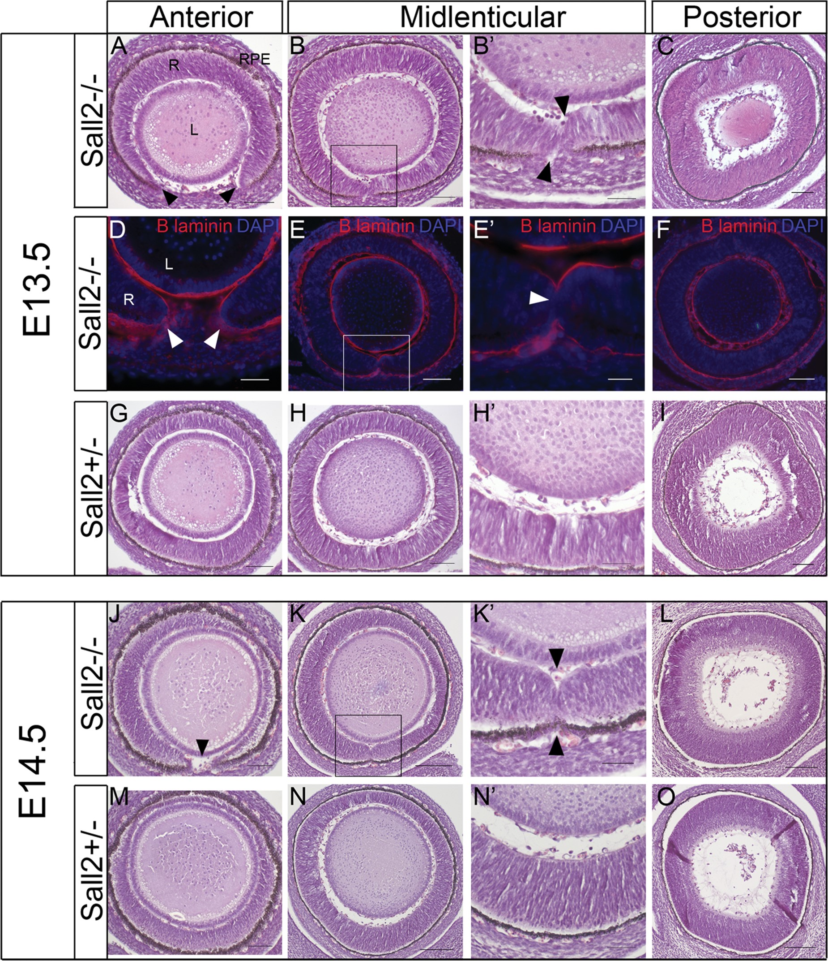
Figure 3. Analysis of optic fissure closure in embryonic eyes from Sall2^{−/−} mice. (A–C) Coronal sections of ...
Notes:
Figure 3. Analysis of optic fissure closure in embryonic eyes from Sall2−/− mice. (A–C) Coronal sections of the eye from an E13.5 homozygous Sall2−/− embryo showing a gap in the neural retina at the anterior aspect of the eye (arrowheads in A). At the mid-lenticular region (B) the retinal margins meet and touch each other with visible indentations at the opposing tissue margins (arrowheads in B′ which shows a magnification of the boxed region in B). Posteriorly (C), the retina appears fused and morphologically continuous and indistinguishable from the control (I). (D–F) Immunohistochemistry of sections from E13.5 Sall2−/− eyes using anti-laminin (red) to identify the basement membrane. Laminin staining is observed surrounding the unfused fissure margins anteriorly (arrowheads in D). At the point of contact between the tips of retina in the mid-lenticular region laminin staining is not detectable (E, E′) suggesting dissolution of the basal lamina. Posteriorly, no laminin staining is observed, suggesting the fusion of the optic fissure in this region (F). Cell nuclei are stained with DAPI (shown in blue). (G–I) Comparative sections from control Sall2+/− at E13.5 showing fusion of the optic fissure at all levels of the eye. (J–L) Coronal sections of the eye from E14.5 Sall2−/− embryo showing similar failure of optic fissure fusion in the anterior (arrowhead in J) and mid-lenticular regions (K, K′, arrowheads in K′ indicate indentations in the inner and outer aspects of the retina consistent with incomplete fusion), with a normal appearance posteriorly (L). (M–O) Representative sections from a control embryo showing the continuous morphological appearance of the fused retina at E14.5. In all images, the ventral aspect is shown at the bottom of the image. L, lens; RPE, retinal pigmented epithelium; R, neural retina. Scale bars represent 50 µm in (B′, E′, H′, K′ and N′), 100 µm in (A, B, D, E, G, H, J, K, M and N) and 200 µm in (C, F, I, L and O).
Unless provided in the caption above, the following copyright applies to the content of this slide: © The Author 2014. Published by Oxford University Press.This is an Open Access article distributed under the terms of the Creative Commons Attribution License (http://creativecommons.org/licenses/by/3.0/), which permits unrestricted reuse, distribution, and reproduction in any medium, provided the original work is properly cited.

Slide 4
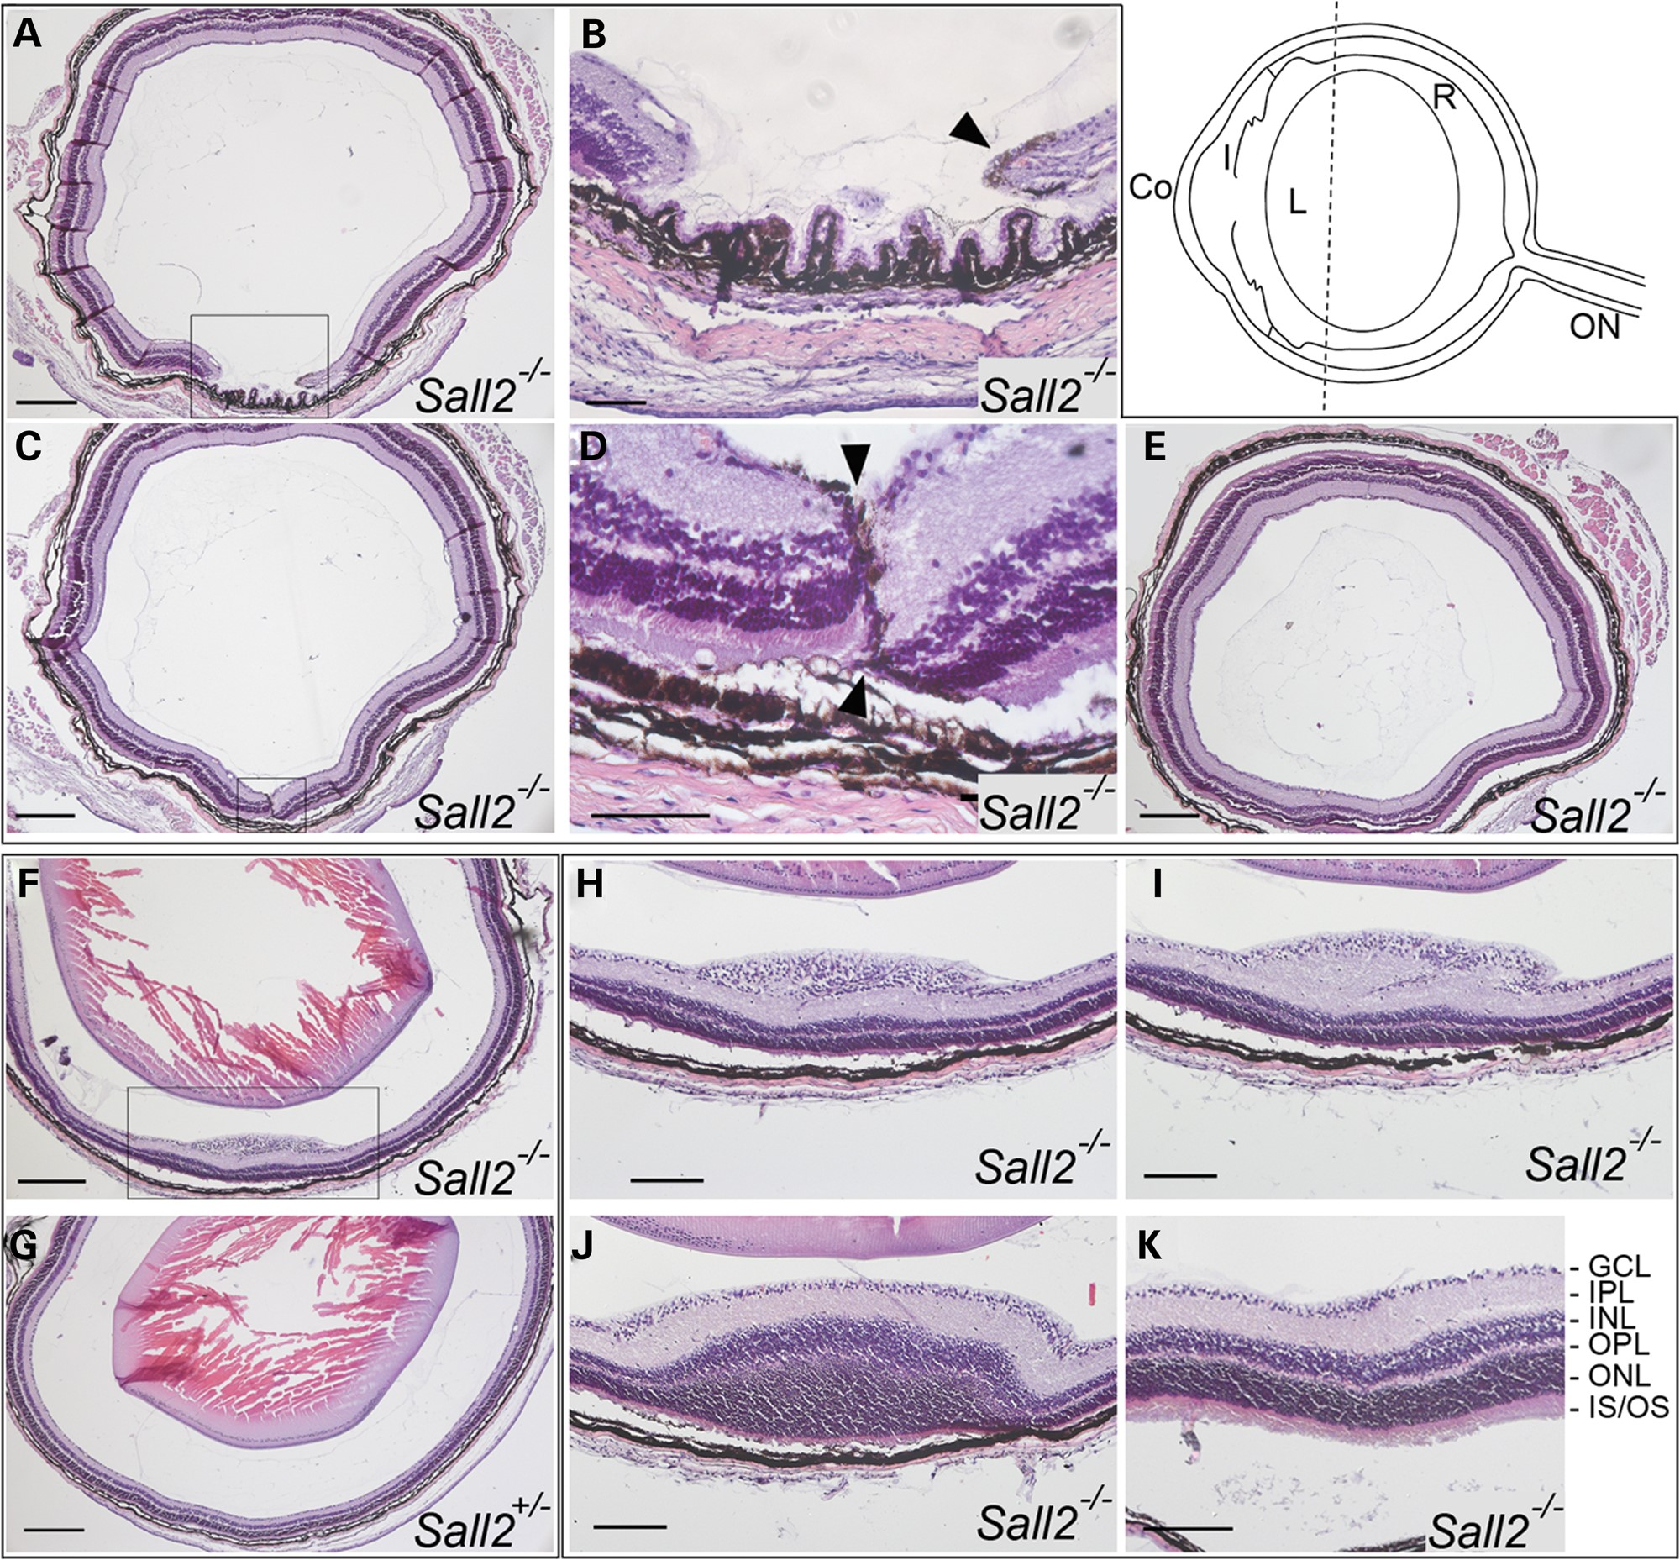
Figure 4. Histological analysis of eyes dissected from P20 Sall2^{−/−} mice. Top right. Schematic ...
Notes:
Figure 4. Histological analysis of eyes dissected from P20 Sall2−/− mice. Top right. Schematic representation of a mouse eye showing the plane of sectioning and approximate anterior location of the observed retinal abnormality (dotted line). Co, cornea; I, iris; L, lens; R, neural retina; ON, optic nerve. (A–E) Coronal sections of the eye from a P20 homozygous Sall2−/− mouse showing a gap in the neural retina visible anteriorly (A and B). In serial sections towards the posterior pole, the tips of the retinal margins meet with residual pigment visible surrounding the tips of the margins (arrowheads in B and D which show magnifications of boxed region in A and C, respectively). (E) More posteriorly, beyond the mid-lenticular region, the retina appears fused and indistinguishable from normal. Note, the lens was removed during processing. (F) Representative coronal section from a homozygous Sall2−/− mouse showing localized elevated lesion of the retina as compared with (G) equivalent coronal section of eye from P20 heterozygous Sall2+/− mouse showing no abnormality. (H–J) Consecutive anterior-to-posterior sections showing magnification of boxed region in (F) showing progressive swelling and disorganization of ganglion cell layer (H), inner plexiform layer (I) and inner and outer nuclear layers (M). In more posterior sections, the retina shows normal lamination (K). GCL, ganglion cell layer; IPL, inner plexiform layer; INL, inner nuclear layer; OPL, outer plexiform layer; ONL, outer nuclear layer; IS/OS, photoreceptor inner and outer segments. Scale bars represent 200 µm in (A, C, F, G and E), 50 µm in (B and D) and 100 µm in (H–K).
Unless provided in the caption above, the following copyright applies to the content of this slide: © The Author 2014. Published by Oxford University Press.This is an Open Access article distributed under the terms of the Creative Commons Attribution License (http://creativecommons.org/licenses/by/3.0/), which permits unrestricted reuse, distribution, and reproduction in any medium, provided the original work is properly cited.

Slide 5
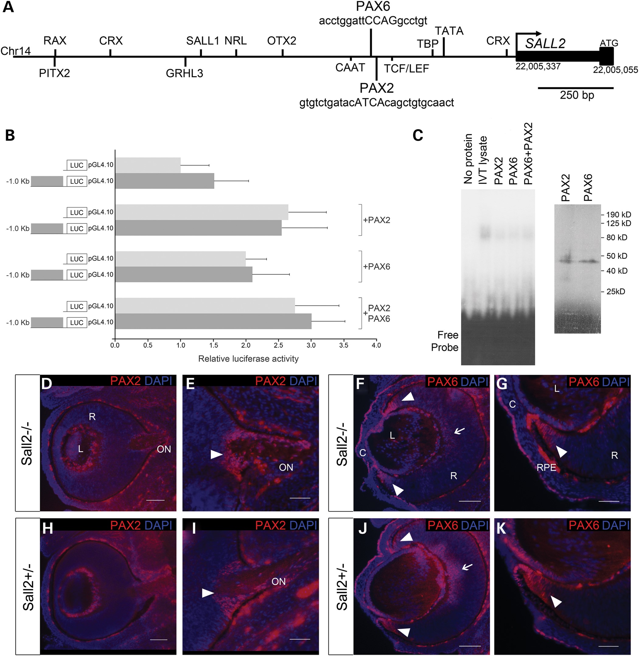
Figure 5. Analysis of SALL2 in relation to PAX2 and PAX6. (A) Schematic diagram of 1.6 kb of the human SALL2 proximal ...
Notes:
Figure 5. Analysis of SALL2 in relation to PAX2 and PAX6. (A) Schematic diagram of 1.6 kb of the human SALL2 proximal promoter region showing selected transcription factor-binding sites relevant to ocular development. (B) Luciferase reporter assay in HEK293 cells showing that neither PAX2 nor PAX6 activate transcription of a luciferase reporter construct (LUC) containing 1023 bp of the SALL2 promoter encompassing putative binding sites for both proteins. No significant difference in activation was observed between the SALL2 promoter construct (dark gray bars) compared with the promoterless reporter (pGL4.10, light gray bars) when co-transfected with PAX2 or PAX6 expression constructs either singly or in combination. Data are presented as mean ± SD of three repeat experiments each performed in triplicate. (C) EMSA showing that no specific protein:DNA complex is formed between in vitro translated PAX2 or PAX6, either singly or in combination, and a DNA probe containing both predicted binding sites in the SALL2 promoter as shown in (A). Right hand panel shows in vitro translation of PAX2 and PAX6 proteins incorporating [35S]-l-methionine showing equivalent amounts of protein are synthesized in each reaction; bands of the expected sizes of 44 and 46 kDa are observed for PAX2 and PAX6, respectively (D–G) Immunohistochemistry of sagittal sections of the eye from E13.5 mouse embryos stained with anti-PAX2 (red). Specific expression of PAX2 is observed in the developing optic nerve head (arrowheads in E and G). No difference in expression pattern is observed between Sall2−/− (D and E) and control Sall2+/− (F and G) eyes. (H and I) Immunohistochemical analysis of PAX6 (red) in sagittal eye sections from E13.5 Sall2−/− (H and I) and Sall2+/− control (J and K) embryos. PAX6 expression is detected in the retina (arrows) with strong expression seen in the anterior periphery of the retina (arrowheads), as well as the corneal epithelium and lens. No difference in PAX6 protein expression was observed between Sall2−/− and control eyes. Nuclei were counterstained with DAPI (blue). C, cornea; L, lens; R, retina; ON, optic nerve. Scale bars represent 50 µm in (E, G, I and K) and 100 µm in (D, F, H and J).
Unless provided in the caption above, the following copyright applies to the content of this slide: © The Author 2014. Published by Oxford University Press.This is an Open Access article distributed under the terms of the Creative Commons Attribution License (http://creativecommons.org/licenses/by/3.0/), which permits unrestricted reuse, distribution, and reproduction in any medium, provided the original work is properly cited.

