Slide 1
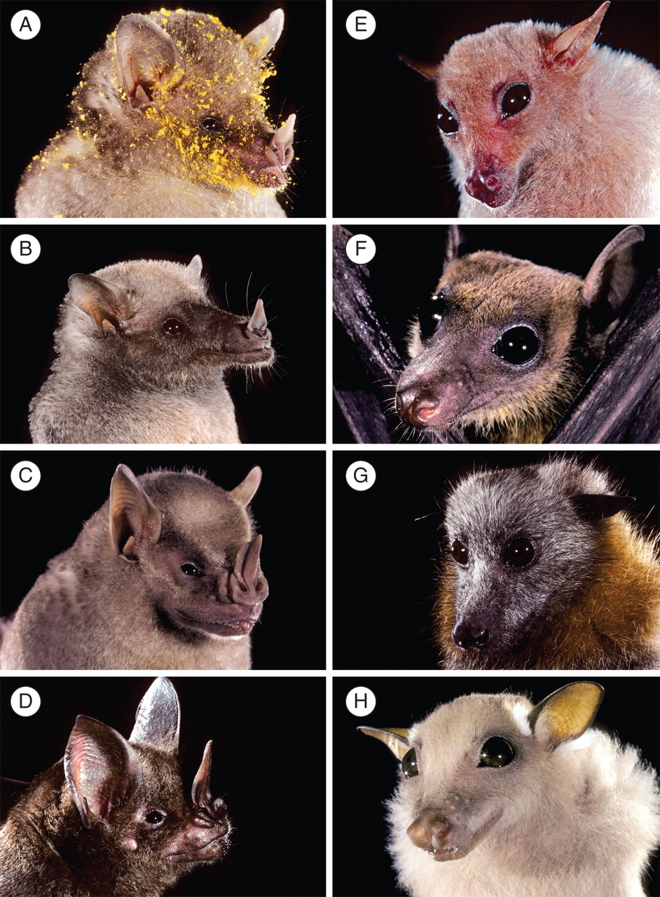
Fig. 1. Portraits of flower-visiting bats. Approximate body masses are in parentheses. (A) Glossophaga soricina (10 ...
Notes:
Fig. 1. Portraits of flower-visiting bats. Approximate body masses are in parentheses. (A) Glossophaga soricina (10 g), a basal glossophagine; (B) Choeronycteris mexicana (16 g), a derived glossophagine; (C) Artibeus jamaicensis (45 g) and (D) Phyllostomus elongatus (60 g), two opportunistic flower-visiting phyllostomids; (E) Syconycteris australis (20 g) and (F) Eonycteris spelaea (70 g), two specialized nectarivorous pteropodids; (G) Pteropus poliocephalus (750 g) and (H) Epomophorus gambianus (100 g), two opportunistic flower-visiting pteropodids. Photo credits: Merlin D. Tuttle, Bat Conservation International.
Unless provided in the caption above, the following copyright applies to the content of this slide: © The Author 2009. Published by Oxford University Press on behalf of the Annals of Botany Company. All rights reserved. For Permissions, please email: journals.permissions@oxfordjournals.org

Slide 2
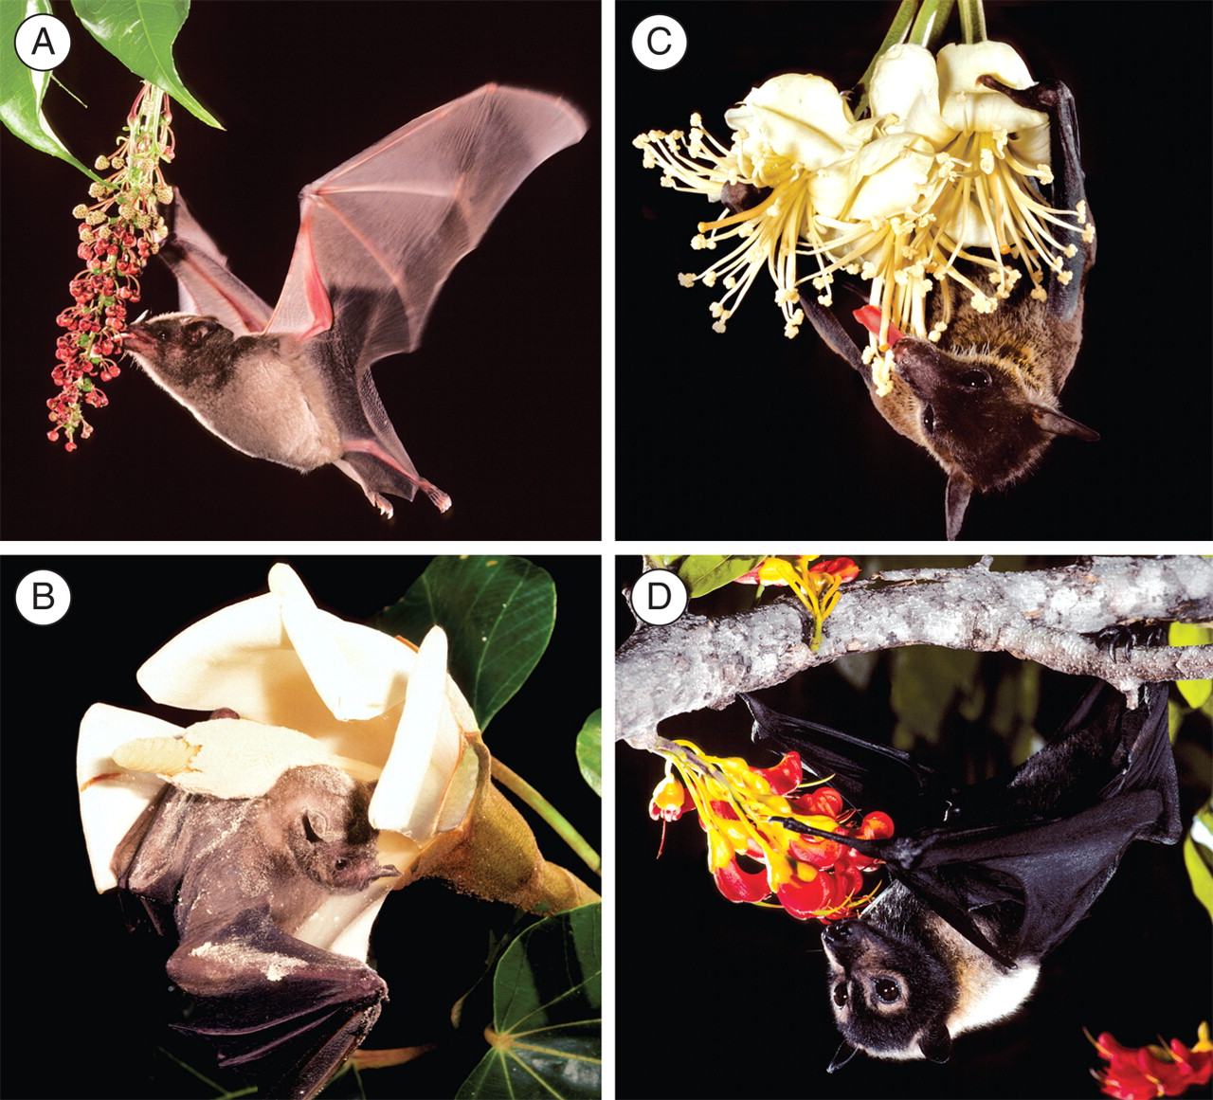
Fig. 2. Nectar-feeding bats visiting flowers. (A) Glossophaga soricina at flowers of Mabea occidentalis ...
Notes:
Fig. 2. Nectar-feeding bats visiting flowers. (A) Glossophaga soricina at flowers of Mabea occidentalis (Euphorbiaceae); (B) Artibeus jamaicensis on a flower of Ochroma pyramidale (Bombacaceae s.s.); (C) Eonycteris spelaea on flowers of Durio zibethinus (Bombacaceae s.s.); (D) Pteropus conspicillatus at flowers of Castanospermum australe (Fabaceae). Photo credits: Merlin D. Tuttle, Bat Conservation International.
Unless provided in the caption above, the following copyright applies to the content of this slide: © The Author 2009. Published by Oxford University Press on behalf of the Annals of Botany Company. All rights reserved. For Permissions, please email: journals.permissions@oxfordjournals.org

Slide 3
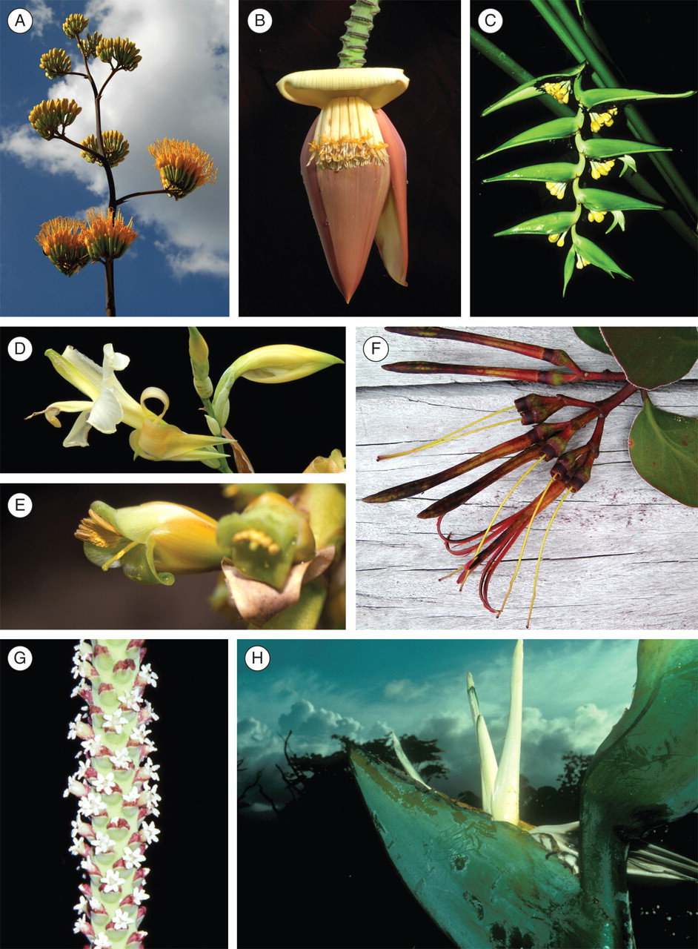
Fig. 3. Bat-pollinated flowers, corolla or perianth length (when known), and their pollinators. (A) Agave palmeri ...
Notes:
Fig. 3. Bat-pollinated flowers, corolla or perianth length (when known), and their pollinators. (A) Agave palmeri (Asparagales: Agavaceae), corolla tube 45–60 mm, glossophagine bats; (B) Musa acuminata (Zingiberales: Musaceae), perianth 70 mm, opportunistic and specialized pteropodid bats; (C) Heliconia solomonensis (Zingiberales: Heliconiaceae), perianth 45–75 mm, specialized pteropodid bats; (D) Canna liliiflora (Zingiberales: Cannaceae), glossophagine bats; (E) Vriesia sp. (Poales: Bromeliaceae), glossophagine bats; (F) Psittacanthus acinarius (Santalales: Loranthaceae), corolla 50–75 mm, glossophagine bats; (G) Calyptrogyne ghiesbreghtiana (Arecales: Arecaceae), rachilla 220 mm, opportunistic phyllostomid bats; (H) Phenakospermum guyannense (Zingiberales: Strelitziaceae), perianth up to 280 mm, opportunistic phyllostomid bats. Photo credits: T. Fleming (A), W. J. Kress (B–E, G, H), C. Geiselman (F).
Unless provided in the caption above, the following copyright applies to the content of this slide: © The Author 2009. Published by Oxford University Press on behalf of the Annals of Botany Company. All rights reserved. For Permissions, please email: journals.permissions@oxfordjournals.org

Slide 4
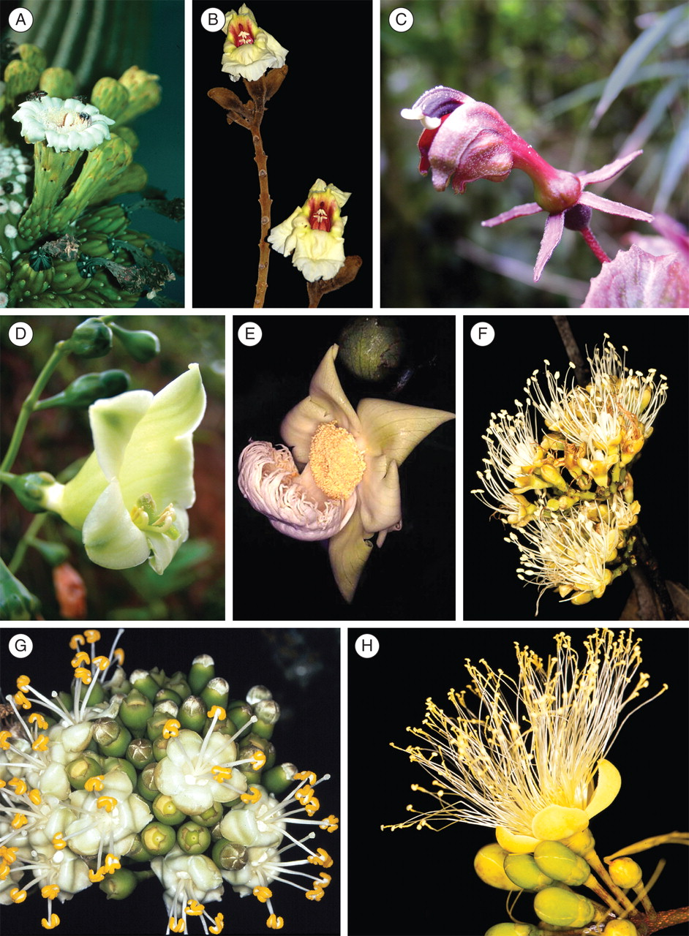
Fig. 4. Bat-pollinated flowers, their corolla or perianth length (when known), and their pollinators. (A) Carnegiea ...
Notes:
Fig. 4. Bat-pollinated flowers, their corolla or perianth length (when known), and their pollinators. (A) Carnegiea gigantea (Caryophyllales: Cactaceae), corolla 112 mm, opportunistic and specialized phyllostomid bats; (B) Markhamia stipulata (Lamiales: Bignoniaceae), specialized pteropodid bats; (C) Burmeistera ceratocarpa (Asterales: Campanulaceae), corolla 13·2 mm, glossophagine bats; (D) Chelonanthus alatus (Gentianales: Gentianaceae), corolla 30–45 mm, glossophagine bats; (E) Lecythis poiteaui (Ericales: Lecythidaceae), androecium 50 mm, glossophagine bats; (F) Hymenaea courbaril (Fabales: Fabaceae), flower diameter 25 mm, opportunistic and specialized phyllostomid bats; (G) Ceiba pentandra (Malvales: Malvaceae), flower diameter 25–35 mm, opportunistic and specialized phyllostomids and pteropodids; (H) Caryocar glabrum (Malpighiales: Caryocaraceae), flower diameter 40 mm, opportunistic and specialized phyllostomid bats. Photo credits: T. Fleming (A, B), C. Geiselman (D), S. Mori (E–H), N. Muchhala (C).
Unless provided in the caption above, the following copyright applies to the content of this slide: © The Author 2009. Published by Oxford University Press on behalf of the Annals of Botany Company. All rights reserved. For Permissions, please email: journals.permissions@oxfordjournals.org

Slide 5
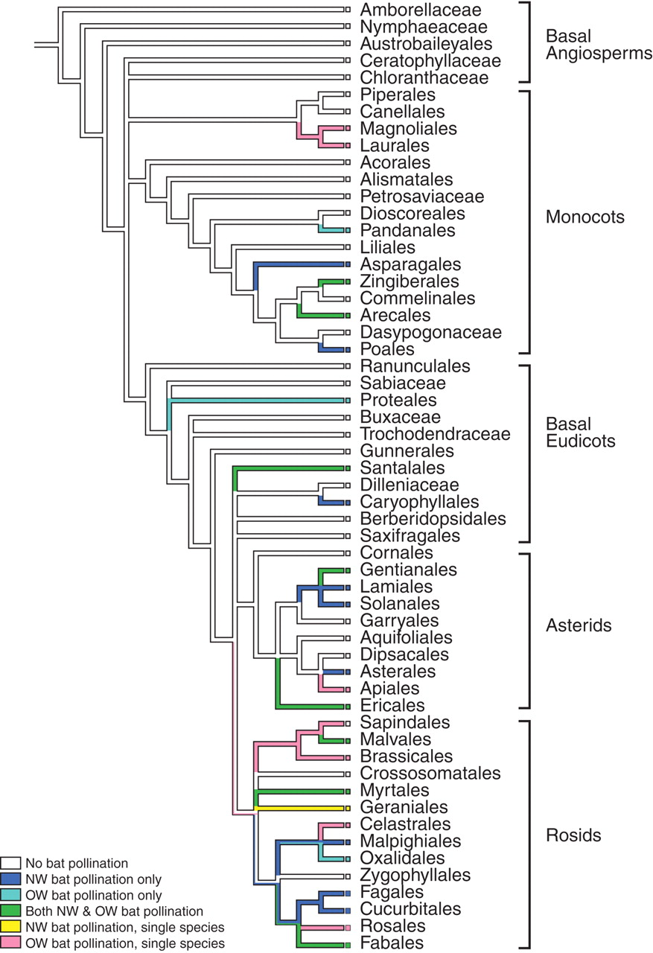
Fig. 5. Cladogram showing the evolutionary relationships of orders of angiosperms and the distribution of families ...
Notes:
Fig. 5. Cladogram showing the evolutionary relationships of orders of angiosperms and the distribution of families containing bat-pollinated taxa among them. Five types of bat pollination are highlighted: pollination only by New World phyllostomids, pollination only by Old World pteropodids, pollination by both bat families, and single species pollinated either by New World or Old World bats. Cladogram based on Soltis et al. (2005).
Unless provided in the caption above, the following copyright applies to the content of this slide: © The Author 2009. Published by Oxford University Press on behalf of the Annals of Botany Company. All rights reserved. For Permissions, please email: journals.permissions@oxfordjournals.org

