Slide 1
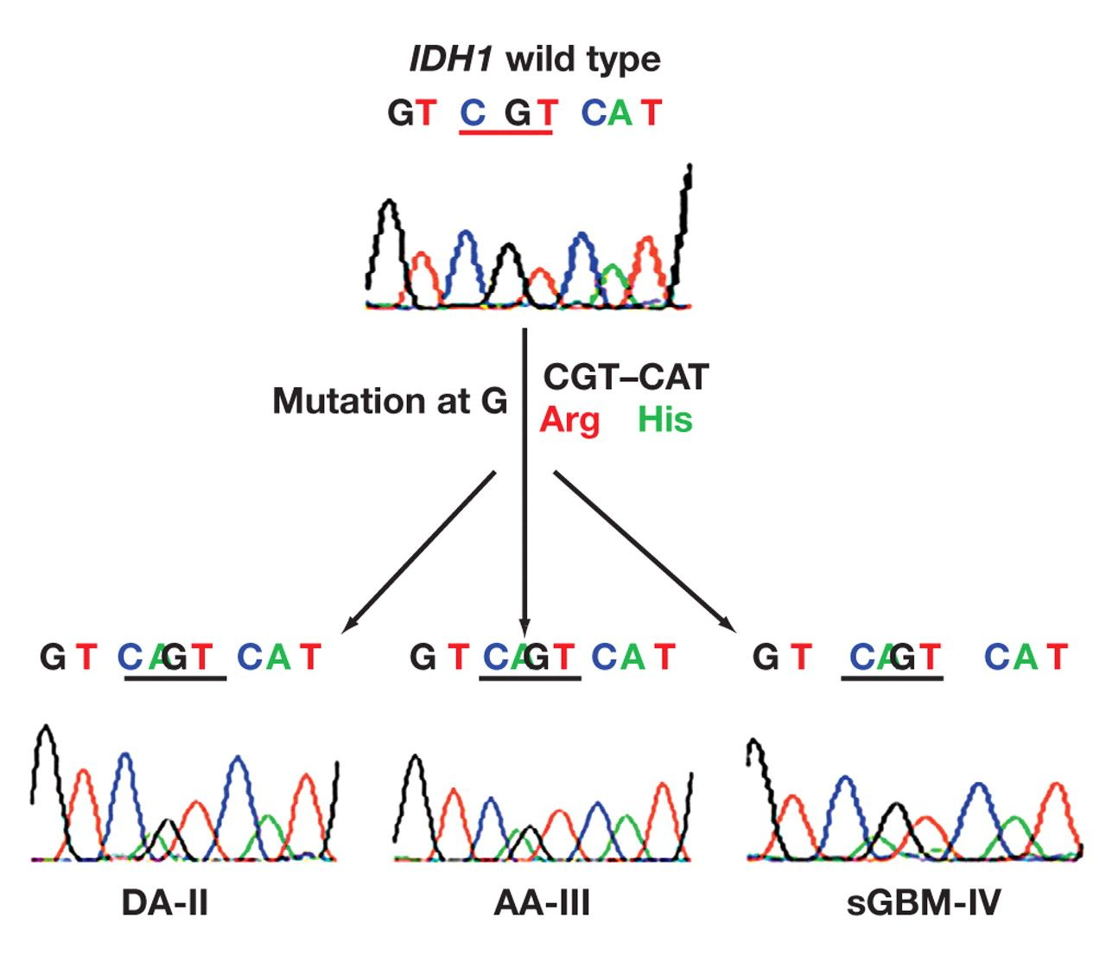
Figure 1 A resultant chromatogram profile after direct DNA sequencing showing IDH1 mutations in diffuse astrocytoma ...
Notes:
Figure 1 A resultant chromatogram profile after direct DNA sequencing showing IDH1 mutations in diffuse astrocytoma (DA), anaplastic astrocytoma (AA) and secondary glioblastoma (sGBM) tumors. The mutation affects codon 132, which results in amino acid sequence alteration with an amino acid substitution of arginine to histidine (CGT-CAT).
Unless provided in the caption above, the following copyright applies to the content of this slide: © American Society for Clinical Pathology

Slide 2
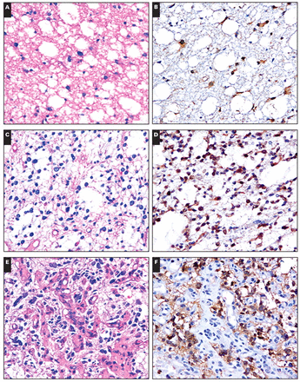
Image 1 Immunohistochemical expression of IDH1-R132H mutated protein in different grades of astrocytoma. A, Diffuse ...
Notes:
Image 1 Immunohistochemical expression of IDH1-R132H mutated protein in different grades of astrocytoma. A, Diffuse astrocytoma, World Health Organization (WHO) grade II (H&E) stained section. B, Positively stained diffuse astrocytoma cell, WHO grade II (immunohistochemical staining with mIDH1R132H). C, Anaplastic astrocytoma, WHO grade III (H&E). D, Positively stained anaplastic astrocytoma, WHO grade III (immunohistochemical staining with mIDH1R132H). E, G, Glioblastoma, WHO grade IV (H&E). F, Positively stained, and H, negatively stained glioblastoma, WHO grade IV (immunohistochemical staining with mIDH1R132H) (A- H, ×400).
Unless provided in the caption above, the following copyright applies to the content of this slide: © American Society for Clinical Pathology

Slide 3
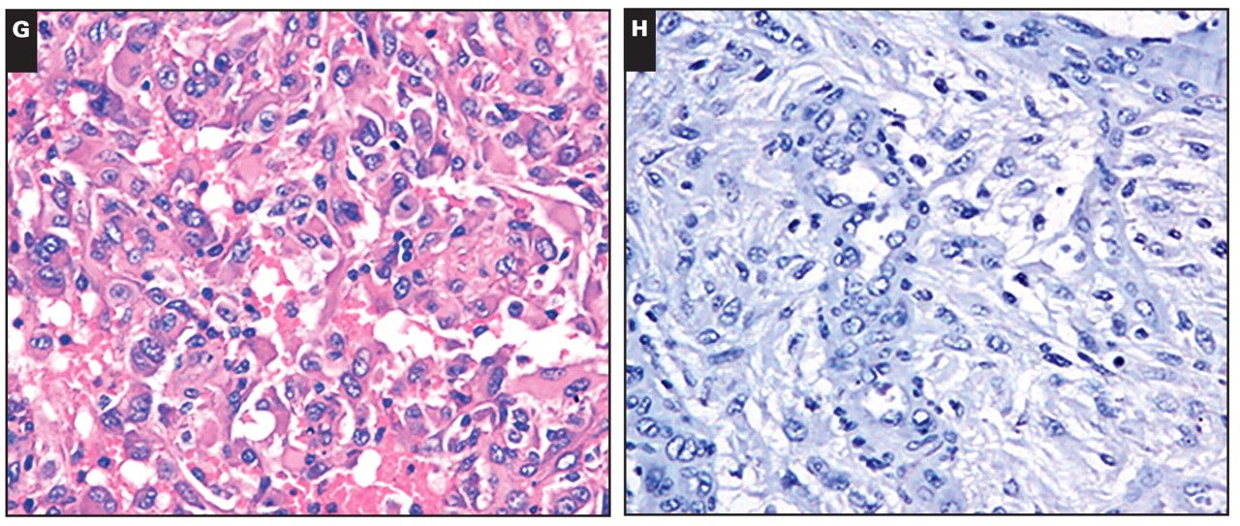
Image 1 Immunohistochemical expression of IDH1-R132H mutated protein in different grades of astrocytoma. A, Diffuse ...
Notes:
Image 1 Immunohistochemical expression of IDH1-R132H mutated protein in different grades of astrocytoma. A, Diffuse astrocytoma, World Health Organization (WHO) grade II (H&E) stained section. B, Positively stained diffuse astrocytoma cell, WHO grade II (immunohistochemical staining with mIDH1R132H). C, Anaplastic astrocytoma, WHO grade III (H&E). D, Positively stained anaplastic astrocytoma, WHO grade III (immunohistochemical staining with mIDH1R132H). E, G, Glioblastoma, WHO grade IV (H&E). F, Positively stained, and H, negatively stained glioblastoma, WHO grade IV (immunohistochemical staining with mIDH1R132H) (A- H, ×400).
Unless provided in the caption above, the following copyright applies to the content of this slide: © American Society for Clinical Pathology

