Slide 1
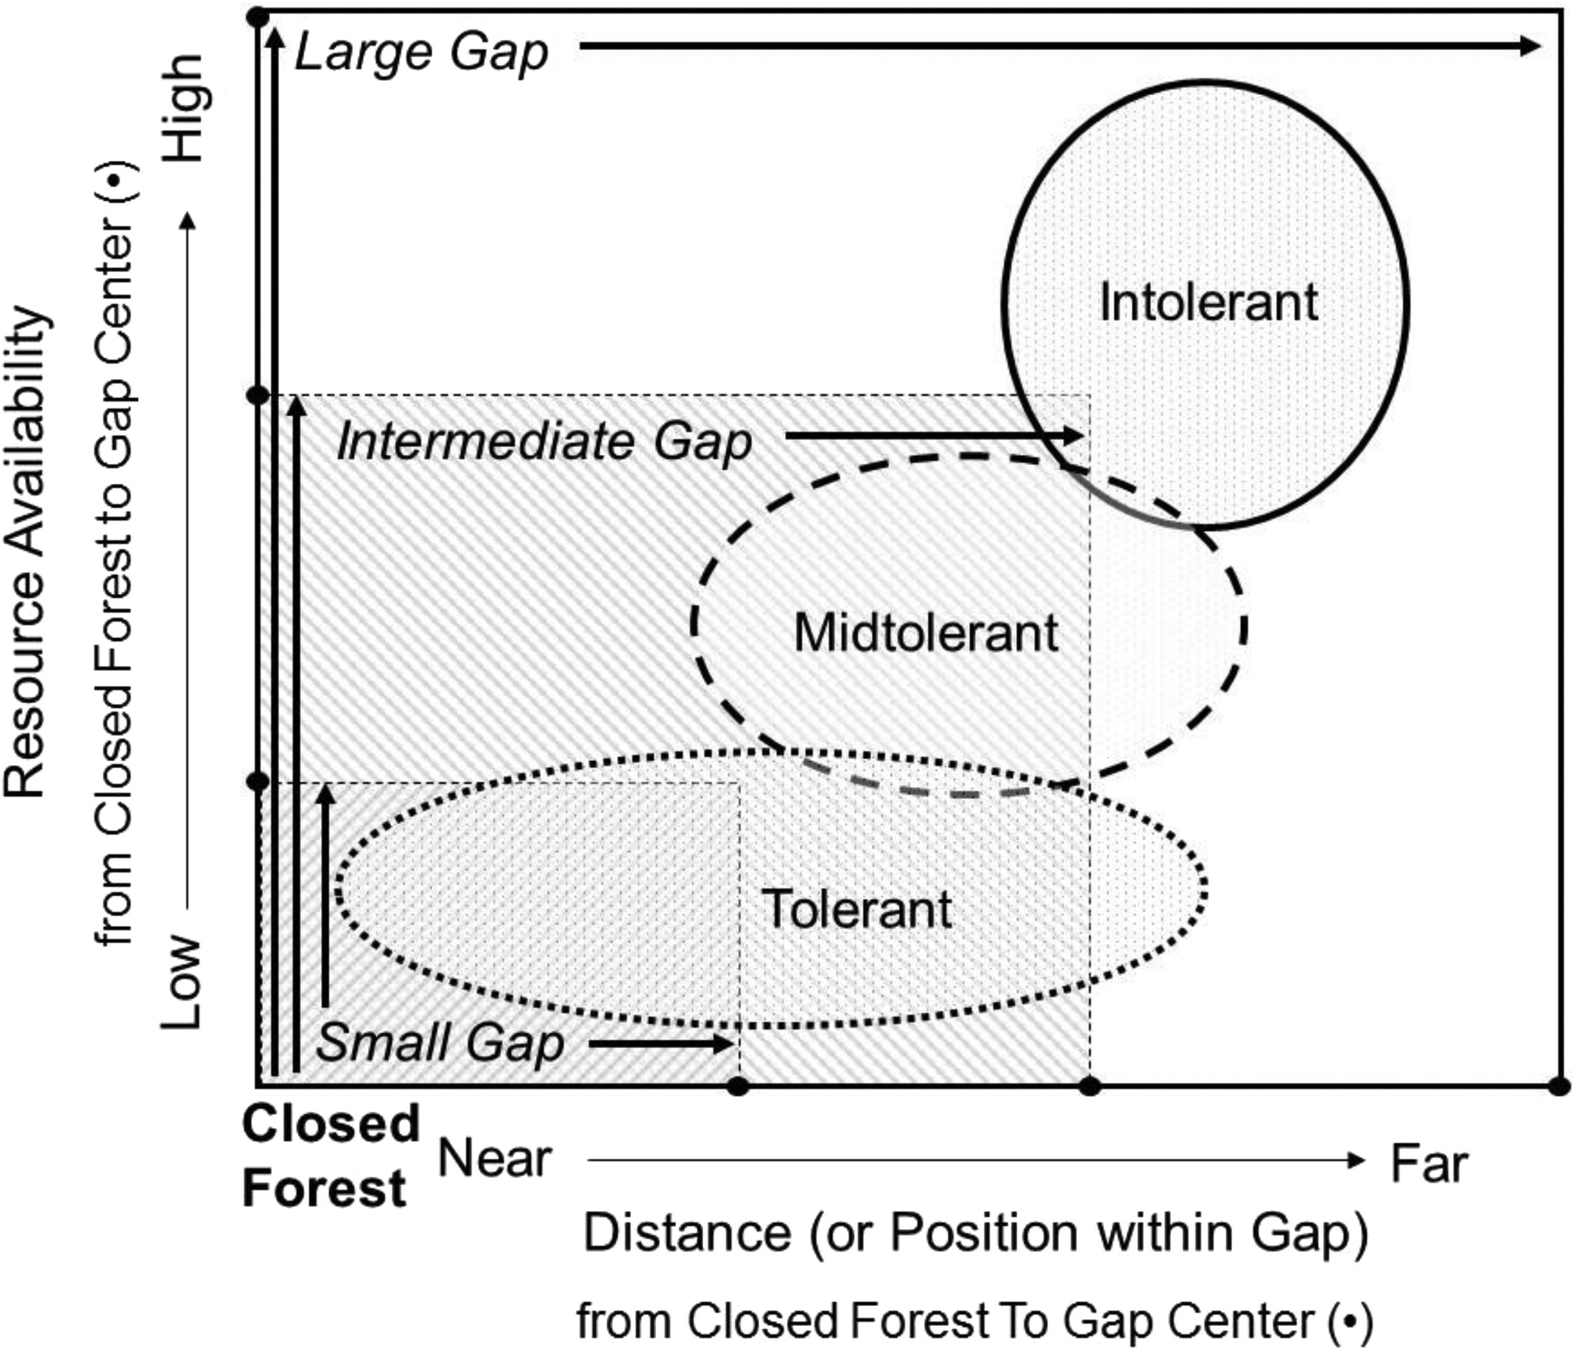
Figure 1 An illustration of the gap partitioning (Grubb, 1977) as the conceptual relationship for shade tolerance ...
Notes:
Figure 1 An illustration of the gap partitioning (Grubb, 1977) as the conceptual relationship for shade tolerance strategies with plant essential resources (y-axis) and within-gap position (x-axis). Stress and competition constrain tolerance groups within the gap. Species with tolerant strategies dominate in gap edge positions. Intolerant species dominate in gap positions far from gap edge. Mid-tolerant species are intermediate in distance from edge to tolerant and intolerant species, and, as a result, composition is differentiated by gap position. Gap size is also partitioned with intolerant species unique to large gaps (white, entire response surface), mid-tolerant species dominating in intermediate gaps (down, right hatching) and shade-tolerant species dominating small gaps (down, left hatching).
Unless provided in the caption above, the following copyright applies to the content of this slide: Published by Oxford University Press on behalf of Institute of Chartered Foresters 2016. This work is written by (a) US Government employee(s) and is in the public domain in the US.

Slide 2
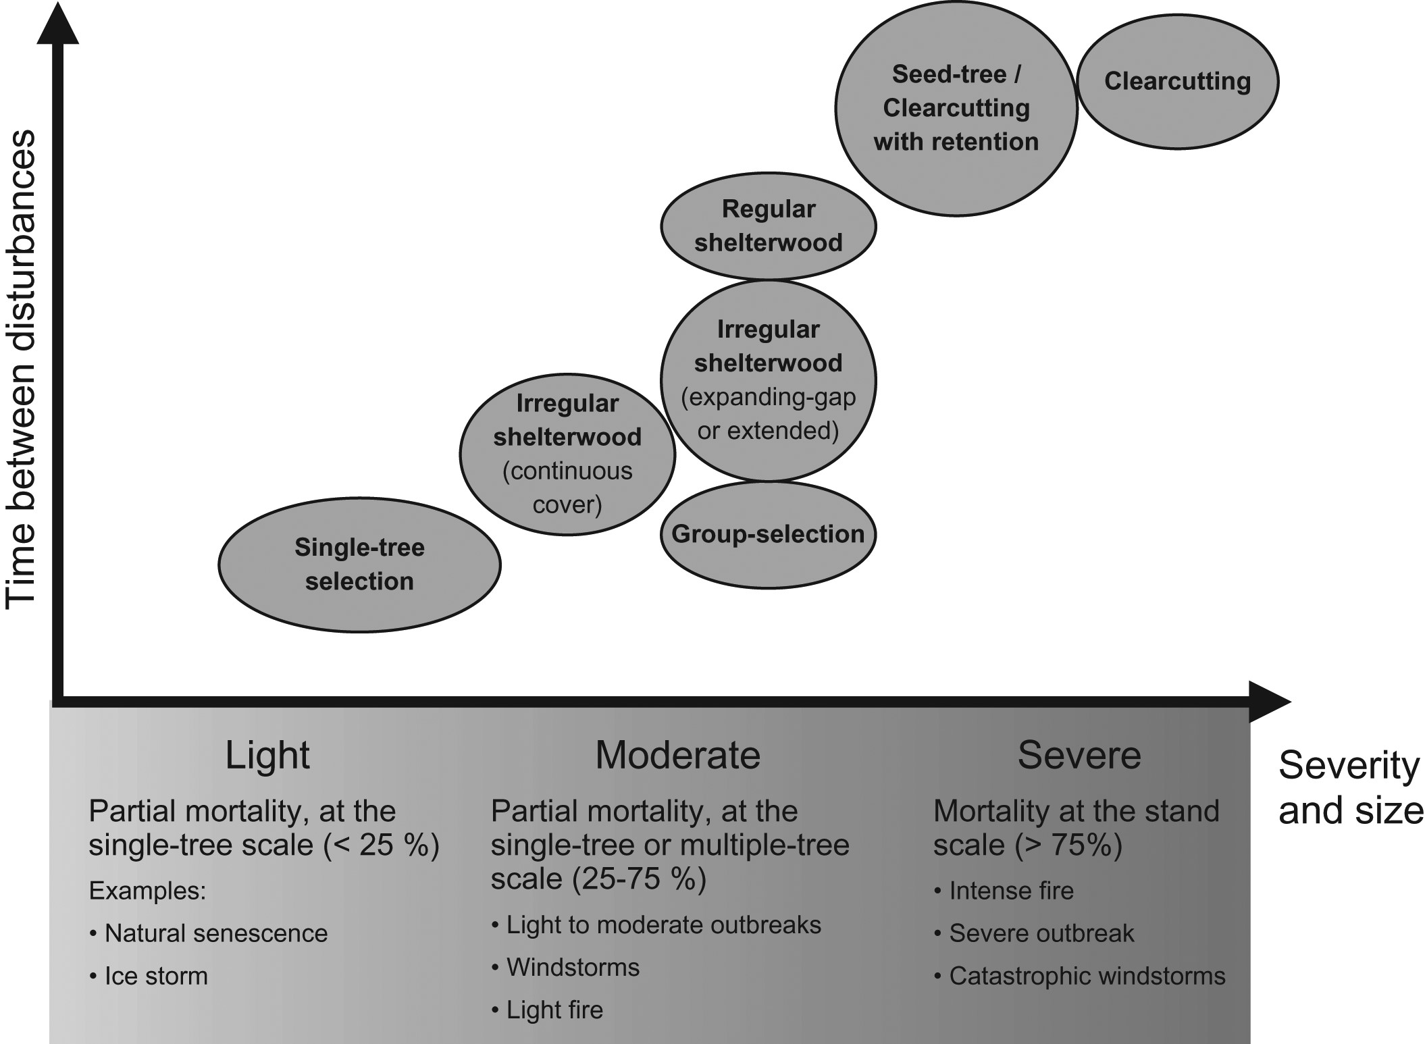
Figure 2 Conceptual framework situating silvicultural systems according to a gradient of severity, size and frequency ...
Notes:
Figure 2 Conceptual framework situating silvicultural systems according to a gradient of severity, size and frequency of disturbances at the stand scale (adapted from Raymond et al., 2013).
Unless provided in the caption above, the following copyright applies to the content of this slide: Published by Oxford University Press on behalf of Institute of Chartered Foresters 2016. This work is written by (a) US Government employee(s) and is in the public domain in the US.

Slide 3
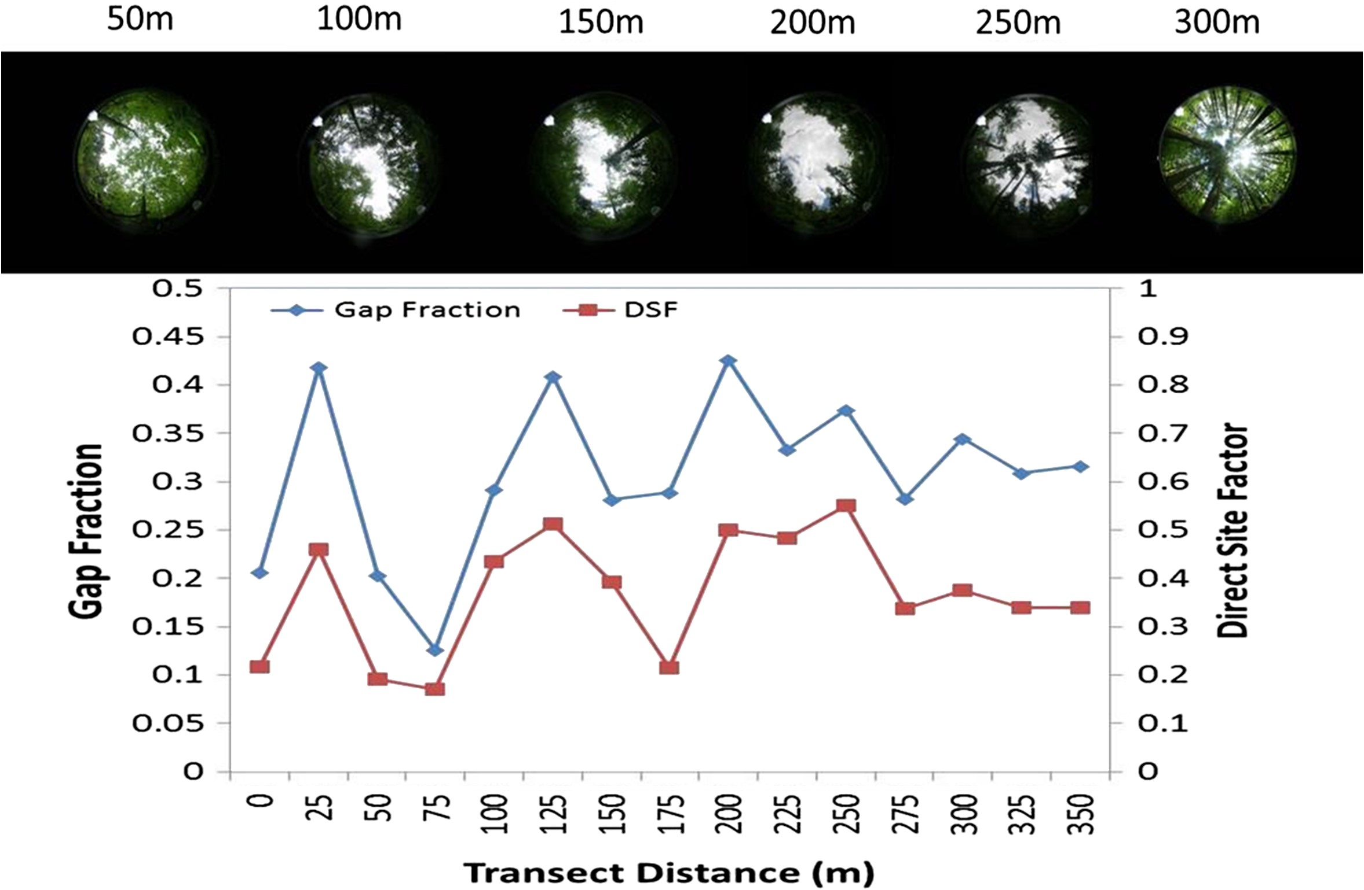
Figure 3 Spatial variability in canopy openness 4 years after a moderate-intensity windstorm in a uneven-aged, ...
Notes:
Figure 3 Spatial variability in canopy openness 4 years after a moderate-intensity windstorm in a uneven-aged, mixedwood forest in the Adirondack Mountains of New York, US. Canopy openness was measured with hemispheric photographs (top panel) and canopy metrics (bottom panel) following a transect through the middle of the blowdown event. Gap fraction (primary vertical axis) represents the ratio of canopy in open sky. Direct Site Factor (DSF, secondary vertical axis) is a measure of light availability or ratio of direct light below the canopy to direct light above (Keeton unpublished).
Unless provided in the caption above, the following copyright applies to the content of this slide: Published by Oxford University Press on behalf of Institute of Chartered Foresters 2016. This work is written by (a) US Government employee(s) and is in the public domain in the US.

