Slide 1
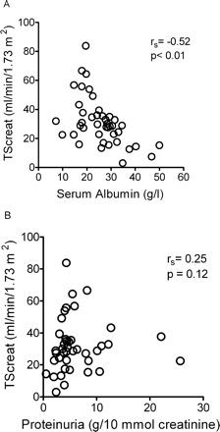
Fig. 1. The clearance of creatinine by tubular secretion (TScreat) vs serum albumin (A), and vs proteinuria (B) in ...
Notes:
Fig. 1. The clearance of creatinine by tubular secretion (TScreat) vs serum albumin (A), and vs proteinuria (B) in patients (n = 42) with proteinuria. A significant correlation was only observed between TScreat and serum albumin.
Unless provided in the caption above, the following copyright applies to the content of this slide: © The Author [2005]. Published by Oxford University Press on behalf of ERA-EDTA. All rights reserved. For Permissions, please email: journals.permissions@oupjournals.org

Slide 2
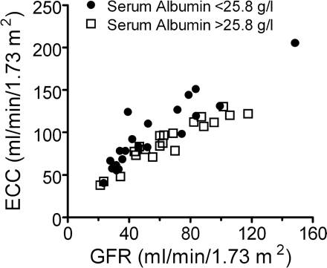
Fig. 2. Glomerular filtration rate (GFR) vs endogenous creatinine clearance (ECC) in patients with proteinuria and a ...
Notes:
Fig. 2. Glomerular filtration rate (GFR) vs endogenous creatinine clearance (ECC) in patients with proteinuria and a serum albumin level 25.8 g/l (open squares). The overestimation of GFR by ECC was more pronounced in patients with low serum albumin levels.
Unless provided in the caption above, the following copyright applies to the content of this slide: © The Author [2005]. Published by Oxford University Press on behalf of ERA-EDTA. All rights reserved. For Permissions, please email: journals.permissions@oupjournals.org

Slide 3
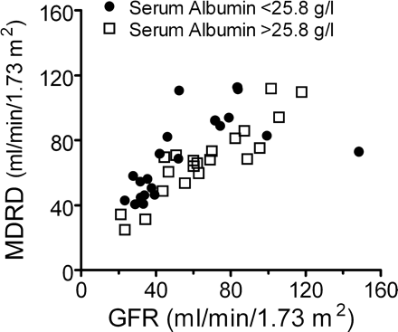
Fig. 3. Glomerular filtration rate (GFR) vs MDRD–GFR in patients with proteinuria and a serum albumin level <25.8 g/l ...
Notes:
Fig. 3. Glomerular filtration rate (GFR) vs MDRD–GFR in patients with proteinuria and a serum albumin level 25.8 g/l (open squares). In patients with low serum albumin levels the GFR was overestimated by the MDRD–GFR.
Unless provided in the caption above, the following copyright applies to the content of this slide: © The Author [2005]. Published by Oxford University Press on behalf of ERA-EDTA. All rights reserved. For Permissions, please email: journals.permissions@oupjournals.org

