Slide 1
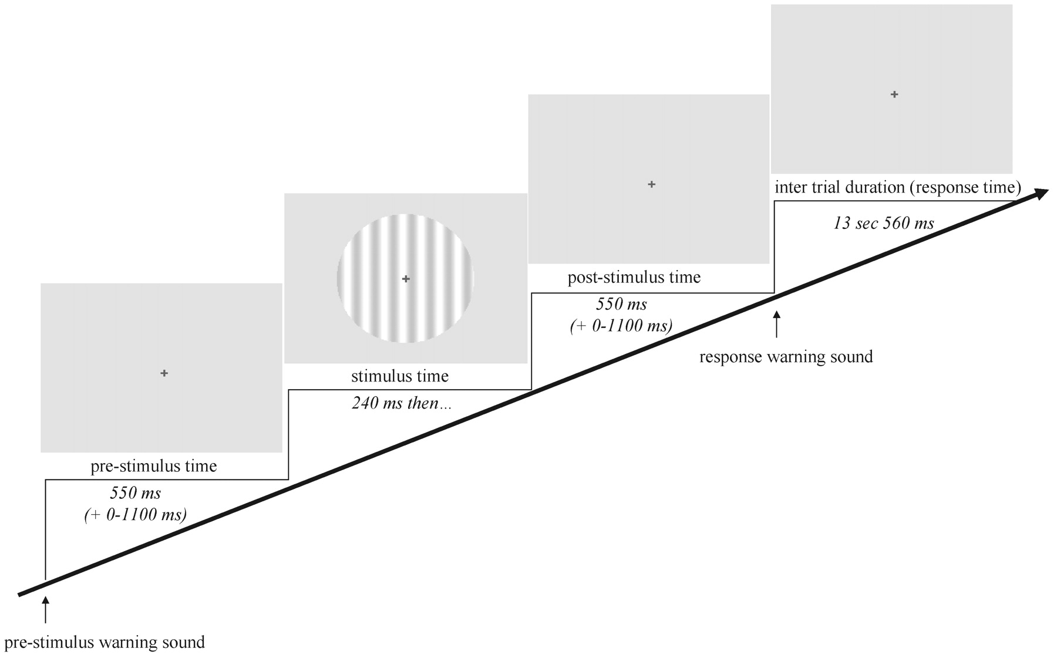
Figure 1. Time course of a trial for the fMRI experiment. A warning sound was followed by the grating after a ...
Notes:
Figure 1. Time course of a trial for the fMRI experiment. A warning sound was followed by the grating after a pre-stimulus time of 550 ms (plus a random time of 0–1100 ms). A second sound (response prompt) appeared after a post-stimulus time of 550 ms (plus the remainder of the random time). Subjects gave their responses after the response prompt and waited for the next trial (inter-trial interval 13.56 s). The same trial design was used for training and EP sessions with different timing parameters.
Unless provided in the caption above, the following copyright applies to the content of this slide: © Oxford University Press

Slide 2
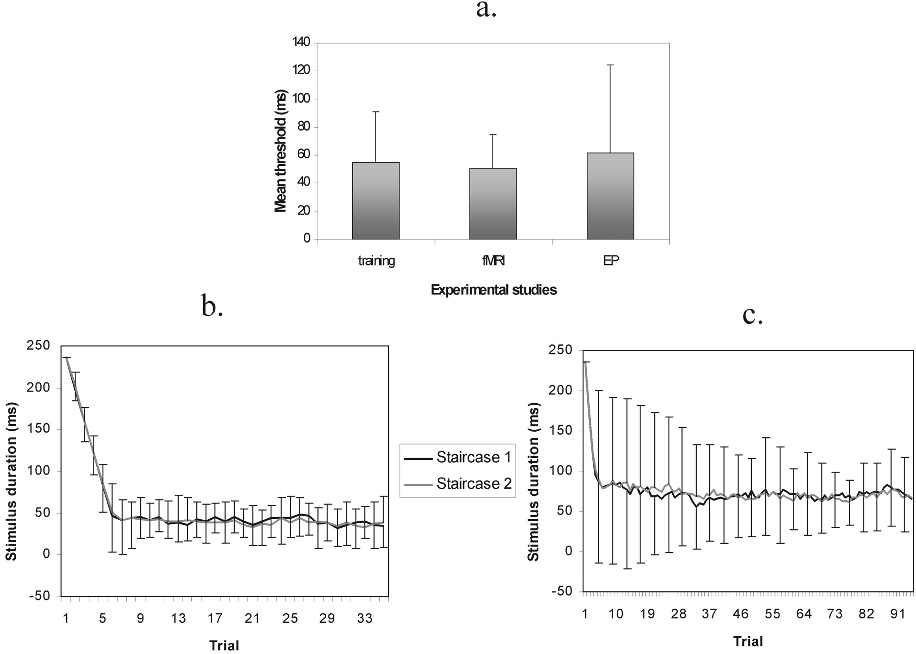
Figure 2. (a) Mean brief threshold estimate (+ SD) in training, fMRI and EP sessions. The threshold was not affected by ...
Notes:
Figure 2. (a) Mean brief threshold estimate (+ SD) in training, fMRI and EP sessions. The threshold was not affected by the differences in recording environment. (b) Mean (±SD) grating duration for each trial in the fMRI session. (c) Mean (±SD) grating duration in the EP session. Subjects reached a threshold level within the first 10 trials of both sessions.
Unless provided in the caption above, the following copyright applies to the content of this slide: © Oxford University Press

Slide 3
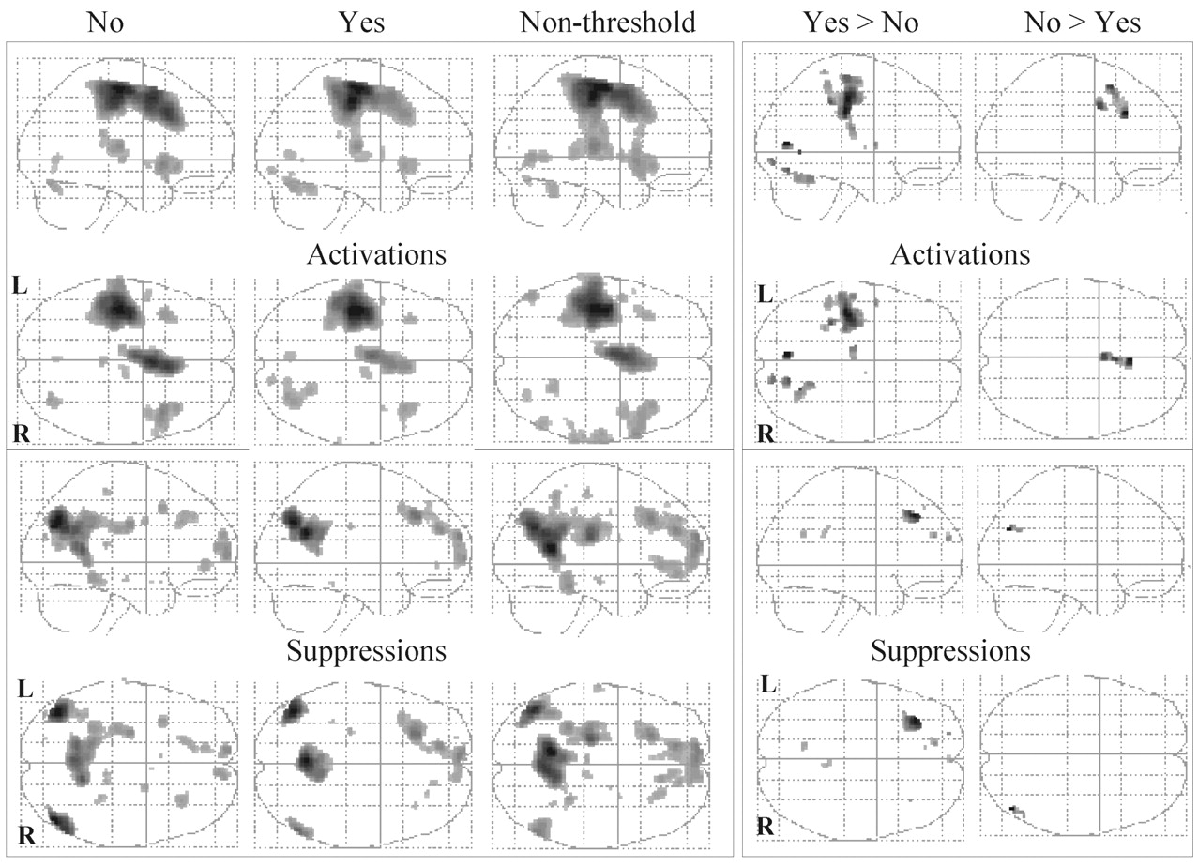
Figure 3. The left of the figure shows fMRI activations and suppressions for No, Yes and non-threshold trials in the ...
Notes:
Figure 3. The left of the figure shows fMRI activations and suppressions for No, Yes and non-threshold trials in the fixed effect model. Two ‘glass brain’ views are displayed for each condition (upper image = viewed from side; lower image = viewed from above). The images have been thresholded at P < 0.05 corrected for multiple comparisons at the voxel level. Consistent responses are shown across the three trial categories. The right of the figure shows regions differentially activated or suppressed by Yes and No trials at P < 0.05 uncorrected within the region of interest defined by Yes trials.
Unless provided in the caption above, the following copyright applies to the content of this slide: © Oxford University Press

Slide 4
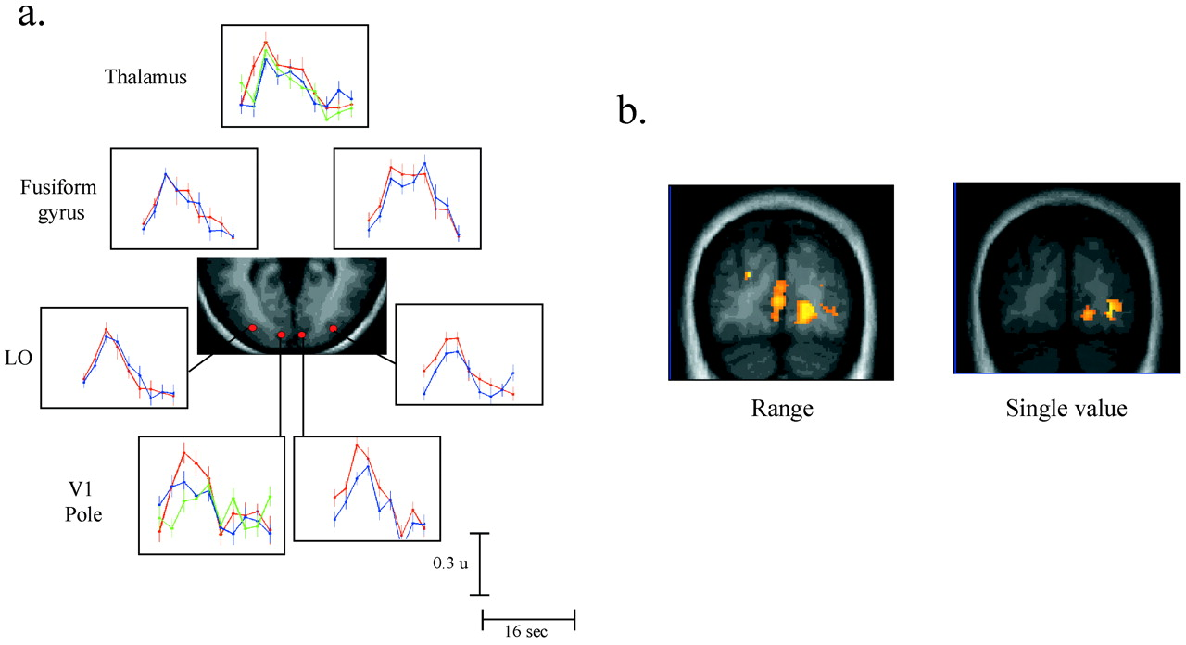
Figure 4. (a) Visual activations for V1, LO, fusiform and thalamic regions. The graph for each region shows the ...
Notes:
Figure 4. (a) Visual activations for V1, LO, fusiform and thalamic regions. The graph for each region shows the haemodynamic response (arbitrary units) associated with Yes (red) and No (blue) trials (±inter-subject standard error). The left of the image is the left of the brain. The visual activations from the subgroup of two subjects who were presented Catch trials (green) are also presented for left V1 and the posterior thalamus. Differential Yes > No responses are shown at the occipital pole. (b) Occipital Yes > No activations for threshold stimuli defined by a single value or a range. While right V1 and LO remain differentially activated in the single value model, the loss of statistical power results in the left hemisphere activity failing to reach our threshold of significance.
Unless provided in the caption above, the following copyright applies to the content of this slide: © Oxford University Press

Slide 5
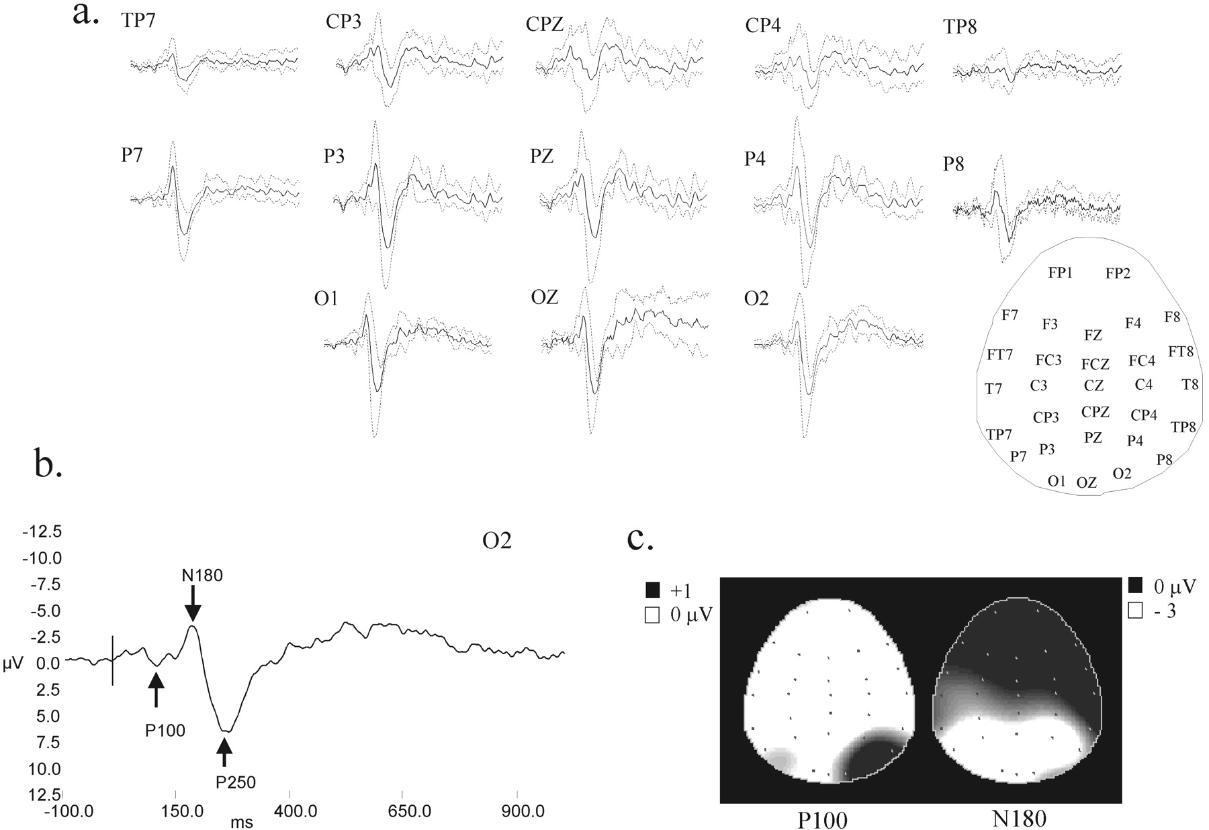
Figure 5. The inter-subject average EP for high contrast gratings. (a) The response at each occipital and parietal ...
Notes:
Figure 5. The inter-subject average EP for high contrast gratings. (a) The response at each occipital and parietal electrode with the scalp electrode positions given in the inset on the right. Electrodes are arranged as if looking at the head from above (left is left, top is forehead). Mastoid referenced data are shown as occipital electrodes form the posterior boundary of the recording cap, precluding Laplacian transformation. The inter-subject SD of the response is given by the dotted line. (b) The response at O2 showing timing and voltage calibrations. The vertical line indicates the onset of the grating. P100, N180 and P250 waves have been marked. (c) The scalp topography of P100 and N180 responses. Each dot corresponds to an electrode, the greyscale value relates to the voltage at the given time point.
Unless provided in the caption above, the following copyright applies to the content of this slide: © Oxford University Press

Slide 6
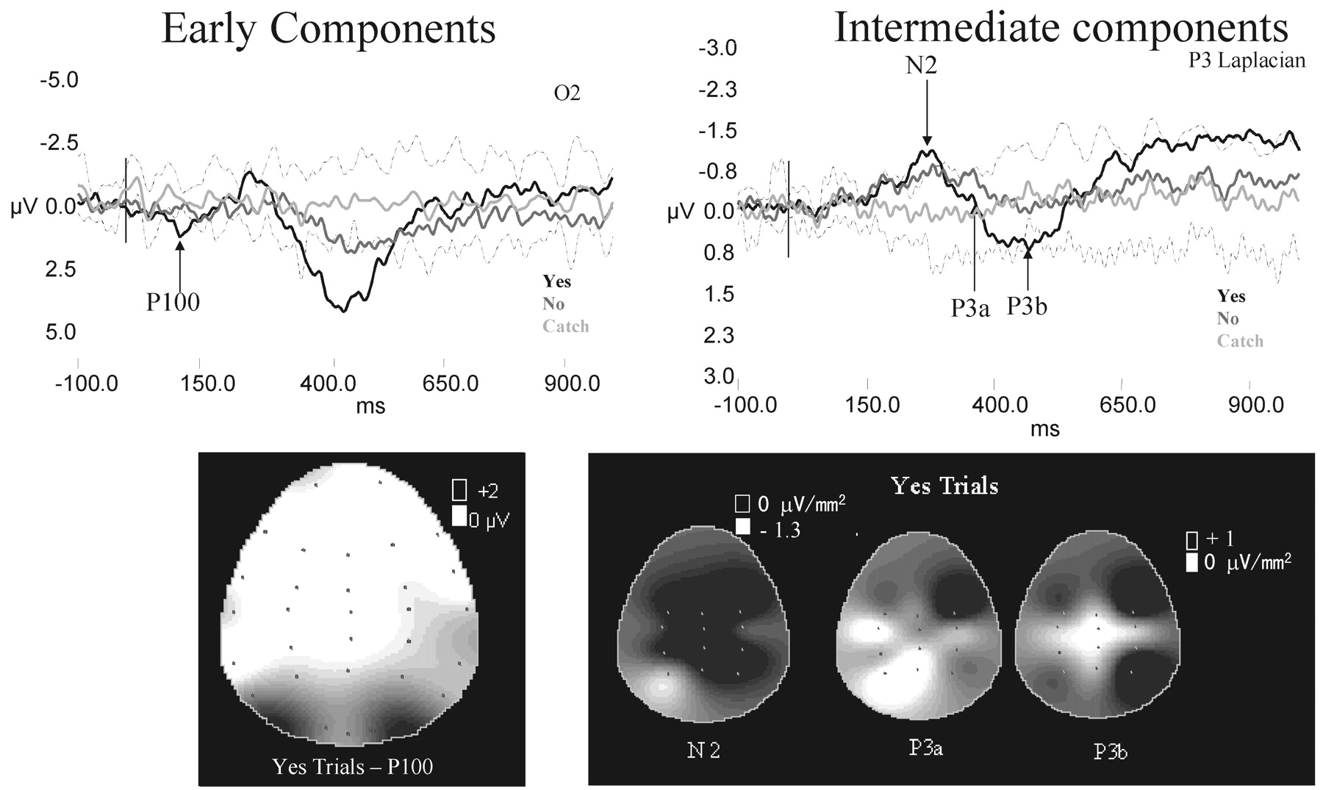
Figure 6. The inter-subject average EPs for threshold gratings. Early latency components are shown on the left (linked ...
Notes:
Figure 6. The inter-subject average EPs for threshold gratings. Early latency components are shown on the left (linked mastoid referenced data) with the scalp topography of the threshold P100 wave. Topography conventions as in Figure 5. Yes trials are shown in black, No trials in dark grey, Catch trials in light grey and the inter-subject SD for Catch trials as a dotted line. P100 is of greater amplitude for Yes than No trials. Its topography and waveform is the same at threshold as for the high contrast grating. The right of the figure shows the intermediate latency components: N2, P3a and P3b and their scalp topography. Note that the intermediate latency data have been transformed into its Laplacian derivative, removing the outer electrodes from the montage. N2 is localized to the left parietal region, P3a to bilateral frontal regions and P3b to bilateral parietal regions. N2, P3a and right P3b show significant differential Yes > No responses.
Unless provided in the caption above, the following copyright applies to the content of this slide: © Oxford University Press

Slide 7
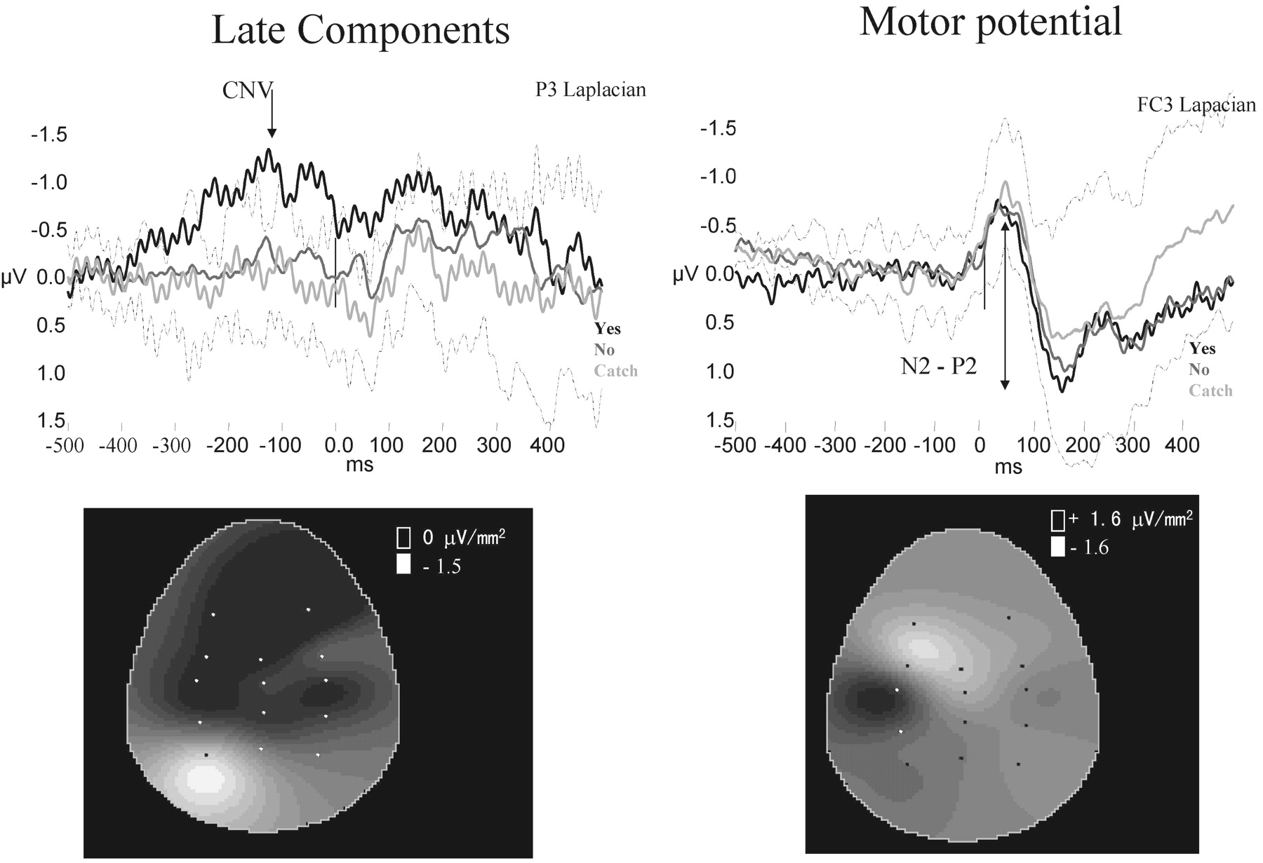
Figure 7. The inter-subject average EPs for late components and motor potentials. Conventions as in Figures 5 and 6. ...
Notes:
Figure 7. The inter-subject average EPs for late components and motor potentials. Conventions as in Figures 5 and 6. The slow wave scalp map relates to Yes trials at –200 ms, the motor scalp map to P2 in Yes trials. The slow wave is maximal over left parietal cortex. The motor potential is characterized by a tangential dipolar pattern. Both the slow wave and motor potentials exhibit a significant differential response (Yes > No).
Unless provided in the caption above, the following copyright applies to the content of this slide: © Oxford University Press

Slide 8
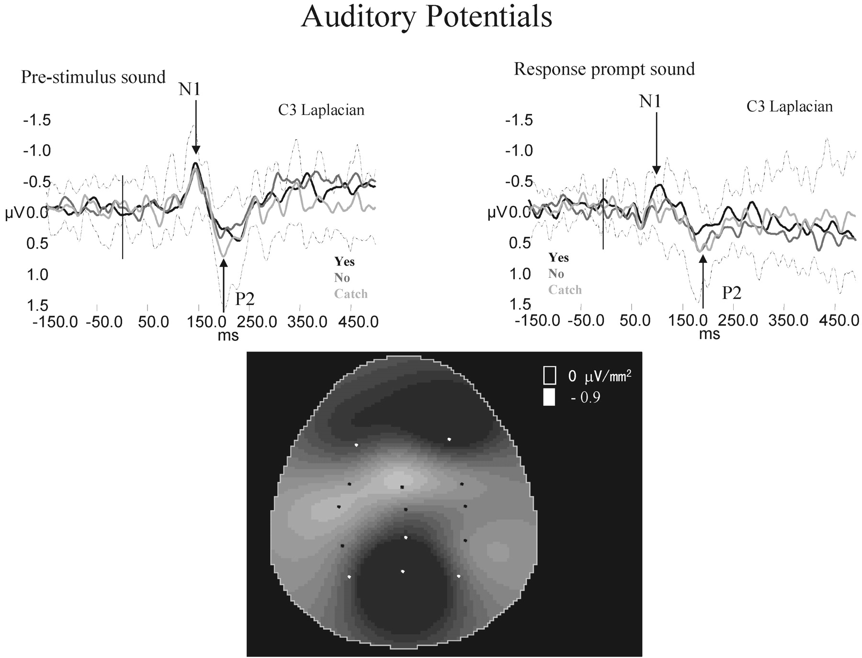
Figure 8. The inter-subject average EPs for sound prompts. The response to the pre-stimulus warning sound is shown on ...
Notes:
Figure 8. The inter-subject average EPs for sound prompts. The response to the pre-stimulus warning sound is shown on the left, while the response to the response prompt is shown on the right. Conventions as in Figures 5 and 6. The scalp map is of N1 for the warning sound, averaged across Yes, No and Catch trials. Only the second sound shows significant differential N1 activity.
Unless provided in the caption above, the following copyright applies to the content of this slide: © Oxford University Press

Slide 9
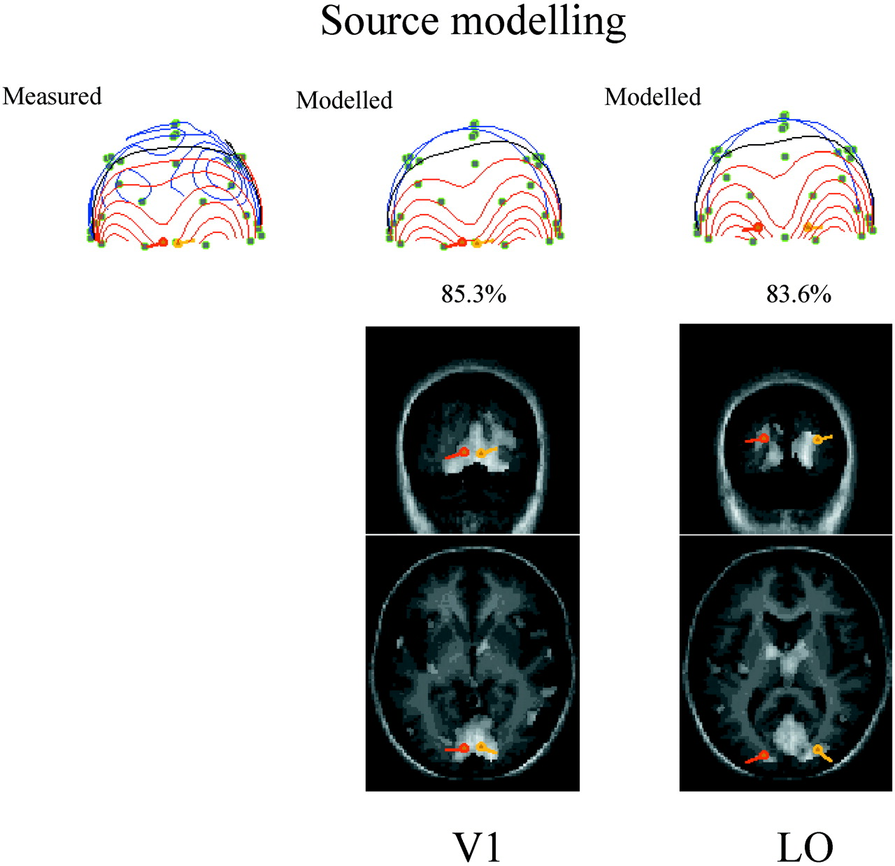
Figure 9. Source modelling. The scalp distribution of the threshold P100 response is shown on the left of the figure ...
Notes:
Figure 9. Source modelling. The scalp distribution of the threshold P100 response is shown on the left of the figure presented as a sphere viewed from behind (red = positive; blue = negative scalp potential). The scalp topography of modelled dipole generators placed in V1 and LO are shown on the right (red = left dipole; yellow = right dipole). A coronal and axial slice is shown for each model. The generators have been placed in fMRI activation foci for Yes trials (shown in white) in the sub-group of subjects who took part in the EP experiments. The V1 generators account for the scalp topography better than the LO generators.
Unless provided in the caption above, the following copyright applies to the content of this slide: © Oxford University Press

