Slide 1
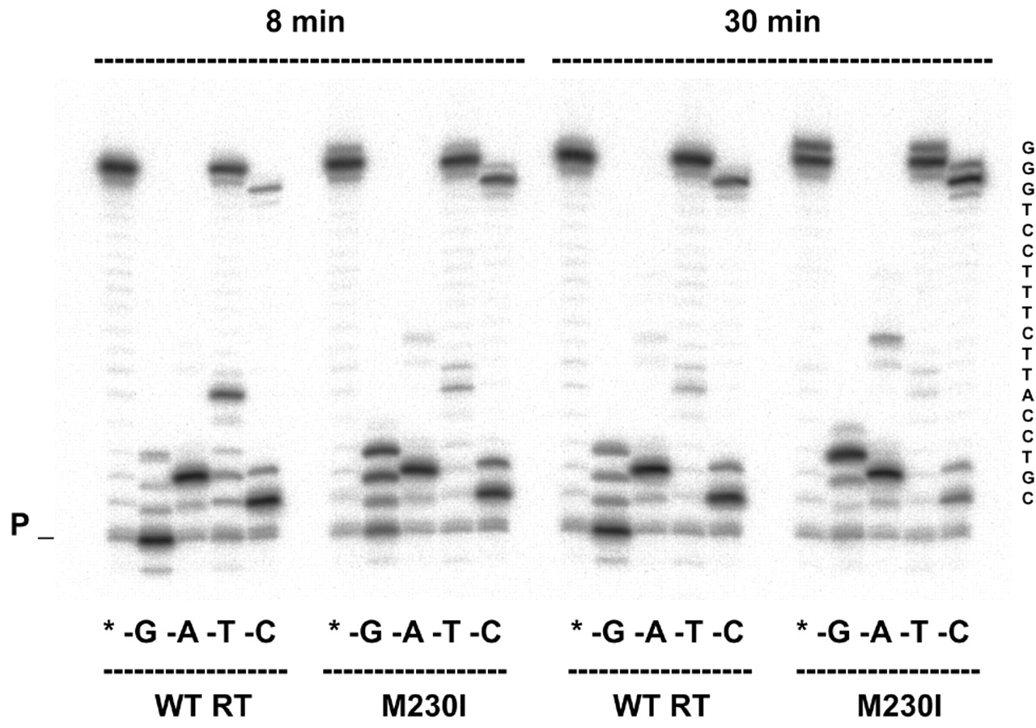
Figure 3.Extension of primer 20PG5 by WT RT and mutant M230I in assays containing a DNA template (D38) and ...
Notes:
Figure 3.Extension of primer 20PG5 by WT RT and mutant M230I in assays containing a DNA template (D38) and lacking a complementary dNTP. Reactions were incubated for 8 and 30 min, as indicated. Lanes marked with an asterisk indicate that all four nucleotides are included in the dNTP mix. Lanes marked –G, –A, –T and –C represent the missing fourth nucleotide from the dNTP mix in the respective set of experiments. The sequence of the single-stranded template extension is shown on the right. P indicates the position of the unextended primer.
Unless provided in the caption above, the following copyright applies to the content of this slide:

Slide 2
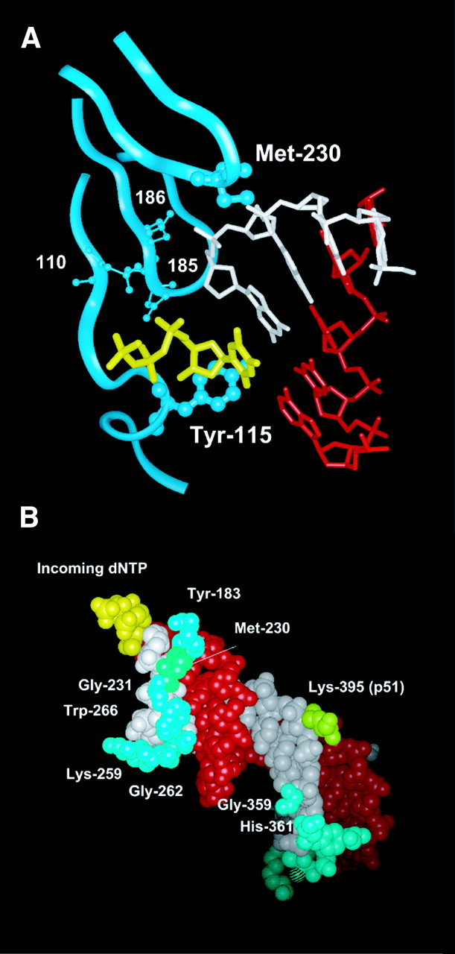
Figure 2. Interaction between Met230 and the primer strand in an HIV-1 RT/DNA/DNA template/primer/dNTP ...
Notes:
Figure 2. Interaction between Met230 and the primer strand in an HIV-1 RT/DNA/DNA template/primer/dNTP complex. (A) View of the dNTP-binding site showing the location of Tyr115 and Met230 (represented by a ball and stick model). The template, primer and incoming dNTP are shown in red, white and yellow, respectively. Ribbons correspond to the p66 backbone at residues 108–120, 180–190 and 225–235. Catalytic aspartic acid residues at positions 110, 185 and 186 are also shown. The template strand (red), the primer strand (white) and the incoming dNTP (yellow) are shown in (B), together with residues of HIV-1 RT that interact with the primer strand, using a space filling representation. Indicated amino acids (Tyr183, Met230, Gly231, Lys259, Gly262, Trp266, Gly359 and His361 of p66 and Lys395 of p51) are located at <4 Å from the primer. Figures were made with the program Insight II v.98.0, using the Brookhaven Protein Databank coordinates 1RTD (2).
Unless provided in the caption above, the following copyright applies to the content of this slide:

Slide 3
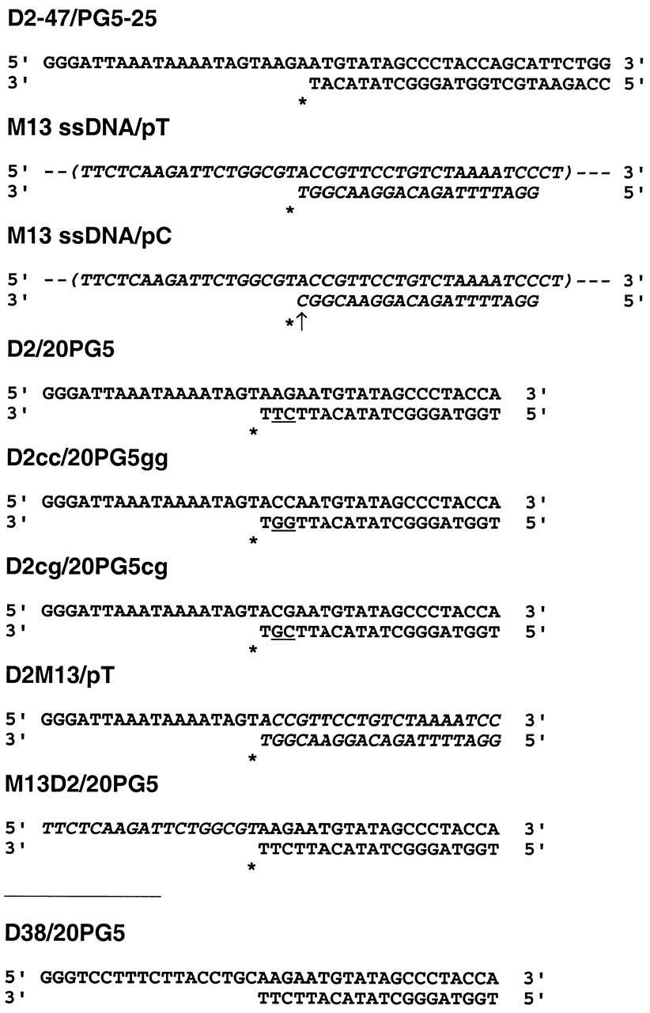
Figure 1. Nucleotide sequences of the template/primer complexes used in the assays. Templates D2, D38 and ...
Notes:
Figure 1. Nucleotide sequences of the template/primer complexes used in the assays. Templates D2, D38 and D2-47 derive from an HIV-1BH10gag sequence that starts at nucleotide 915 (5′-end), according to the sequence numbering of GenBank accession no. M15654. M13-derived sequences are shown in italic. Incorporation sites are indicated with an asterisk and the mismatch in template/primer M13 ssDNA/pC is marked with an arrow. Underlined nucleotides at positions –2 and –3 of primers highlight the differences between templates/primers D2/20PG5, D2cc/20PG5gg and D2cg/20PG5cg. M13 ssDNA, M13 single-stranded DNA.
Unless provided in the caption above, the following copyright applies to the content of this slide:

