Slide 1
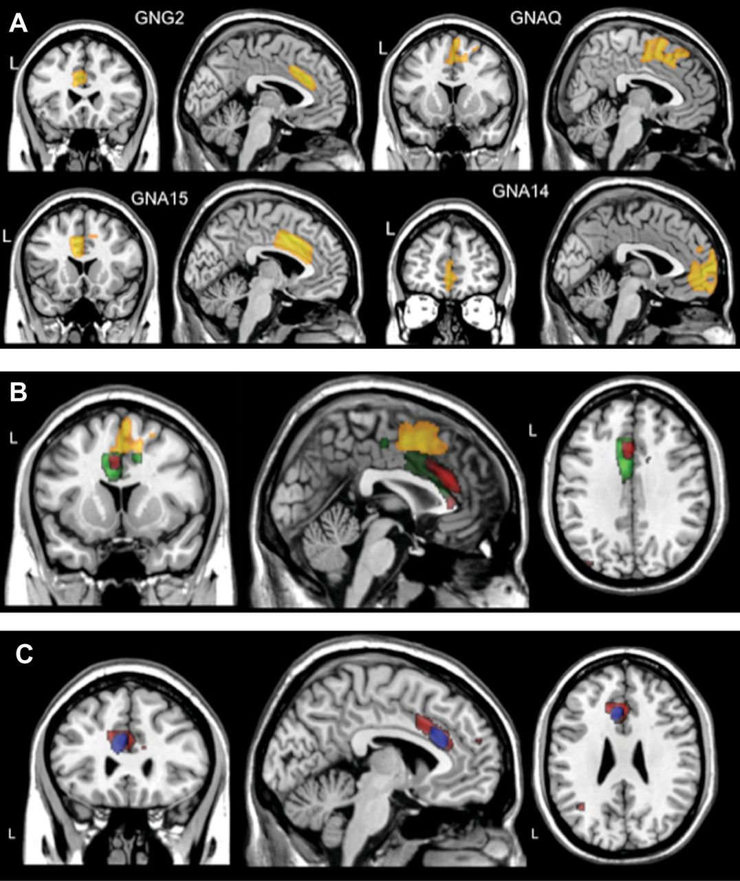
Figure 1. Anatomical locations of SNP-association clusters of G-proteins genes that showed significant FWE corrected P ...
Notes:
Figure 1. Anatomical locations of SNP-association clusters of G-proteins genes that showed significant FWE corrected P values of local gray matter differences in the medial frontal cortex. (A) The anatomical cluster for each gene corresponds to the SNP that had the lowest significant association P values after Bonferroni correction in the discovery sample: GNG2 (rs1185703), GNAQ (rs4745679), GNA15 (rs2238628), GNA14 (rs4745639). (B) Overlap of 3 clusters of SNP-associated G-proteins genes that showed significant association with local gray matter differences in the medial frontal cortex (Brodmann areas 24 and 32). Red Cluster: GNG2 (rs11851703); yellow cluster: GNAQ (rs4745678); green cluster: GNA15 (rs2238628). (C) Anatomical location of the overlapping cluster of SNP rs11851703 (GNG2 gene) in the discovery sample (red cluster) and the replication sample (blue cluster). “L”: left hemisphere.
Unless provided in the caption above, the following copyright applies to the content of this slide: © The Authors 2012. Published by Oxford University Press.This is an Open Access article distributed under the terms of the Creative Commons Attribution Non-Commercial License (http://creativecommons.org/licenses/by-nc/3.0), which permits unrestricted non-commercial use, distribution, and reproduction in any medium, provided the original work is properly cited.

