Slide 1
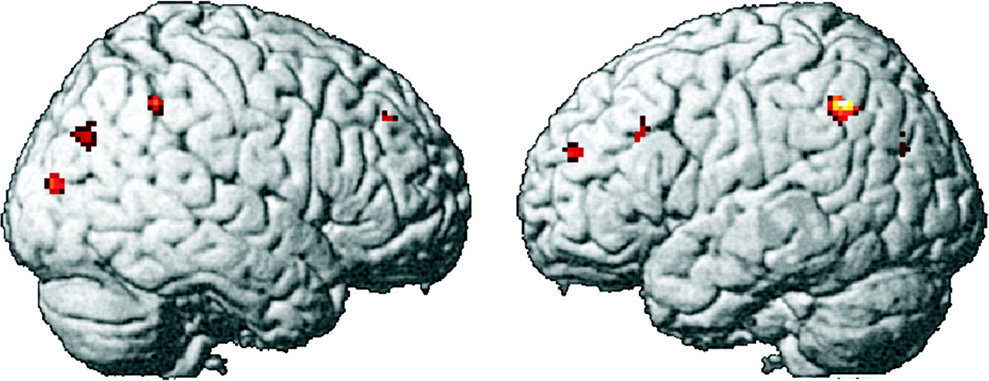
Figure 4. Group contrast showing areas where control participants have more activation than the autism group in the TOL ...
Notes:
Figure 4. Group contrast showing areas where control participants have more activation than the autism group in the TOL task.
Unless provided in the caption above, the following copyright applies to the content of this slide: © The Author 2006. Published by Oxford University Press. All rights reserved. For permissions, please e-mail: journals.permissions@oxfordjournals.org

Slide 2
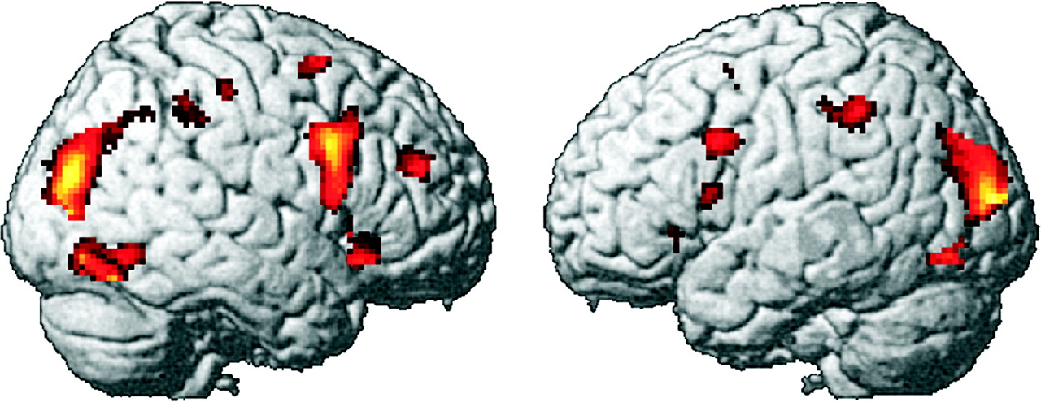
Figure 3. Activation in the autism group in the TOL task (contrast with fixation condition).
Notes:
Figure 3. Activation in the autism group in the TOL task (contrast with fixation condition).
Unless provided in the caption above, the following copyright applies to the content of this slide: © The Author 2006. Published by Oxford University Press. All rights reserved. For permissions, please e-mail: journals.permissions@oxfordjournals.org

Slide 3
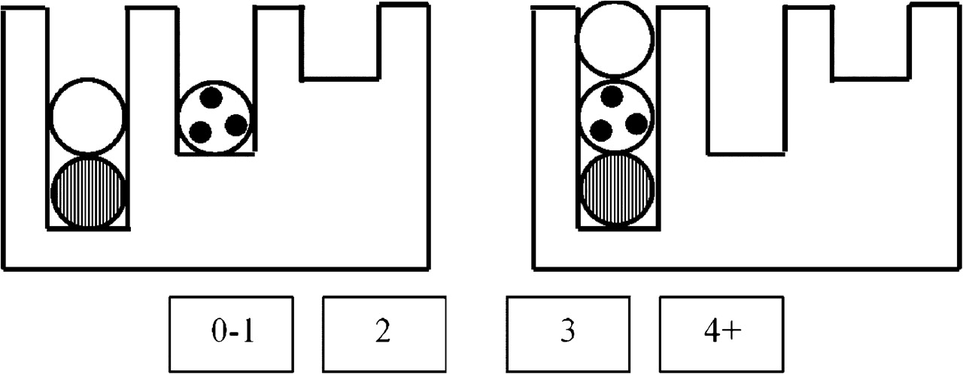
Figure 1. A sample TOL problem, with the start state on the left and the goal state on the right. The participant's ...
Notes:
Figure 1. A sample TOL problem, with the start state on the left and the goal state on the right. The participant's task is to indicate the number of moves required to solve the problem using the response buttons.
Unless provided in the caption above, the following copyright applies to the content of this slide: © The Author 2006. Published by Oxford University Press. All rights reserved. For permissions, please e-mail: journals.permissions@oxfordjournals.org

Slide 4
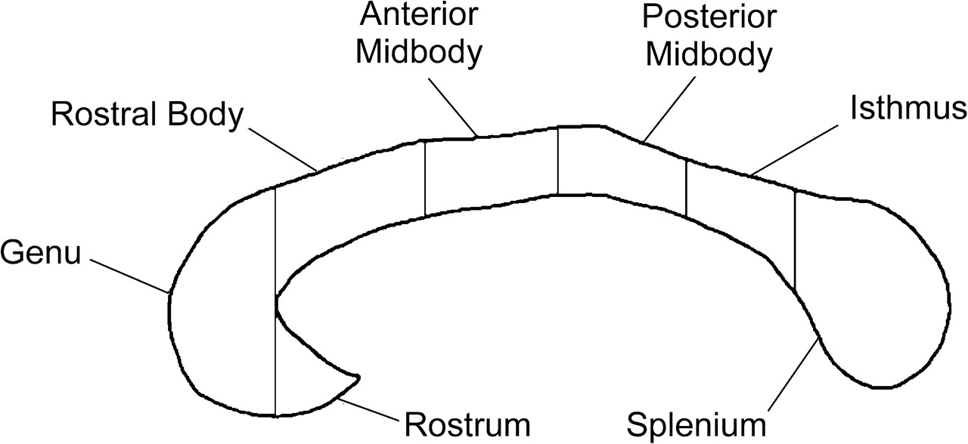
Figure 2. Subdivisions of the midsagittal slice of the human corpus callosum (adapted from Witelson, 1989).
Notes:
Figure 2. Subdivisions of the midsagittal slice of the human corpus callosum (adapted from Witelson, 1989).
Unless provided in the caption above, the following copyright applies to the content of this slide: © The Author 2006. Published by Oxford University Press. All rights reserved. For permissions, please e-mail: journals.permissions@oxfordjournals.org

Slide 5
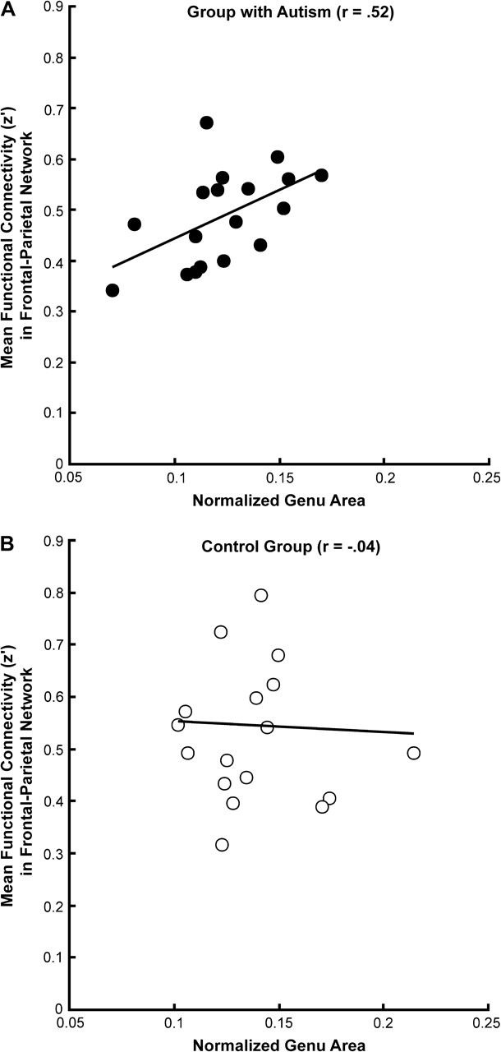
Figure 5. Correlation between the midsagittal area of the genu portion of the corpus callosum and the mean functional ...
Notes:
Figure 5. Correlation between the midsagittal area of the genu portion of the corpus callosum and the mean functional connectivity between frontal and parietal areas for the Autism Group (A) and the Control Group (B).
Unless provided in the caption above, the following copyright applies to the content of this slide: © The Author 2006. Published by Oxford University Press. All rights reserved. For permissions, please e-mail: journals.permissions@oxfordjournals.org

Slide 6
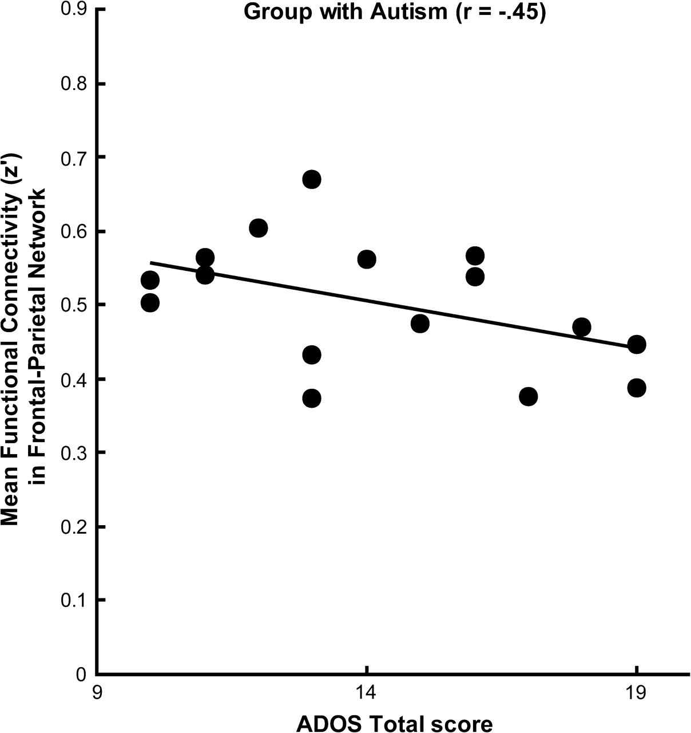
Figure 6. Correlation between the ADOS total score and the functional connectivity in the frontal–parietal network.
Notes:
Figure 6. Correlation between the ADOS total score and the functional connectivity in the frontal–parietal network.
Unless provided in the caption above, the following copyright applies to the content of this slide: © The Author 2006. Published by Oxford University Press. All rights reserved. For permissions, please e-mail: journals.permissions@oxfordjournals.org

