Slide 1
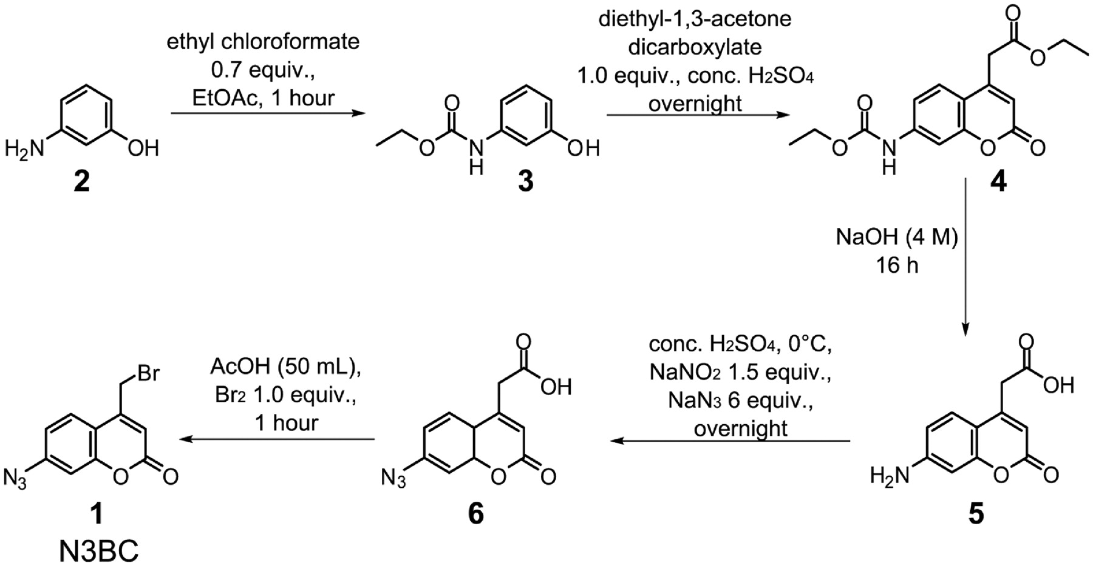
Figure 1. Synthesis of 7-azido-4-(bromomethyl)-2H-chromen-2-one 1 (N3BC). Experimental details of the Pechmann ...
Notes:
Figure 1. Synthesis of 7-azido-4-(bromomethyl)-2H-chromen-2-one 1 (N3BC). Experimental details of the Pechmann condensation are described in the supplement.
Unless provided in the caption above, the following copyright applies to the content of this slide: © The Author(s) 2011. Published by Oxford University Press.This is an Open Access article distributed under the terms of the Creative Commons Attribution Non-Commercial License (http://creativecommons.org/licenses/by-nc/3.0), which permits unrestricted non-commercial use, distribution, and reproduction in any medium, provided the original work is properly cited.

Slide 2
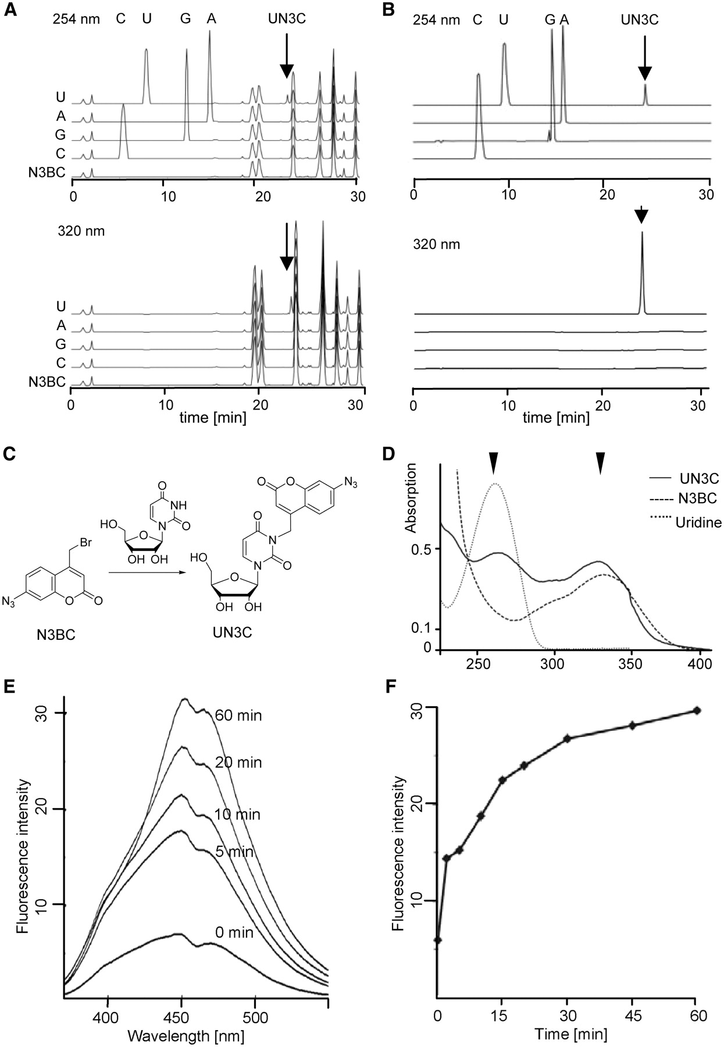
Figure 2. Reactivity of N3BC with RNA nucleosides and homopolynucleotides. Reactions of N3BC with free nucleosides and ...
Notes:
Figure 2. Reactivity of N3BC with RNA nucleosides and homopolynucleotides. Reactions of N3BC with free nucleosides and homopolynucleotides were performed as described in ‘Materials and Methods’ section. Reaction products with nucleosides were directly used for HPLC analysis ( A ), while homopolynucleotides (polyC, polyU etc.) were precipitated to remove unreacted N3BC, and were then digested to free nucleosides for HPLC analysis ( B ). Only uridine forms a reaction product with N3BC, termed UN3C, which is indicated by an arrow in (A) and (B). Note that N3BC itself is so unpolar that it elutes in the later part of the gradient which is not displayed. ( C ) Reaction of N3BC with uridine to UN3C. ( D ) UV-spectra of N3BC, uridine and UN3C. Arrows indicate wavelengths used to monitor aromatic rings (254 nm, upper panels in A and B) and coumarins (320 nm, lower panels in A and B). ( E ) Fluorescence kinetic of a solution of UN3C upon UV-irradiation at 365 nm. Full emission spectra were recorded at selected time points. ( F ) Time course of the fluorescence intensity at 450 nm plotted from the data in (E).
Unless provided in the caption above, the following copyright applies to the content of this slide: © The Author(s) 2011. Published by Oxford University Press.This is an Open Access article distributed under the terms of the Creative Commons Attribution Non-Commercial License (http://creativecommons.org/licenses/by-nc/3.0), which permits unrestricted non-commercial use, distribution, and reproduction in any medium, provided the original work is properly cited.

Slide 3
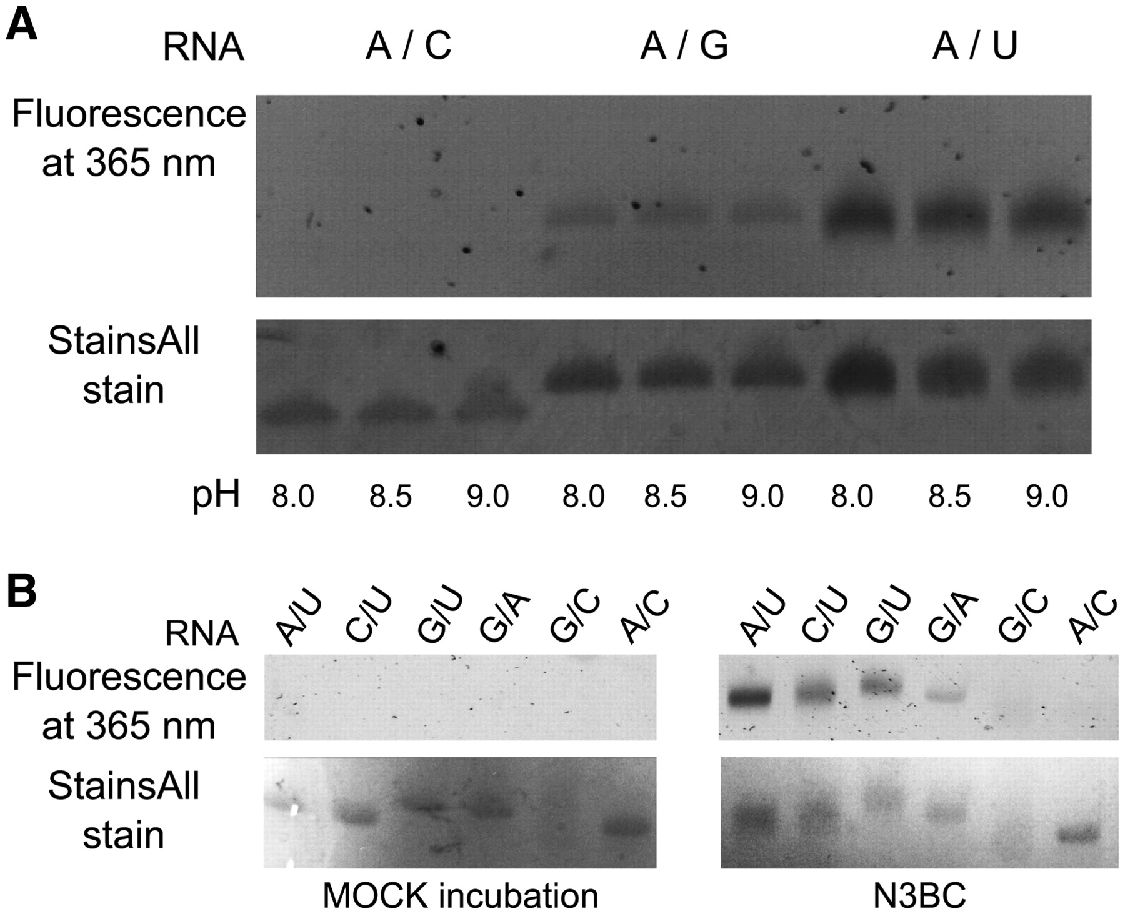
Figure 3. In-gel detection of RNA-coumarin conjugates of binary oligomers. ( A ) Polyacrylamide gel of binary ...
Notes:
Figure 3. In-gel detection of RNA-coumarin conjugates of binary oligomers. ( A ) Polyacrylamide gel of binary oligomers A/C, A/G and A/U (200 pmol each) after reaction with N3BC at pH 8.0, 8.5 and 9.0 (indicated on the bottom of the panel). Samples were exposed to daylight for 1 h prior to PAGE. The loading control with StainsAll was imaged with a conventional digital camera, and fluorescence upon excitation at 365 nm was imaged with a GelDoc. Note that the loading control developed with StainsAll does not allow comparison among binary oligomers of different composition (compare Supplementary Figure S4 ). ( B ) Polyacrylamide gel of binary oligomers (300 pmol each) of all six permutations of nucleobases (the nucleobase composition is indicated above the gel image) after reaction with N3BC at pH 8.5 (right panels) or mock incubation (left panels). Imaging was done as described in (A) Note that the signal of the GC oligomer smears in the loading control as a consequence of incomplete denaturation.
Unless provided in the caption above, the following copyright applies to the content of this slide: © The Author(s) 2011. Published by Oxford University Press.This is an Open Access article distributed under the terms of the Creative Commons Attribution Non-Commercial License (http://creativecommons.org/licenses/by-nc/3.0), which permits unrestricted non-commercial use, distribution, and reproduction in any medium, provided the original work is properly cited.

Slide 4
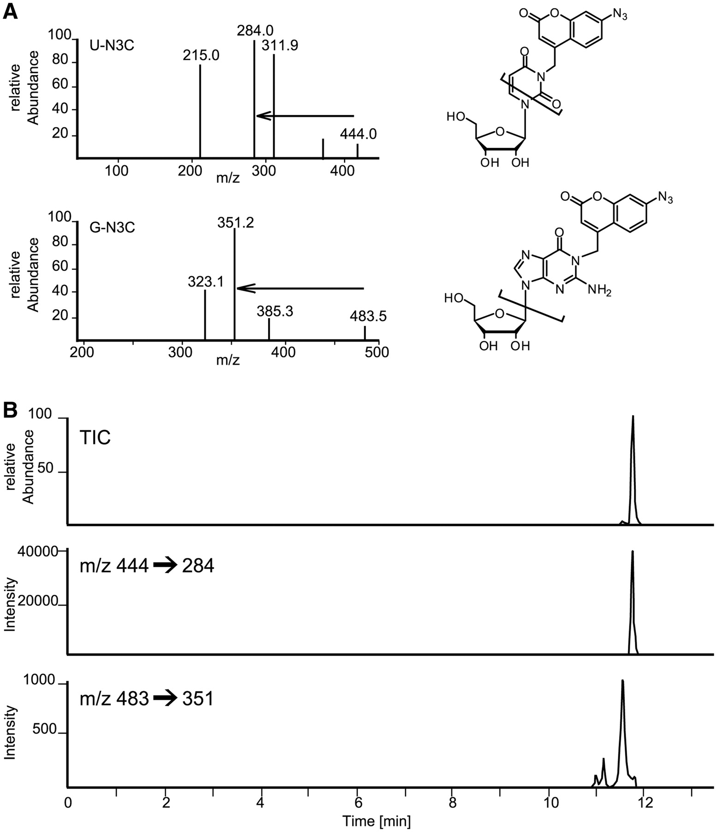
Figure 4. LC/MS/MS analysis of reaction products of N3BC with uridine and guanosine residues in RNA. ( A ) Mass ...
Notes:
Figure 4. LC/MS/MS analysis of reaction products of N3BC with uridine and guanosine residues in RNA. ( A ) Mass spectrum, structure and main fragmentation of positively charged [M + H] + of conjugates of N3BC to uridine (upper panel) and guanosine (lower panel). Mass transitions used in ( B ) are indicated by arrows. The structure of the guanosine product is one out of three possible reaction products of nitrogen alkylation. (B) LC/MS/MS transition trace for guanosine adducts (lower trace) and the uridine adduct (middle trace). The total ion count (TIC) in the upper trace is the weighed sum of the lower two traces. Note the disparate relative intensities in the TIC trace: the smaller peak corresponds to guanosine adducts and resolves into three species seen in the lower trace.
Unless provided in the caption above, the following copyright applies to the content of this slide: © The Author(s) 2011. Published by Oxford University Press.This is an Open Access article distributed under the terms of the Creative Commons Attribution Non-Commercial License (http://creativecommons.org/licenses/by-nc/3.0), which permits unrestricted non-commercial use, distribution, and reproduction in any medium, provided the original work is properly cited.

Slide 5
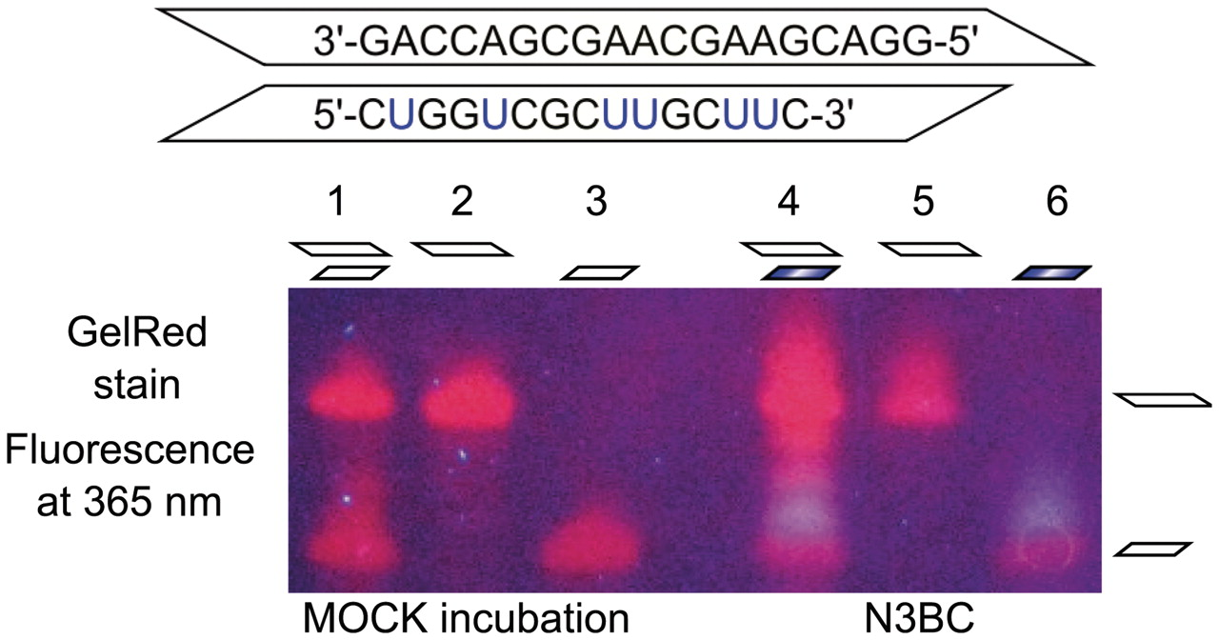
Figure 5. Influence of RNA secondary structure on UN3C formation investigated by in-gel detection of RNA-coumarin ...
Notes:
Figure 5. Influence of RNA secondary structure on UN3C formation investigated by in-gel detection of RNA-coumarin conjugates. The two ternary GAC and CUG oligomers shown in the upper part are complementary save for a 5′-overhang on the GAC oligomer. The oligomers were reacted with N3BC separately (lanes 5 and 6), and as an equimolar mixture (lane 4). Lanes 1–3 show the corresponding mock incubation controls. The samples were run on a denaturing PAGE and stained with GelRed. Upon excitation at 365 nm, the fluorescence was imaged with a conventional digital camera. The blue coumarin fluorescence can be clearly distinguished from the red fluorescence of the GelRed stain. Note that coumarin conjugates migrate more slowly than unreacted RNA.
Unless provided in the caption above, the following copyright applies to the content of this slide: © The Author(s) 2011. Published by Oxford University Press.This is an Open Access article distributed under the terms of the Creative Commons Attribution Non-Commercial License (http://creativecommons.org/licenses/by-nc/3.0), which permits unrestricted non-commercial use, distribution, and reproduction in any medium, provided the original work is properly cited.

Slide 6
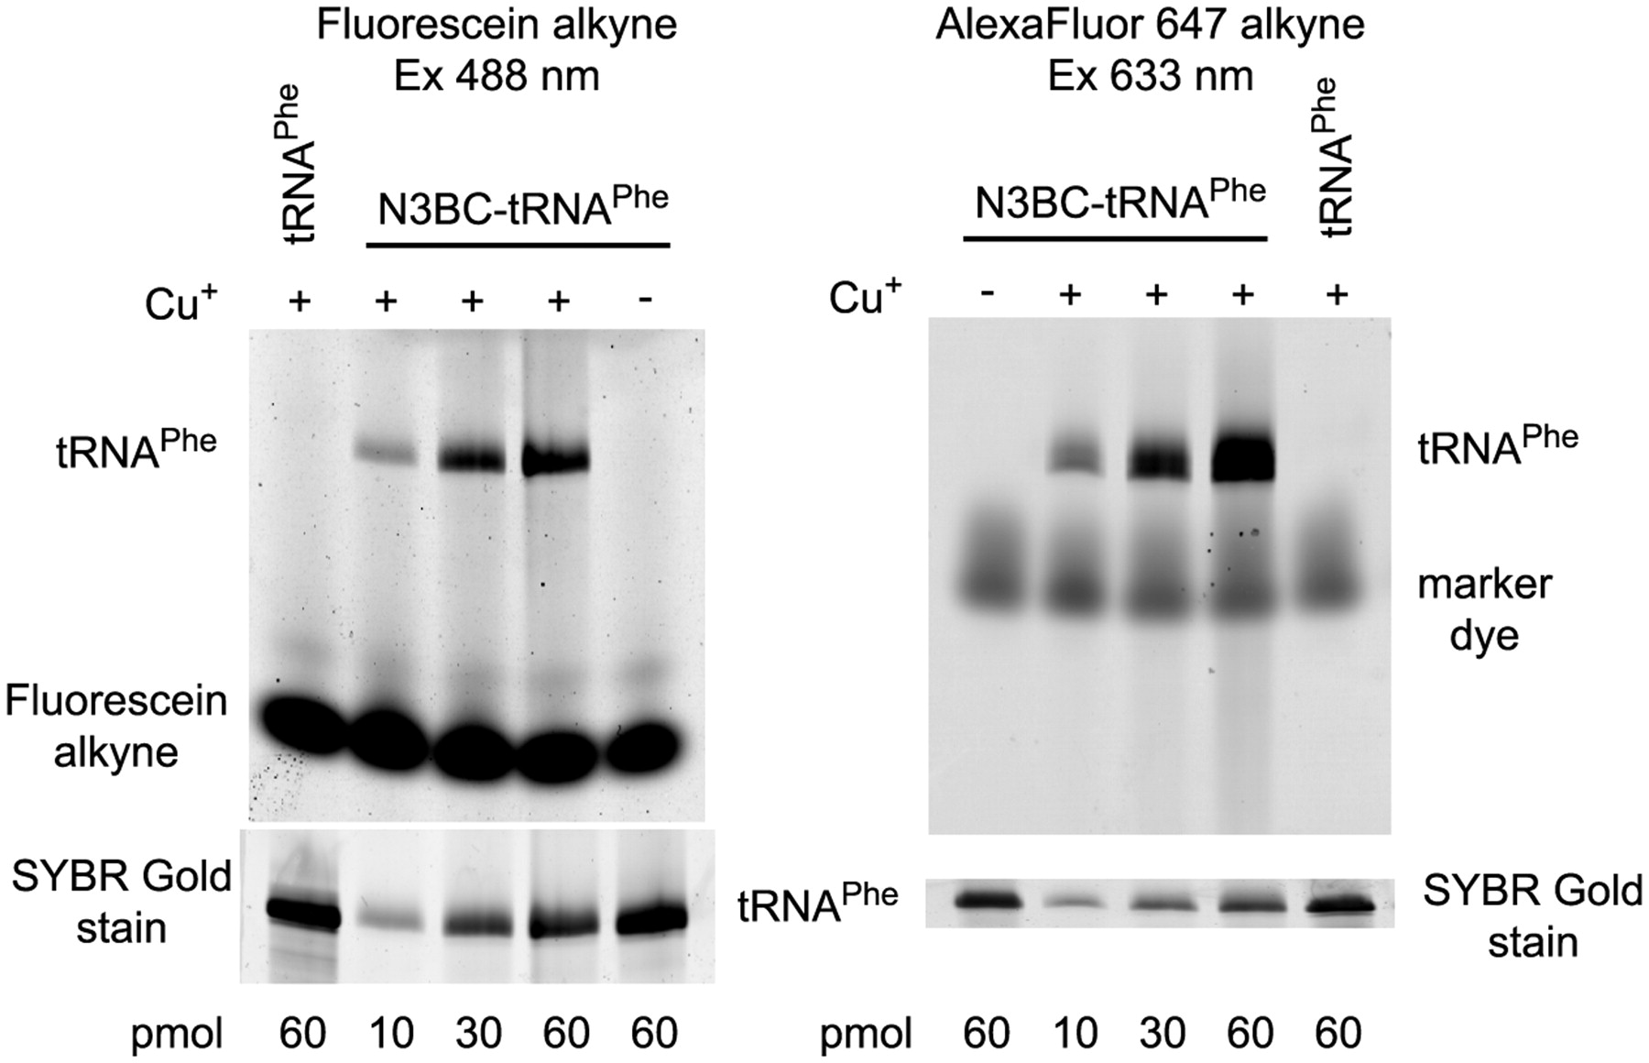
Figure 6. Click-modification of N3BC-treated tRNA ^{Phe} with alkyne-coupled fluorescent dyes. N3BC-treated ...
Notes:
Figure 6. Click-modification of N3BC-treated tRNA Phe with alkyne-coupled fluorescent dyes. N3BC-treated tRNA and untreated control tRNA were incubated with fluorescein-alkyne (left panel) or with AlexaFluor 647-alkyne (right panel) in the presence and absence of copper ions, as indicated above the gel images. For incubation, 10, 30 and 60 pmol of N3BC-treated tRNA and 60 pmol of untreated tRNA transcript (as indicated below the gel image) were used. Analysis was done by urea–PAGE and subsequent fluorescence imaging. Gels were stained by SYBR Gold to provide an RNA loading control.
Unless provided in the caption above, the following copyright applies to the content of this slide: © The Author(s) 2011. Published by Oxford University Press.This is an Open Access article distributed under the terms of the Creative Commons Attribution Non-Commercial License (http://creativecommons.org/licenses/by-nc/3.0), which permits unrestricted non-commercial use, distribution, and reproduction in any medium, provided the original work is properly cited.

Slide 7
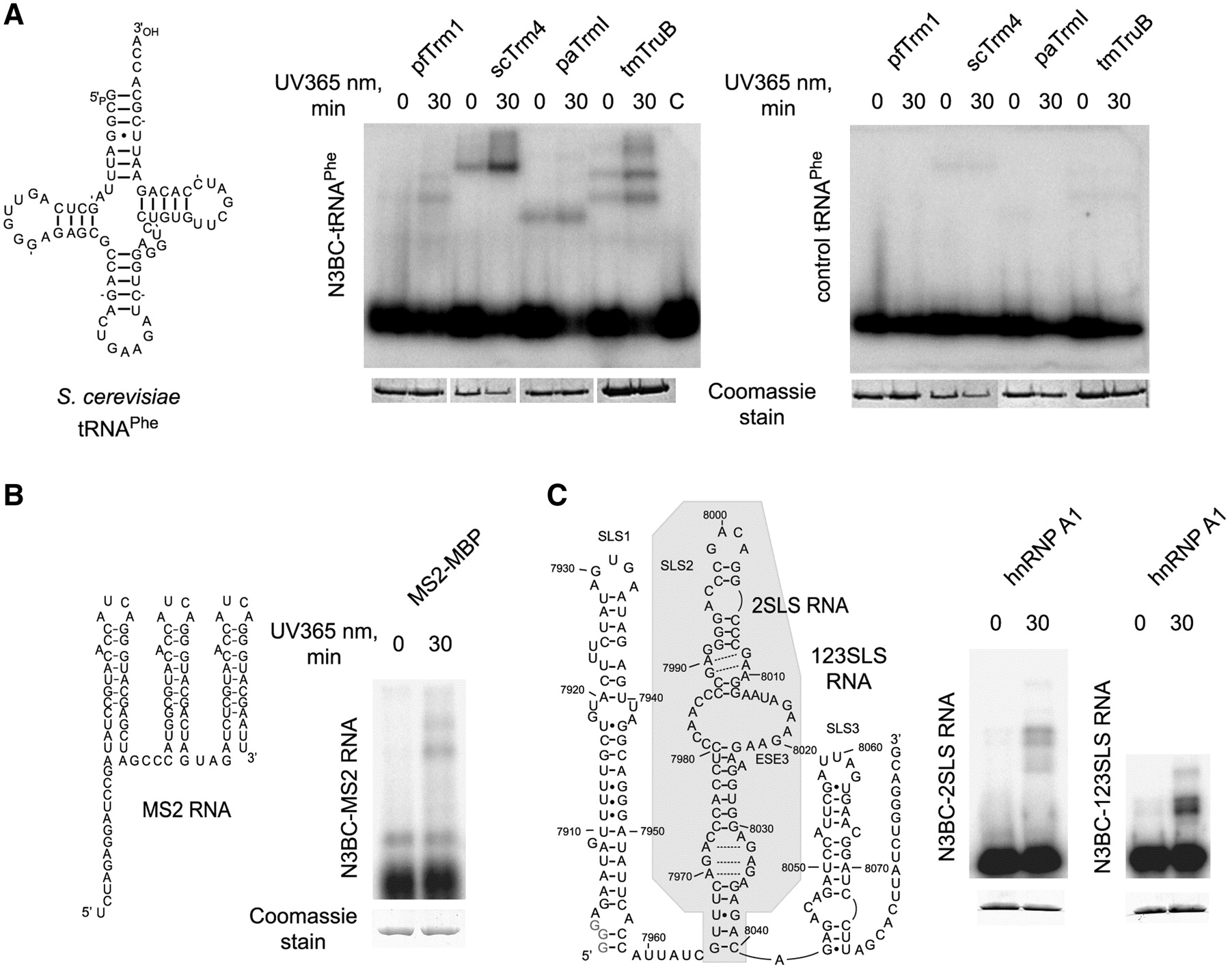
Figure 7. Use of N3BC-treated RNA in RNA–protein crosslinking studies. ( A ) N3BC-treated tRNA ^{Phe} ...
Notes:
Figure 7. Use of N3BC-treated RNA in RNA–protein crosslinking studies. ( A ) N3BC-treated tRNA Phe crosslinks with RNA binding proteins upon irradiation. The secondary tRNA structure is shown on the left. 5′- 32 P-labeled N3BC-treated tRNA Phe or similar amounts of control tRNA Phe transcript were irradiated (as indicated above the gel image) for 0 min or 30 min at 365 nm. RNA–protein crosslinked products were analyzed by SDS–PAGE shown in the middle panel. The following RNA binding proteins were used: P. furiosus Trm1 (pfTrm1), P. abyssi TrmI (paTrmI), S. cerevisiae Trm4 (scTrm4) and T. maritima TruB (tmTruB). Gels were Coomassie Blue stained to verify similar loading of different proteins (shown at the bottom). The lane labeled ‘C’ shows a tRNA sample irradiated in the absence of protein. The negative control in the right panel shows an SDS–PAGE of samples which were not treated with N3BC prior to crosslinking. A control experiment with proteins known not to bind to RNA is shown in Supplementary Figure S11 . ( B ) Secondary structure of MS2 RNA (left) and crosslinking of N3BC-treated MS2 RNA with the recombinant MS2-MBP fusion protein (right). Incubations, crosslinking and analysis were performed as described above for tRNA Phe . ( C ) Secondary structure of HIV-1 derived SLS2 and SLS123 RNAs (left). The region corresponding to SLS2 RNA is shaded. Numbering corresponds to nucleotide numbering in the HIV-1 genome. Crosslinking of SLS2 and SLS123 RNAs to the recombinant hnRNP A1 protein is shown in the right panel. Incubations, crosslinking and analysis were performed as described above for tRNA Phe .
Unless provided in the caption above, the following copyright applies to the content of this slide: © The Author(s) 2011. Published by Oxford University Press.This is an Open Access article distributed under the terms of the Creative Commons Attribution Non-Commercial License (http://creativecommons.org/licenses/by-nc/3.0), which permits unrestricted non-commercial use, distribution, and reproduction in any medium, provided the original work is properly cited.

