Slide 1
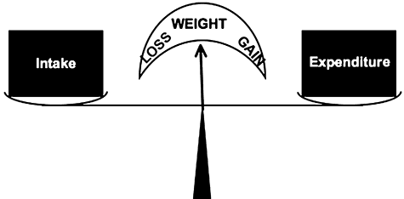
Figure 1 A common conceptualization of the energy balance equation as it applies to the regulation of body weight.
Notes:
Figure 1 A common conceptualization of the energy balance equation as it applies to the regulation of body weight.
Unless provided in the caption above, the following copyright applies to the content of this slide: © 2009 International Life Sciences Institute

Slide 2
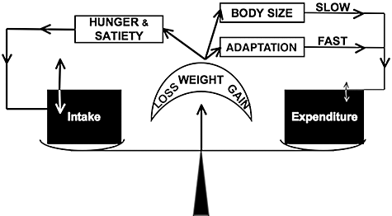
Figure 3 A more mechanistic conceptualization of the energy balance equation that incorporates some of the feedback ...
Notes:
Figure 3 A more mechanistic conceptualization of the energy balance equation that incorporates some of the feedback mechanisms interrelating energy expenditure, energy intake, and body weight.
Unless provided in the caption above, the following copyright applies to the content of this slide: © 2009 International Life Sciences Institute

Slide 3
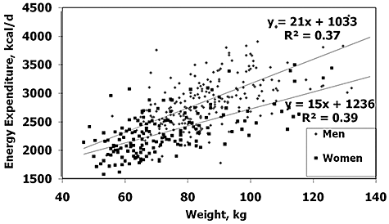
Figure 2 Cross-sectional relationship between total energy expenditure and body weight in 40–69-year-old US adults. ...
Notes:
Figure 2 Cross-sectional relationship between total energy expenditure and body weight in 40–69-year-old US adults. Drawn using data from the OPEN study in Tooze et al. (2007).31
Unless provided in the caption above, the following copyright applies to the content of this slide: © 2009 International Life Sciences Institute

