Slide 1
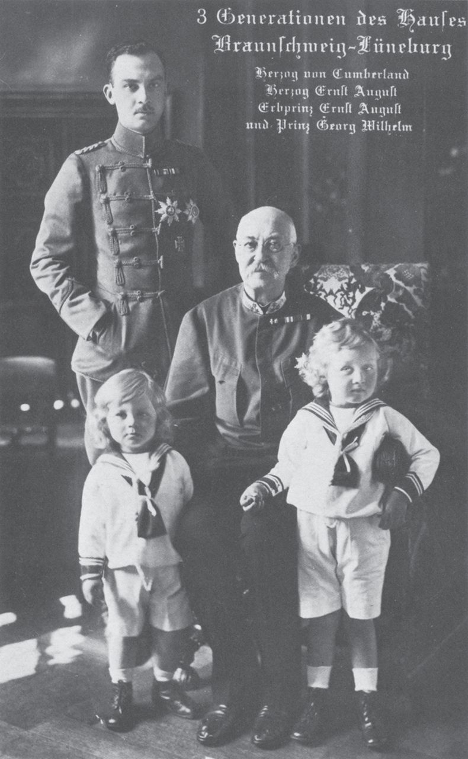
Fig. 1. A postcard of c. 1917 featuring Duke Ernst August III (standing), with his father, Ernst August I (seated) ...
Notes:
Fig. 1. A postcard of c. 1917 featuring Duke Ernst August III (standing), with his father, Ernst August I (seated) and his two sons, Ernst August and Georg Wilhelm. From Patrick M. De Winter, The Sacral Treasure of the Guelphs (Cleveland, 1985), p. 132.
Unless provided in the caption above, the following copyright applies to the content of this slide: © The Author 2015. Published by Oxford University Press. All rights reserved.

Slide 2
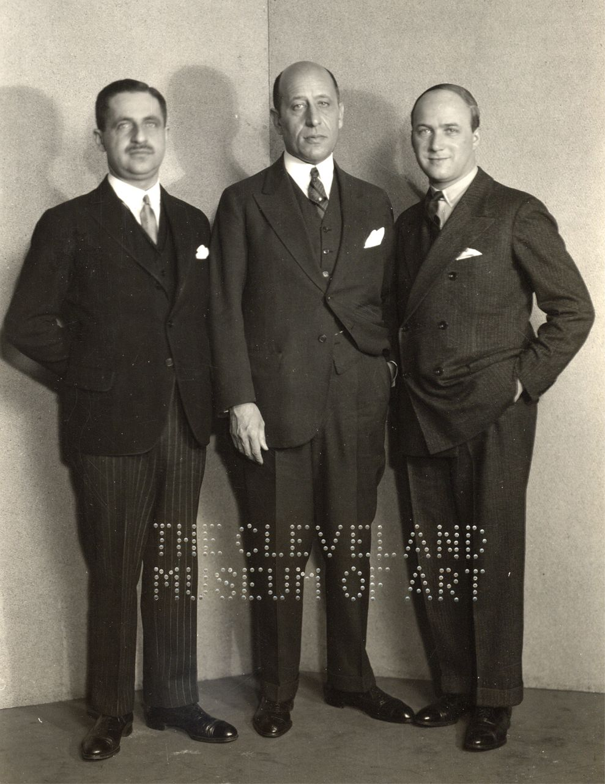
Fig. 2. The dealers: Z. M. Hackenbroch, Julius F. Goldschmidt, and Saemy Rosenberg, 1931. Photograph Collection, Box ...
Notes:
Fig. 2. The dealers: Z. M. Hackenbroch, Julius F. Goldschmidt, and Saemy Rosenberg, 1931. Photograph Collection, Box 9, Z. M. Hackenbroch and Julius F. Goldschmidt, and Mr. Rosenberg, Guelph Treasure Dealers, 1931, Cleveland Museum of Art Archives.
Unless provided in the caption above, the following copyright applies to the content of this slide: © The Author 2015. Published by Oxford University Press. All rights reserved.

Slide 3
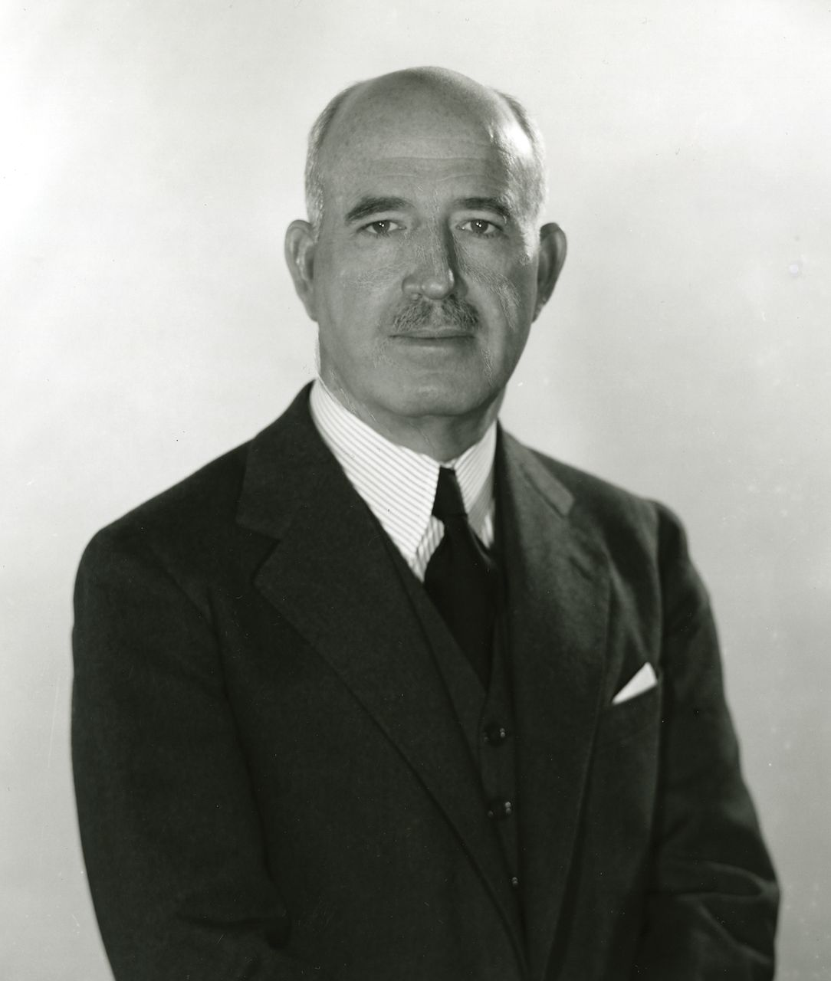
Fig. 3. The director: William Mathewson Milliken. Photograph Collection, Box 11, Milliken, William M., Cleveland ...
Notes:
Fig. 3. The director: William Mathewson Milliken. Photograph Collection, Box 11, Milliken, William M., Cleveland Museum of Art Archives.
Unless provided in the caption above, the following copyright applies to the content of this slide: © The Author 2015. Published by Oxford University Press. All rights reserved.

Slide 4
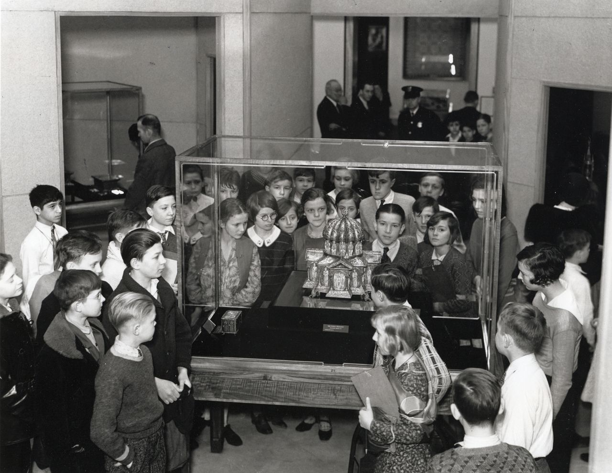
Fig. 4. Visitors to the Guelph Treasure exhibition in Cleveland. Photograph Collection, Box 6, Guelph Treasure ...
Notes:
Fig. 4. Visitors to the Guelph Treasure exhibition in Cleveland. Photograph Collection, Box 6, Guelph Treasure Opening Days, January 1931, Cleveland Museum of Art Archives.
Unless provided in the caption above, the following copyright applies to the content of this slide: © The Author 2015. Published by Oxford University Press. All rights reserved.

Slide 5
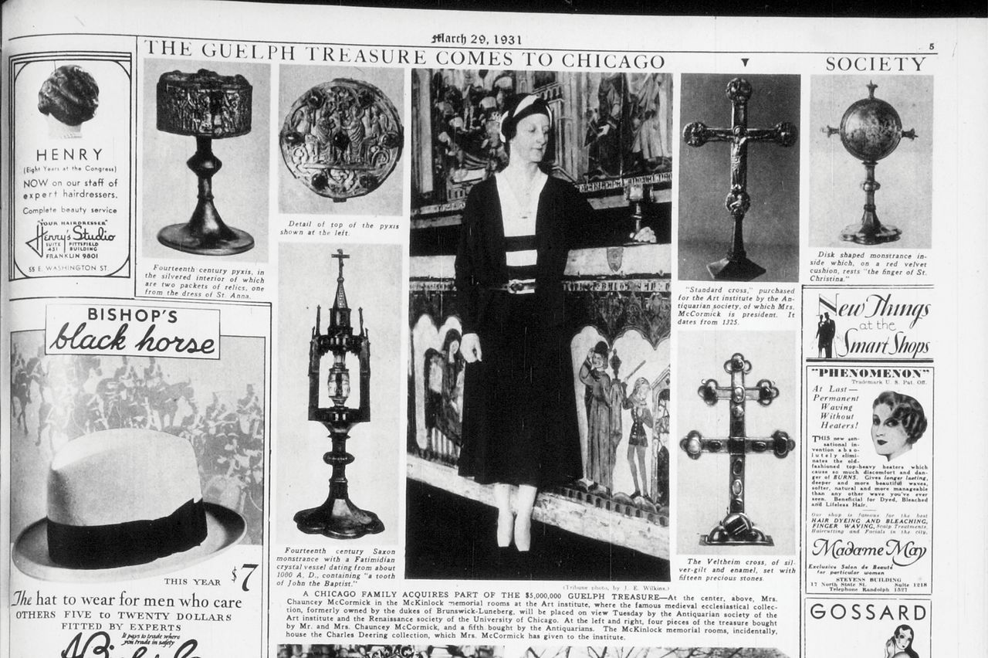
Fig. 5. Standing before the altarpiece that she had inherited from her father and given to the Art Institute, Marion ...
Notes:
Fig. 5. Standing before the altarpiece that she had inherited from her father and given to the Art Institute, Marion McCormick displays her newly acquired pyx from the Guelph Treasure. From the Chicago Tribune , 29 March 1931.
Unless provided in the caption above, the following copyright applies to the content of this slide: © The Author 2015. Published by Oxford University Press. All rights reserved.

Slide 6
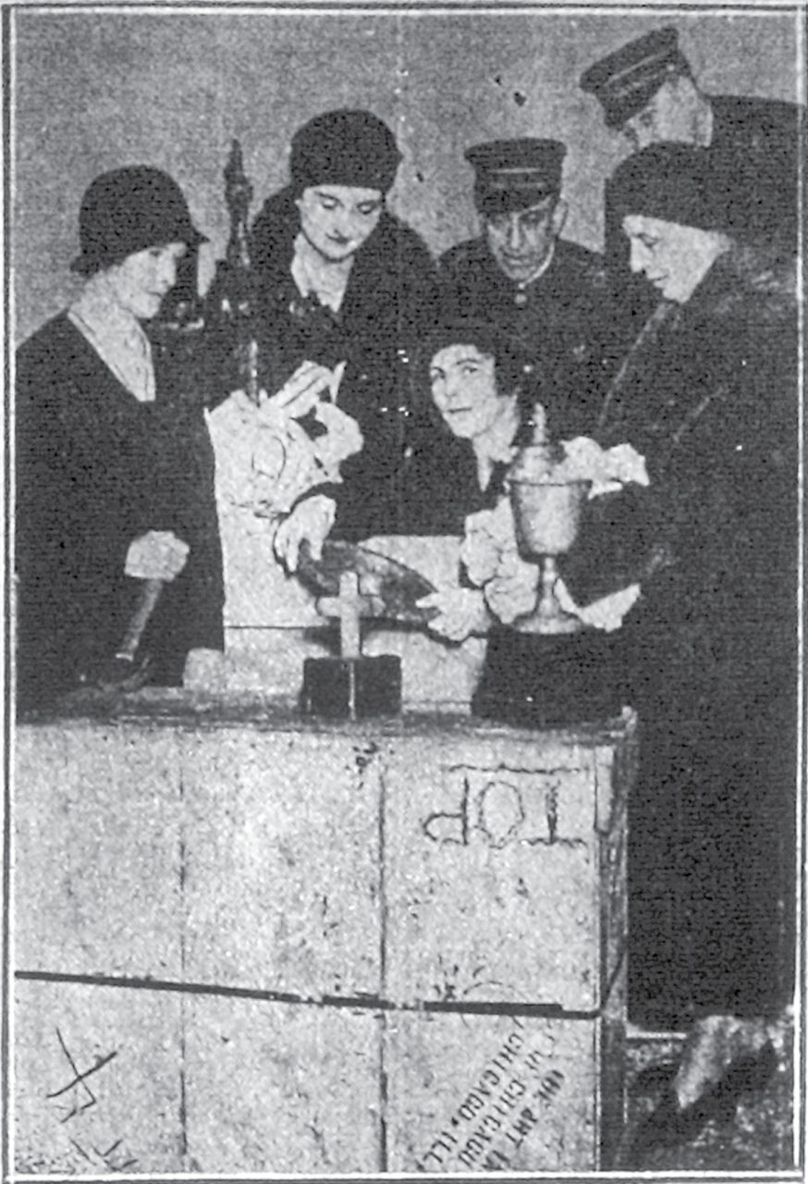
Fig. 6. Guarded by policemen, members of the Antiquarian Society unpack crates containing the Guelph Treasure upon ...
Notes:
Fig. 6. Guarded by policemen, members of the Antiquarian Society unpack crates containing the Guelph Treasure upon its arrival in Chicago. From the Chicago Evening Post , 28 March 1931.
Unless provided in the caption above, the following copyright applies to the content of this slide: © The Author 2015. Published by Oxford University Press. All rights reserved.

Slide 7
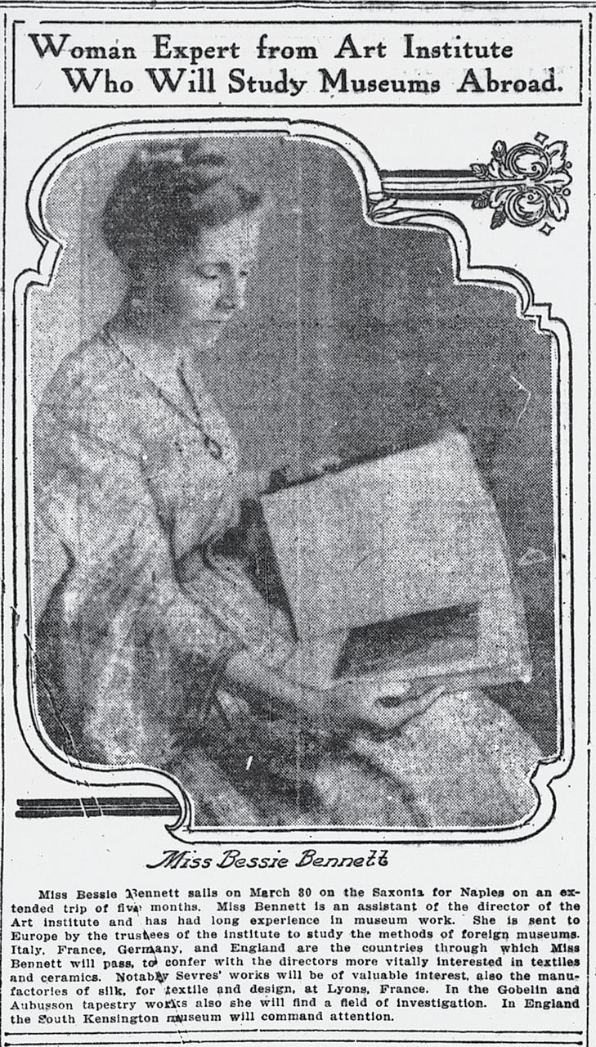
Fig. 7. Art Institute curator Bessie Bennett prepares for a European voyage. From the Chicago Tribune , 30 March ...
Notes:
Fig. 7. Art Institute curator Bessie Bennett prepares for a European voyage. From the Chicago Tribune , 30 March 1911.
Unless provided in the caption above, the following copyright applies to the content of this slide: © The Author 2015. Published by Oxford University Press. All rights reserved.

