Slide 1
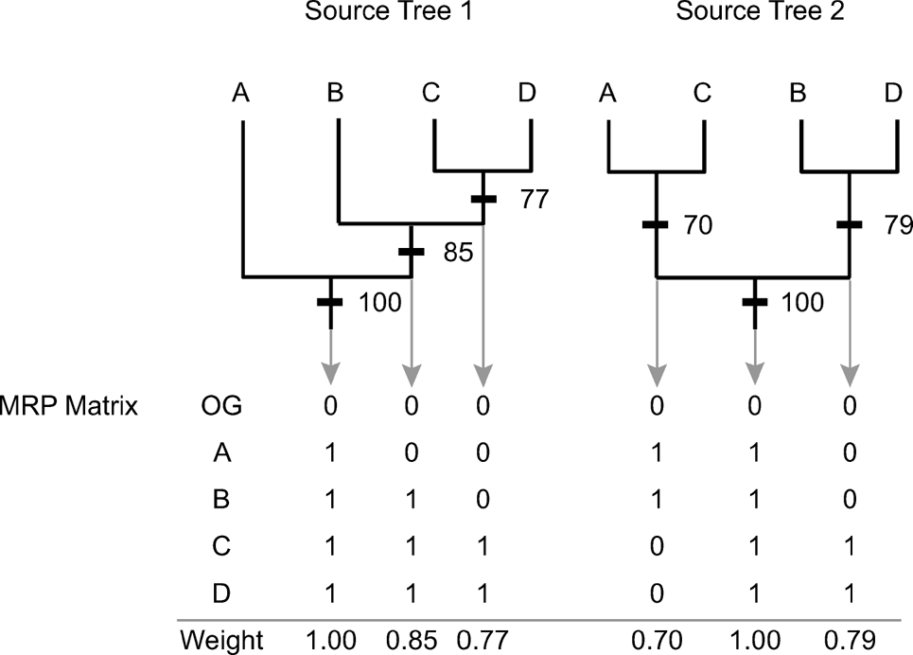
Figure 1 Conventional and bootstrap-weighted MRP. Each node in the set of source trees contributes an element to the ...
Notes:
Figure 1 Conventional and bootstrap-weighted MRP. Each node in the set of source trees contributes an element to the MRP matrix, which is scaled by the corresponding nodal-support value under the bootstrap-weighting scheme (i.e., the row of weights at the bottom of the matrix). OG = outgroup.
Unless provided in the caption above, the following copyright applies to the content of this slide: © 2006 Society of Systematic Biologists

Slide 2
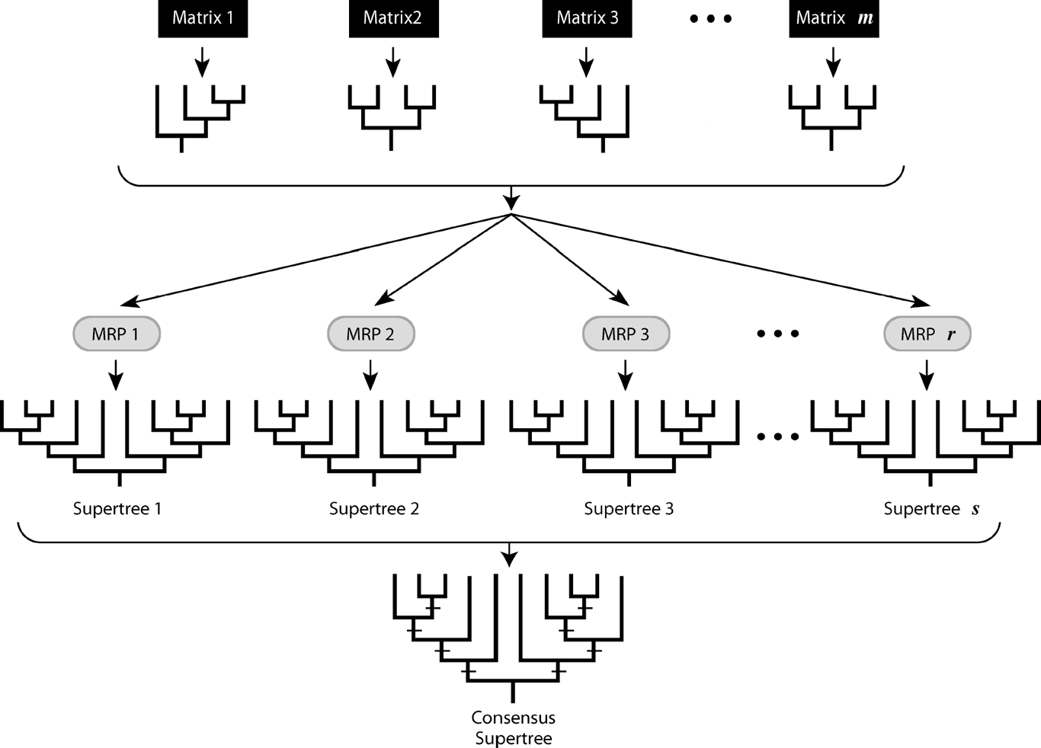
Figure 2 Source-tree bootstrapping. A set of m random draws (with replacement) are made from the set of source trees. ...
Notes:
Figure 2 Source-tree bootstrapping. A set of m random draws (with replacement) are made from the set of source trees. Each set of source trees is then translated into an MRP matrix, from which a supertree is estimated and appended to an array. This procedure is replicated r times. The resulting array of s supertrees is summarized by majority-rule consensus such that the frequencies of nodes in the consensus supertree provide an estimate of the topological congruence among the set of source-tree topologies. This approach is referred to as EPT-based source-tree bootstrapping when samples are drawn from the entire set of equally parsimonious source trees, and as MRC-based source-tree bootstrapping when samples are drawn from the set of majority-rule consensus of those equally parsimonious source trees. See text for details.
Unless provided in the caption above, the following copyright applies to the content of this slide: © 2006 Society of Systematic Biologists

Slide 3
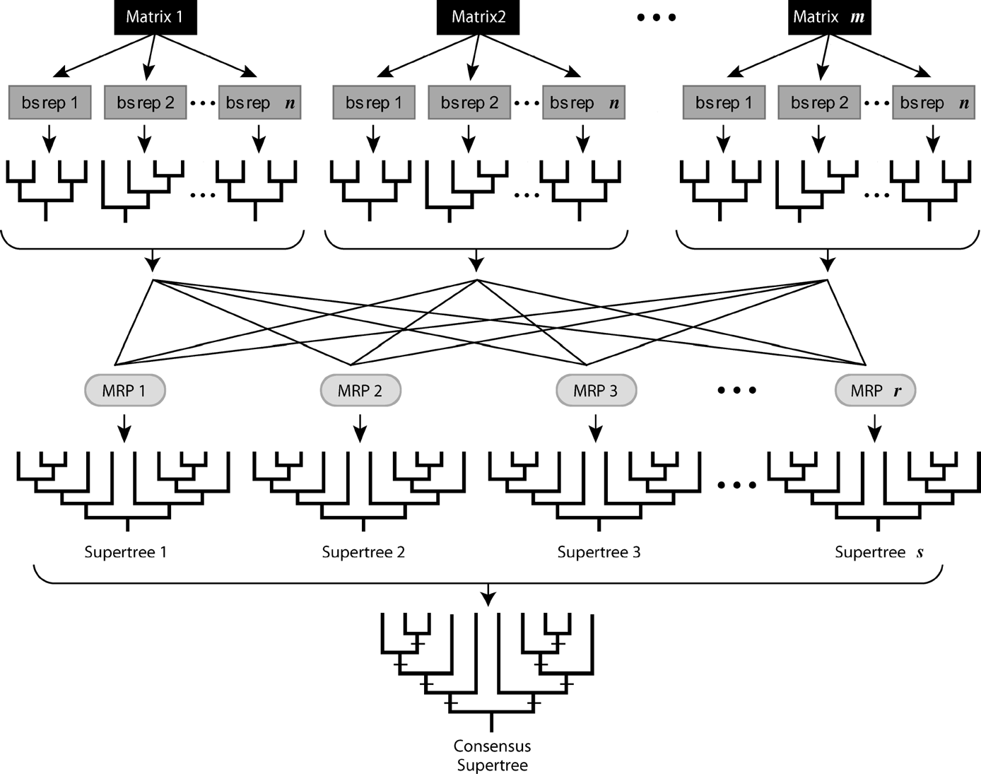
Figure 3 Hierarchical bootstrapping. This procedure is similar to that of source-tree bootstrapping (illustrated in ...
Notes:
Figure 3 Hierarchical bootstrapping. This procedure is similar to that of source-tree bootstrapping (illustrated in Fig. 2), but differs in two important respects. First, each replicate set of source trees is drawn randomly from the set of m source-tree bootstrap profiles, such that each source-tree profile contributes one tree to each bootstrap replicate (with P = 1/n). Second, the frequencies of clades in the consensus supertree rendered under this approach provide an estimate of the underlying character support within the set of source-tree data matrices that is analogous to conventional bootstrap proportions. See text for details.
Unless provided in the caption above, the following copyright applies to the content of this slide: © 2006 Society of Systematic Biologists

Slide 4
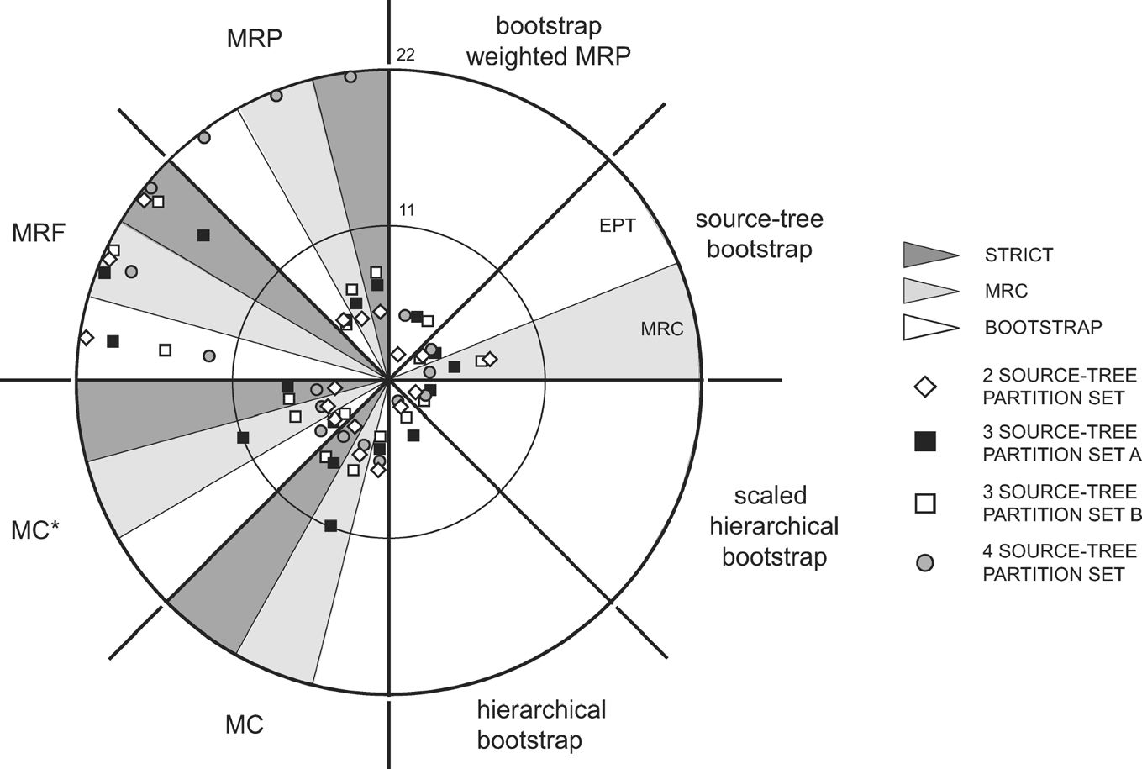
Figure 6 Topological similarity of supertree estimates to a target phylogeny based on a simultaneous analysis of the ...
Notes:
Figure 6 Topological similarity of supertree estimates to a target phylogeny based on a simultaneous analysis of the combined dataset for the plant group, Dipsacales. The target tree is located at the center of the graph, and each supertree is plotted within (sub)sectors for each of the supertree estimation methods. The radial distance from each supertree to the center of the graph reflects its topological distance to the target tree in units of NNI (nearest-neighbor interchange) branch swaps. Abbreviations for supertree methods: MC = MinCut; MC* = modified MinCut; MRP = matrix representation with parsimony; MRF = matrix representation with flipping. Abbreviations for sets of source trees from which supertree estimates were derived: EPT = set of equally parsimonious source trees; MRC = set of majority-rule consensus source trees; STRICT = set of set of strict consensus source trees; BOOTSTRAP = set of bootstrap source trees. The degree of resolution for each supertree estimate is listed in Table 2.
Unless provided in the caption above, the following copyright applies to the content of this slide: © 2006 Society of Systematic Biologists

Slide 5
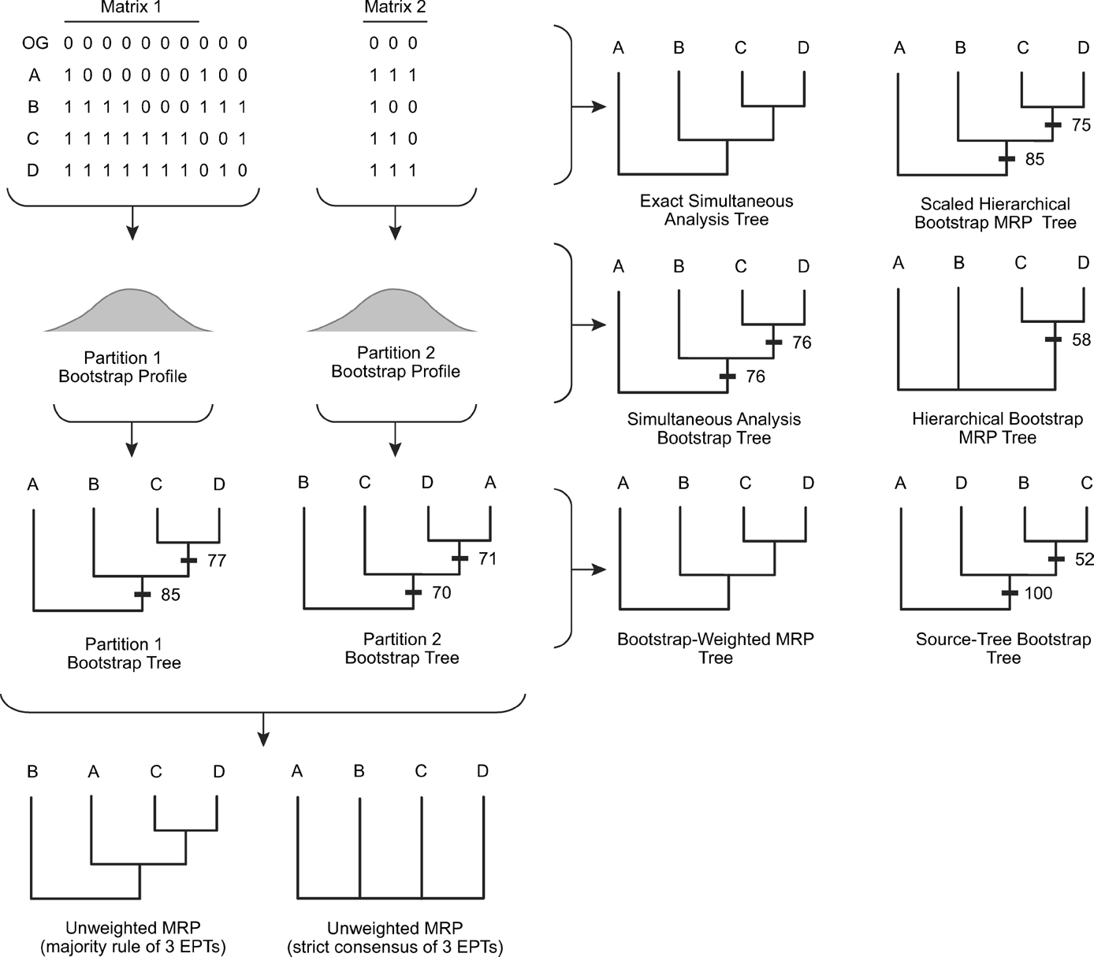
Figure 5 A second hypothetical example illustrating additional aspects of the proposed bootstrap approaches. Bootstrap ...
Notes:
Figure 5 A second hypothetical example illustrating additional aspects of the proposed bootstrap approaches. Bootstrap analyses of the two data partitions in this example produce bootstrap proportions similar to those of the first example (Fig. 4) despite differences in the weight of character evidence between the matrices. The hierarchical bootstrap tree is compatible with (but less resolved than) the simultaneous bootstrap tree (i.e., the target tree), but converges on the target tree when scaled to reflect the relative weight of evidence in the two source-tree data matrices. In contrast to the first example, the tree based on unweighted MRP in this case differs from the target tree, but the bootstrap-weighted MRP tree is identical to the target (however, it is also still identical to the source tree with the higher bootstrap proportions).
Unless provided in the caption above, the following copyright applies to the content of this slide: © 2006 Society of Systematic Biologists

Slide 6
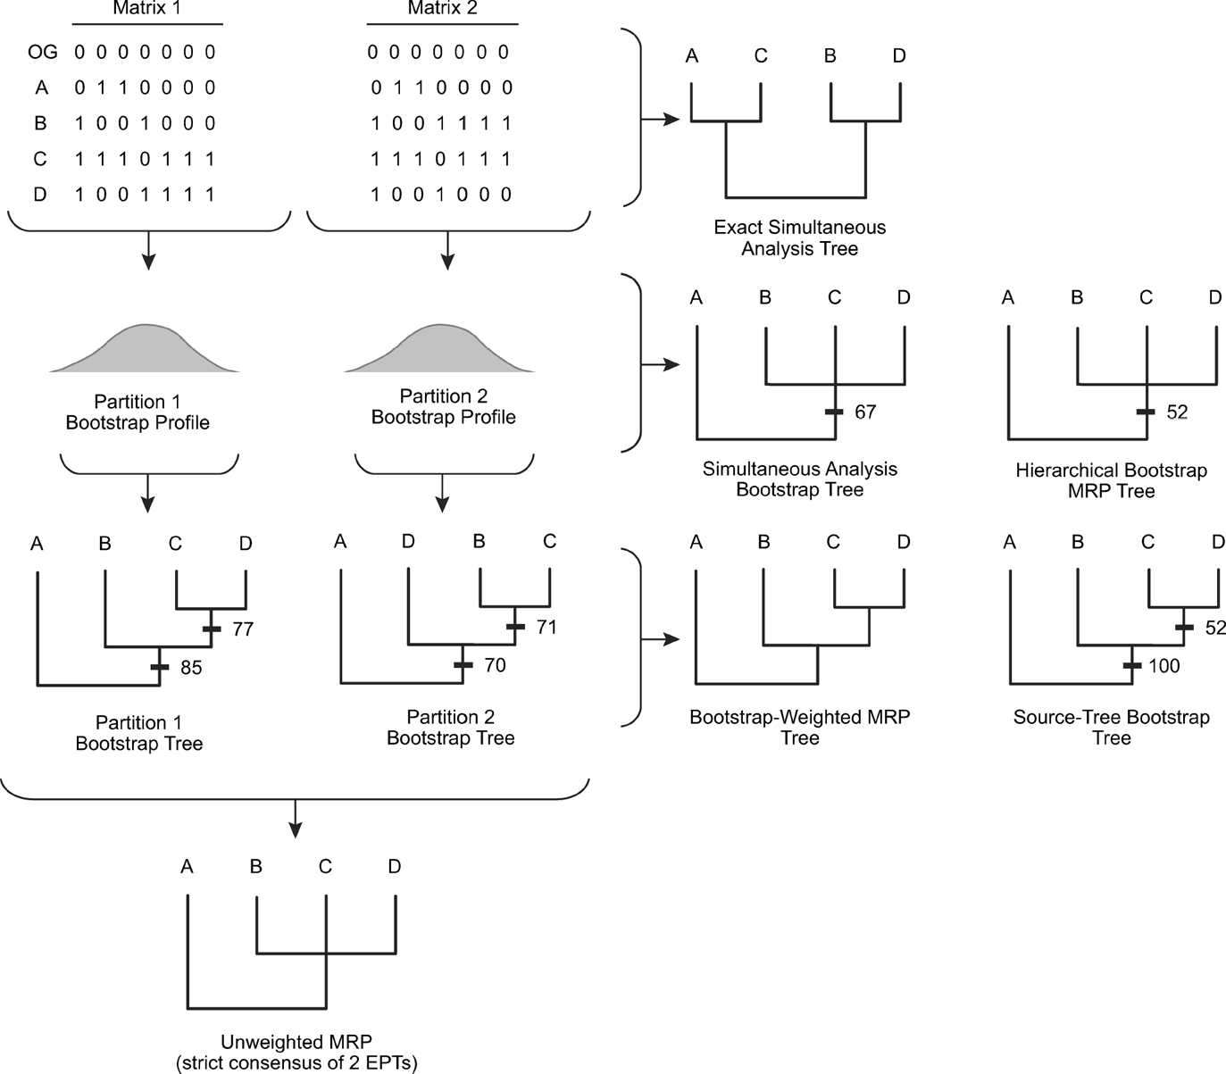
Figure 4 A hypothetical example illustrating the proposed bootstrap approaches (modified from Barrett et al., 1991; ...
Notes:
Figure 4 A hypothetical example illustrating the proposed bootstrap approaches (modified from Barrett et al., 1991; see also Pisani and Wilkinson, 2002). The example was originally contrived to illustrate the phenomenon of “weak-signal enhancement”: congruent sub-signals in the two component matrices combine to become the dominant signal when the component matrices are analyzed simultaneously. The two trees derived from separate analyses differ from that sanctioned by the simultaneous analysis. Although the latter topology is not recovered by the supertree bootstrapping approaches, neither is it recovered by a conventional bootstrap analysis. The estimate based on hierarchical bootstrapping is identical to the simultaneous bootstrap tree (i.e., the target tree). In this example, the strict consensus of the two equally parsimonious trees found by unweighted MRP is also identical to the target tree, but the estimate derived by bootstrap-weighted MRP is not (but is identical to the source tree with the higher bootstrap proportions).
Unless provided in the caption above, the following copyright applies to the content of this slide: © 2006 Society of Systematic Biologists

Slide 7
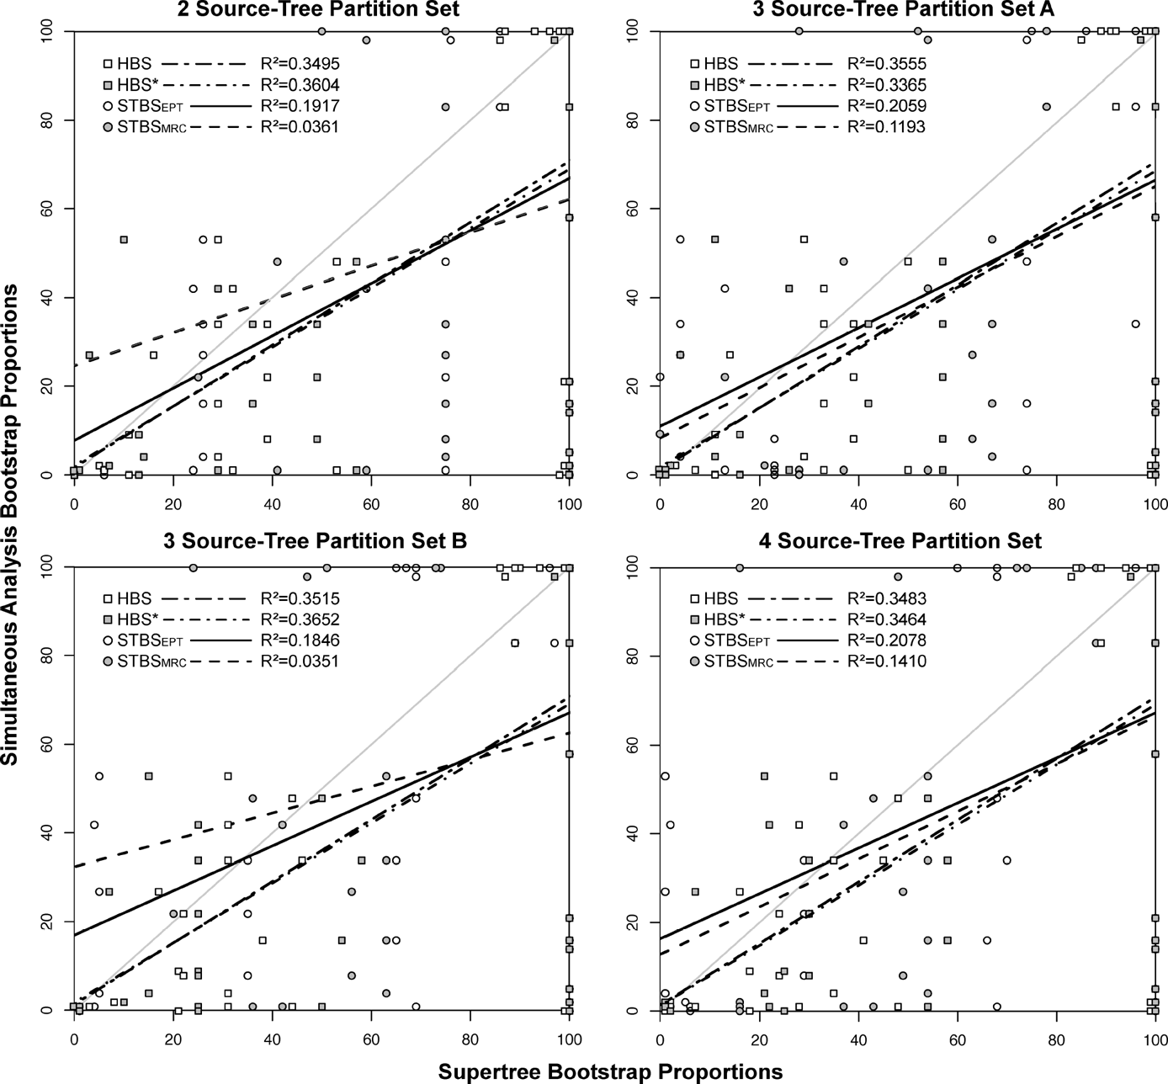
Figure 7 Correspondence between bootstrap proportions based on a simultaneous analysis and those estimated by the four ...
Notes:
Figure 7 Correspondence between bootstrap proportions based on a simultaneous analysis and those estimated by the four bootstrapping approaches for each of the four data partition sets. A line was fitted through each set of points using linear regression. Unbiased estimates of supertree bootstrap proportions would fall along the diagonal. Abbreviations for the bootstrapping procedures: HBS = hierarchical bootstrap, HBS* = scaled hierarchical bootstrap; STBSEPT = source-tree bootstrapping based on the set of equally parsimonious source trees; STBSMRC = source-tree bootstrapping based on the set of majority-rule consensus of equally parsimonious source trees.
Unless provided in the caption above, the following copyright applies to the content of this slide: © 2006 Society of Systematic Biologists

Slide 8
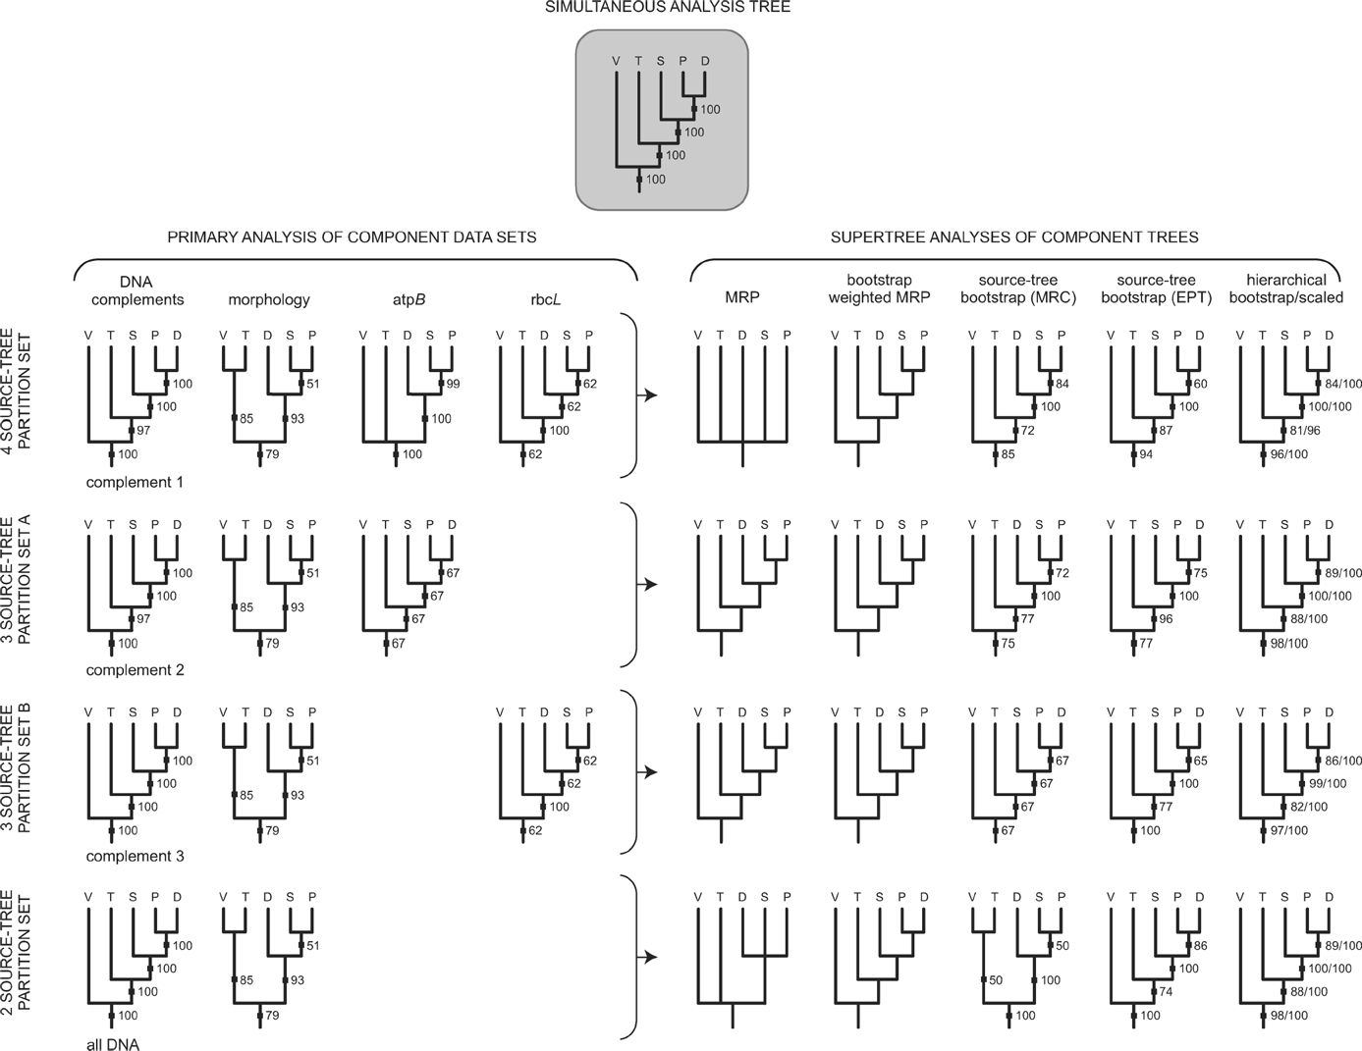
Figure 8 Dipsacaceae as a locus of phylogenetic conflict. The phylogeny estimated from a simultaneous analysis of the ...
Notes:
Figure 8 Dipsacaceae as a locus of phylogenetic conflict. The phylogeny estimated from a simultaneous analysis of the combined data is depicted at the top of the figure, and those based on conventional analyses of the various data partitions associated with the four partition schemes are arranged in rows on the left side of the figure. Each of the resulting four sets of source trees were variously combined using six supertree methods arranged in five columns in the adjacent rows to the right side of the figure. Abbreviations for taxon names: V, Valerianaceae; T, Triplostegia; D, Dipsacus; S, Scabiosa; P, Pterocephalus.
Unless provided in the caption above, the following copyright applies to the content of this slide: © 2006 Society of Systematic Biologists

