Slide 1
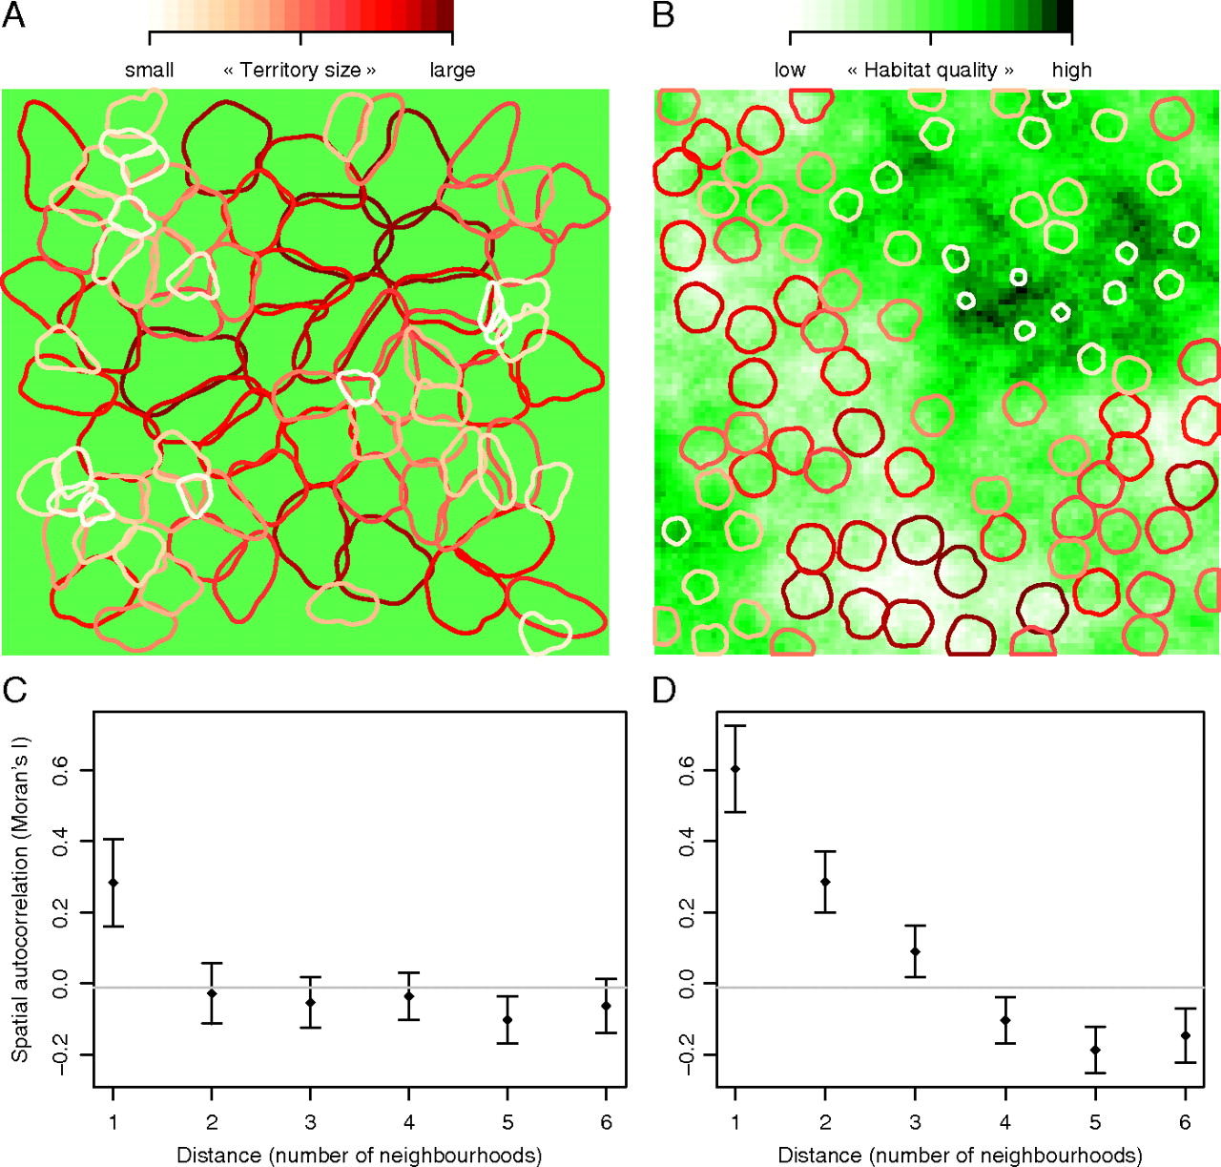
Figure 1 Examples of inherent and induced SAC of territory size at different spatial scales. Inherent SAC results ...
Notes:
Figure 1 Examples of inherent and induced SAC of territory size at different spatial scales. Inherent SAC results solely from interindividual interactions and space partitioning without any influence of the habitat (A). The corresponding correlogram (C) shows positive and significant* SAC only at the scale of the nearest neighbors. Induced SAC appears as a result of the negative correlation between territory size and habitat quality (B). The corresponding correlogram (D) shows significant* SAC at all spatial scales. In both scenarios, the same number of territories (bivariate normal kernels) were generated; for simulation procedures see Valcu and Kempenaers 2010). The correlograms show Moran's I coefficient ± standard deviation at 6 distance classes (distance 1 refers to closest neighbors; distance 2 refers to second-order neighbors, and so on). Moran's I coefficient is comparable with a Pearson's correlation coefficient; it takes values between 0 and 1 in the case of positive SAC and between −1 and 0 in the case of negative SAC (Fortin and Dale 2005). The horizontal line is the expected value of Moran's I under the null hypothesis of no autocorrelation. (*after Bonferroni correction).
Unless provided in the caption above, the following copyright applies to the content of this slide: © 2010 The AuthorsThis is an Open Access article distributed under the terms of the Creative Commons Attribution Non-Commercial License (http://creativecommons.org/licenses/by-nc/2.5), which permits unrestricted non-commercial use, distribution, and reproduction in any medium, provided the original work is properly cited.

