Slide 1
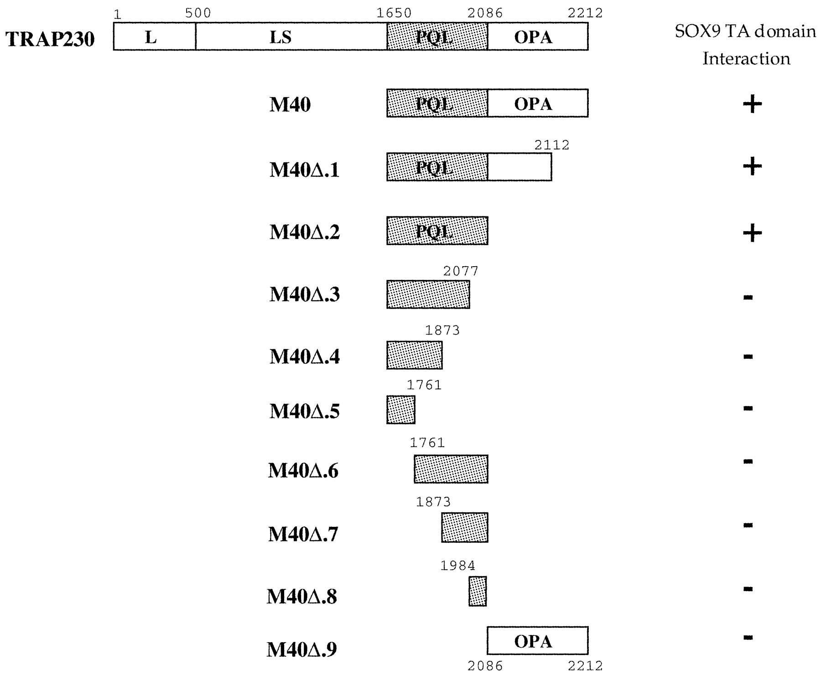
Figure 1. SOX9 interacts with the PQL domain of TRAP230 by yeast two‐hybrid assays. L, leucine‐rich domain; ...
Notes:
Figure 1. SOX9 interacts with the PQL domain of TRAP230 by yeast two‐hybrid assays. L, leucine‐rich domain; LS, leucine‐ and serine‐rich domain; PQL, proline‐, glutamine‐ and leucine‐rich domain; OPA, glutamine‐rich domain. The C‐terminal peptide encoded by clone M40 and systematic deletions of this M40 peptide cloned in the pAD‐GAL4 vector were tested for interactions with the SOX9 TA‐domain, which was cloned in frame with the GAL4 DNA‐binding domain in pGBT9. Positive (+) or negative (–) interactions were tested for both HIS3 and LacZ reporter genes.
Unless provided in the caption above, the following copyright applies to the content of this slide:

Slide 2
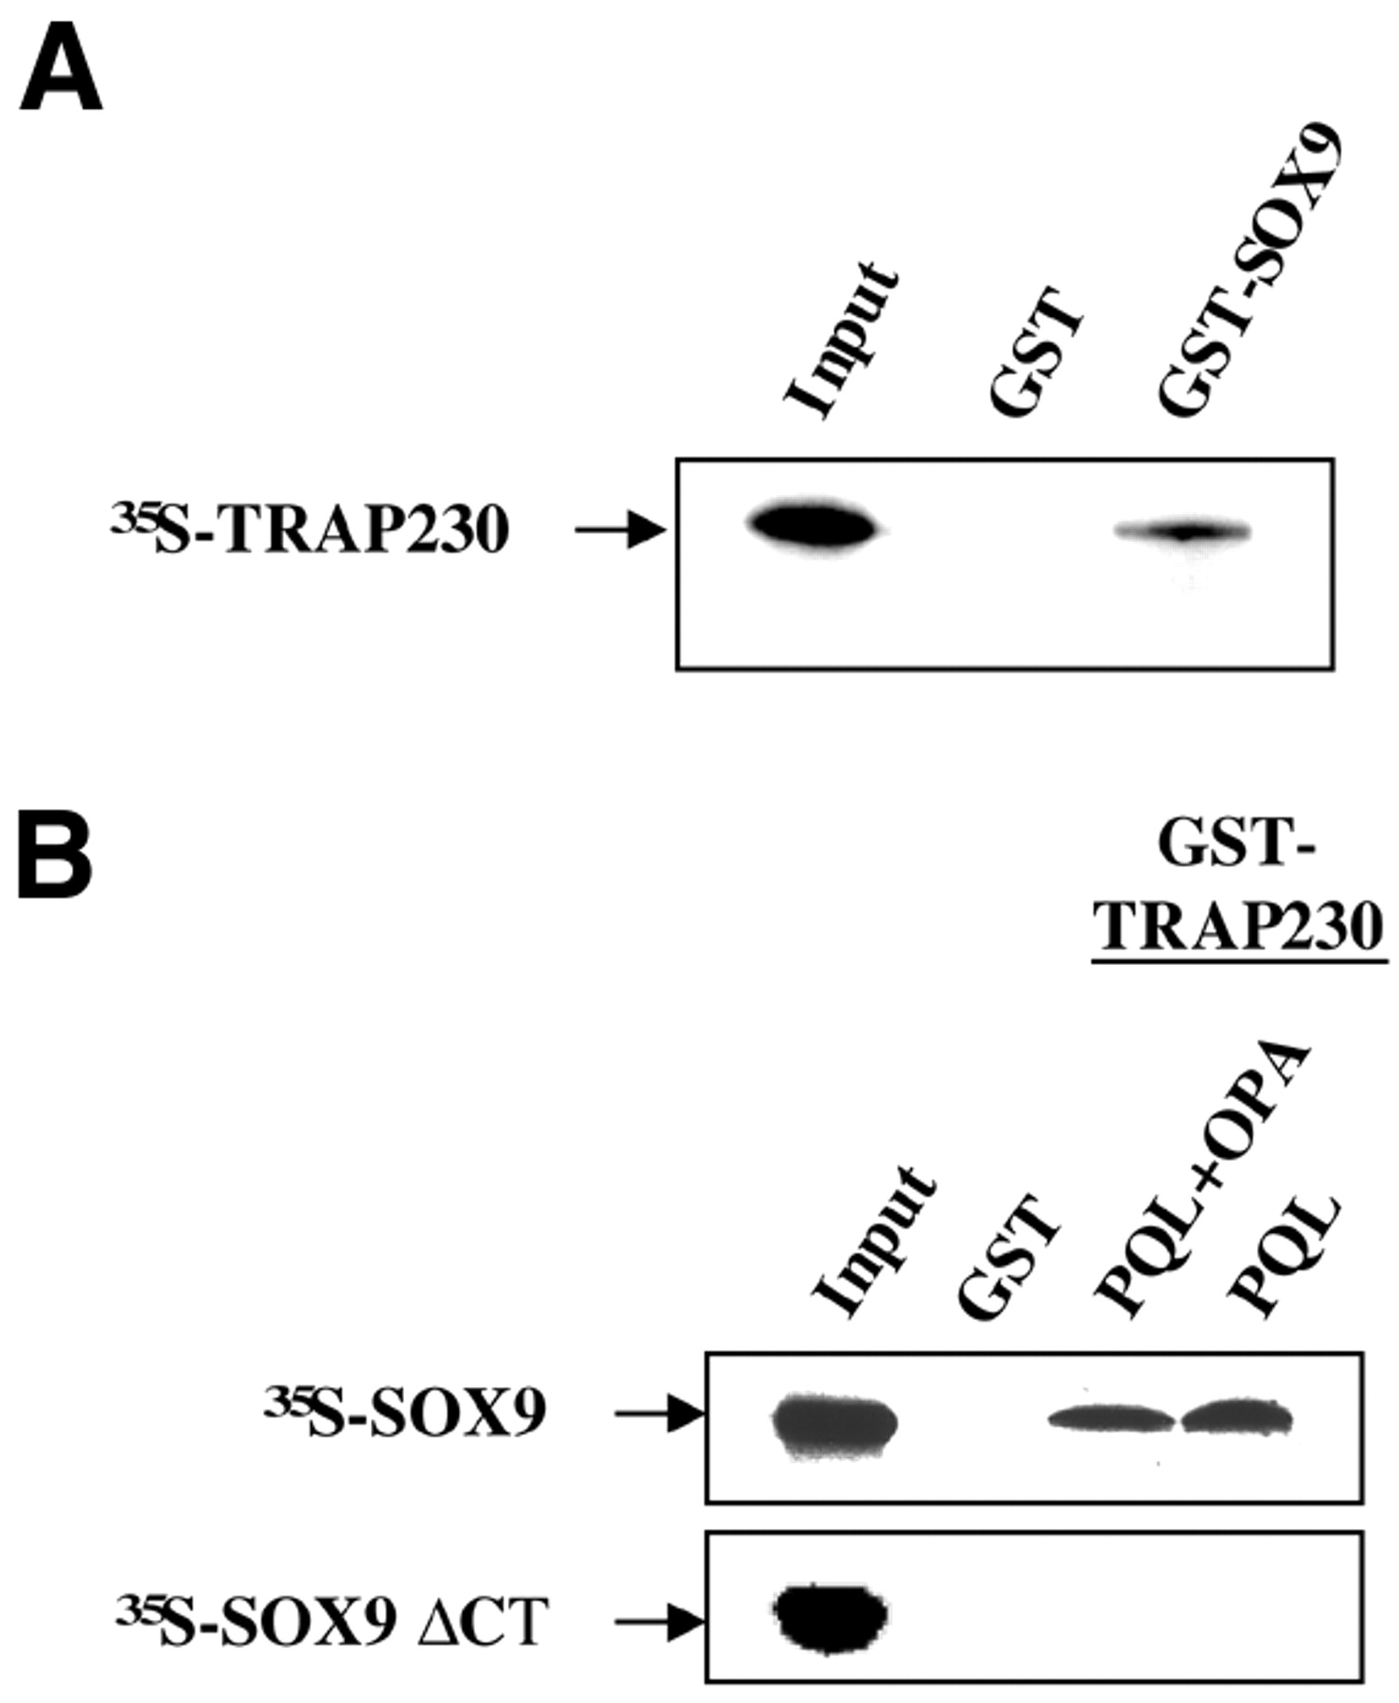
Figure 2. SOX9 and TRAP230 interact in vitro. (A) Full‐length TRAP230 protein was translated in vitro in the ...
Notes:
Figure 2. SOX9 and TRAP230 interact in vitro. (A) Full‐length TRAP230 protein was translated in vitro in the presence of [35S]methionine and analyzed for binding to either GST or GST‐SOX9 fusion protein bound to glutathione–Sepharose. The GST pull‐down assay is described in Materials and Methods. The 10% input (left lane) and bound proteins (middle and right lanes) were separated by SDS–PAGE and then visualized by autoradiography. (B) 35S‐labeled full‐length SOX9 protein or SOX9 deleted of the C‐terminus (ΔCT mutant protein) were analyzed for binding to GST, GST‐TRAP230‐OPA or GST‐TRAP230‐PQL‐OPA fusion proteins by GST pull‐down assays.
Unless provided in the caption above, the following copyright applies to the content of this slide:

Slide 3
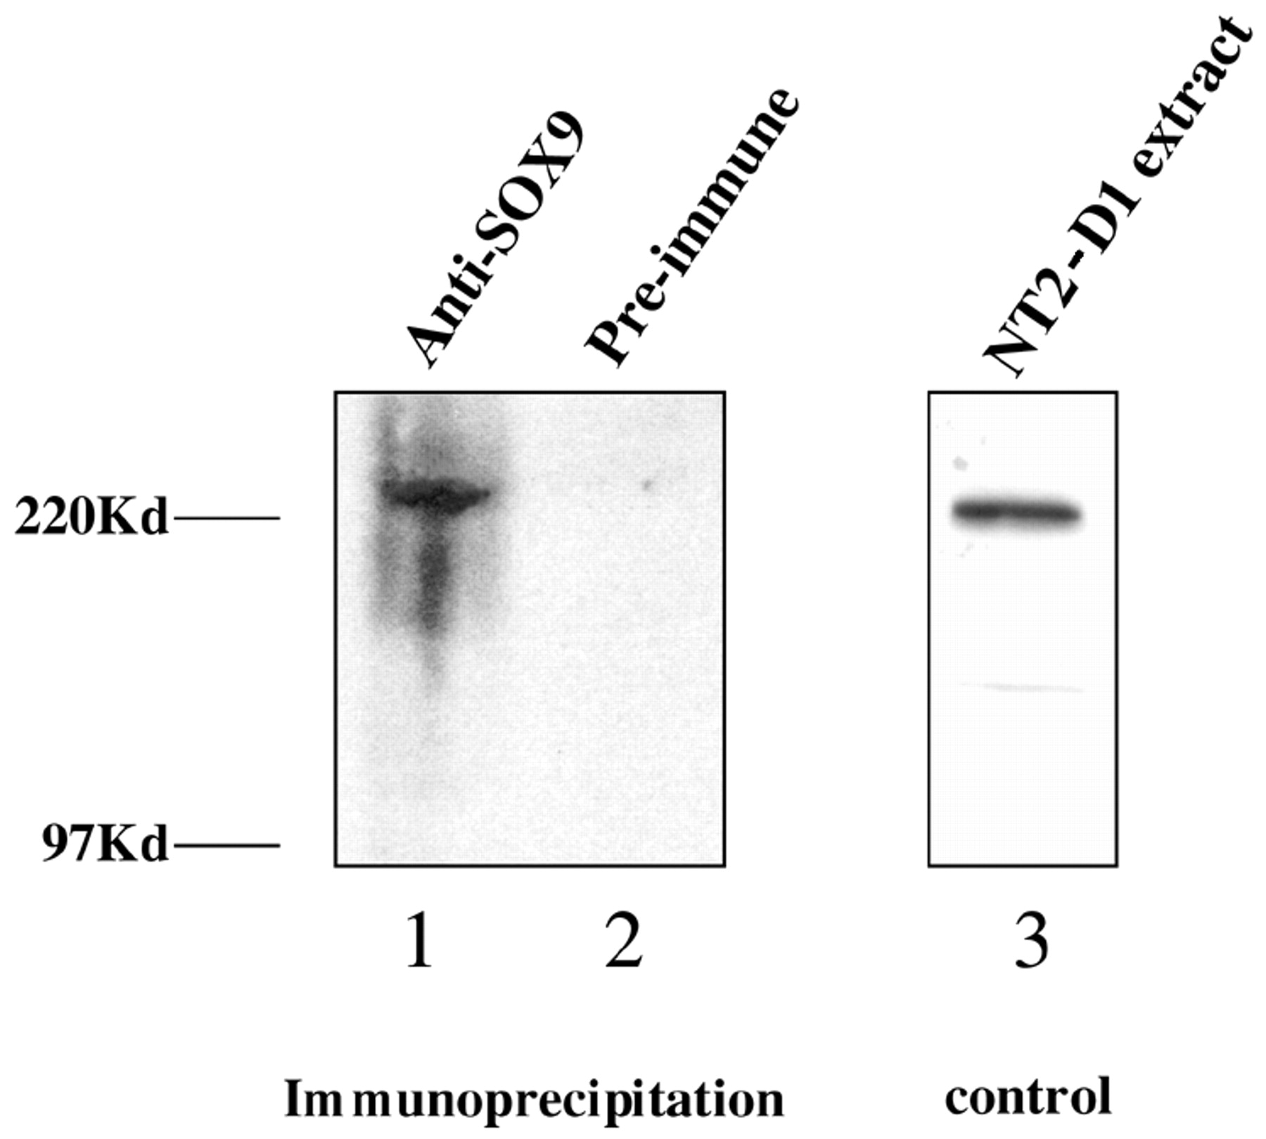
Figure 3. Co‐immunoprecipitation of SOX9 and TRAP230 from NT2‐D1 cells. NT2‐D1 nuclear cell extracts ...
Notes:
Figure 3. Co‐immunoprecipitation of SOX9 and TRAP230 from NT2‐D1 cells. NT2‐D1 nuclear cell extracts (prepared as described in Materials and Methods) were immunoprecipitated with SOX9 antibodies (lane 1) or pre‐immune antibodies (lane 2). The complexes were resolved by SDS–PAGE and TRAP230 was detected by western blotting with anti‐TRAP230 antibody. In lane 3, a direct western blotting of the TRAP230 protein in NT2‐D1 cell nuclear extract is shown as a control.
Unless provided in the caption above, the following copyright applies to the content of this slide:

Slide 4
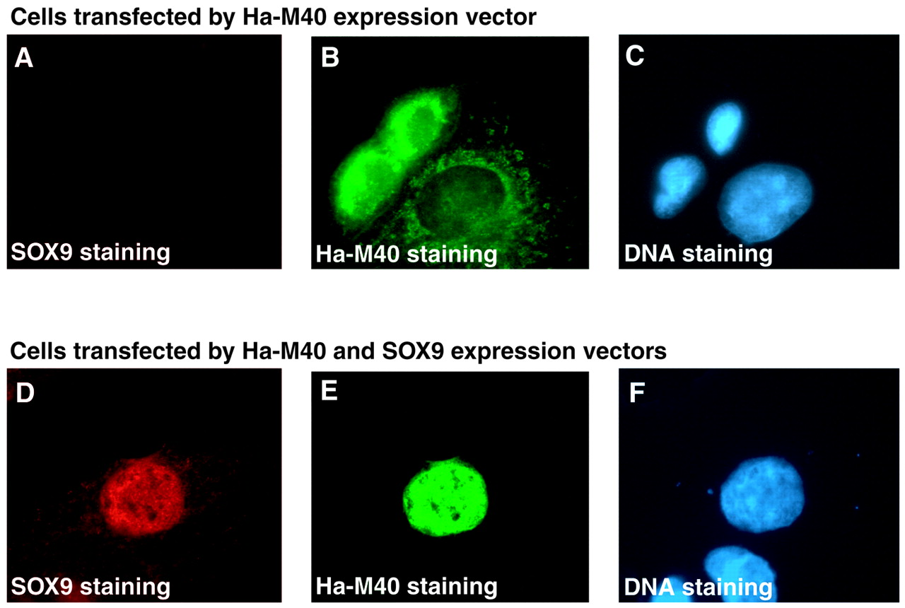
Figure 4. SOX9 localizes the TRAP230‐derived M40 fragment to the nucleus. Immunostaining of CV1 cells after ...
Notes:
Figure 4. SOX9 localizes the TRAP230‐derived M40 fragment to the nucleus. Immunostaining of CV1 cells after pcDNA‐HA‐M40 plasmid transfection reveals a cytoplasmic sublocalization for HA‐M40 (B). pcDNA‐SOX9 and pcDNA‐HA‐M40 plasmid co‐transfection leads to HA‐M40 nuclear localization (E). Absence of SOX9 expression in untransfected CV1 cells (A) and SOX9 nuclear localization after transfection (D) are shown as controls. Nuclear staining using Hoescht 33286 is shown in each case (C and F).
Unless provided in the caption above, the following copyright applies to the content of this slide:

Slide 5
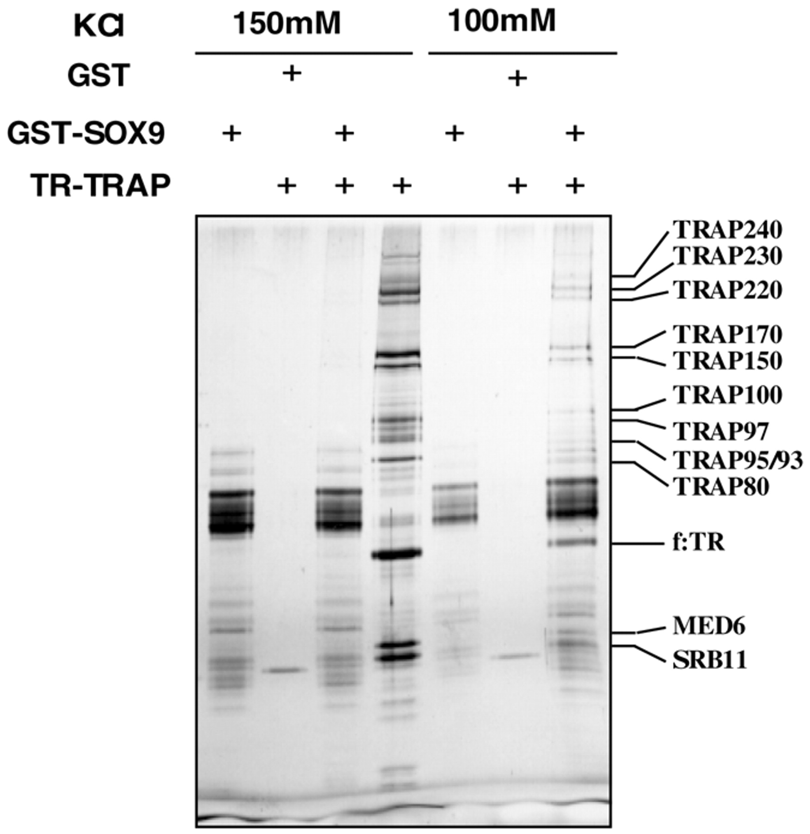
Figure 5. TR–TRAP complex interactions with SOX9 in vitro. GST (control; lanes 2 and 6) or GST‐SOX9 fusion ...
Notes:
Figure 5. TR–TRAP complex interactions with SOX9 in vitro. GST (control; lanes 2 and 6) or GST‐SOX9 fusion (lanes 1, 3, 5 and 7) proteins (1 µg each) immobilized on glutathione–Sepharose were incubated with 5 µl input (lane 4) at either 100 (lanes 5–7) or 150 mM KCl (lanes 1–3). After washing at the same salt concentrations, bound proteins were eluted with Sarkosyl, resolved by 5–15% SDS–PAGE and visualized by silver staining. f:TR is the FLAG‐tagged thyroid hormone receptor through which the associated TRAP complex was purified (Materials and Methods). The indicated TRAPs, MED6 and SRB11 are all subunits of the human TRAP/Mediator complex (16).
Unless provided in the caption above, the following copyright applies to the content of this slide:

Slide 6
Figure 6. Immunolocalization of TRAP230 and SOX9 proteins in chondrocytes from a 6‐week‐old (CS 17) human ...
Notes:
Figure 6. Immunolocalization of TRAP230 and SOX9 proteins in chondrocytes from a 6‐week‐old (CS 17) human embryo. Immunostaining of TRAP230 in red (A) and of SOX9 in green (B) or both (C) is shown. As a control a counterstaining of cell nuclei with Hoechst 33286 in blue is shown (D).
Unless provided in the caption above, the following copyright applies to the content of this slide:

Slide 7
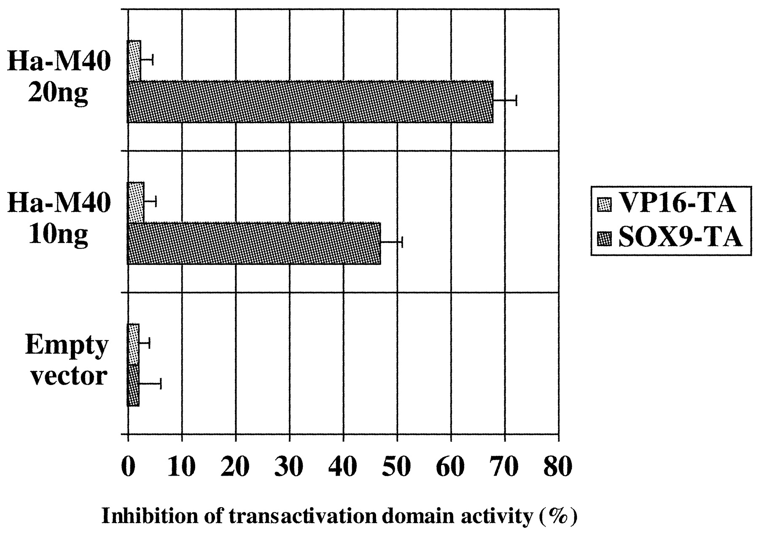
Figure 7. Inhibition of TRAP230 function in transfected COS‐7 cells by the TRAP230‐derived M40 fragment. ...
Notes:
Figure 7. Inhibition of TRAP230 function in transfected COS‐7 cells by the TRAP230‐derived M40 fragment. Increasing amounts of the TRAP230/M40 fragment fused to HA tag (HA‐M40) inhibit the transactivation capacity of GAL4‐SOX9 TA‐domain, whereas HA‐M40 has no inhibitory effect on the transactivation capacity of GAL4‐VP16. COS‐7 cells were transfected with 10 ng of pBIND SOX9‐TA‐domain or pBIND VP16‐TA‐domain, 500 ng of GAL4‐responsive luciferase reporter plasmid (5× UAS Luc) and either 10 or 20 ng of pcDNA HA‐M40, or an empty vector pcDNA (20 ng). Luciferase values have been normalized to SOX9‐TA mediated activation without pcDNA Ha‐M40 but with an empty pcDNA taken as 100%, which corresponds to a 10–15‐fold induction from one experiment to another. Results are expressed as percentage inhibition of the SOX9 TA‐domain activity and represent the means of triplicate experiments performed six times.
Unless provided in the caption above, the following copyright applies to the content of this slide:

