Slide 1
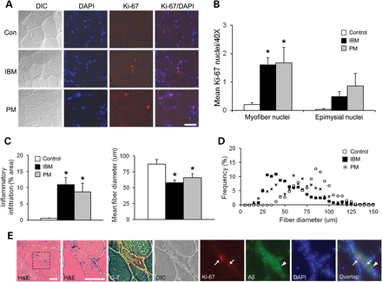
Figure 1. Induction of Cdc and characterization of inflammation and myodegeneration in human IBM and PM. ...
Notes:
Figure 1. Induction of Cdc and characterization of inflammation and myodegeneration in human IBM and PM. Photomicrographs of immunofluorescently labeled Ki-67 (cellular proliferation marker, red) in representative muscle sections of IBM, PM and age-matched normal control (A). Patient demographics are given in (26). The mean number of Ki-67-positive myofiber nuclei in 6 random 40× fields was significantly increased in IBM and PM compared with normal control. Small but significant Ki-67 induction in both intra-myofiber and to lesser extent epimysial nuclei is noted (B). IBM and PM showed comparable significant increases in inflammatory infiltration and decreases in fiber diameter compared with normal control (C). The distribution frequency of fiber diameters in IBM, PM and normal control is given in (D). Colocalization of Ki-67 nuclei and Aβ deposits in human IBM (E). Serial quadriceps muscle sections from IBM were labeled with anti-Ki-67 and -Aβ (R1282). H&E and modified Gomori trichrome (G-T) histochemistry is shown. Ki-67 nuclei (arrows) were present with Aβ deposits (arrow head) in the same abnormal myofiber bearing rimmed vacuoles. All data presented are mean ± SEM. *P < 0.05 versus control (ANOVA). Scale bar: 50 μm. DIC, differential interference contrast.
Unless provided in the caption above, the following copyright applies to the content of this slide: © The Author 2014. Published by Oxford University Press. All rights reserved. For Permissions, please email: journals.permissions@oup.com

Slide 2
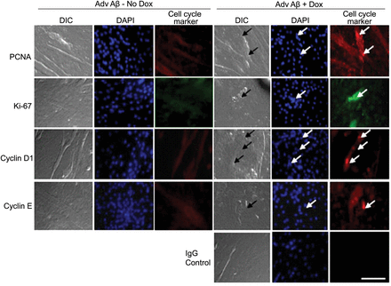
Table 1. Statistical quantification of Supplementary Data C2C12 myotubes were cultured on chamber slides coinfected ...
Notes:
Table 1. Statistical quantification of Supplementary Data C2C12 myotubes were cultured on chamber slides coinfected with Adv-TRE-Aβ and Adv Tet-On and expression induced with 24 h doxycycline. No added doxycycline served as control. Immunofluorescence co-staining with anti-Ki-67 and Aβ (6E10 or R1282), anti-PCNA and Aβ, anti-cyclin D1 and Aβ and anti-cyclin E and Aβ was carried out and detected using antibodies of monoclonal goat anti-mouse cy2 or cy3 or polyclonal goat anti-rabbit cy2 or cy3. Myonuclei were identified by DAPI and the number of multinucleated myotubes containing 1 and ≥2 nuclei bearing Ki-67, PCNA, cyclin D1 or E decoration were counted over five random, 40× fields in each of the four development conditions. Means and SEM (not shown) were calculated over triplicate (n = 3) experiments. In each 8 × 8 mm well, mean counts were also made of Aβ bearing myotubes and of those expressing both Aβ and cyclin marker. The correlation of Aβ expression with cell cycle entry markers in the same myotube was tested using 2 × 2 tables and χ2 method. The ratio of Aβ and cycle marker co-occurrence to the sum number of their dissociation is given at bottom. In each of the four marker and Aβ expression tests listed at the top, the association was significant to P < 0.0001. χ2-values were highest for PCNA/Aβ and in descending order; Ki-67/Aβ, cyclin E/Aβ and cyclin D1/Aβ (960.4, 834.9, 675.8, 298.2, respectively, df = 1). $: mean # of myotubes positive for cytosolic Aβ expression by antibody as listed; ( ): mean # of myotubes, density or total # in the absence of doxycycline (control). Figure 2.Cultured myotubes bearing intracellular β-amyloid evidence cell cycle initiation. Immunofluorescence photomicrographs of Adv Aβ-infected myotubes. Following a 24 h treatments with Adv-TRE-Aβ and Adv Tet-On, Aβ expression was induced by treatment of doxycycline (Dox, 2 µg/ml) for 24 h. The Dox-untreated myotubes showed no positive staining with the cell cycle markers (left 3 panels), whereas nuclei in Dox-treated myotubes were positive for antibodies to PCNA (S-phase marker; red) and Ki-67 (cellular proliferation marker; green), cyclin D1 (G1 to S phase marker; red) and cyclin E (G1 to S phase marker; red) (right 3 panel columns). Arrows indicate myonuclei in atrophic cells labeled with cell cycle markers indicated along figure left. Absence of IgG uptake serves as negative control. Scale bar: 50 μm.
Unless provided in the caption above, the following copyright applies to the content of this slide: © The Author 2014. Published by Oxford University Press. All rights reserved. For Permissions, please email: journals.permissions@oup.com

Slide 3
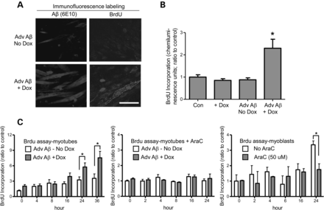
Figure 3. BrdU incorporation and time course in Aβ42-expressing myotubes. New DNA synthesis in myotubes shown by ...
Notes:
Figure 3. BrdU incorporation and time course in Aβ42-expressing myotubes. New DNA synthesis in myotubes shown by immunofluorescence in (A) and quantified by ELISA in (B). Cell cultures were treated as in Figure 2. BrdU (10 µM) added to the medium for 2 h before fixation and ELISA (n = 6). Scale bar: 30 μm. (C) New DNA synthesis rate is significantly increased in Aβ-induced cultured myotubes at 24 and 36 h after Aβ induction (left). Treatment with AraC (50 µm) blocked Aβ-induced new DNA synthesis beginning at 4 h after Aβ induction (meddle, note different scale from left). Control elimination of cell division by AraC in dividing myoblasts shown to the right. All data presented are mean ± SEM. *P < 0.05 versus Adv Aβ-Dox (ANOVA).
Unless provided in the caption above, the following copyright applies to the content of this slide: © The Author 2014. Published by Oxford University Press. All rights reserved. For Permissions, please email: journals.permissions@oup.com

Slide 4
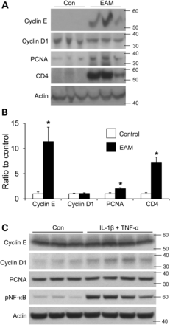
Figure 4. An in vivo model of myositis (EAM) induces cell cycle entry markers independent of β-amyloid. Normal mice ...
Notes:
Figure 4. An in vivo model of myositis (EAM) induces cell cycle entry markers independent of β-amyloid. Normal mice immunized with C muscle protein. (A) Muscle proteins were extracted and analyzed by western blot. Representative immunoblot shows induction of cyclin E and PCNA. CD4, a helper T cell marker of cellular inflammation, was also induced. (B) Densitometric quantification of western blots. (C) An in vitro model of passive inflammation in myotubes employing exogenous cytokines evidenced modest cyclin D1induction. TNF-α and IL-1β (100 and 50 ng/ml, respectively) were co-added to myotubes for 72 h. Cyclin E and PCNA were unchanged. Co-additions of TNF-α and IFN-γ had no effect (not shown). All data presented are mean ± SEM. *P < 0.01 versus control (t-test).
Unless provided in the caption above, the following copyright applies to the content of this slide: © The Author 2014. Published by Oxford University Press. All rights reserved. For Permissions, please email: journals.permissions@oup.com

Slide 5
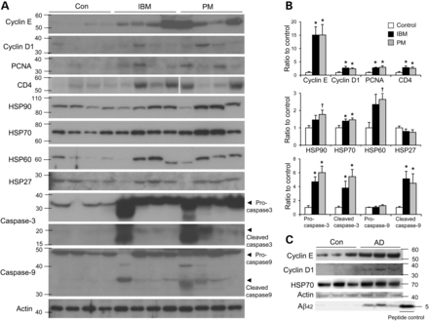
Figure 5. Coordinate expression of cell cycle markers with caspase activation and HSP induction in human IBM and PM. ...
Notes:
Figure 5. Coordinate expression of cell cycle markers with caspase activation and HSP induction in human IBM and PM. Muscle proteins were extracted from human IBM, PM and normal control muscle (n = 8 each group) and analyzed by western blot. (A) Representative western blots of human muscle proteins and (B) densitometric quantification. The levels of cyclins E and D1 and PCNA are increased in inflammatory myositis, consistent with Figure 1A result. CD4 showed induction in IBM and PM. In the same samples, levels of HSP60, 70 and 90 are also increased. HSP27 is unchanged. Evidence for procaspase-3 induction and caspases-3 and -9 cleavage is shown (B, middle and low charts). Changes in procaspase-9 levels were not observed. For comparison, proteins extracted from human AD brains were analyzed by western. The levels of cyclins E and D1 and HSP70 were similarly increased in AD compared with the control (25 µg total protein). All data presented are mean ± SEM. *P < 0.05 versus control (ANOVA). †P < 0.05 versus control (t-test). Twenty micrograms of protein loaded per lane.
Unless provided in the caption above, the following copyright applies to the content of this slide: © The Author 2014. Published by Oxford University Press. All rights reserved. For Permissions, please email: journals.permissions@oup.com

Slide 6
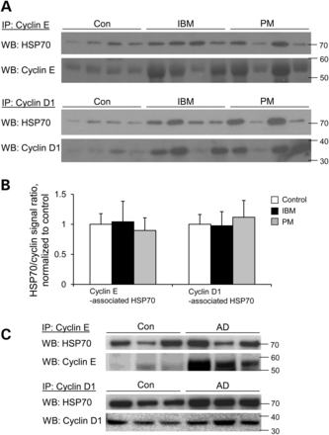
Figure 6. Cyclin induction in IBM and PM is proportional to physical interaction with HSP chaperones. (A) Interaction ...
Notes:
Figure 6. Cyclin induction in IBM and PM is proportional to physical interaction with HSP chaperones. (A) Interaction of cyclins E and D1 with HSP70 in human muscle. Human muscle proteins extracted from IBM, PM and normal control patients (n = 8 in total each group) were immunoprecipitated with cyclins E or D1 rabbit polyclonal antibody and detected by western blot with mouse monoclonal antibodies as indicated. (B) Densitometric quantification of western blot (WB). HSP70 coprecipitated with cyclins E or D1 in all the three groups. Consistent with Figure 5, the binding ratio of HSP70 to cyclins E or D1 did not differ. (C) Proteins extracted from human AD brains (250 µg total brain lysate) were like-wise analyzed by immunoprecipitation (IP)-WB to show binding of cyclins E or D1 to HSP70. A reverse IP shows like pull-down of cyclins E or D1 with anti-HSP70 (results and binding ratio not shown). All data presented are mean ± SEM.
Unless provided in the caption above, the following copyright applies to the content of this slide: © The Author 2014. Published by Oxford University Press. All rights reserved. For Permissions, please email: journals.permissions@oup.com

Slide 7
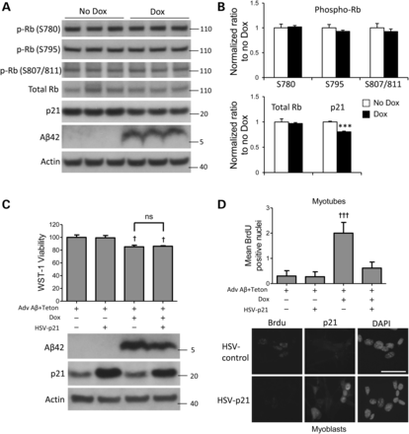
Figure 7. Aβ expression and cell cycle regulators Rb and p21. (A) Myotubes were infected with Adv TRE-Aβ and Tet-On for ...
Notes:
Figure 7. Aβ expression and cell cycle regulators Rb and p21. (A) Myotubes were infected with Adv TRE-Aβ and Tet-On for 24 h and induced to express Aβ after adding doxycycline (Dox, 2 µg/ml) for another 24 h. Western of whole cell extracts (A) and densitometric quantification (B) demonstrate a decrease in p21 corresponding to Aβ overexpression. There were no differences in the levels of phosphorylated or total Rb between the groups. (C) p21 overexpression (HSV-p21) did not rescue the decrease in myotube viability attributable to Aβ induction (lane 4 versus lane 3). Doxycycline alone control does not affect WST reduction (not shown). Western blot below confirms expression of Aβ and/or p21. (D) Control experiments for p21 activity. The stimulation of DNA synthesis by Aβ (lane 3) is reversed by co-expression of p21 (lane 4) in myotubes. Quantification is of BrdU-positive nuclei from 6 random 40× fields. Representative immunofluorescence photomicrographs below demonstrate p21 expression in myoblasts. All data presented are mean ± SEM. ***P < 0.001 versus no Dox (t-test). †P < 0.05, †††P < 0.001 versus no Dox and no HSV-p21or HSV-GFP control (ANOVA). Scale bar: 30 μm.
Unless provided in the caption above, the following copyright applies to the content of this slide: © The Author 2014. Published by Oxford University Press. All rights reserved. For Permissions, please email: journals.permissions@oup.com

