Slide 1
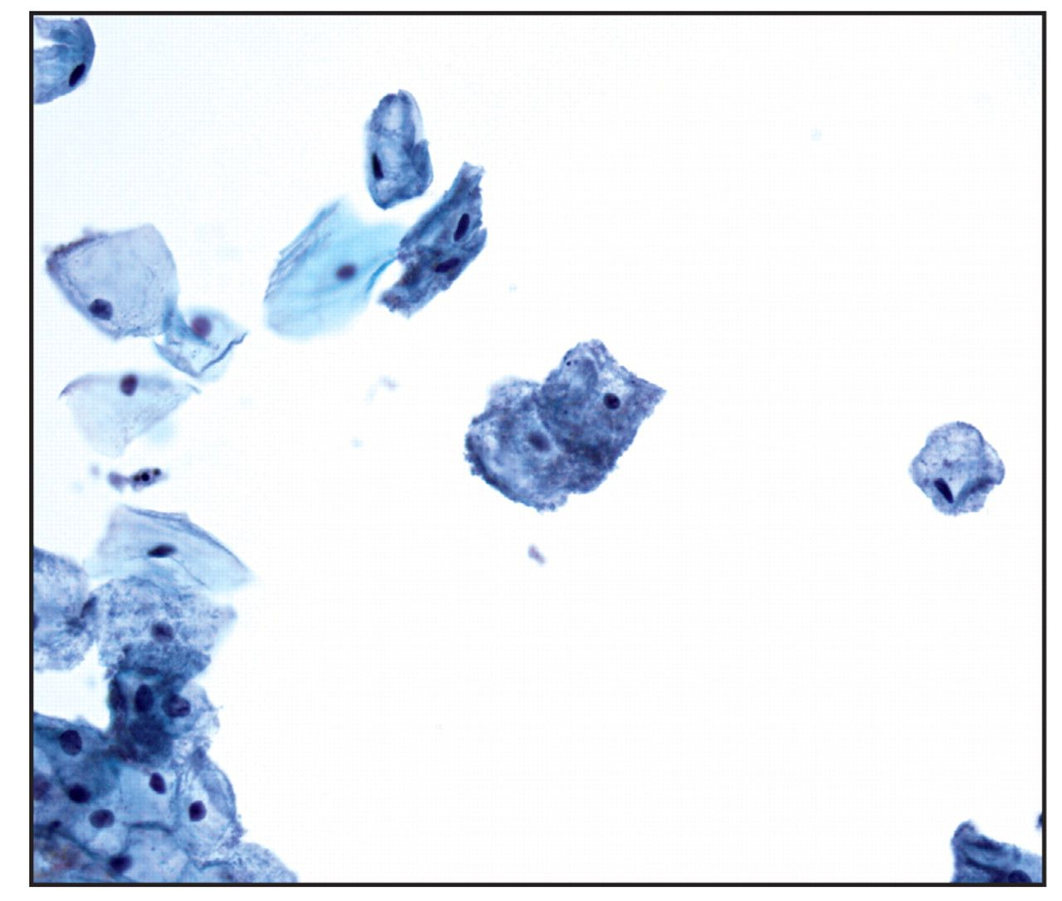
Image 1 Individual squamous cells coated with a layer of coccobacilli along the cell membranes (so-called clue cells) ...
Notes:
Image 1 Individual squamous cells coated with a layer of coccobacilli along the cell membranes (so-called clue cells) and conspicuous absence of lactobacilli characteristic of bacterial vaginosis (Papanicolaou, ×400).
Unless provided in the caption above, the following copyright applies to the content of this slide: © American Society for Clinical Pathology

Slide 2
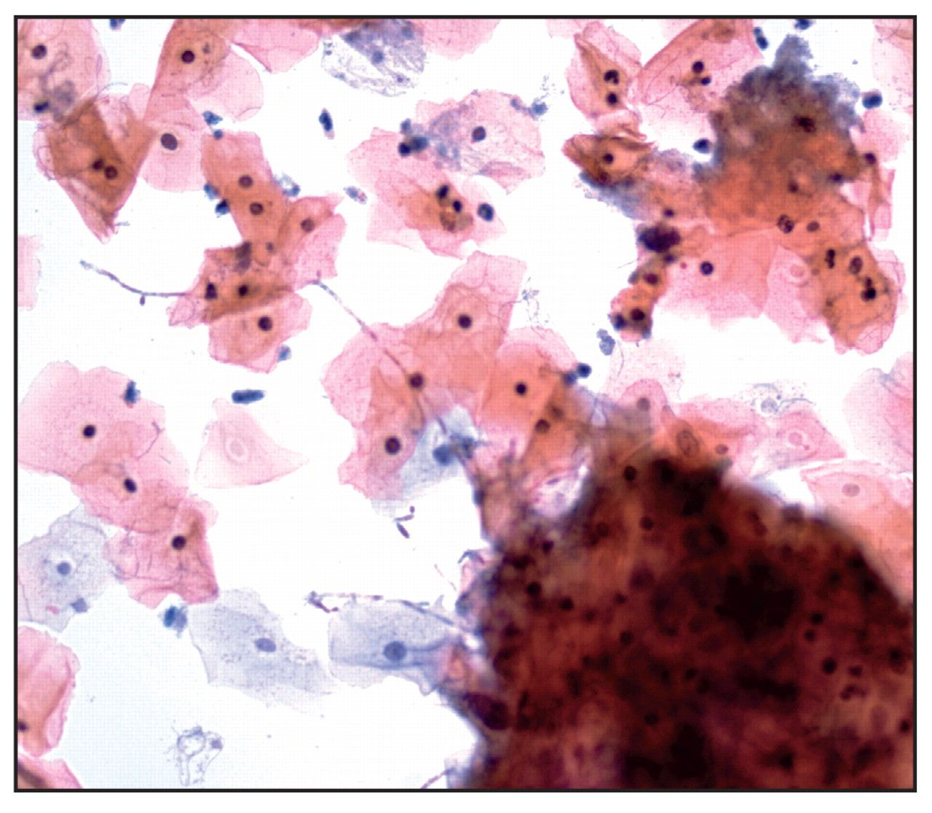
Image 2 Pseudohyphae characteristic of Candida species formed by elongated budding hyphae with constrictions along ...
Notes:
Image 2 Pseudohyphae characteristic of Candida species formed by elongated budding hyphae with constrictions along their length (Papanicolaou, ×400).
Unless provided in the caption above, the following copyright applies to the content of this slide: © American Society for Clinical Pathology

Slide 3
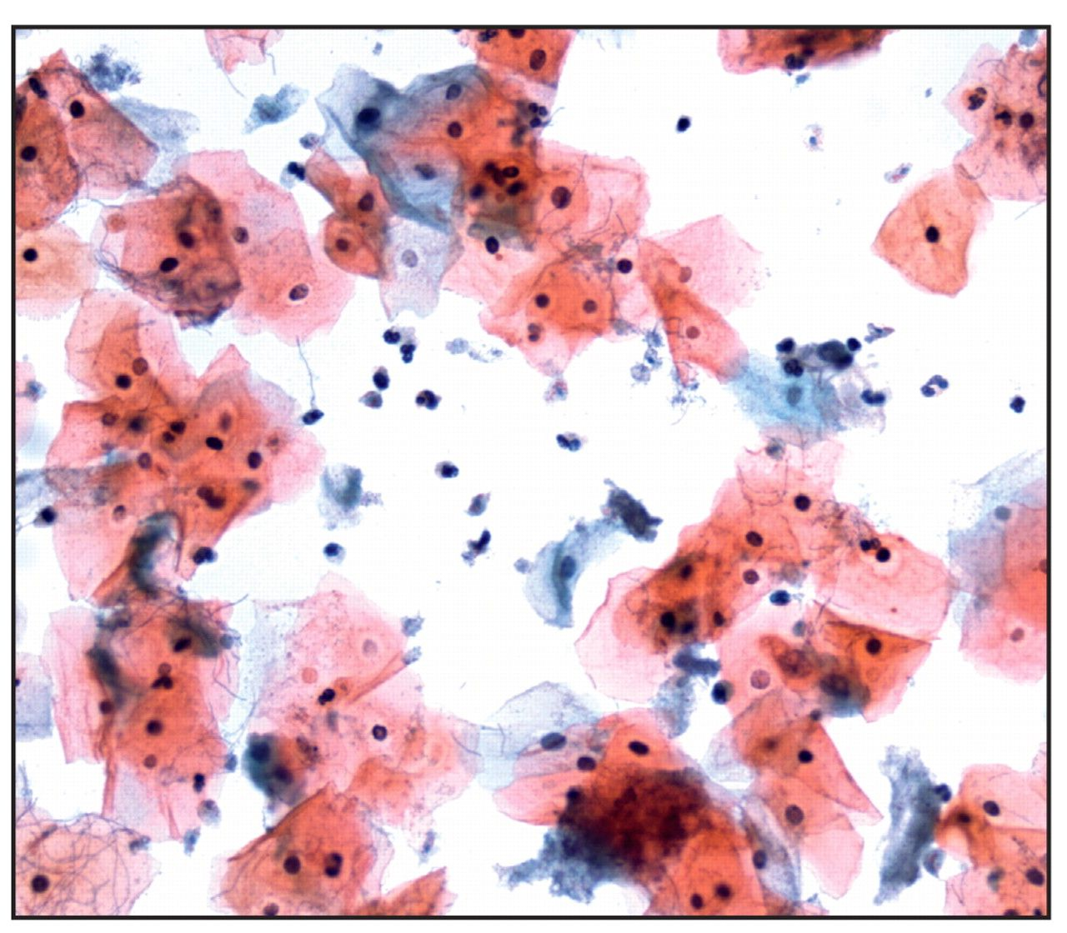
Image 3 Trichomonas vaginalis (Papanicolaou, ×400). Pearshaped, 15- to 30-μm structures with a centrally located ...
Notes:
Image 3 Trichomonas vaginalis (Papanicolaou, ×400). Pearshaped, 15- to 30-μm structures with a centrally located nucleus and eosinophilic cytoplasmic granules. Leptothrix may be seen in association with Trichomonas.
Unless provided in the caption above, the following copyright applies to the content of this slide: © American Society for Clinical Pathology

Slide 4
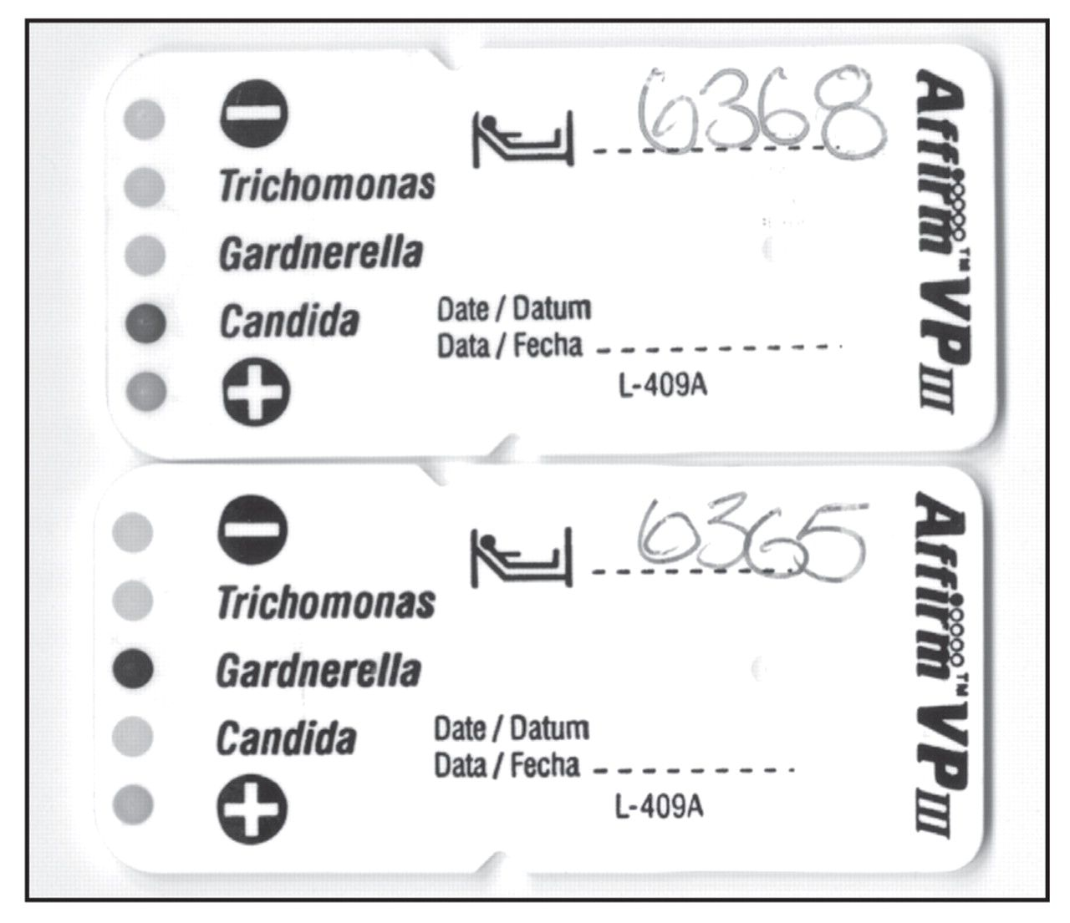
Image 4 Affirm VPIII Probe Analysis Card for 2 patient samples. The Probe Analysis Card on top is visually ...
Notes:
Image 4 Affirm VPIII Probe Analysis Card for 2 patient samples. The Probe Analysis Card on top is visually interpreted as positive for Candida; the Probe Analysis Card on the bottom is positive for Gardnerella. Each Probe Card includes positive and negative controls for each patient sample.
Unless provided in the caption above, the following copyright applies to the content of this slide: © American Society for Clinical Pathology

