Slide 1
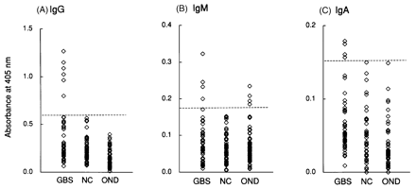
Fig. 1 ELISA values for IgG anti-H. influenzae antibodies (A), IgM anti-H. influenzae antibodies (B) and IgA anti-H. ...
Notes:
Fig. 1 ELISA values for IgG anti-H. influenzae antibodies (A), IgM anti-H. influenzae antibodies (B) and IgA anti-H. influenzae antibodies (C). GBS = Guillain–Barré syndrome; NC = normal controls; OND = other neurological diseases (multiple sclerosis and ALS). Dashed lines show cut-off values (3 SD above the mean value for normal controls).
Unless provided in the caption above, the following copyright applies to the content of this slide: © Oxford University Press 2000

Slide 2
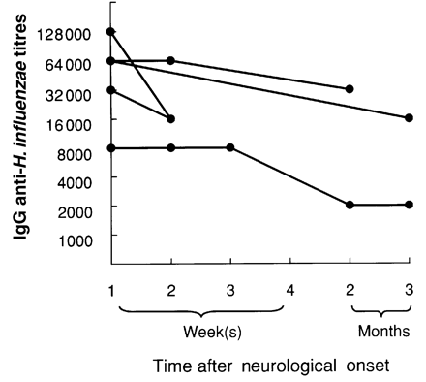
Fig. 2 Longitudinal study of IgG anti-H. influenzae antibody titre in the anti-H. influenzae-positive Guillain–Barré ...
Notes:
Fig. 2 Longitudinal study of IgG anti-H. influenzae antibody titre in the anti-H. influenzae-positive Guillain–Barré syndrome patients. Data for five of the six patients are shown (the serum of the sixth patient was not sampled sequentially after 2 weeks).
Unless provided in the caption above, the following copyright applies to the content of this slide: © Oxford University Press 2000

Slide 3
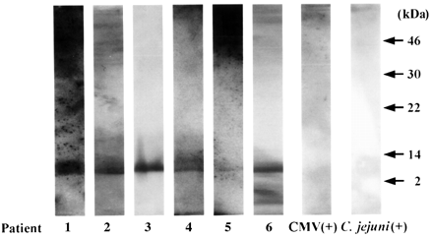
Fig. 3 Reactivity of serum antibodies against the purified H. influenzae LPS in H. influenzae-positive ...
Notes:
Fig. 3 Reactivity of serum antibodies against the purified H. influenzae LPS in H. influenzae-positive Guillain–Barré syndrome patients, one CMV-positive Guillain–Barré syndrome patient [CMV(+)] and one C. jejuni-positive Guillain–Barré syndrome patient [C. jejuni(+)].
Unless provided in the caption above, the following copyright applies to the content of this slide: © Oxford University Press 2000

