Slide 1
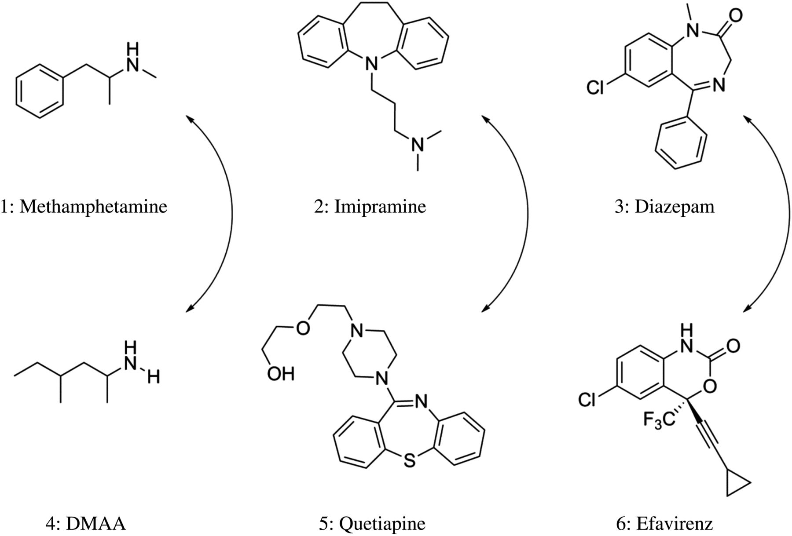
Table I False-Positive Results for Amphetamine Immunoassays Structures of methamphetamine, imipramine and diazepam ...
Notes:
Table I False-Positive Results for Amphetamine Immunoassays Structures of methamphetamine, imipramine and diazepam (top) along with cross-reacting compounds (bottom).
Unless provided in the caption above, the following copyright applies to the content of this slide: Published by Oxford University Press 2014. This work is written by (a) US Government employee(s) and is in the public domain in the US.

Slide 2
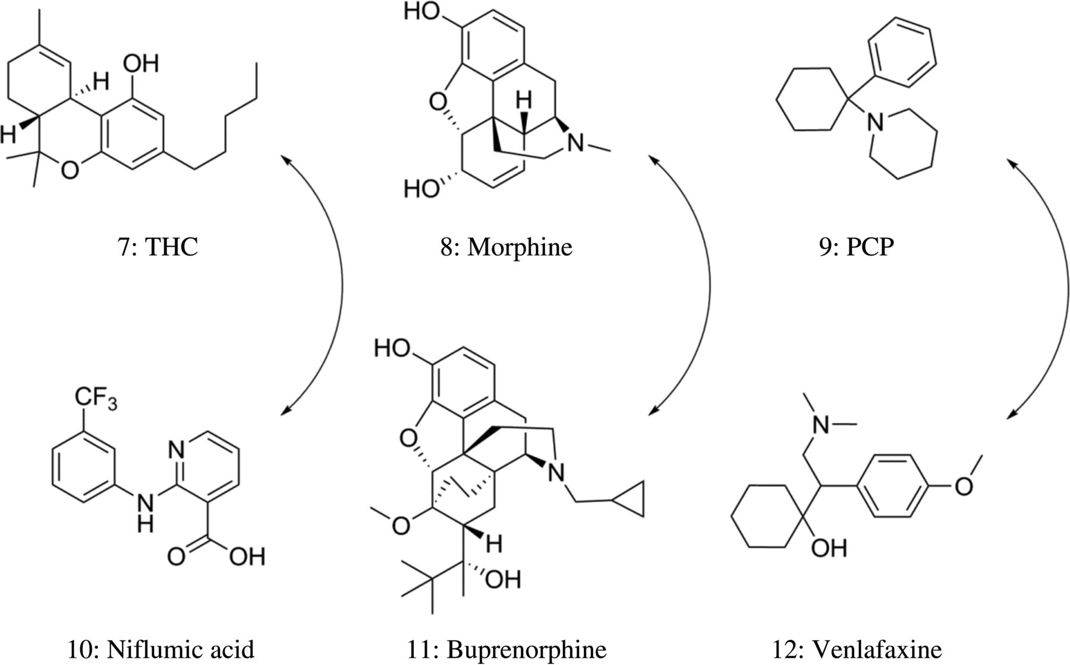
Figure 2. Structures of THC, morphine and PCP (top) along with cross-reacting compounds (bottom).
Notes:
Figure 2. Structures of THC, morphine and PCP (top) along with cross-reacting compounds (bottom).
Unless provided in the caption above, the following copyright applies to the content of this slide: Published by Oxford University Press 2014. This work is written by (a) US Government employee(s) and is in the public domain in the US.

